Slide 1
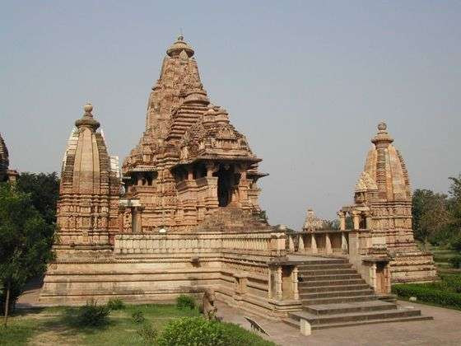
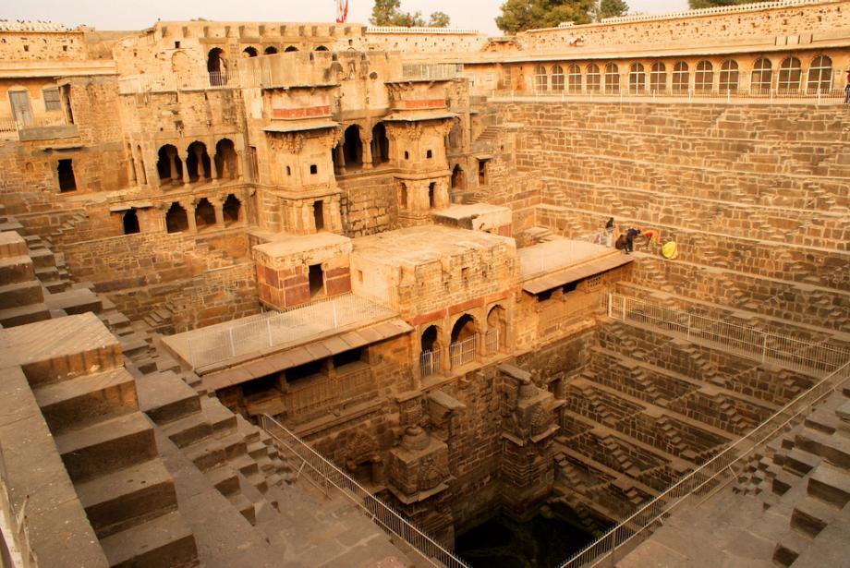
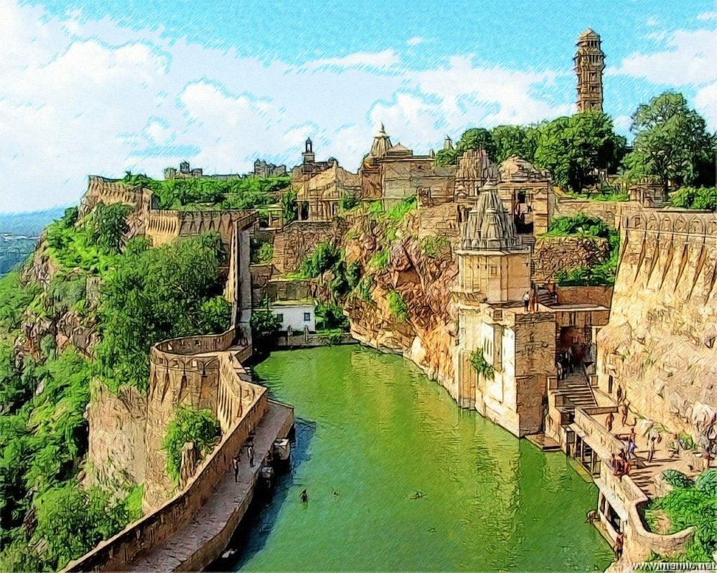
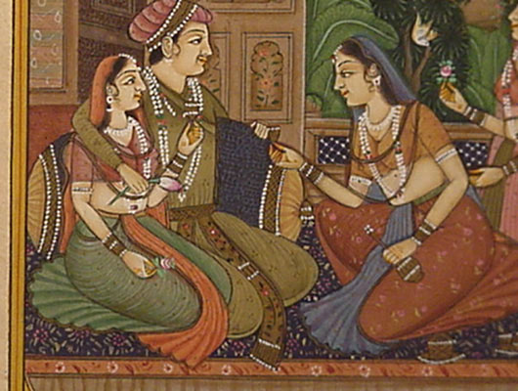
Ancient India

Slide 2
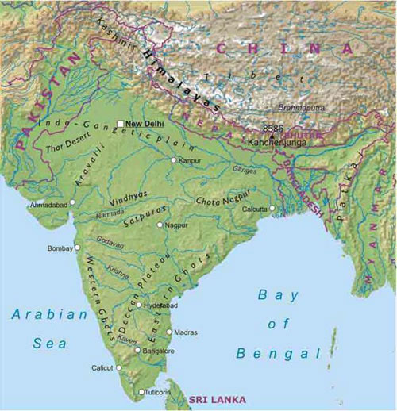
Geography
Shaped like a triangle on the southern edge of Asia.
Subcontinent
Himalaya mountains in north acting as a walled barrier.
Main regions of India’s culture
Ganges River valley in the south
Indus River valley in the west

Slide 3
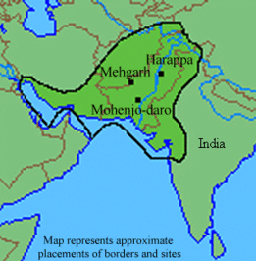
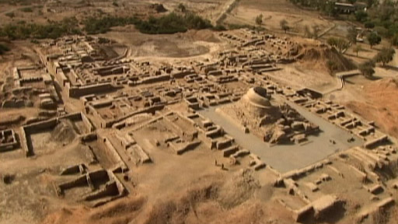
India’s 1st Civilization
Emerged in river valleys like other areas.
Indus River
Evidence of remains of more than a 1,000 settlements in this region.
2 major cities (Indus Civilization)
Harappa
Mohenjo-Daro

Slide 4
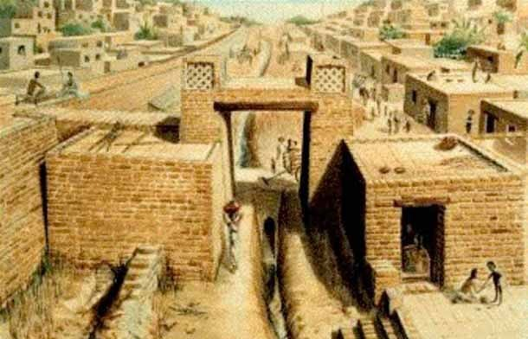
2 Major Cities
Harappa and Mohenjo-Daro both had about 35,000 or more people.
Both very similar in city plans
Streets ran perfectly north-south and east-west
Walled neighborhoods
Houses all had a square courtyard surrounded by rooms.
Public wells of water
Advanced drainage systems

Slide 5
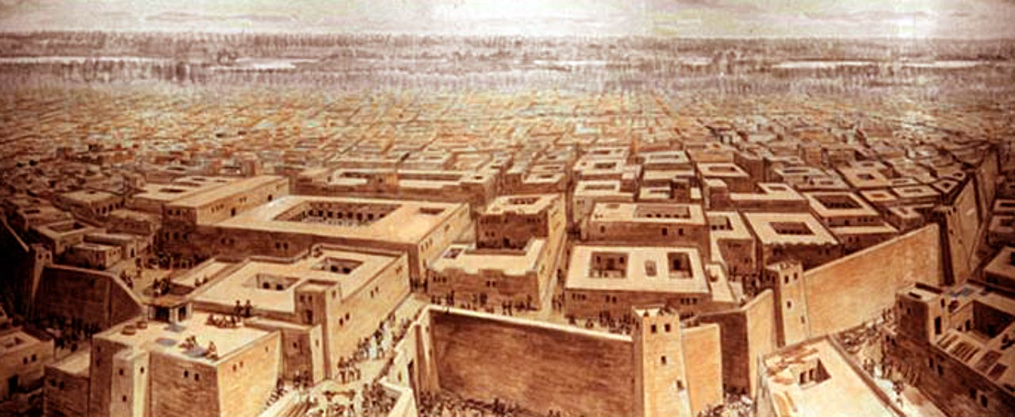
2 Major Cities
Only a well organized government could do such careful city planning and structure.
2 cities almost identical

Slide 6
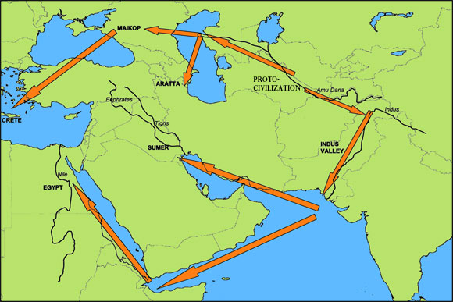
Rulers and Economy
Rulers believed in power of divine assistance.
Religion and political power were closely linked.
Palace and holy temple combined in same location.
Economy mainly based on farming
Indus River flooded every year providing rich soil.
Traded with Mesopotamia
Carried by ship on Indian Ocean or by land.

Slide 7
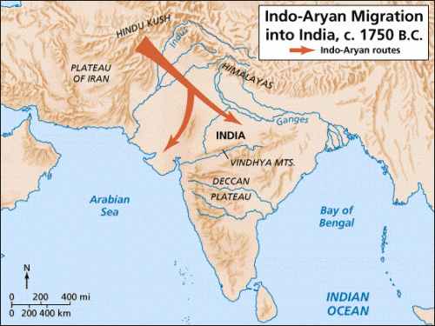
Arrival of Aryans
Indus River valley already weakened by flooding, an earthquake, and invaders.
Indo-European nomadic people
Moved out of central Asia across the Hindu Kush mountain range
Conquered Harappans and created a new Indian society of Aryan culture
Excelled at art of war

Slide 8
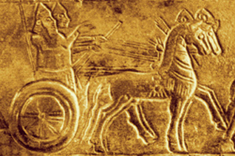
Aryan Way of Life
Gave up nomadic life for farming.
Used iron tools
Constant warring kingdoms and shifting alliances.

Slide 9
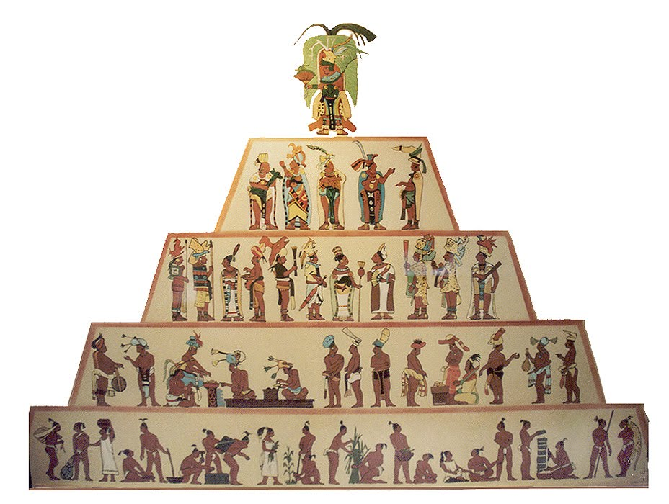
Caste System
Determined:
Occupation
Economic potential
Social position in society
Based in part on skin color
Aryans light-skinned and people they conquered were generally darker skinned.

Slide 10
Caste System
Five Major Divisions (Castes)
Priests: Brahmans
Warriors: Kshatriyas
Commoners: Vaisyas
Conquered, dark-skinned people: Sudras
Majority of the population
Untouchables: Given the worst jobs
About 5% of population

Slide 11
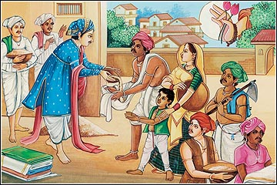
Family in Ancient India
3 generations under one roof
Grandparents
Parents
Children
Males could only inherit property
Patriarchal society (male dominated)

Slide 12
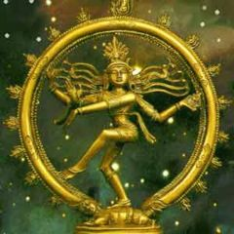
Hinduism
Origins in the religious beliefs of the Aryan people.
Single universal force – Brahman
Reincarnation – Belief that the individual soul is reborn in a different form after death.
Final goal is a union with the Brahman

Slide 13
Hinduism
Karma – Force generated by a person’s actions that determines how the person will be reborn in the next life.
Dharma – Requires that all people do their duty, the divine law of karma.

Slide 14
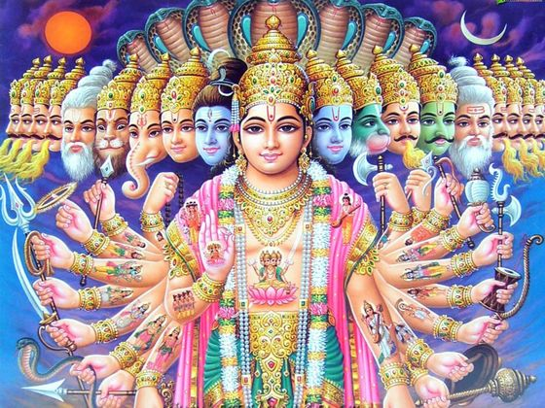
Hinduism
Most ordinary Indians needed something to relate to.
Probably why the Hindu religion came to have a number of human-like gods and goddesses.
More than 33,000 deities

Slide 15
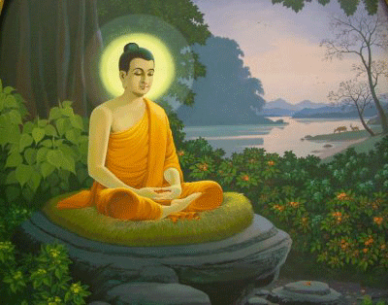
Buddhism
Appeared in northern India
Became a rival of Hinduism
Founder was Siddhartha Gautama
Raised in a wealthy family and life
After seeing much suffering of others, gave up his wealth to find the “meaning of life.”

Slide 16
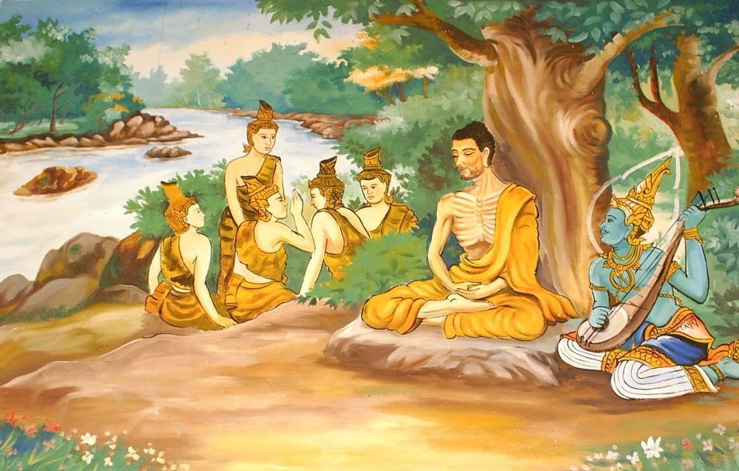
Buddhism
Followed example of the ascetics.
People who practice self-denial to achieve an understanding of ultimate reality.
Abandoned this idea after physical suffering

Slide 17
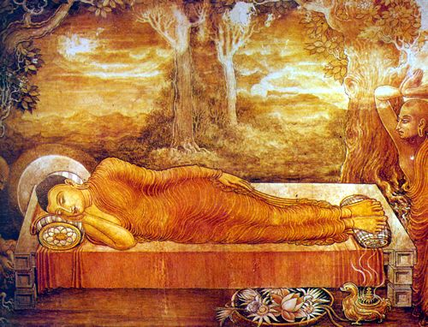
Buddhism
Basic Principles
Let go of worldly wants and materials
Believed they led to suffering
Achieving wisdom was key to reaching nirvana.
Ultimate reality

Slide 18
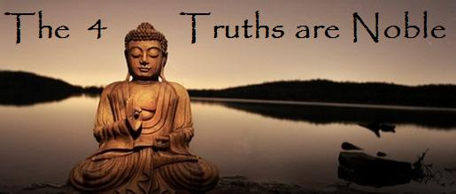
Buddhism
4 Noble Truths
Ordinary life is full of suffering
Suffering caused by desire to satisfy ourselves
End suffering by ending desire
Way to end desire is the Middle Path

Slide 19
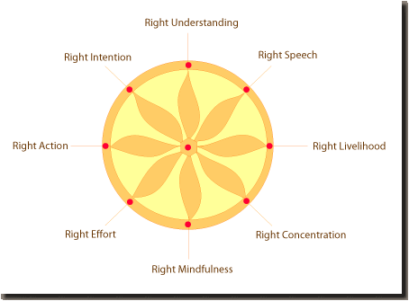
Buddhism
Middle Path (Eightfold Path)
Right view
Right intention
Right speech
Right action
Right livelihood
Right effort
Right mindfulness
Right concentration

Slide 20
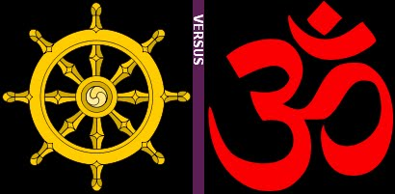
Hinduism vs. Buddhism
Buddhism accepted reincarnation but rejected caste system.
All human beings could reach nirvana.
Buddhism was more simplistic

Slide 21
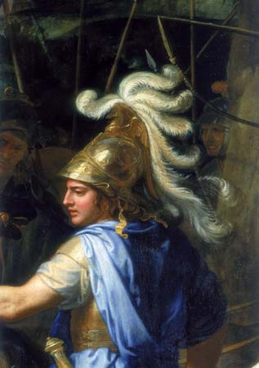
New Empires in India
Aryans were constantly fighting and shifting alliances.
Peace was unstable
Led to invasions by Persians, Greeks, and Macedonians.
Alexander the Great
Macedonian king who conquered much of western India.

Slide 22
Mauryan Dynasty
Drove Macedonians out.
Started by Chandragupta Maurya who ruled as king.
Established capital at Pataliputra
Northern India (Ganges Valley)
Centralized rule to keep control
King appointed governors of different regions
Large army and secret police

Slide 23
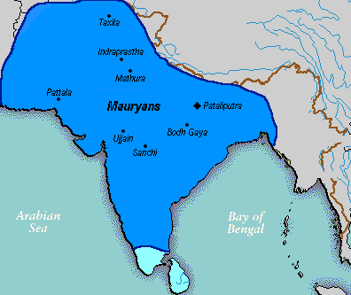
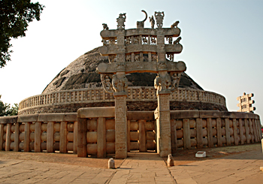
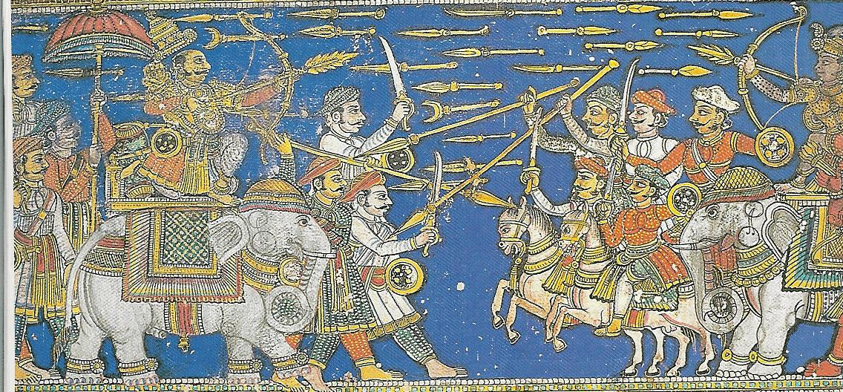
Mauryan Empire

Slide 24
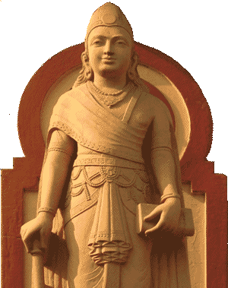
Ashoka Comes to Power
Grandson of Chandragupta Maurya
Considered greatest ruler in India’s history
Converted to Buddhism
Buddhist ideals to guide his rule
Kingdom prospered
Major crossroads of trade
Decline of Mauryan Empire after his death

Slide 25
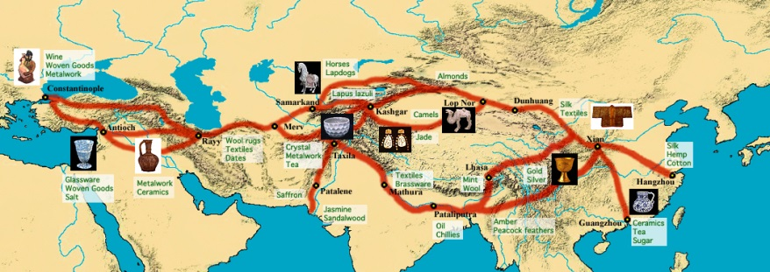
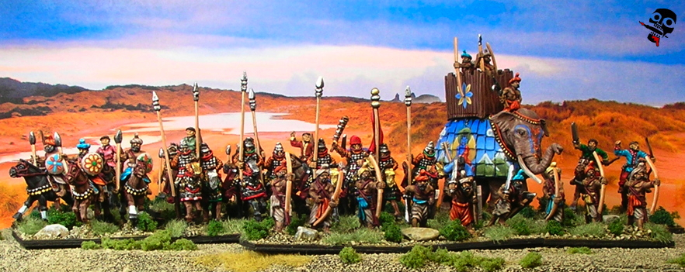
Kushan Kingdom
Nomadic warriors who established kingdom after the fall of Mauryan empire.
Prospered from trade
Center between Mediterranean Sea and Pacific Ocean
Between Roman Empire and China
Silk Road (About 4,000 miles)

Slide 26
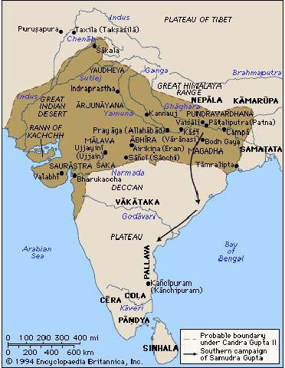
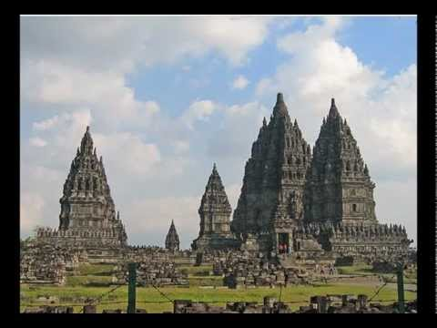
Kingdom of the Guptas
Reestablished capital at Pataliputra
Kingdom became dominant political force in India.
Traded with China, Southeast Asia, and the Mediterranean region.
Crumpled after invasions by the nomadic Huns.

Slide 27
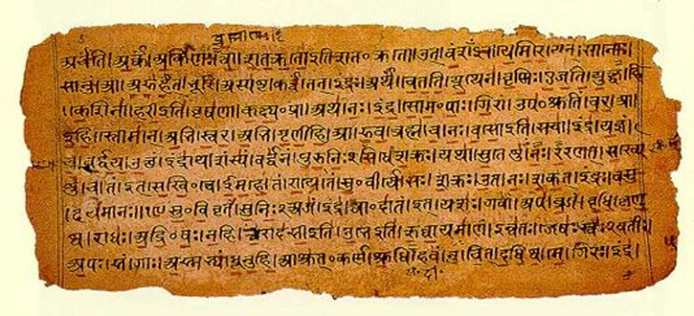
World of Indian Culture
Produced cultural fields of literature, architecture, and science.
Vedas: religious Aryan literature
Mahabharata and Ramayana
India’s greatest historical epics
Contributions to mathematics
Decimal system of counting in tens
Introduced the concept of zero

Slide 28
Page 86 (#4-7) and page 87 (#1-2)

