Slide 1
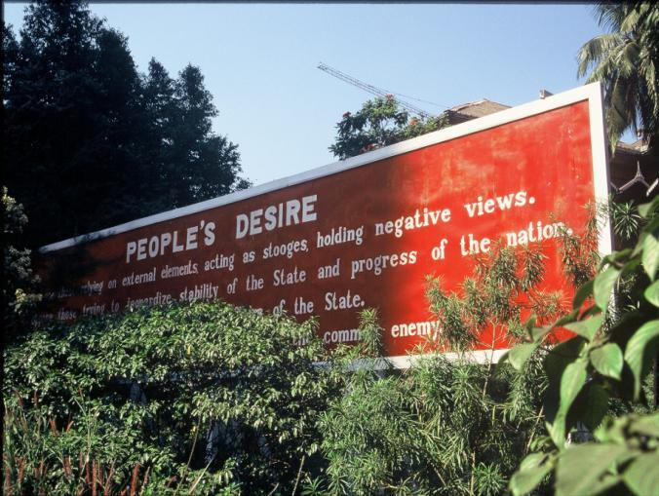
Political Geography
Concept Caching: Burma, Myanmar
© Barbara Weightman

Slide 2
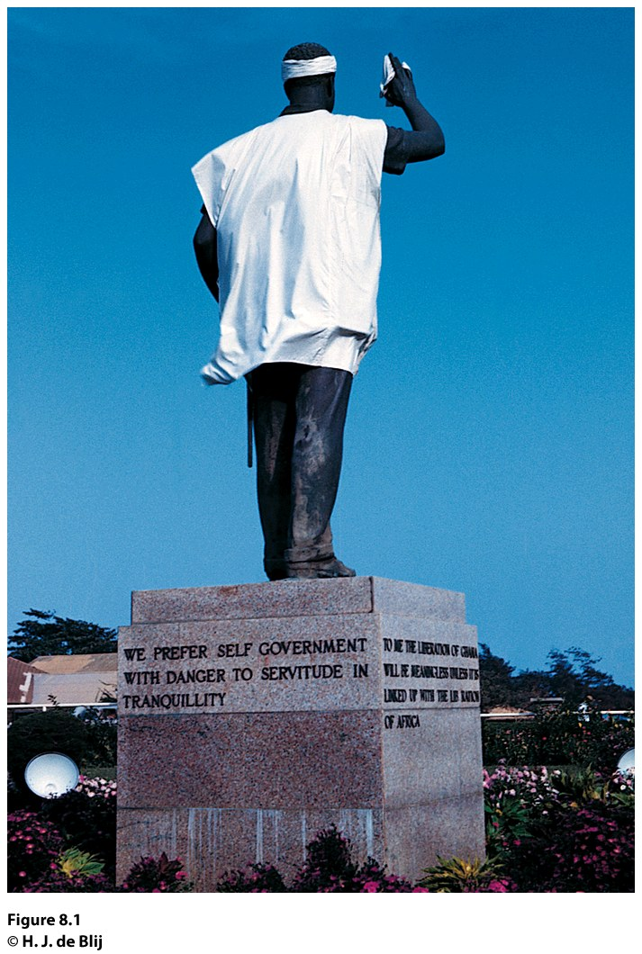
Field Note: Independence Is Better than Servitude
“I arrived in Ghana just after an assassination attempt on the country’s first president, Kwame Nkrumah. As I drove through the capital city of Accra in 1962, I stopped short when I saw a statue of President Nkrumah in the middle of the street. I have seen plenty of statues of leaders in my travels, but this one was unique. Ghanaians had dressed their hospital-ridden president in a hospital gown and bandaged his head!”
Notes:
*Could be an audio file.
Figure 8.1
Accra, Ghana. Statue of Kwame Nkrumah, the fi rst president
of Ghana. © H. J. de Blij.

Slide 3
Key Question
How is space politically organized into states and nations?

Slide 4
How Is Space Politically Organized into States and Nations?
Political geography is the study of the political organization of the world.
A state is a politically organized territory with a permanent population, a defined territory, and a government.
Geographer Stuart Elden: modern concept of territory arose in early modern Europe as a system of political units came into being with fixed, distinct boundaries and at least a quasi-independent government; process by which this happens is territoriality.

Slide 5
How Is Space Politically Organized into States and Nations?
Today, territoriality is tied to the concept of sovereignty.
Sovereignty means having a recognized right to control a territory both politically and militarily.
Under international law, states are sovereign, and they have the right to defend their territorial integrity against incursion from other states.

Slide 6
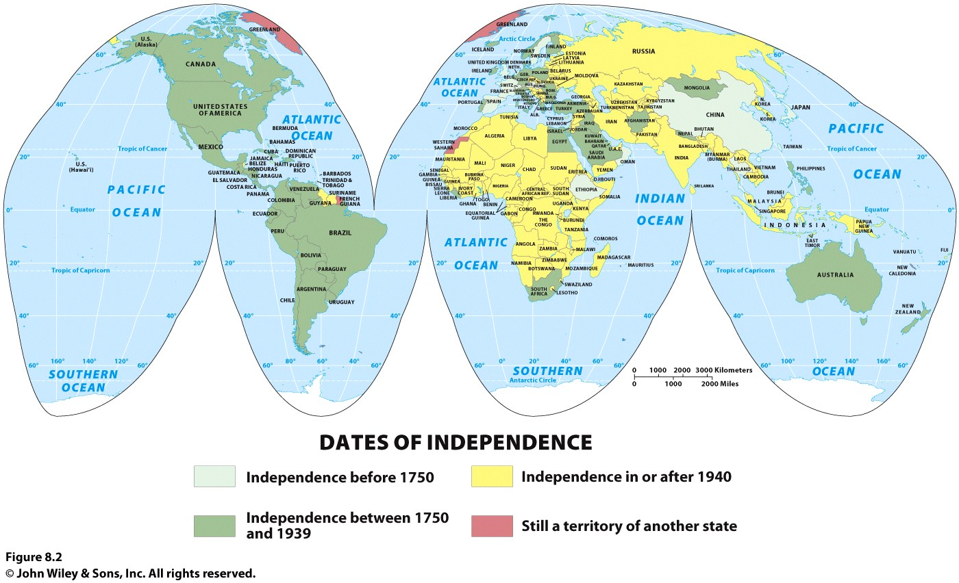
Notes:
Figure 5.2
United States. Although biologically there is only one human
race, we are constantly asked to choose race “boxes” for ourselves.
This page of the 2010 United States Census asks the
individual, “What is your race?” and directs the individual to
“Mark one or more races to indicate what you consider yourself to be.” © U.S. Census Bureau

Slide 7
The Modern State Idea
How Is Space Politically Organized into States and Nations?
Idea of the state appeared in various forms across world regions 400 or 500 years ago
The European state idea most influenced the development of the modern state system
Emerging political state was accompanied by mercantilism, which led to the accumulation of wealth through plunder, colonization, and the protection of home industries and foreign markets

Slide 8
The Modern State Idea
How Is Space Politically Organized into States and Nations?
The Peace of Westphalia, negotiated in 1648, marks the beginning of the modern state system.
In the Westphalian system it became the territory that defined the society.
Territory is treated as a fixed element of political identification, and states define exclusive, nonoverlapping territories.

Slide 9
Nations
How Is Space Politically Organized into States and Nations?
Nation is a culturally defined term, and few people agree on exactly what it means.
The term was originally meant to refer to a group of people who think of themselves as one based on a sense of shared culture and history, and who seek some degree of political-territorial autonomy.
All nations are ultimately mixtures of different peoples.
A nation is identified by its own membership; therefore, we cannot simply define a nation as the people within a territory

Slide 10
Nation-State
How Is Space Politically Organized into States and Nations?
A nation-state is a politically organized area in which nation and state occupy the same space.
The goal of creating nation-states dates to the French Revolution: democracy
Key problem associated with the idea of the nation-state is that it assumes the presence of reasonably well-defined, stable nations living contiguously in discrete territories.

Slide 11
Nation-State
How Is Space Politically Organized into States and Nations?
When people have a strong sense of nationalism, they have a loyalty to and a belief in the nation itself.
A state, in contrast, seeks to promote a sense of nationhood that coincides with its own borders.
To help people within the borders relate to the dominant national ideal, states provide security, infrastructure, and goods and services for their citizens.

Slide 12
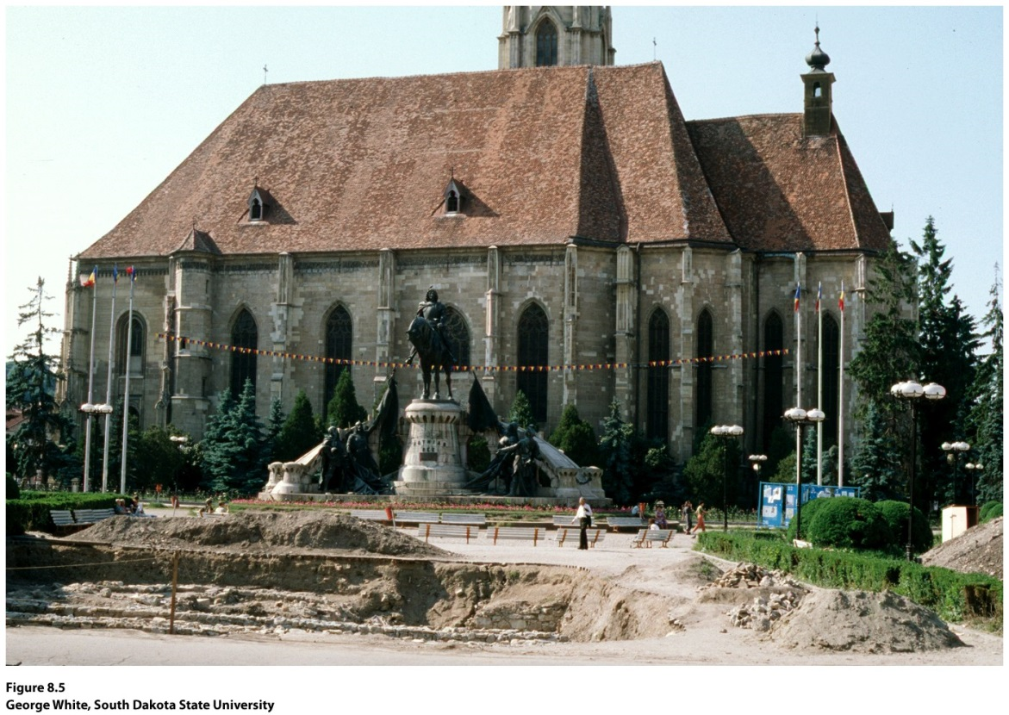
Guest Field Note: Cluj-Napoca, Romania
“To Hungarians, Transylvania is significant because it was an important part of the Hungarian Kingdom for a thousand years. Many of their great leaders were born and buried there, and many of their great churches, colleges, and architectural achievements are located there too.”
Notes:
*Could be an audio file.
Figure 8.5
Credit: George White, South Dakota State University

Slide 13
Multistate Nations, Multinational States, and Stateless Nations
How Is Space Politically Organized into States and Nations?
Nearly every state in the world is a multinational state, a state with more than one nation inside its borders.
When a nation stretches across borders and across states, the nation is called a multistate nation.
When multiple nations or states claim attachments to the same piece of territory, the potential for conflict is significant.

Slide 14
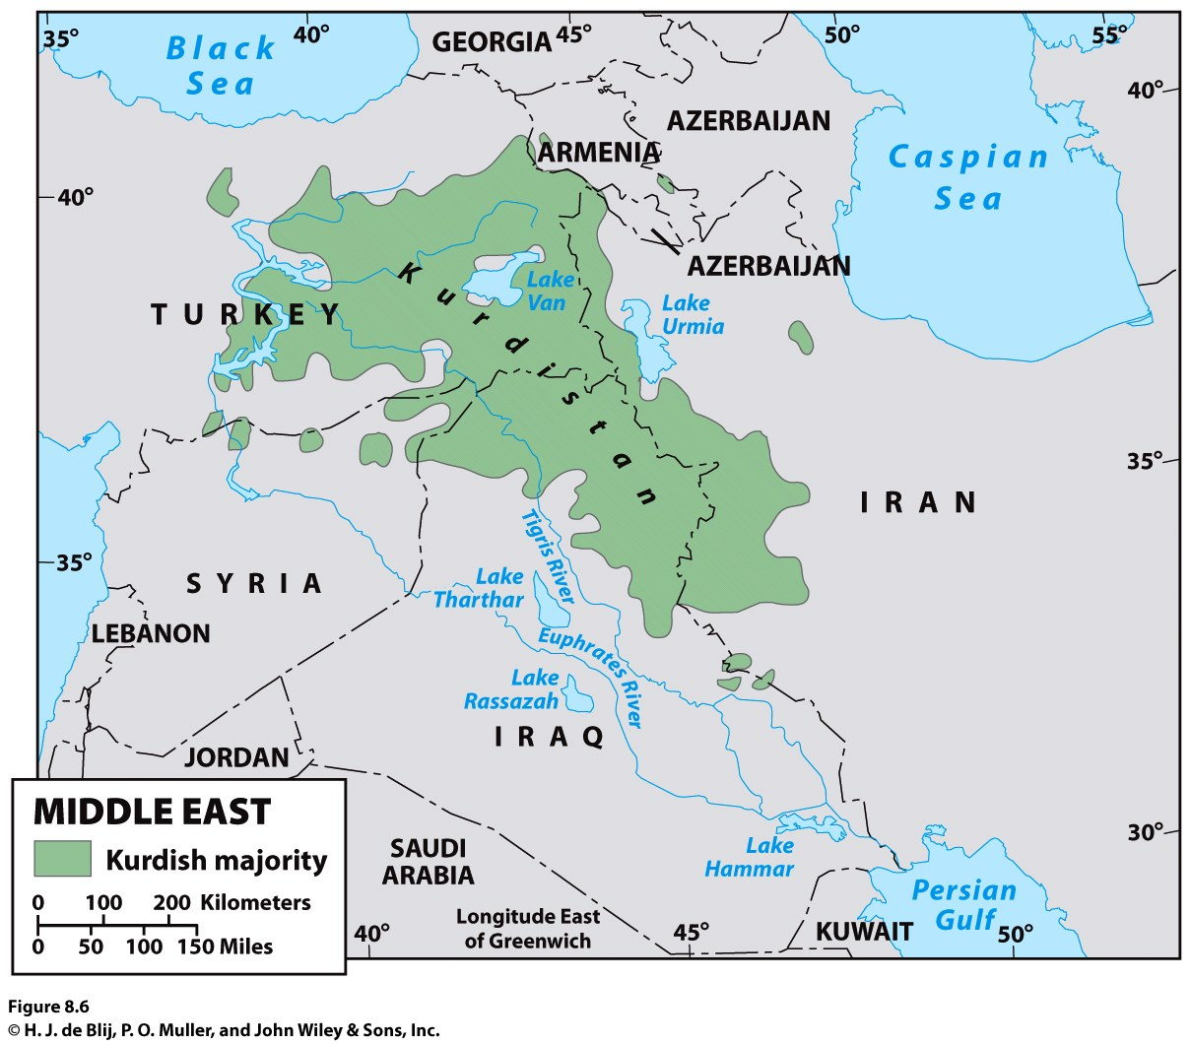
Another complication that arises from the lack of fit between nations and states is that some nations do not have a state; they are stateless nations.
Ex.: the Kurds
Notes:
Figure 8.6
Kurdish Region of the Middle East. © H. J.
de Blij , P. O. Muller, and John W i ley & Sons.

Slide 15
European Colonialism and the Diffusion of the Nation-State Model
How Is Space Politically Organized into States and Nations?
Europe exported its concepts of state, sovereignty, and the desire for nation-states to much of the rest of the world through two waves of colonialism.
During the heyday of colonialism, imperial powers exercised ruthless control over their domains and organized them for maximum economic exploitation.
Despite the end of colonialism, the political organization of space and the global world economy persist.

Slide 16
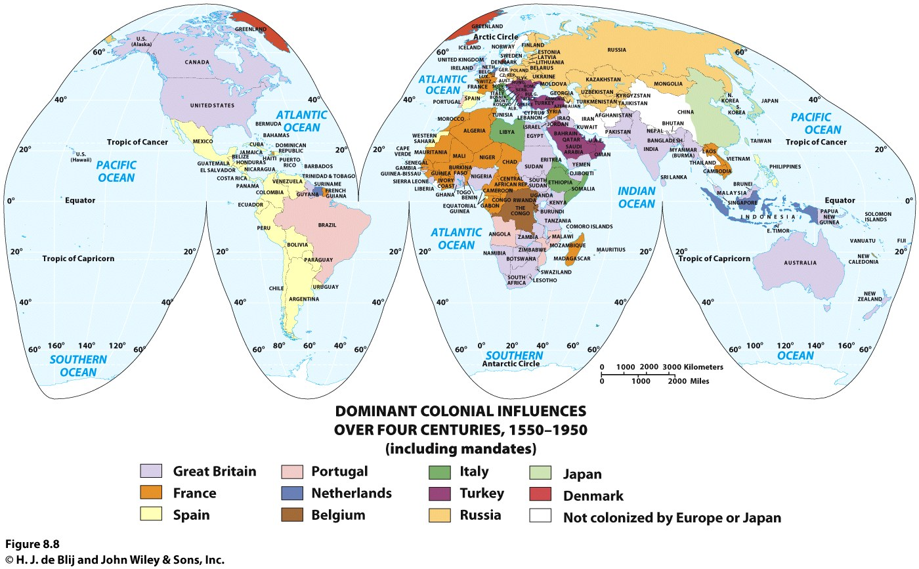
Notes:
Figure 8.8
Dominant Colonial Infl uences, 1550–1950. The map shows the dominant European or
Japanese colonial infl uence in each country over the four centuries. © H. J. de Blij , John W i ley & Sons.

Slide 17
Construction of the Capitalist World Economy
How Is Space Politically Organized into States and Nations?
One of the most powerful impacts of colonialism was the construction of a global order characterized by great differences in economic and political power.
The concentration of wealth that colonialism brought to Europe, and to parts of the world dominated by European settlers.
Colonialism is at the heart of highly uneven global distribution of power that continues even today.

Slide 18
Construction of the Capitalist World Economy
How Is Space Politically Organized into States and Nations?
Social scientists seek to see how each “dot” fits into the whole.
Proponents of world-systems theory view the world as much more than the sum total of the world’s states.

Slide 19
Construction of the Capitalist World Economy
How Is Space Politically Organized into States and Nations?
The three basic tenets of world-systems theory, as Immanuel Wallerstein defines them:
1. The world economy has one market and a global division of labor.
Capitalism: in the world economy, individuals, corporations, and states produce goods and services that are exchanged for profit.
Commodification is the process of placing a price on a good, service, or idea and then buying, selling, and trading that item.

Slide 20
Construction of the Capitalist World Economy
How Is Space Politically Organized into States and Nations?
2. Although the world has multiple states, almost everything takes place within the context of the world economy:
Colonialism played a major role in establishing this system by exporting the European state idea and facilitating the construction of an interdependent global economy.

Slide 21
Construction of the Capitalist World Economy
How Is Space Politically Organized into States and Nations?
3. The world economy has a three-tier structure:
Core is where one is most likely to find higher levels of education, higher salaries, and more technology
Periphery: processes associated with a more marginal position in the world economy
Semiperiphery: places where core and periphery processes are both occurring

Slide 22
Construction of the Capitalist World Economy
How Is Space Politically Organized into States and Nations?
Major concerns of the world-systems theory:
Overemphasizes economic factors in political development
Very state-centric
Does not fully account for how places move from one category to another

Slide 23
How Is Space Politically Organized into States and Nations?
World-Systems and Political Power
Each state is theoretically sovereign, but not all states have the same ability to influence others or achieve their political goals.
World-systems theory helps explain how Europe politically reorganized the world during colonialism.
Regardless of many problems and lack of simple solutions to nation and state conflicts, the European territorial state idea became the world model and still shapes the political organization of space worldwide.
The Enduring Impact of the Nation-State Idea

Slide 24
Key Question
How do states spatially organize their governments?

Slide 25
How Do States Spatially Organize Their Governments?
Political geographer Richard Hartshorne described the forces within the state that unify the people as centripetal and the forces that divide them as centrifugal.
According to Hartshorne, whether a state continues to exist depends on the balance between centripetal and centrifugal forces.

Slide 26
Form of Government
How Do States Spatially Organize Their Governments?
Unitary governments: centralized states whose administrative framework is designed to ensure the central government’s authority over all of the state.
In a strong federal system, the regions have much control over government policies and funds, and in a weak federal system, the central government retains a significant measure of power.
Federalism accommodates regional interests by vesting primary power in provinces, States, or other regional units over all matters except those explicitly given to the central government.

