Slide 1
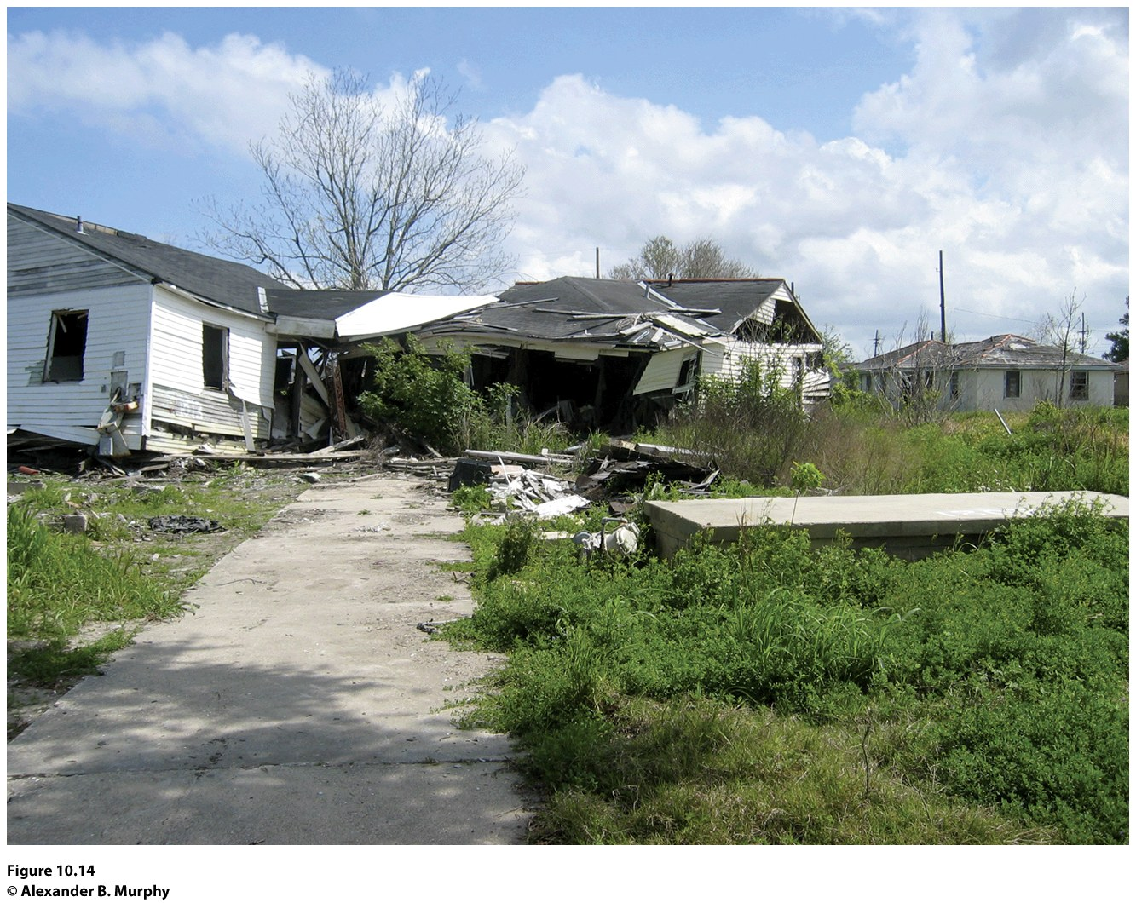
Development
Notes:
Concept Caching: New Orleans, Louisiana

Slide 2
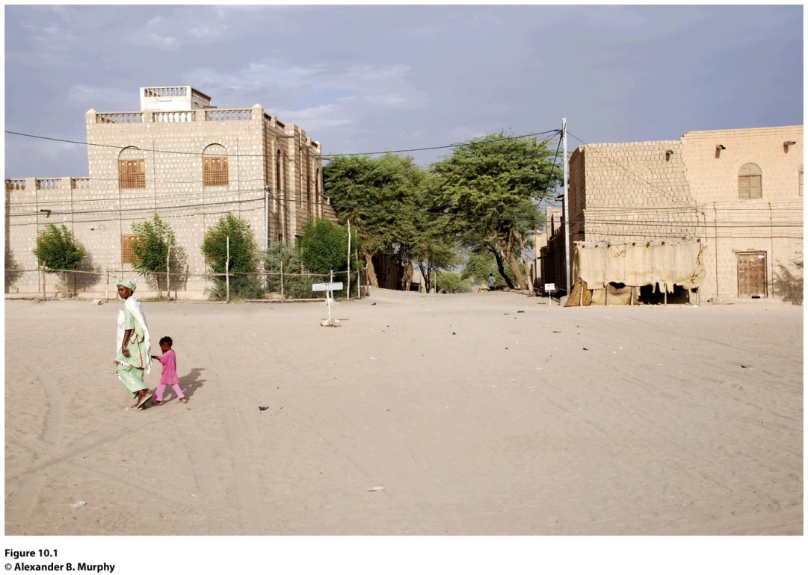
Field Note: Geography, Trade, and Development
“Walking down one of the major streets of Timbuktu, Mali , I could hardly believe I was in the renowned intellectual, spiritual, and economic center of the thirteenth to sixteenth centuries. At that time, the place had a great reputation for wealth, which spurred the first European explorations along the African coast. What survives is a relatively impoverished town of some 35,000 people providing central place functions for the surrounding area and seeking to attract some tourist
business based on its legendary name.”
Notes:
Figure 10.1
Central Square, Timbuktu, Mali. Sited along the Niger River on the edge of the Sahara
Desert, Timbuktu was once a major trade center. Goods from the north carried on camels were
traded with goods from the south brought in on boats. The development of sea trade routes in
the sixteenth century allowed traders to circumvent Timbuktu. In turn, the city’s central trade
role declined. © Alexander B. Murphy.

Slide 3
Key Question
How is development defined and measured?

Slide 4
How Is Development Defined and Measured?
Wealth does not depend solely on what is produced; it depends in large part on how and where it is produced.
A country that is developing is making progress in technology, production, and socioeconomic well- being.
Ways of measuring development fit into three major areas of concern: development in economic welfare, development in technology and production, and development in social welfare.

Slide 5
How Is Development Defined and Measured?
Gross National Income
GNP is a measure of the total value of the officially recorded goods and services produced by the citizens and corporations of a country in a given year, and includes things produced both inside and outside the country’s territory.
Gross domestic product (GDP), which encompasses only goods and services produced within a country during a given year.

Slide 6
How Is Development Defined and Measured?
Gross National Income
Gross national income (GNI): monetary worth of what is produced within a country plus income received from investments outside the country minus income payments to other countries.
The most common way to standardize GNI data is to divide it by the population of the country, yielding the per capita GNI.
Formal economy: the legal economy that governments tax and monitor.
Informal economy: uncounted or illegal economy that governments do not tax and keep track of.

Slide 7
How Is Development Defined and Measured?
Gross National Income
GNI per capita masks extremes in the distribution of wealth within a country.
GNI per capita measures only outputs (i.e., production). It does not take into account the nonmonetary costs of production.
The limitations of GNI have prompted some analysts to look for alternative measures of economic development, ways of measuring the roles that technology, production, transportation, and communications play in an economy.

Slide 8
How Is Development Defined and Measured?
Gross National Income
Other analysts focus on social welfare to measure development dependency ratio: a measure of the number of dependents, young and old, that each 100 employed people must support.
A high dependency ratio can result in significant economic and social strain.
We can employ countless other statistics to measure social welfare, including literacy rates, infant mortality, life expectancy, caloric intake per person, percentage of family income spent on food, and amount of savings per capita.

Slide 9
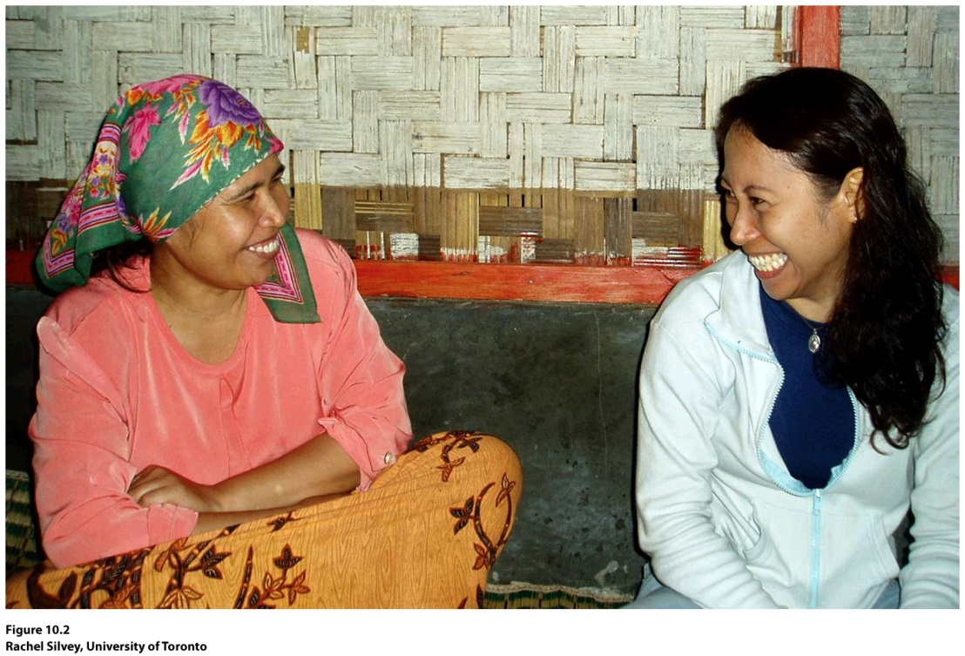
Guest Field Note:
Sukabumi, West Java
“My own research is based on fieldwork in Indonesia as well as ongoing engagement with students in the United States. The women pictured here collaborated with me on a research/activism project for migrant women workers in Indonesia. The woman on the left (“Rina”) had returned from working in Saudi Arabia as a domestic worker for two years. She wanted to return to Saudi Arabia for another contract to earn more money for herself and her family, but she was concerned about her rights and her safety.” Credit: Rachel Silvey, University of Toronto
Notes:
Figure 10.2
Credit: Rachel Silvey, University of Toronto

Slide 10
How Is Development Defined and Measured?
Development Models
Criticism of the development model:
It does not take geographical differences very seriously.
The conceptualization of development has a Western bias.
It does not consider the ability of some countries to influence what happens in other countries.

Slide 11
Walt Rostow’s modernization model: assumes that all countries follow a similar path to development or modernization, advancing through five stages of development:
The society is traditional, and the dominant activity is subsistence farming.
Preconditions of takeoff: New leadership moves the country toward greater flexibility, openness, and diversification.
Takeoff: the country experiences something akin to an Industrial Revolution, and sustained growth takes hold.
Drive to maturity: Technologies diffuse, industrial specialization occurs, and international trade expands.
High mass consumption: high incomes and widespread production of many goods and services.

Slide 12
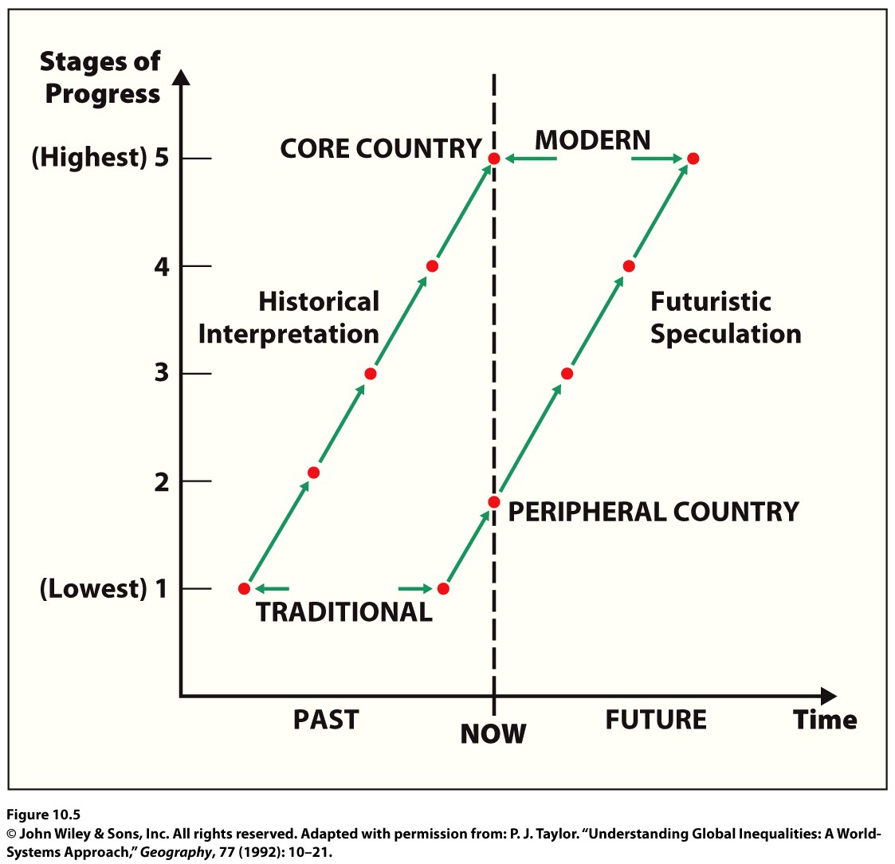
Figure 10.5
Rostow’s Ladder of Development. This ladder assumes that all countries can reach the same level of development and that all will follow a similar path. Adapted with permission from: P. J. Taylor. “Understanding Global Inequalities: A World-Systems Approach,” Geography, 77 (1992): 10–21.
Notes:
Figure 10.5
Rostow’s Ladder of Development. This ladder assumes that
all countries can reach the same level of development and that
all will follow a similar path. Adapted with permission from: P. J.
Taylor. “Understanding Global Inequalities: A World-Systems
Approach,” Geogr a phy , 77 (1992): 10–21.

Slide 13
Key Question
How does geographical situation affect development?

Slide 14
How Does Geographical Situation affect Development?
Development happens in context: it reflects what is happening in a place as a result of forces operating concurrently at multiple scales.
Neocolonialism: the major world powers continue to control the economies of the poorer countries, even though the poorer countries are now politically independent states.
Structuralist theory holds that difficult-to-change, large-scale economic arrangements shape what can happen in fundamental ways.

Slide 15
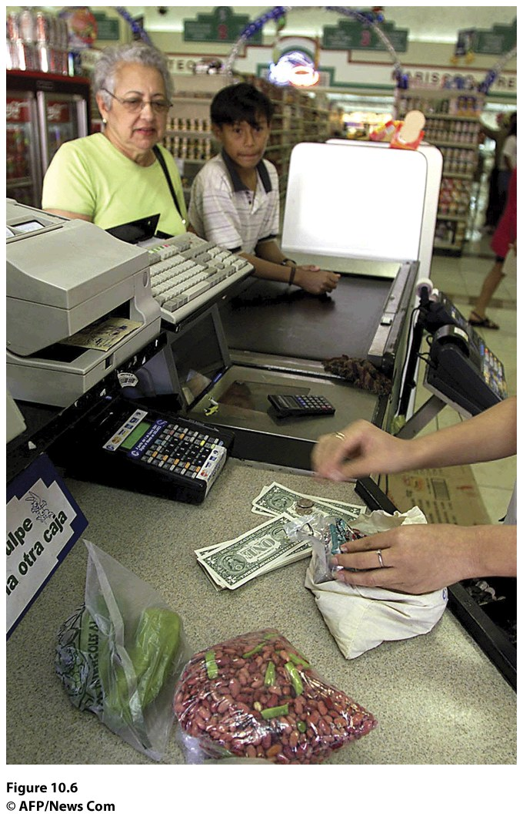
Dependency Theory
Holds that the political and economic relationships between countries and regions of the world control and limit the economic development possibilities of poorer areas.
Dollarization: the country’s currency, the colon, was abandoned in favor of the dollar.
Figure 10.6
San Salvador, El Salvador. A woman and young boy use dollars to pay for groceries in El Salvador, a country that underwent dollarization in 2001.
© AFP/News Com, Yuri Cortez.

Slide 16
Geography and Context
Immanuel Wallerstein’s world-systems theory
Three-tier structure—the core, periphery, and semiperiphery—helps explain the interconnections between places in the global economy.
When core processes are embedded in a place, wealth is generated for the people in that place.
Peripheral processes require little education, lower technologies, and lower wages and benefits.
The semiperiphery exhibits both core and peripheral processes, and semiperipheral places serve as a buffer between the core and periphery in the world-economy.

Slide 17
How Does Geographical Situation affect Development?
Geography and Context
World-systems theory makes the power relations among places explicit and does not assume that socioeconomic change will occur in the same way in all places.
World-systems theorists see domination (exploitation) as a function of the capitalist drive for profit in the global economy.
World-systems theory is applicable at scales beyond the state.

Slide 18
Key Question
What are the barriers to and the costs of economic development?

Slide 19
What Are the Barriers to and the Costs of Economic Development?
United Nations Human Development Index: goes beyond economics and incorporates the “three basic dimensions of human development: a long and healthy life, know ledge and a decent standard of living”
Several statistics, including per capita GDP, literacy rates, school enrollment rates, and life expectancy at birth, factor into the calculation of the Human Development Index.

Slide 20
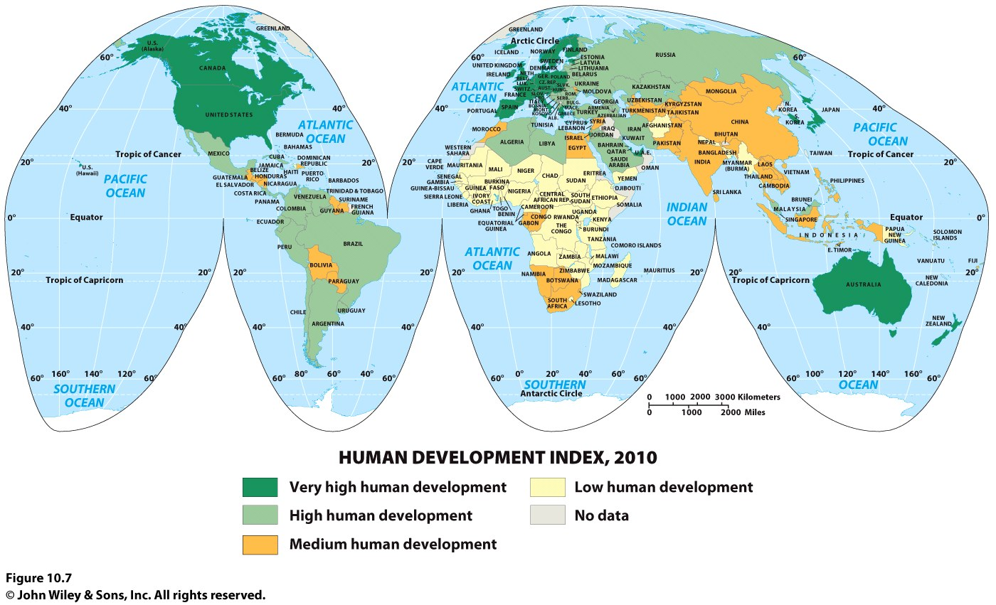

Slide 21
Millennium Development Goals:
What Are the Barriers to and the Costs of Economic Development?
1. Eradicate extreme poverty and hunger.
2. Achieve universal primary education.
3. Promote gender equality and empower women.
4. Reduce child mortality.
5. Improve maternal health.
6. Combat HIV/AIDS, malaria, and other diseases.
7. Ensure environmental sustainability.
8. Develop a global partnership for development.

Slide 22
Barriers to Economic Development
What Are the Barriers to and the Costs of Economic Development?
Social Conditions
High birth rates and low life expectancies at birth, high infant and child mortality rates, lack of access to healthcare, lack of access to education: trafficking
Foreign Debt
structural adjustment loans, neoliberalism (the idea that government intervention into markets is inefficient and undesirable, and should be resisted wherever possible)

Slide 23
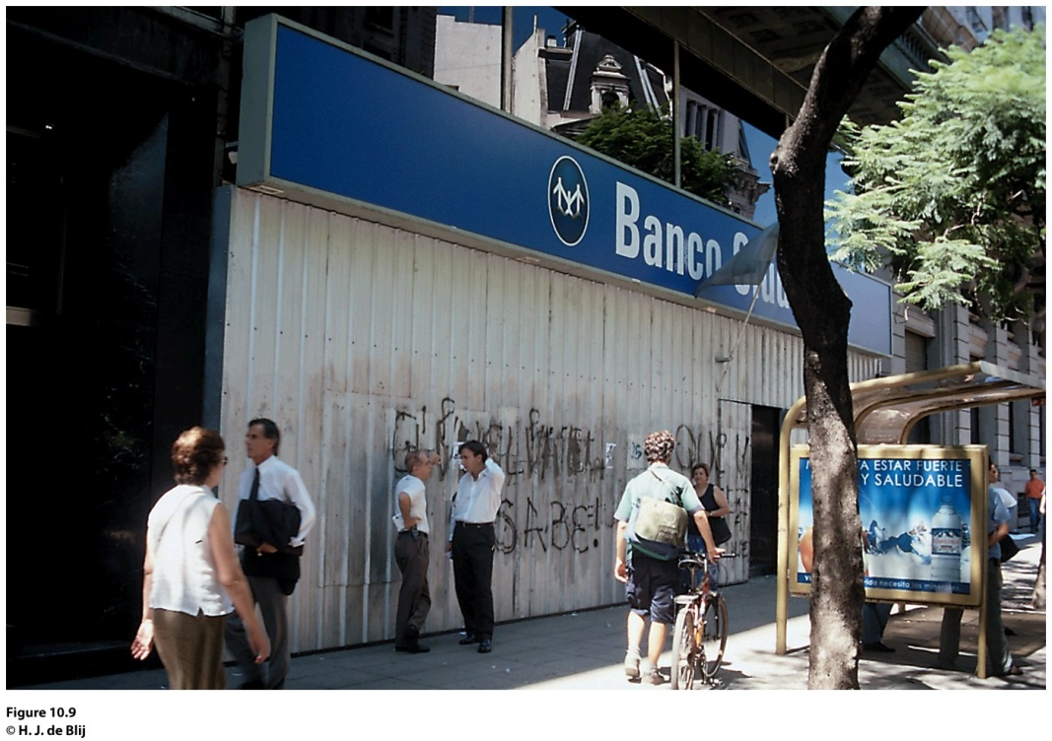
Field Note
“Arriving in Argentina during the political and economic
upheavals that had begun in 2001, I saw signs of dislocation and trouble everywhere. Beggars pursued pedestrians on the once-fashionable Avenida Florida. Banks had installed protective shutters against angry crowds demanding return of their frozen and devalued deposits. A bus trip on the Patagonian Highway turned into an adventure when masked protesters carrying rocks and burning rags stopped vehicles and threatened their occupants. Newspapers carried reports of starvation in Tucumán Province—in a country capable of producing seven times the food its population needs.”
Notes:
Figure 10.9
Buenos Aires, Argentina. © H. J. de Blij.

Slide 24
Barriers to Economic Development
What Are the Barriers to and the Costs of Economic Development?
Disease
Those living in the global economic periphery experience comparatively high rates of disease and a corresponding lack of adequate health care:
Vectored diseases: those spread by one host (person) to another by an intermediate host or vector
Malaria: the “silent tsunami”

Slide 25
Political Corruption and Instability
Can greatly impede economic development.
In peripheral countries, a wide divide often exists between the very wealthy and the poorest of the poor.
Countries of the core have established democracies for themselves but countries in the periphery and semiperiphery have had a much harder time establishing and maintaining democracies.
In places where poverty is rampant, politicians often become corrupt, misusing aid and exacerbating the plight of the poor.
In low-income countries, corrupt leaders can stay in power for decades.

Slide 26
Costs of Economic Development
What Are the Barriers to and the Costs of Economic Development?
Industrialization
Export processing zones (EPZs) offer favorable tax, regulatory, and trade arrangements to foreign firms.
Mexican maquiladoras
Special economic zones of China
In 1992, the United States, Mexico, and Canada established the North American Free Trade Agreement (NAFTA), which prompted further industrialization of the border region.

Slide 27
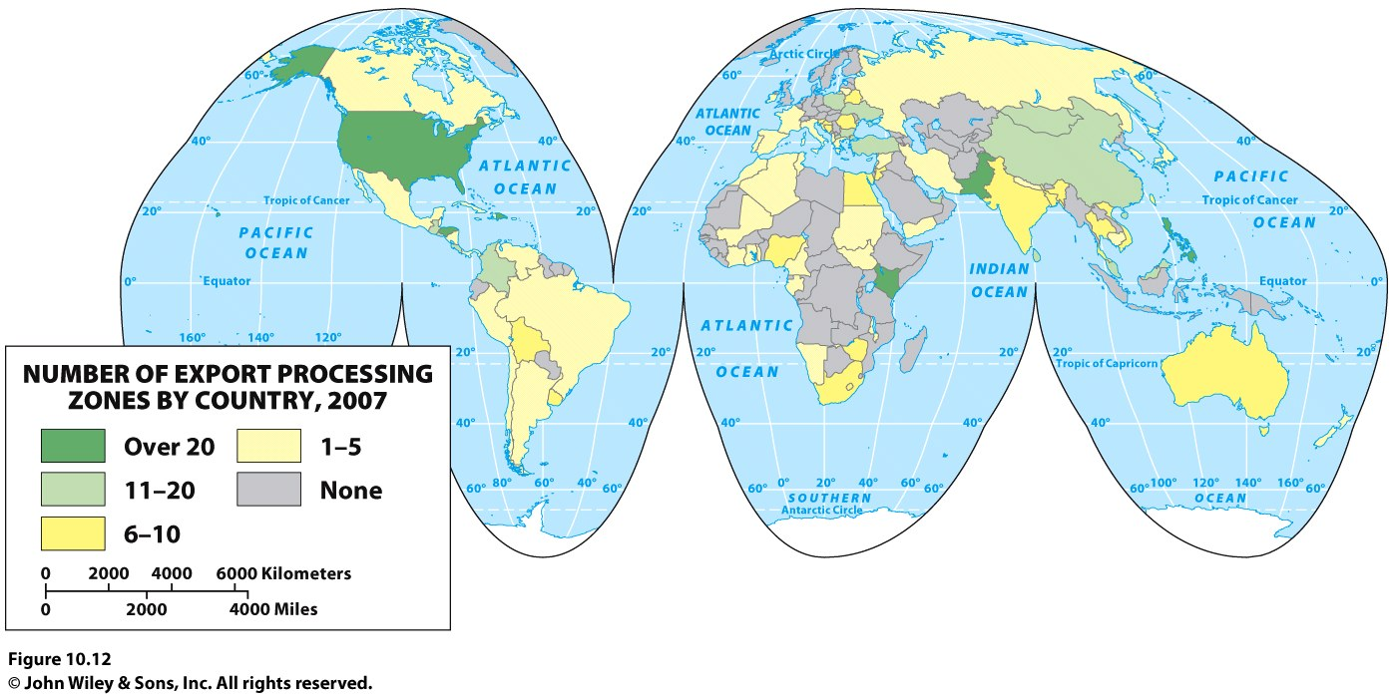
Notes:
Figure 10.12
Export Processing Zones. Number of export processing zones by country, 2006. Data from:
International Labor Organization.

Slide 28
Agriculture
In peripheral countries, agriculture typically focuses on personal consumption or on production for a large agricultural conglomerate.
Little is produced for the local marketplace because distribution systems are poorly organized.
On the farms in the periphery, yields per unit area are low, subsistence modes of life prevail, and many families are constantly in debt.
Desertification is more often exacerbated by humans destroying vegetation and eroding soils through the overuse of lands for livestock grazing or crop production.
Africa has been hit hardest by desertification.

Slide 29
Tourism
Now one of the major industries in the world and has surpassed oil in its overall economic value.
To develop tourism, the “host” country must make a substantial investment.
Much of the income a country receives from tourism revenues are reinvested in the construction of airports, cruise-ports, and other infrastructure that supports more tourism.
Tourism can create local jobs, but they are often low-paying and have little job security.
Tourism frequently strains the fabric of local communities.
The cultural landscape of tourism is frequently a study in harsh contrasts.

Slide 30
Key Question
How do political and economic institutions influence uneven development within states?

Slide 31
How Do Political and Economic Institutions Influence Uneven Development within States?
Regional contrasts in wealth are a reminder that per capita GNI does not accurately represent the economic development of individual places.
The contrasts between rich and poor areas are not simply the result of differences in the economic endowments of places.
Government policy frequently affects development patterns.

Slide 32
The Role of Governments
The distribution of wealth is affected by tariffs, trade agreements, taxation structures, land ownership rules, environmental regulations.
Government policies play an important role at the interstate level, but they also shape patterns of development within states.
Government policy can also help alleviate uneven development.
Economist Pietra Rivola: The Travels of a T-Shirt in the Global Economy: described the significant influences governments have on the distribution of wealth between and within states.

Slide 33
Islands of Development
In most states, the capital city is the political nerve center of the country, its national headquarters and seat of government.
In many countries of the global economic periphery and semiperiphery, the capital cities are by far the largest and most economically influential cities in the state.
Some newly independent states have built new capital cities, away from the colonial headquarters.
Island of development: a government or corporation builds up and concentrates economic development in a certain city or small region.

Slide 34
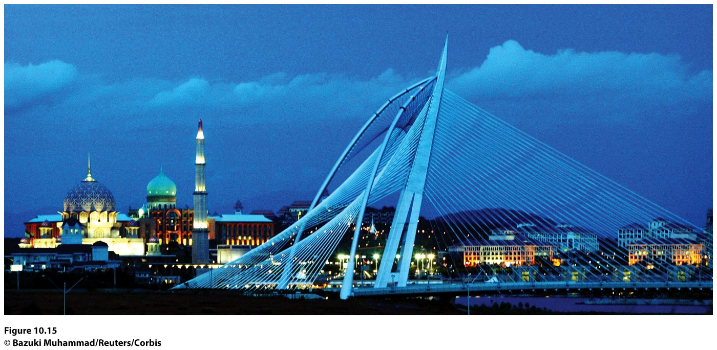
Figure 10.15
Putrajaya, Malaysia. Putrajaya is the newly built capital of Malaysia, replacing Kuala Lumpur.
© Bazuki Muhammad/Reuters/Corbis.

Slide 35
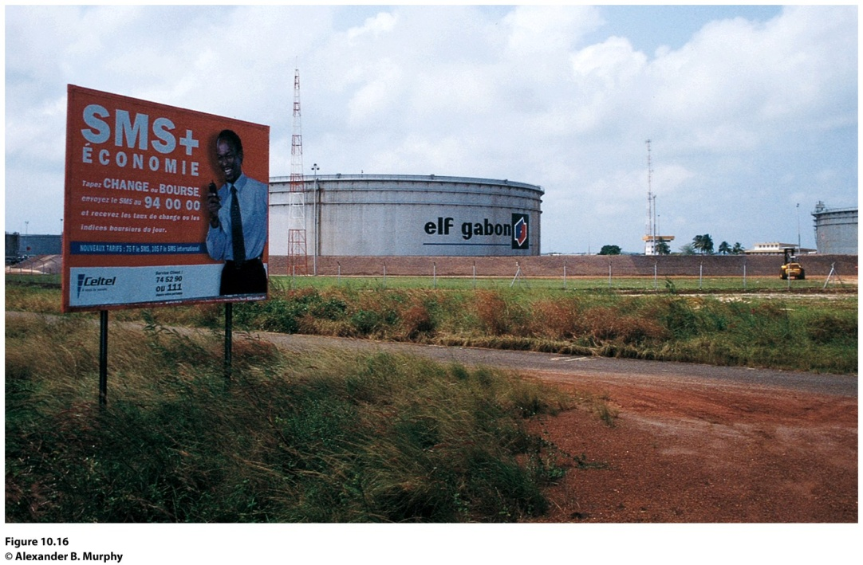
Field Note
“Before the 1970s, Gabon’s principal exports were manganese, hardwoods, and uranium ores. The discovery of oil off the Gabonese coast changed all that. This oil storage tank at the edge of Port Gentil is but one reminder of a development that has transformed Gabon’s major port city—and the economy of the country as a whole. Oil now accounts for 80 percent of Gabon’s export earnings, and that figure is climbing as oil prices rise and new discoveries are made. But how much the average citizen of Gabon is benefiting from the oil economy remains an open question. Even as health care and infrastructure needs remain unmet, the French publication L’Autre Afrique listed Gabon’s recently deceased ruler as the African leader with the largest real estate holdings in Paris.”
Notes:
Figure 10.16
Port Gentile, Gabon. © Alexander B. Murphy.

Slide 36
Creating Growth in the Periphery of the Periphery
In the most rural, impoverished regions of less prosperous countries, some nongovernmental organizations (NGOs) try to improve the plight of people.
Each NGO has its own set of goals, depending on the primary concerns outlined by its founders and financiers.
Microcredit programs give loans to poor people, particularly women, to encourage development of small businesses.

Slide 37
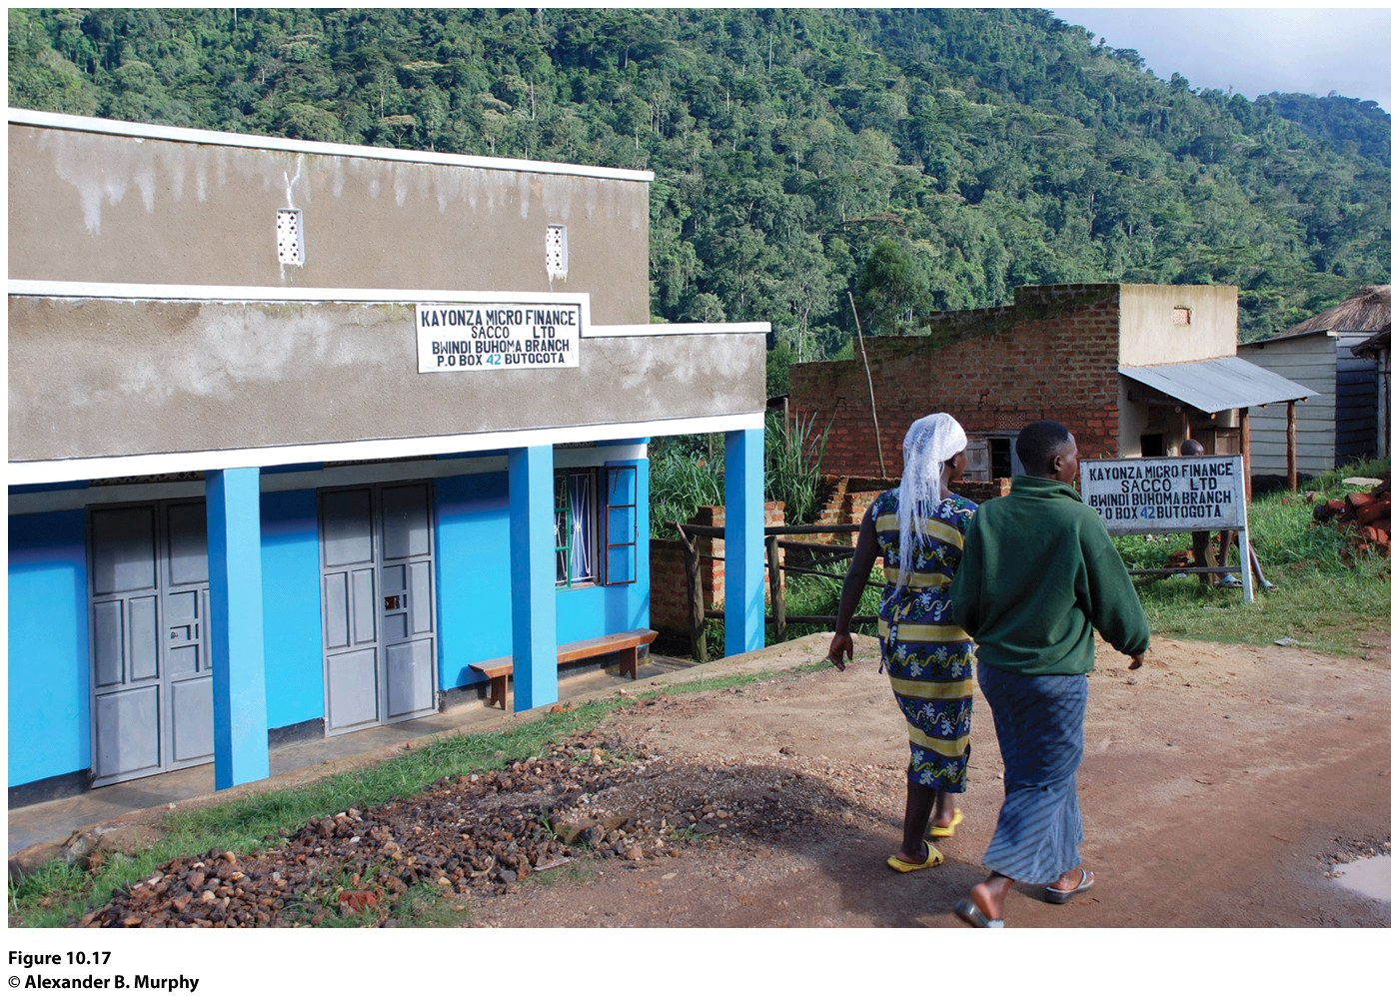
Figure 10.17
Bwindi, Uganda. Women walk by a microcredit agency that works to facilitate economic development in the town. © Alexander B. Murphy.

Slide 38
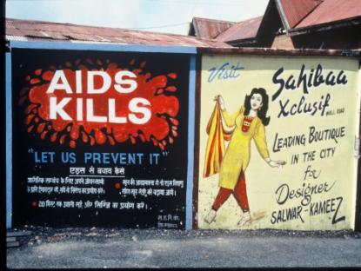
Creating Growth in the Periphery of the Periphery
Some microcredit programs are credited with lowering birth rates in parts of developing countries and altering the social fabric of cultures by diminishing men’s positions of power.
Microcredit programs have been less successful in places with high mortality rates from diseases such as AIDS.
Concept Caching:
AIDS sign—India
© Barbara Weightman

Slide 39
Additional Resources
Global Poverty
http://www.worldbank.org/poverty
Gabon
http://www.learner.org/resources/series180.html#program_descriptions
Click on Video On Demand for Gabon: Sustainable Resources?

