Slide 1
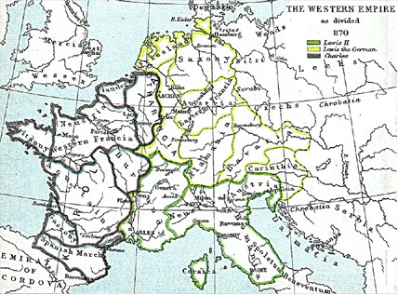
Rule of Charlemagne

Slide 2
Setting the Stage
The Middle Ages in Europe after the fall of the Roman Empire
Spans from 500 – 1500
New Society Emerges:
1) The classical heritage of Rome
2) The beliefs of the Roman Catholic Church
3) Customs of German Tribes

Slide 3
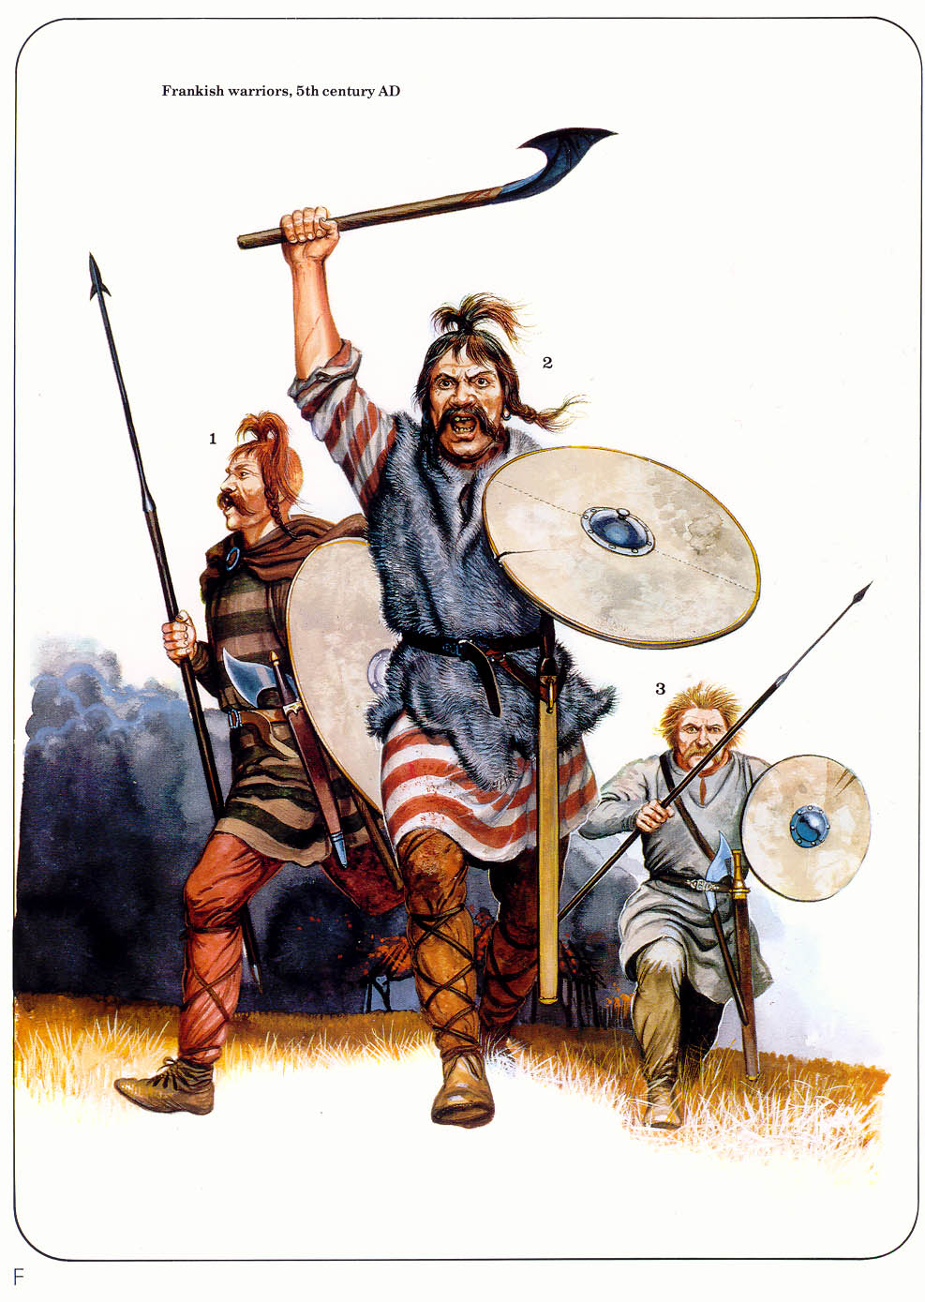
13.1 – Invasions of Western Europe
5th Century: Germanic Tribes overrun the Western Roman Empire
Changes:
Disruption of Trade – Business collapses
Downfall of Cities
Population Shifts – people abandon cities (Urban → Rural)
Decline of Learning – tribes could not read or write
Loss of Common Language – mix of cultures = many languages

Slide 4
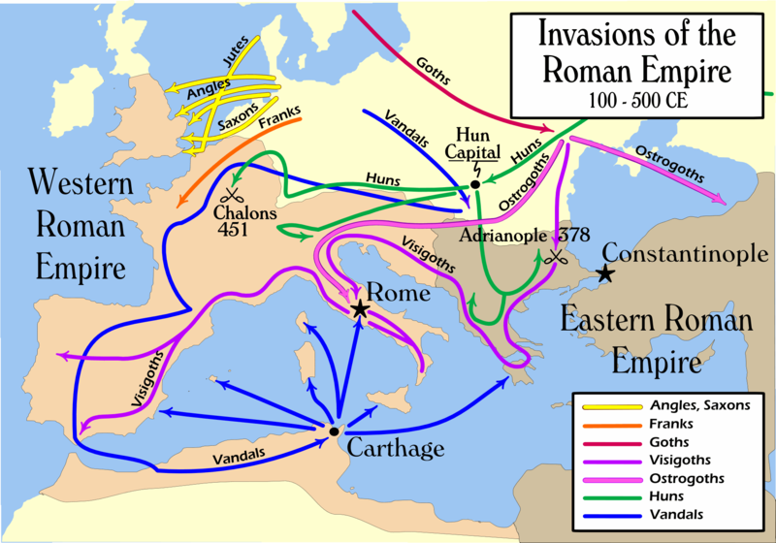

Slide 5
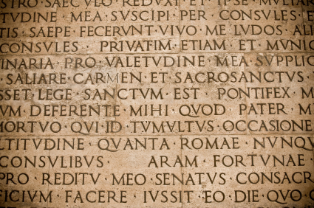
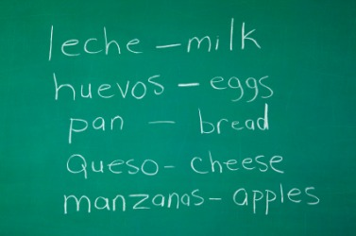
Decline: Learning & Language
Learning sinks as population becomes rural
Priests & church officials maintain classical learning (only source)
Germanic tribes only carried a rich oral tradition
Latin (Roman) changes as Germanic tribes interact = dialects
French, Spanish, etc.

Slide 6
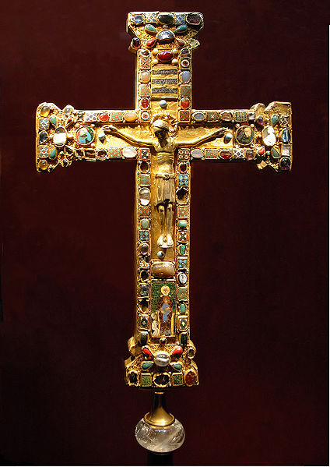
Change in Government
The Church provides order & security
Germanic society focused on the family & small communities (opposite of Rome)
Focused on oaths of loyalty = fight to the death
Germanic loyalty to family = impossible control over large territory

Slide 7
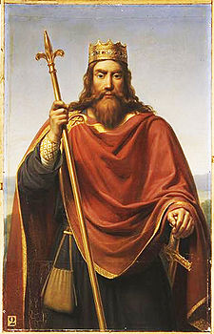
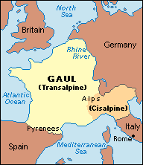
The Franks: Clovis
The Franks: Group of people that settled in Gaul
Clovis: Brought Christianity to the region
Baptizes his army
Church supports military campaigns against the Germans
Powerful Alliance – Why?
511: Clovis unites Franks under one kingdom

Slide 8
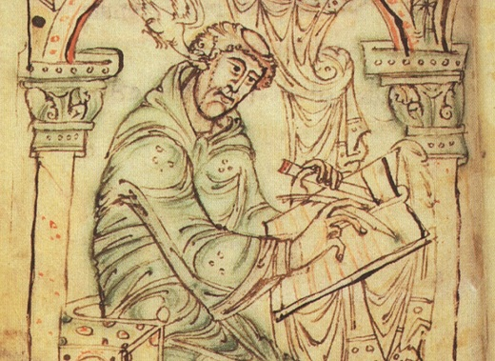
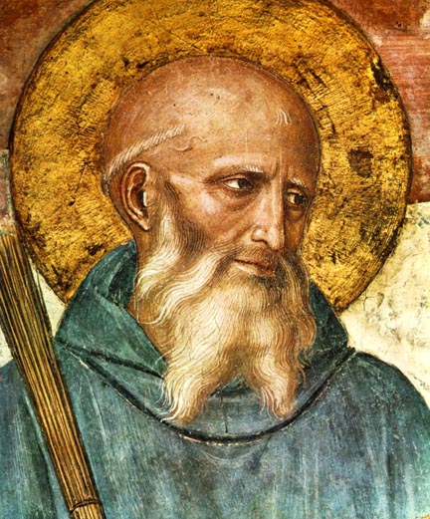
Rise of Christianity in Europe
The Church & Franks convert many Germans through missionaries
Many convert out of fear of Muslim attacks
Monasteries are constructed to form religious communities
Men = monks, Women = nuns
Benedictine Rule – Set of strict rules for monastery life
Monasteries become centers for education (Bede’s History of England)

Slide 9
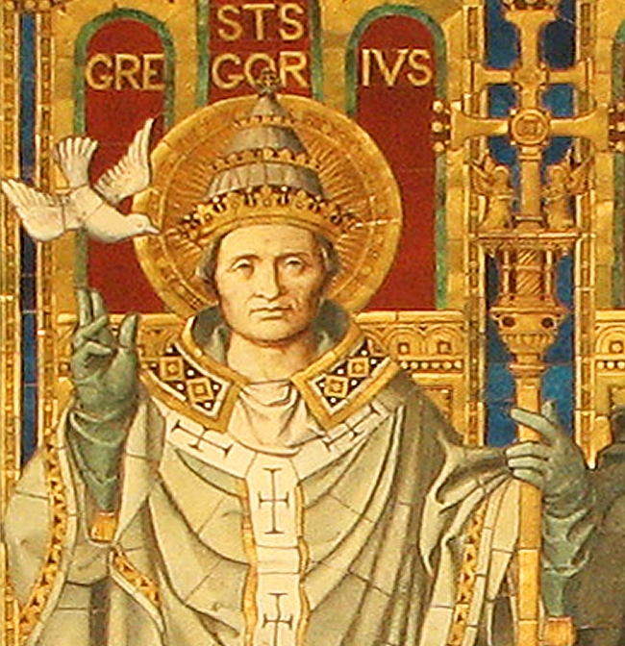
Papal Power Expands
590: Gregory becomes pope
Expands papal power to become involved in politics = secular body
Uses church money for repairing road, helping the poor, raising armies
Viewed papal authority stretched from Italy to England & from Spain to Germany

Slide 10
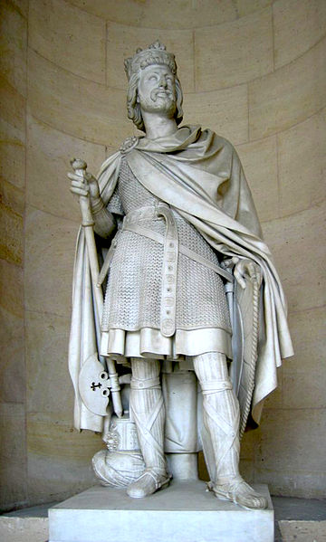
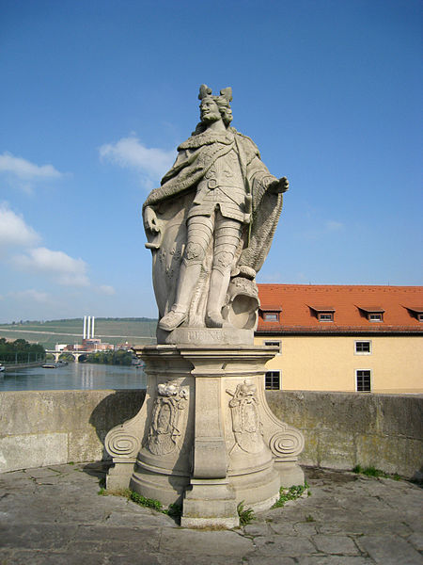
The Franks: Charles Martel & Pepin
1st famous ruler (major domo)
“Charles the Hammer”
Expanded Frankish territory into Central Europe
Battle of Tours (732) – Defeated Muslim army
Preserves Christian Europe
Pepin the Short, succeeds Martel, fights for the Church
Carolingian Dynasty

Slide 11
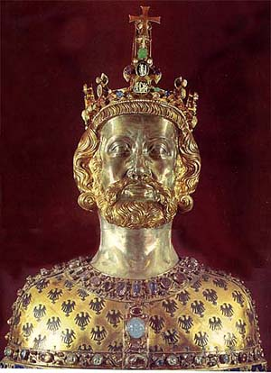
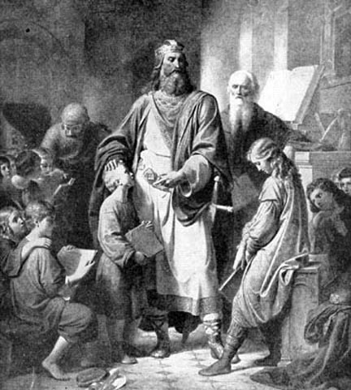
Charlemagne
Built the greatest empire since Rome
Conquers Muslim & Germanic lands
Spread Christianity & reunited Western Europe
800: Crowned Holy Roman Emperor by the Pope in Rome

Slide 12
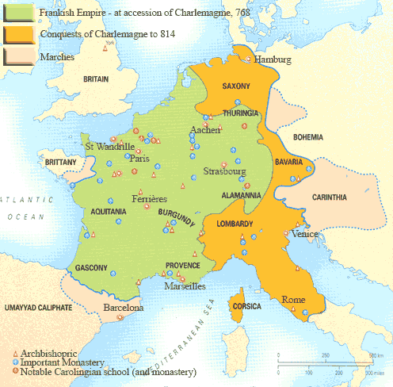

Slide 13
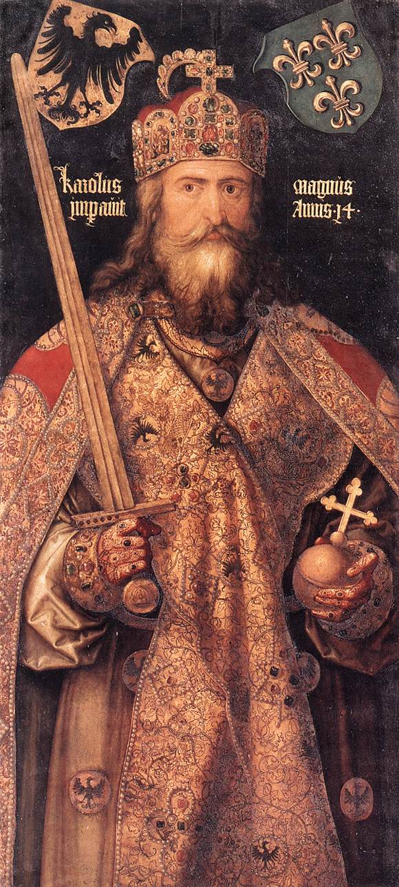
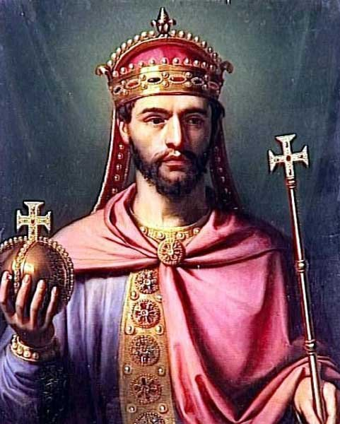
Charlemagne’s Rule & Succession
Restricts noble authority
Traveled & used royal agents to govern his empire
Supports education & set up learning programs
814: Power passes to Louis the Pious (son) – ineffective ruler
Empire splits between his 3 sons with the Treaty of Verdun
Split leads to Feudalism

