Slide 1
Imperial China Collapses
Nationalist and Communist Movements

Slide 2
The Nationalist Party pushed for modernization and nationalization.
Their first great leader was Sun Yixian
In 1911, the last emperor of the Qing dynasty was overthrown by the Nationalists.
END OF IMPERIAL RULE.

Slide 3
1912 Sun became president of the Republic of China
“Three Principles of the People”
nationalism—an end to foreign control
people’s rights—democracy
people’s livelihood—economic security for all Chinese

Slide 4
General Yuan Shikai takes over presidency.
Shikai betrays democratic ideals.
Local revolts break out.
In 1916, CIVIL WAR breaks out after Shikai’s death.
Provincial warlords held real authority

Slide 5
World War I Spells More Problems
Allies gave Japan those territories under Treaty of Versailles.
Treaty of Versailles outrages Chinese.
3,000 angry students gather in Beijing May 4, 1919.
“May Fourth Movement” spreads to other cities in China.
Many Chinese intellectuals reject Sun Yixian’s belief in western democracy in favor of Soviet communism.

Slide 6
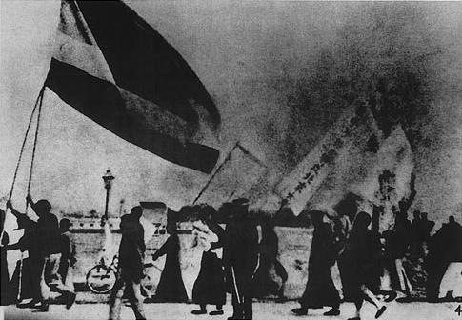
Students in Beijing rallied during the May Fourth Movement.

Slide 7
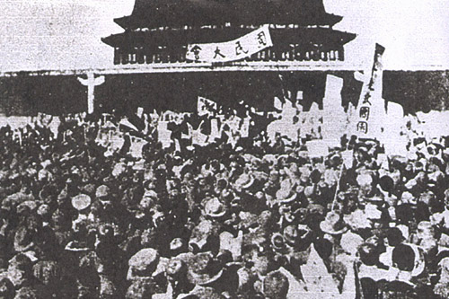
Protestors dissatisfied with the Treaty of Versailles for China

Slide 8
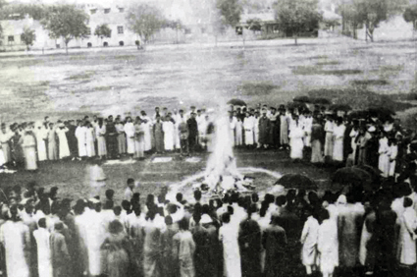
Tsinghua University students burn Japanese goods.

Slide 9
In 1921 a group in Shanghai (including Mao Zedong) organizes the Chinese Communist Party.
Mao Zedong develops his own brand of communism
Lenin based his in the organization of Russia’s cities.
Mao brought the revolution to the rural country.

Slide 10
Lenin Befriends China
Sun Yixian’s government is in south China.
He becomes disillusioned with Western democracies.
Lenin seized opportunity and sends military advisors and equipment to China in 1923.

Slide 11
Peasants Align with the Communists
Sun Yixian died in 1925, and Jiang Jieshi (Chiang Kai-shek) heads the Nationalists.
Jaing (son of a middle-class merchant) feared communist goal of forming a socialist government.
Jaing promised democracy, but his government became corrupt.
As a result peasants threw their support toward the Chinese Communist Party.

Slide 12
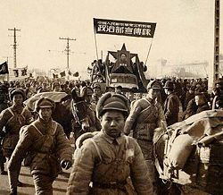
Nationalists and Communists Clash
Briefly Jaing set aside differences and fought warlords alongside the Communists, but later turned against the Communists.
April 1927 Nationalists groups moved on Shanghai and killed many Communists
In 1928 Jiang became president of the Nationalist Republic of China
Great Britain and the United States recognized his government.
The Soviet Union did NOT recognize his government
Civil War breaks out which lasts until 1949.

Slide 13
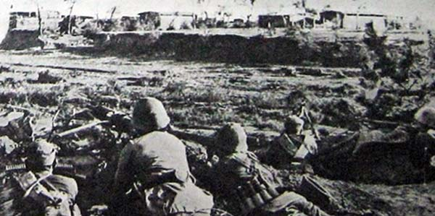
In 1930 a bloody civil war was raging.
Mao and Communists established themselves in south-central China.
Taking his revolution to the countryside was called “swimming in the peasant sea.”
Mao recruited peasants into the Red Army and trained them in guerilla warfare.
Nationalists attacked communists but failed to drive them out.

Slide 14
Civil War Rages in China
The Long March
1933 Jiang gathered an army of 700,000 to surround the Communist stronghold.
In a daring move, 100,000 Communist forces fled 6,000 miles on the Long March to northern China.

Slide 15
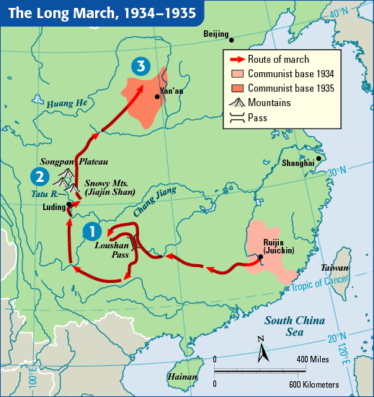

Slide 16
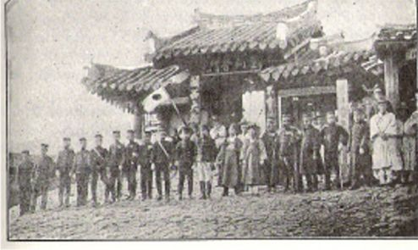
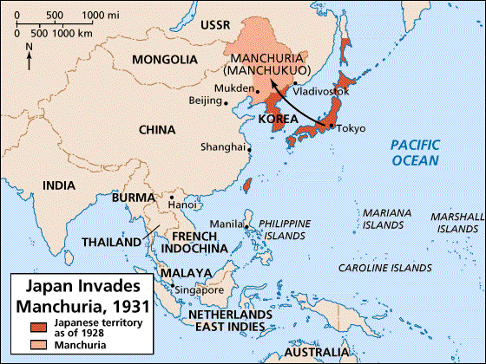
Civil War Suspended
Japan took advantage of China’s weakened situation during the civil war and invaded Manchuria, an industrial province in northeastern China.
In 1937, Japan launched an all-out invasion of China, and held large parts of China by 1938.
The Japanese threat forced an uneasy truce between the Jiang’s and Mao’s forces, and they united to fight the Japanese.

