Slide 1
Europeans Settle North America

Slide 2
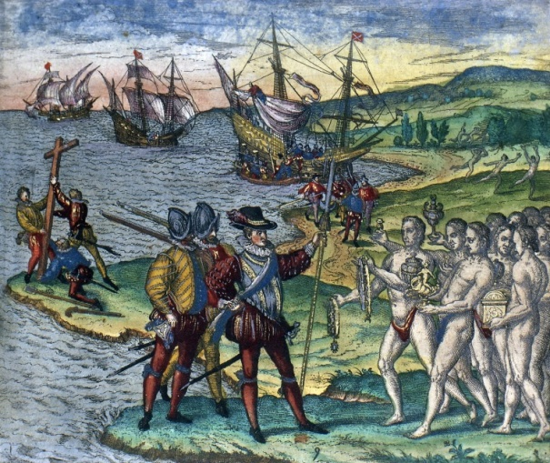
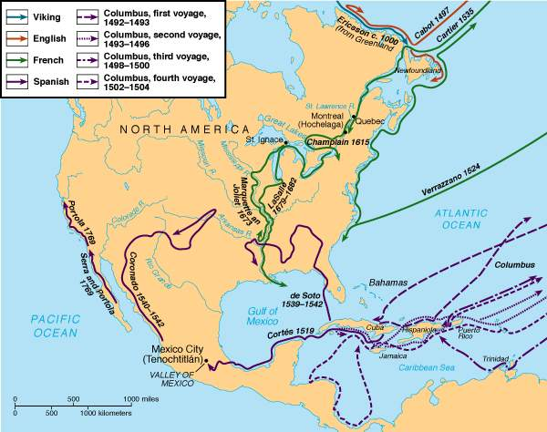
Competition
France, England, & the Netherlands ignore Treaty of Tordesillas between Spain & Portugal = competition
Spain claims South American route to the Pacific = race to find another route
Can’t find another route = establishment of American colonies

Slide 3
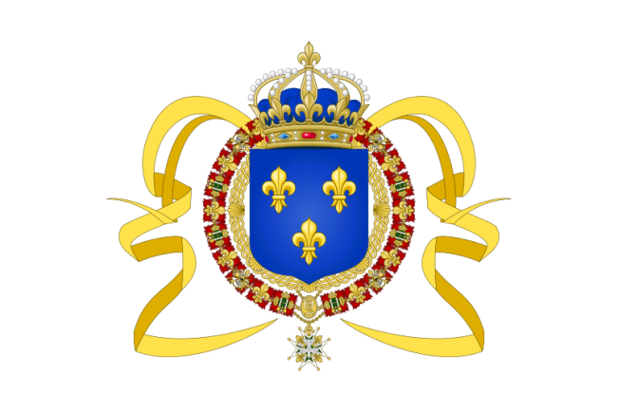
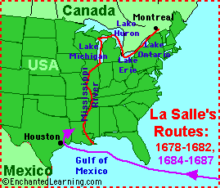
New France
1524: Verrazzano discovers NY harbor
1534: Jacques Cartier sails down the St. Lawrence River; founds Montréal
1608: Samuel de Champlain founds Québec = base for New France
1673: Marquette & Joliet explore the Great Lakes & Mississippi River
De La Salle – claims Mississippi Valley for France = Louisiana

Slide 4
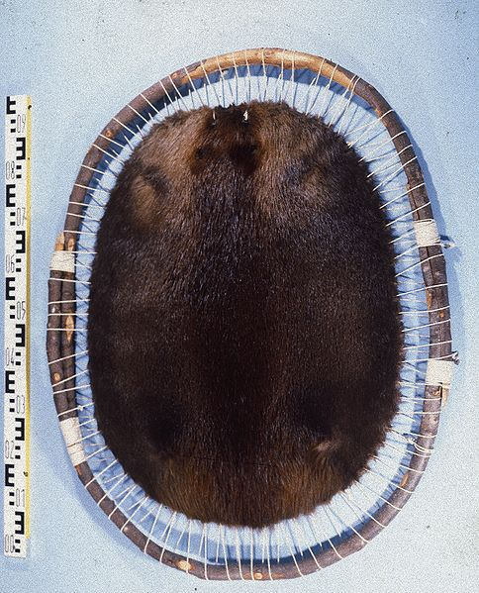
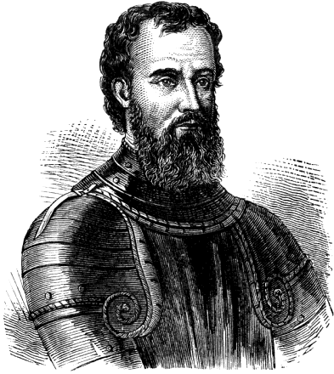
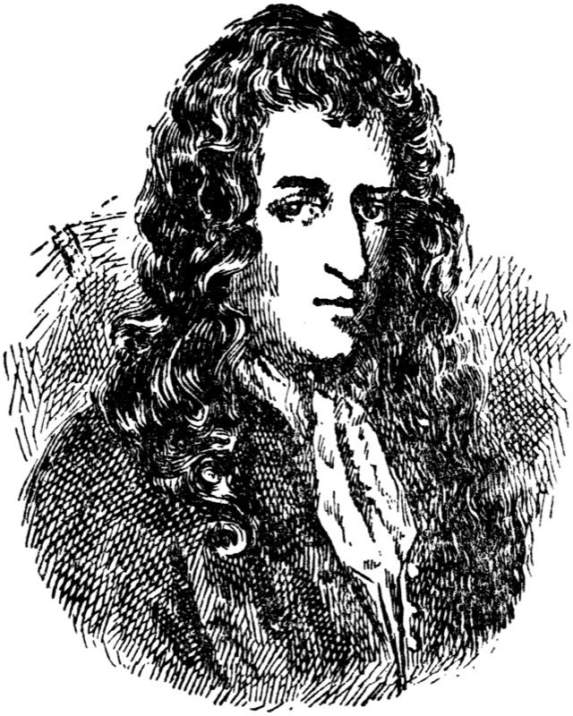
Trading Empire
New France = vast, but sparsely populated
No big desire to settle towns in America
Settlers = Priests & traders
Huge riches for France = Fur Trade
Goal: Money, not occupation

Slide 5
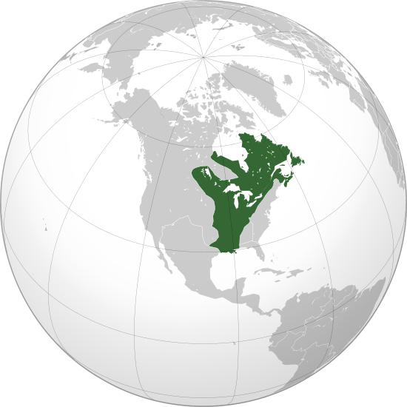
New France – 1712

Slide 6
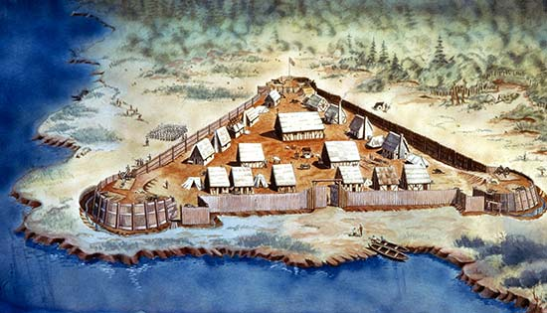
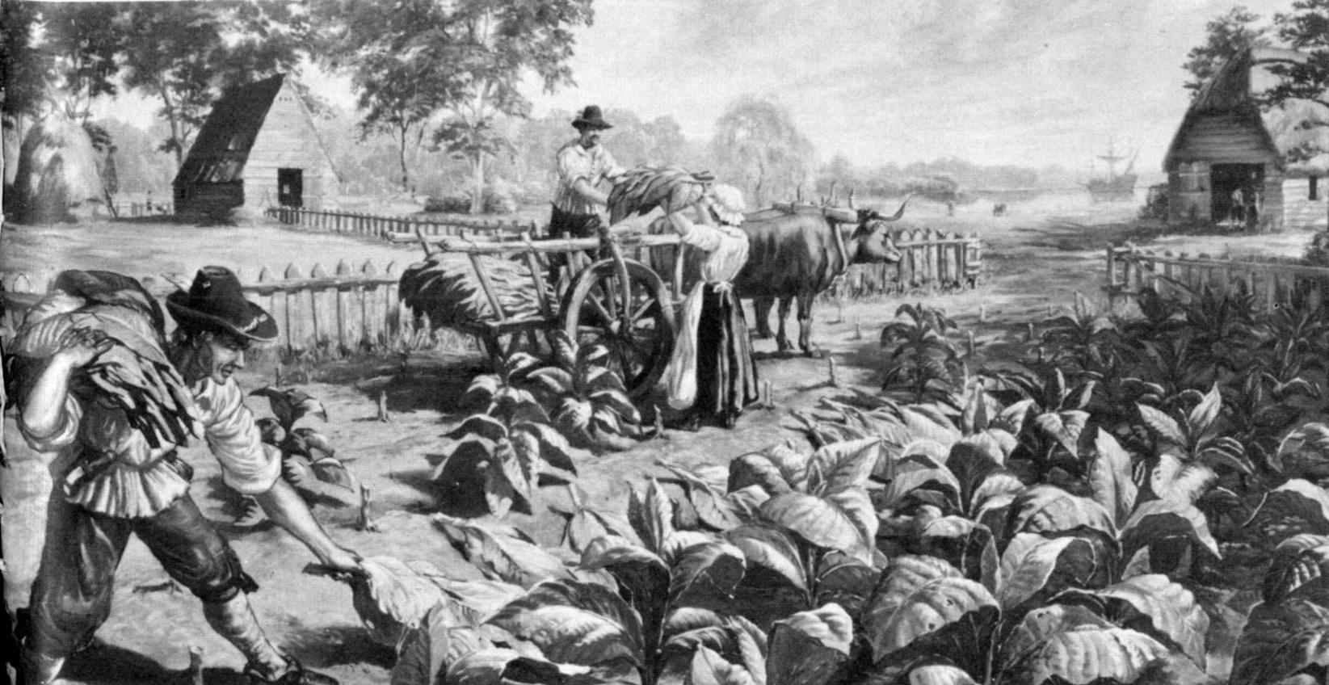
Jamestown
1607: English settle Jamestown in Virginia
Disastrous start: Disease rampant; food scarce
1st permanent English settlement in North America
Fortunes turn: Tobacco – profitable cash crop

Slide 7
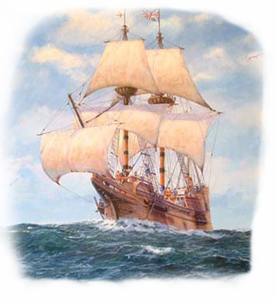
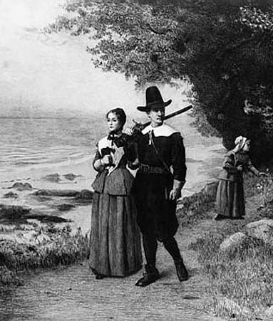
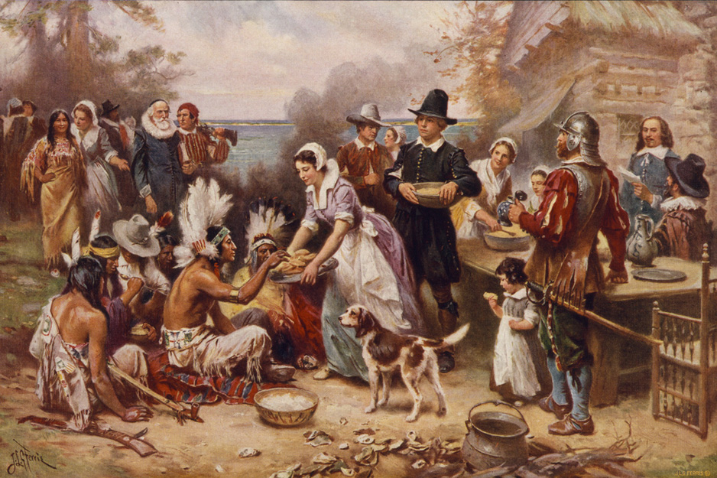
“New England”
1620: Pilgrims (Mayflower) found Plymouth (MA)
Seek religious freedom; persecuted in England
1628-9: Puritans found Massachusetts Bay Colony
Same reasons, larger
Want to build a model community, set example for all
Succeeds b/c several families make-up settlers

Slide 8
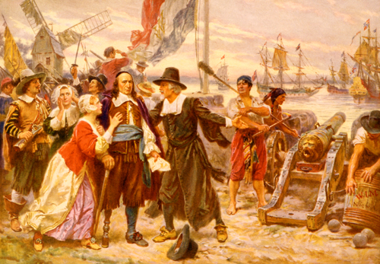
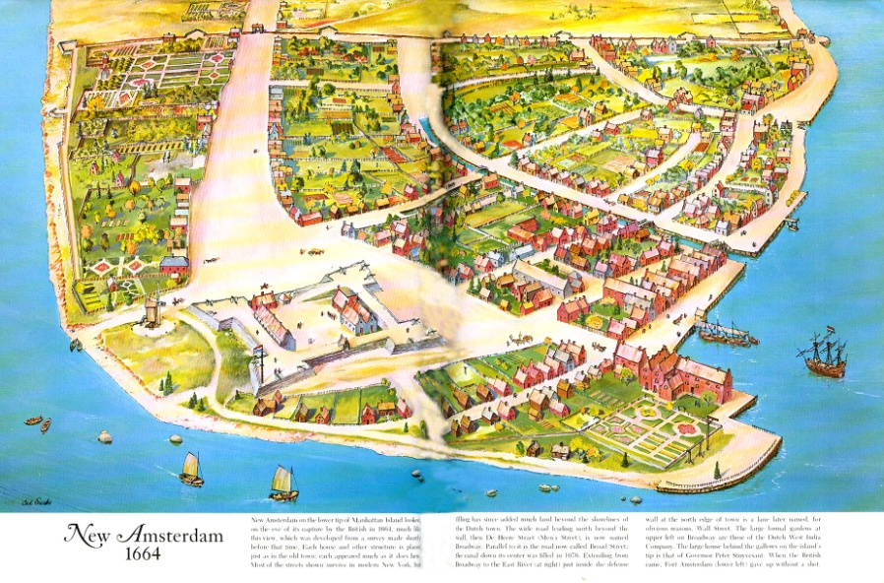
The Dutch
1609: Henry Hudson searches for Northwest Passage
Explores & claims Hudson River, Bay, & Strait
Trade fur w/ Iroquois = trade posts
Fort Orange (Albany) & Manhattan
1621: Dutch West India Company colonizes region & expands fur trade
Holdings = New Netherland
Open colony to other settlers
Germans, French, Scandinavians

Slide 9
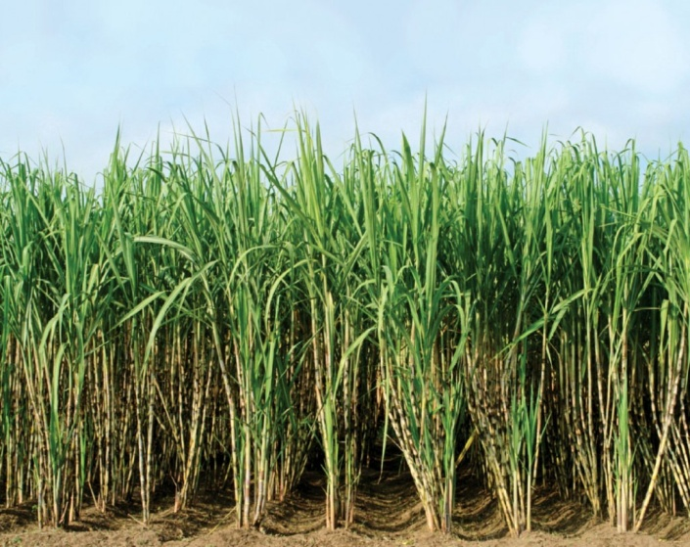
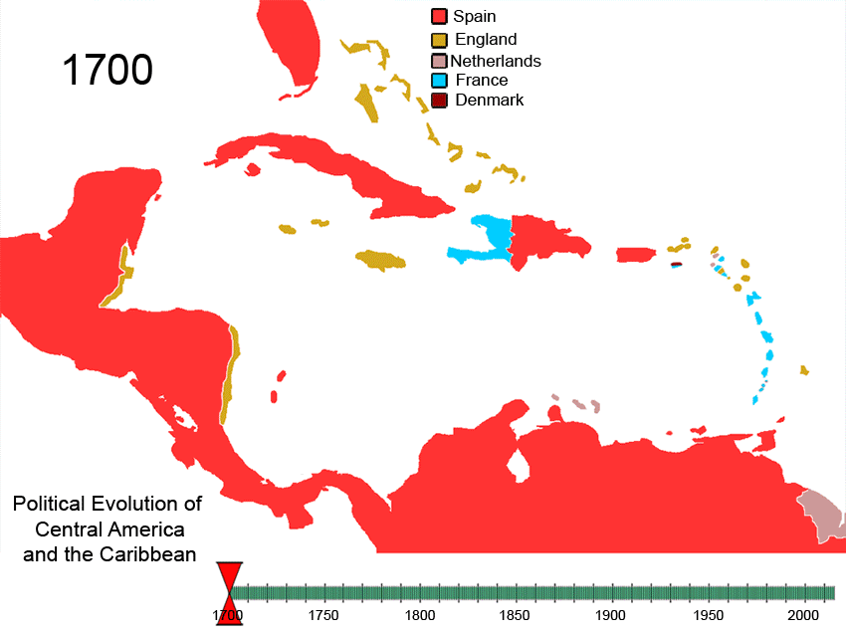
Caribbean
Europe fights to carve up islands of the Caribbean
French: Haiti, Guadaloupe, & Martinique
English: Barbados & Jamaica
Dutch: Capture Aruba & Netherland Antilles from Spain
Plantations: Sugar & Cotton = $$$ & need for labor
Expansion of the slave trade

Slide 10
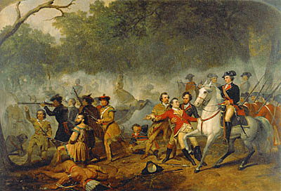
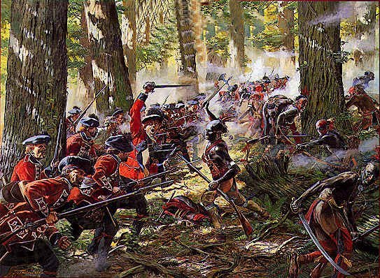
Struggles
Dutch Threat: Splits British colonies
1664: English (Duke of York) surrounds Dutch; surrender
Renamed New York
Atlantic coast opened for British colonization = leads to 13 Colonies
British push west = contact w/ New France
1754: French & Indian War erupts over claims in the Ohio Valley
Larger Conflict: 7 Years’ War (Europe)
1763: French lose; surrender all American holdings

Slide 11
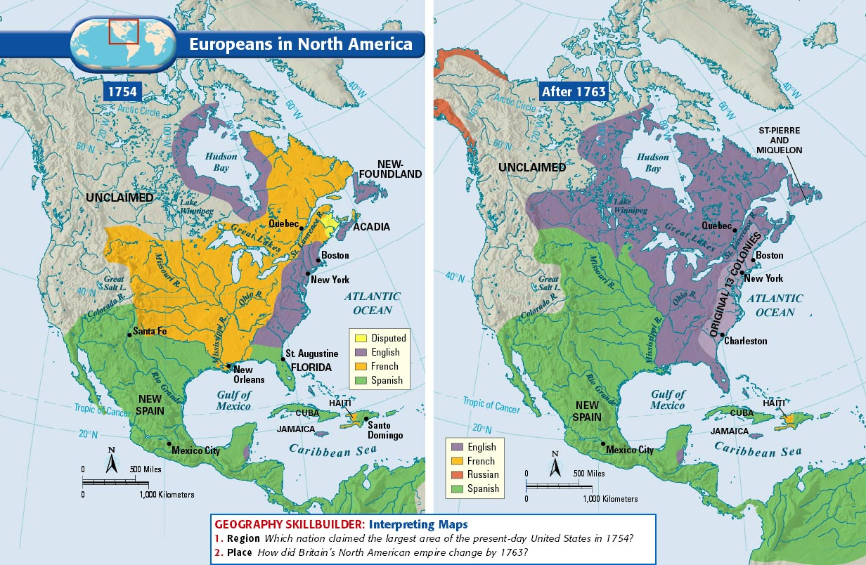

Slide 12
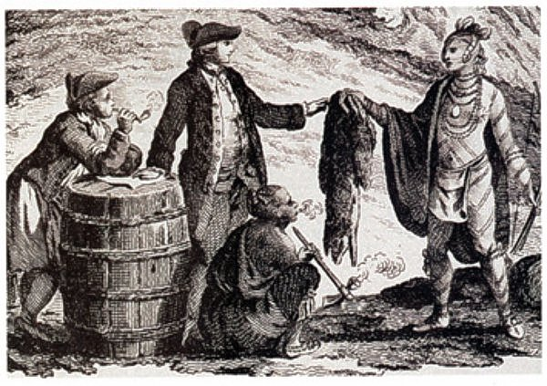
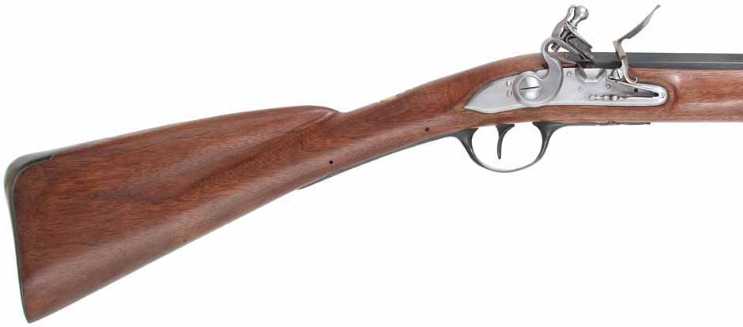
Native Americans
Positive relations w/ French & Dutch
Trade furs for goods (guns, beads, etc)
Strained relations w/ English over land & religion
Difference: Goal to populate colonies
Push natives off land
Considers Native Americans heathens

Slide 13
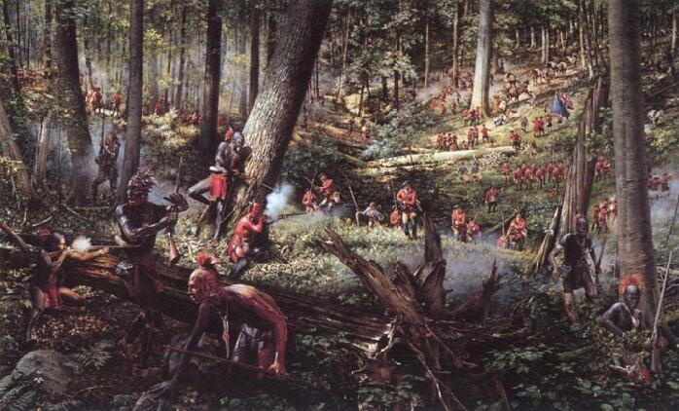

Slide 14
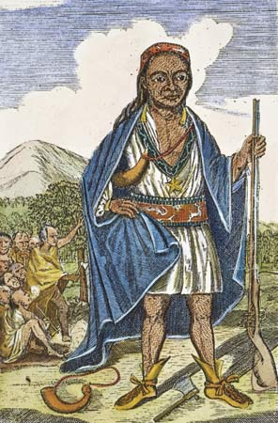
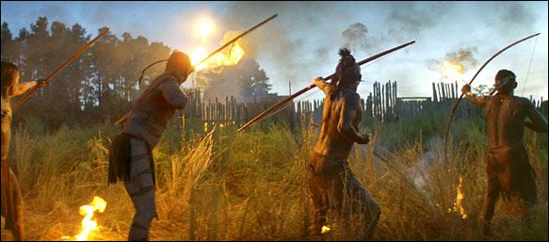
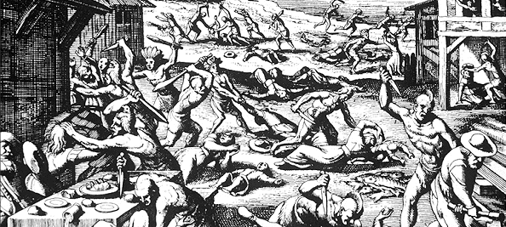
Conflicts & Disease
Hostility = Warfare
1622: Powhatan attack Jamestown
1675-6: King Philip’s War
Metacom attack colonies in Massachusetts (defeated)
Disease decimates Native Americans = severe shortage of labor = African slave trade

