Slide 1
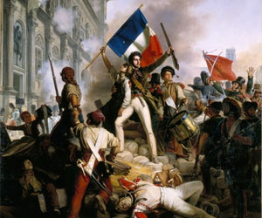
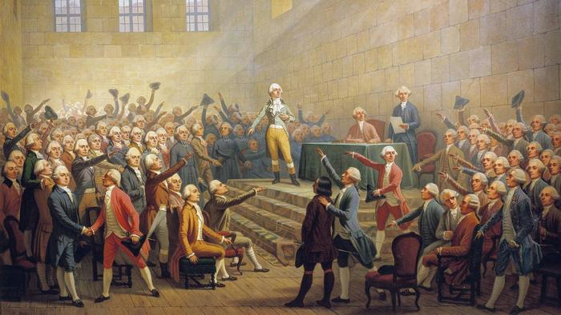
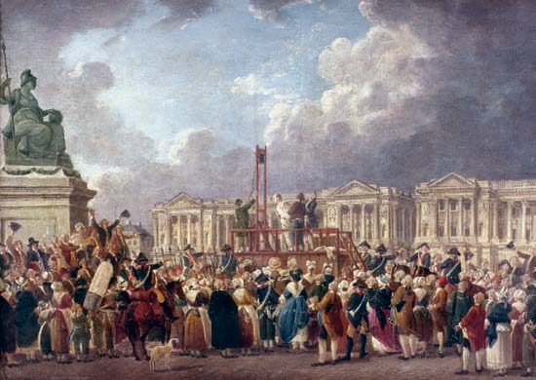
French Revolution

Slide 2
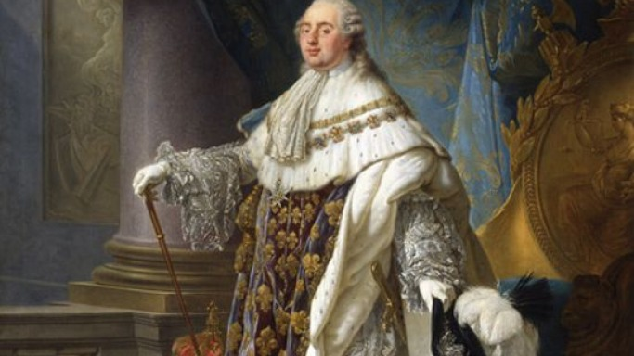
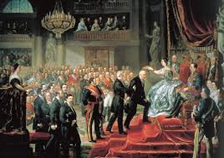
The Beginning

Slide 3
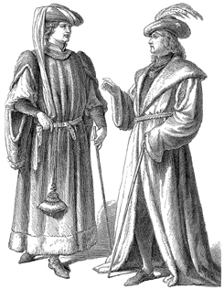
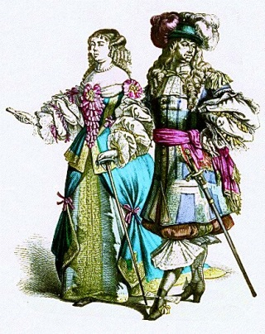
The Old Regime
People of France were divided into 3 large social classes called estates.
1st Estate: Roman Catholic Church
Owned 10% of the land in France
Did not have to pay taxes
Members of the clergy were very rich
2nd Estate: Rich Nobles
2% of population, but owned almost 20% of land
Paid little in taxes

Slide 4
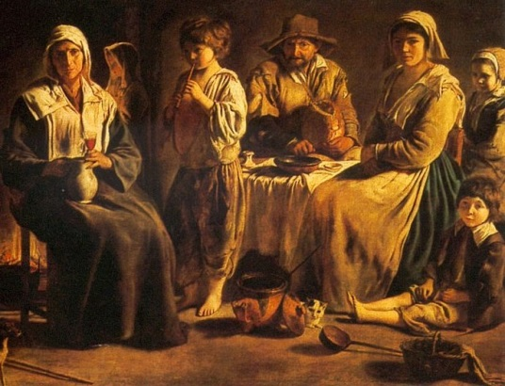
The Old Regime
3rd Estate: 97% of the population
Middle class: Bankers, merchants, factory owners, etc.
Called the bourgeoisie
Workers of France’s cities
Poorest group within the 3rd estate
Paid low wages
Peasants
More than 80% of the 3rd estate
Paid about half their wages in dues to the government

Slide 5
Critical Thinking
Why do you think the 3rd Estate (Largest part of population, but the POOREST) had to pay the most in taxes?
How does this help the 1st and 2nd Estates?
What do you think the attitude of the 3rd Estate was towards the first two?

Slide 6
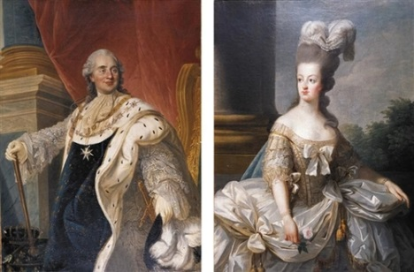
Causes of Change
Enlightenment Ideas
New views about power and authority
Noticed Great Britain had limited the king’s power
Also noticed the success of the American Revolution
Economic Troubles
High taxes and high cost of living
Crop failures,/shortage of grain causing starvation
High debt due to spending by the king and queen
King Louis XVI and Maria Antoinette

Slide 7
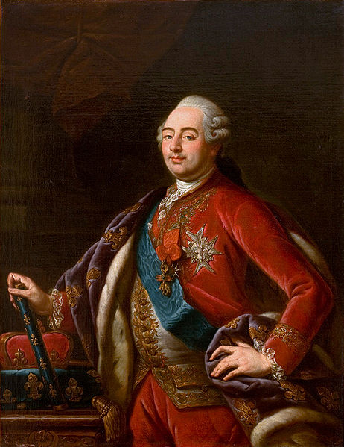
Causes of Change
Weak Leader
King Louis XVI
Unsure when making decisions
Poor advice from the queen, Marie Antoinette
She spent too much money on gowns, jewelry, and gambling
Desperate solution by Louis XVI was to impose taxes on the nobility also.
How do you think they reacted after paying no to little tax for so long?

Slide 8
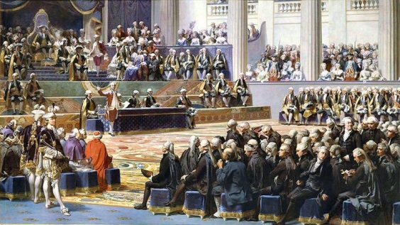
Estates General
The 2nd Estate (nobility) forced Louis XVI to call a meeting of representatives of all the estate groups.
Held at Versailles
Hoped to use the old rules of the estates general meetings of the past.
Each group (estate) would only have 1 vote, which gave the first and second estates power to outvote the third.

Slide 9
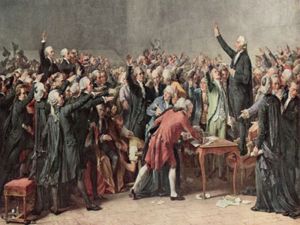
Estates General
Delegates of the 3rd Estate wanted to make change in the government.
Influenced by the Enlightenment
Wanted each delegate (representative) to have a vote, instead of each large group (estate) counting as one vote.
Named themselves the National Assembly
Pass laws and reforms in the name of the French people
End absolute monarchy and form a representative government

Slide 10
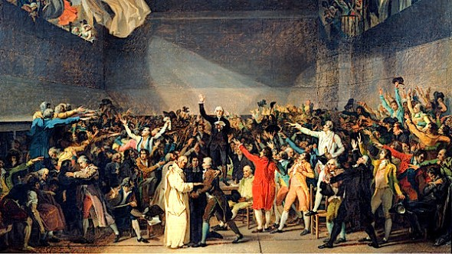
Estates General
King Louis XVI sided with the nobles and wanted the old rules of voting.
One vote per estate group
Locked the National Assembly out of their meeting room
Broke down doors and stormed an indoor tennis court area of Versailles
Tennis Court Oath
Pledged to stay until a new constitution was created
Louis VXI responded by surrounding Versailles with troops.

Slide 11
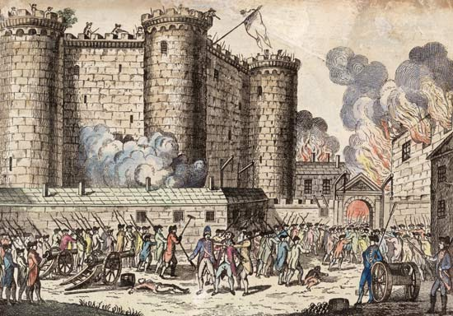
Storming the Bastille
Fearing the use of military force by King Louis XVI, French citizens prepared to defend Paris.
July 14, 1789
Stormed the Bastille (Paris prison) searching for gunpowder
Violently killed prison commander and guards
Paraded the streets with heads on pikes
Date now known as Bastille Day (national holiday)

Slide 12
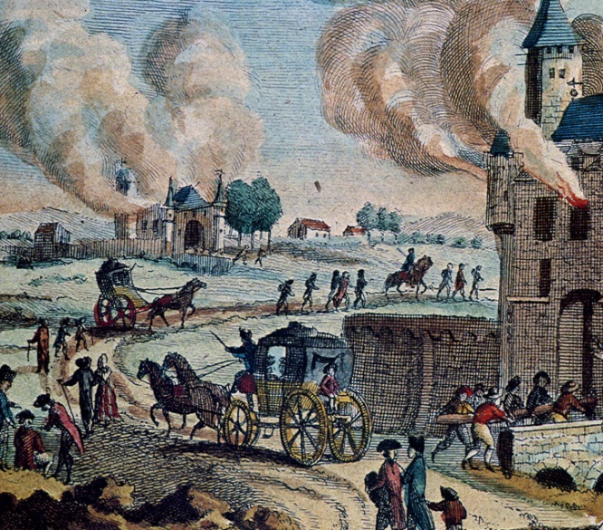
Fear Sweeps France
Rebellion spread from Paris to the countryside.
Fear caused by false rumors that the nobles were going to attack the peasants
GREAT FEAR
Peasants broke into nobles’ houses and destroyed property, documents binding them to the land, and even killed many nobles and their families.

Slide 13
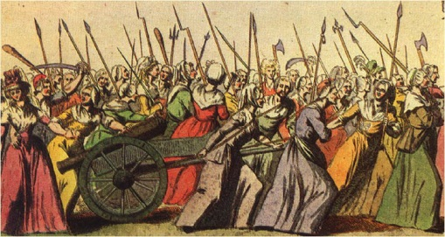
October 1789
Thousands of women from Paris rioted over rising bread prices.
Marched on Versailles with weapons
Broke into the palace killing some of the guards
Demanded the royal family leave Versailles and return to Paris
After some time, King Louis XVI agreed
The royal family would never return to Versailles
Signaled the change of power and radical reform

Slide 14
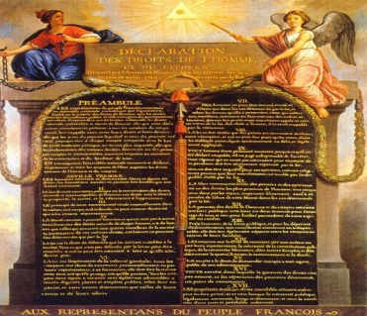
National Assembly Reforms France
Declaration of the Rights of Man and of the Citizen
“Liberty, property, security, ……..”
Equal justice, freedom of speech, and freedom of religion
Only applied to men
State-Controlled Church
Took over Church lands and property
Sales of Church lands helped to pay for France’s debts
Church officials/priests were to be elected/paid as state officials
Opposed by many peasants who were still devout Catholics

Slide 15
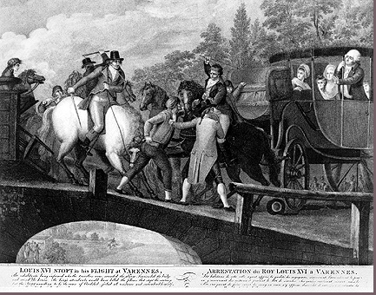
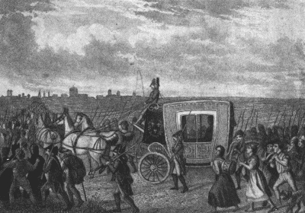
Louis XVI Tries to Escape
Out of fear, the royal family tried to escape from France to the Austrian Netherlands.
Caught near the border and returned to Paris under guard.
Gave further power to his enemies.

Slide 16
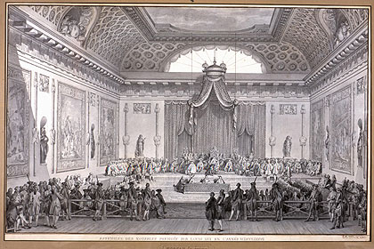
Divisions Develop
1791: Completed the new constitution
Stripped king of authority (limited monarchy)
Created Legislative Assembly
Body of government with power to create laws
Split among different groups of how to run the country.
Radicals wanted sweeping changes
Moderates wanted some change
Conservatives wanted few changes

Slide 17
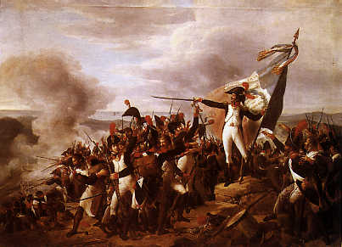
War and Execution
Fear of revolution spreading to other countries caused Austria and Prussia to try and get Louis XVI restored as an absolute monarch.
Legislative Assembly responded by declaring war (1792)
Prussian forces invaded France and threatened to destroy Paris if the royal family was harmed.
In anger, about 20,000 men and women took the palace, massacred the royal guards, and imprisoned the royal family.

Slide 18
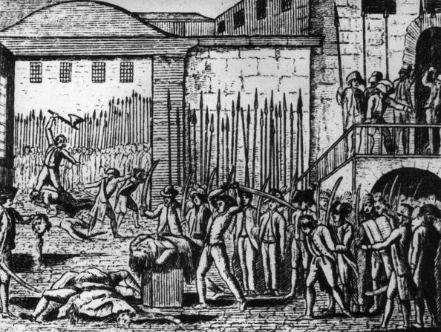
War and Execution
Crowds started massacring anyone in the Paris prisons suspected of supporting the king.
Murdered over 1,000 prisoners (1792)
September Massacres
Creation of National Convention
Permanently abolished the monarchy
Created a republic
Granted right to vote and hold office (Men only still)

Slide 19
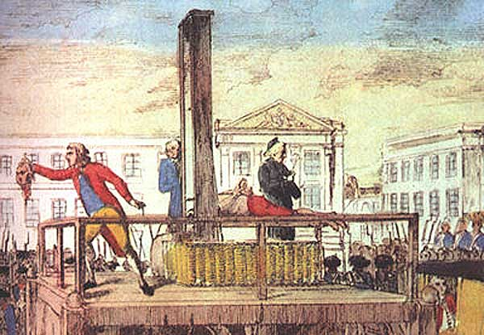
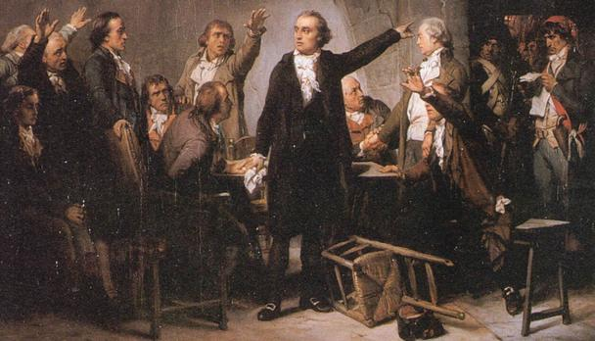
War and Execution
Most people who oversaw government changes were part of a political group called the Jacobins.
Strongly influence the National Convention
Called for the death of all supporters of the king.
Oversaw continued war with other European countries.
Tried Louis XVI and found him guilty of treason
Beheaded by guillotine on January 21, 1793.

Slide 20
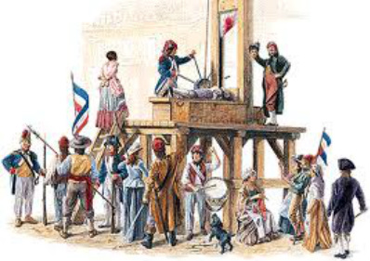
Reign of Terror
Period of Jacobin leader, Maximilien Robespierre, ruling France as a dictator.
Thousands of people were executed
Political rivals, Marie Antoinette, and anyone not seen as radical enough as the Jacobins.
Most of the charges were very weak.
Estimated 40,000 people were executed!

Slide 21
End of the Terror
National Convention turned on Robespierre and had him executed.
Created a new 2-house legislature of government.
Leaders were still corrupt.
This would lead to the future coming of Napoleon Bonaparte.

