Slide 1
America by 2000
By the late 1990s, the U.S. was changing
The economic boom was slowing down & the “tech bubble” was about to burst
Party politics was increasingly hostile, especially after the Republican-led impeachment of Clinton
New terrorist attacks threatened American safety at home & abroad

Slide 2
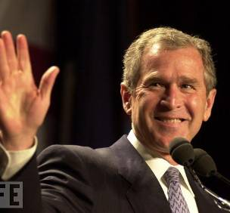
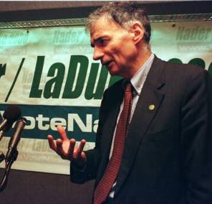
The Election of 2000
The election of 2000 was one of the closest & most controversial elections in U.S. history
Republicans nominated conservative Texas governor George W Bush
Democrats nominated Clinton’s Vice President Al Gore
Consumer & environmental advocate Ralph Nader ran as an independent

Slide 3
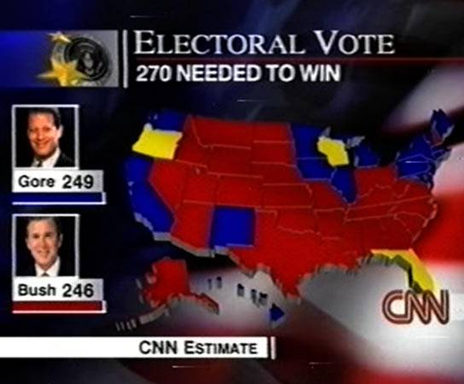
The Election of 2000
The election was so close that which ever candidate won Florida would gain enough electoral votes to win the presidency

Slide 4
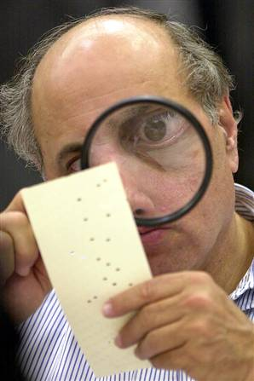
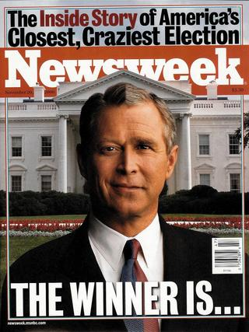
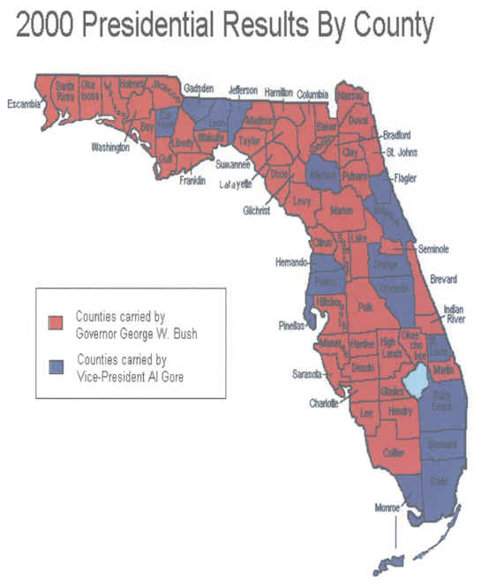
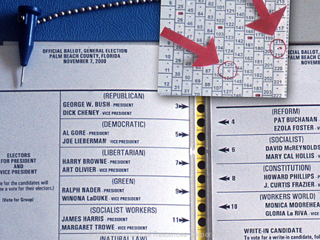
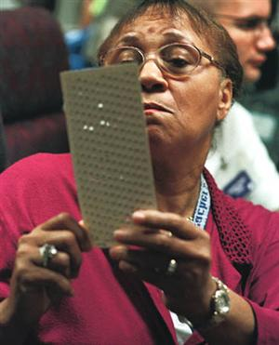
The Election of 2000
But, determining which candidate won in Florida was contested due to voting irregularities
The state supreme court ordered a recount of ballots in some districts

Slide 5
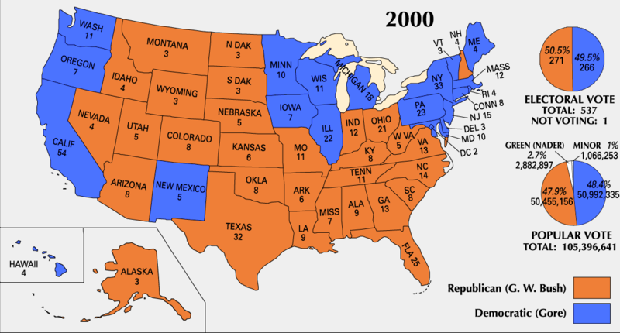
In December 2000, the U.S. Supreme Court ruled in a 5-4 decision to stop the recount & Bush was declared the winner of the election

Slide 6
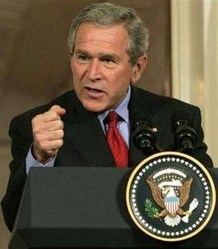
The Presidency of George Bush
In his first year, Bush worked with Congress to:
Create a 1.35 trillion dollar tax cut
Reform education through the No Child Left Behind Act

Slide 7
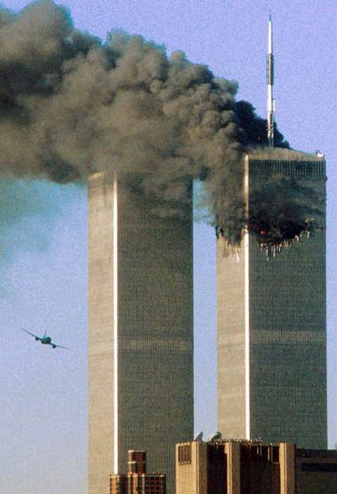
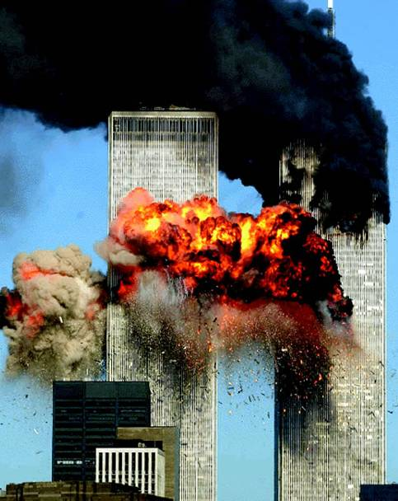
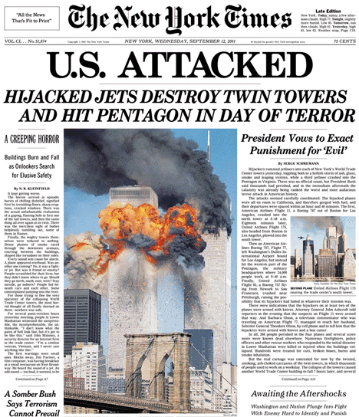
September 11, 2001
Everything changed on September 11, 2001 when an al-Qaeda terrorist plot led to the hijacking of 4 airplanes & attacks on the World Trade Center & the Pentagon
After 9/11, President Bush declared a “War on Terrorism”

Slide 8
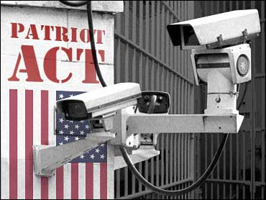
The War on Terrorism
Domestic changes in response to 9/11

Slide 9
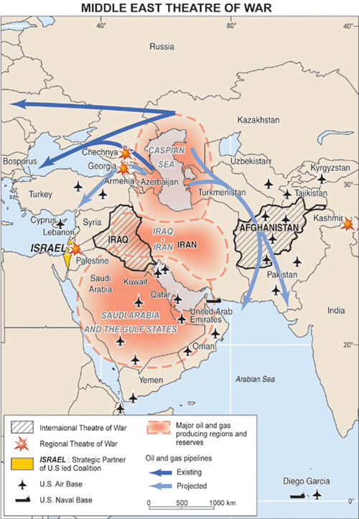
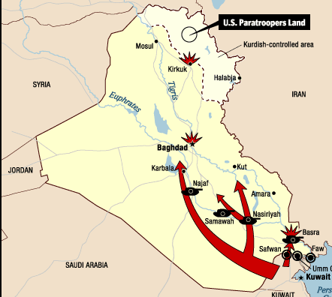
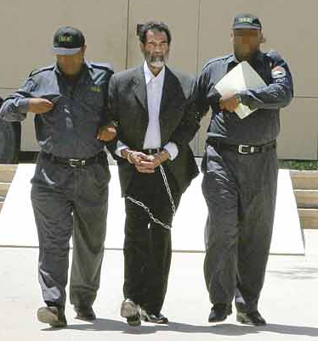
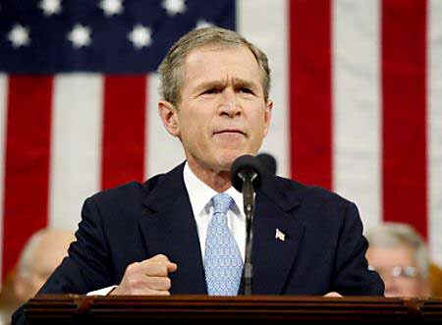
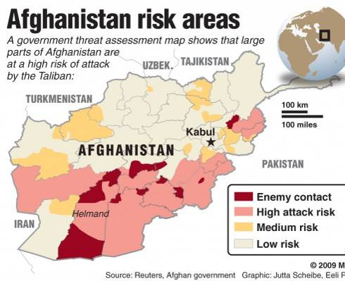
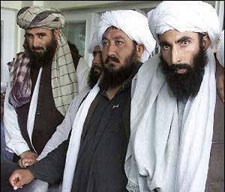
Foreign policy in response to 9/11
al Qaeda terrorists
Iran, Iraq, & North Korea form an “Axis of Evil”
Taliban government

