Slide 1
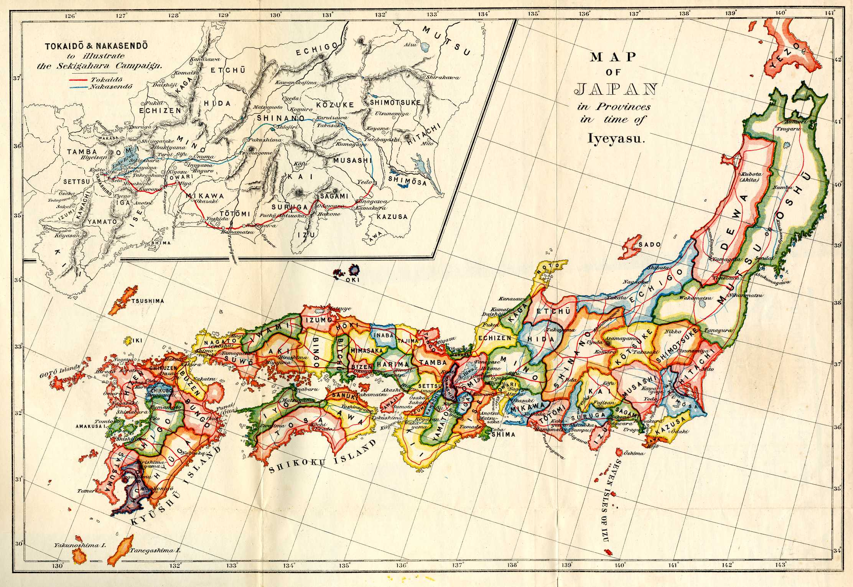
Japan Returns to Isolation

Slide 2
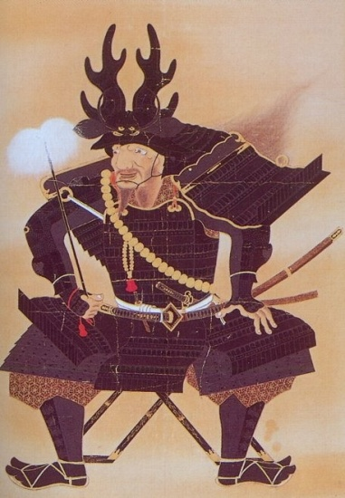
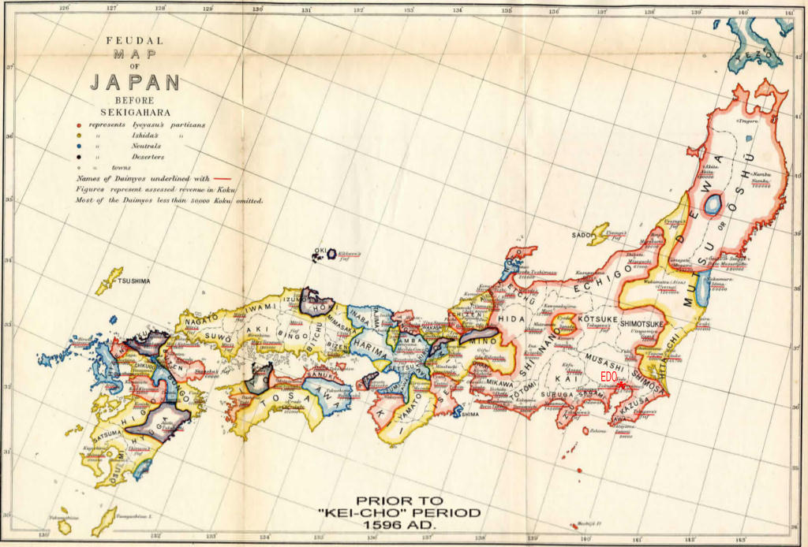
New Feudalism
1467: Civil war spins Japan in chaos = violence
1467-1568: “Warring States” period
Samurai Daimyo rule states
Emperor = figurehead
System resembles Europe
Castles, serfs, local armies, tribute, etc.

Slide 3
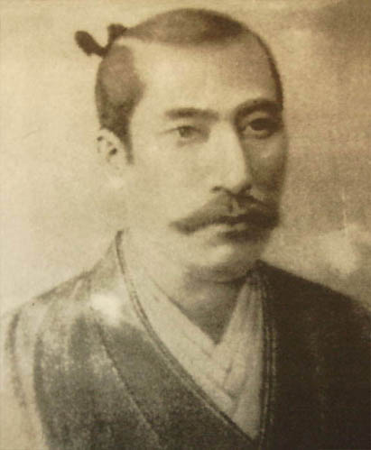
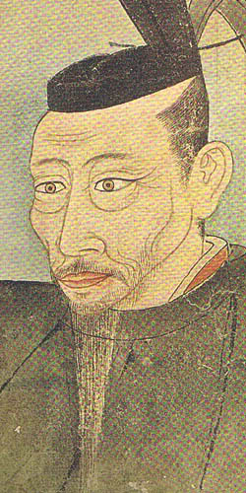
New Leaders
Oda Nobunaga – seizes Kyoto in 1568
Works to eliminate rivals & Buddhist monasteries
First to effectively use firearms
Commits seppuku (suicide) in 1582
Toyotomi Hideyoshi
Nobunaga’s best general
1590: Controls most of Japan through force & alliances
1592: Invades Korea

Slide 4
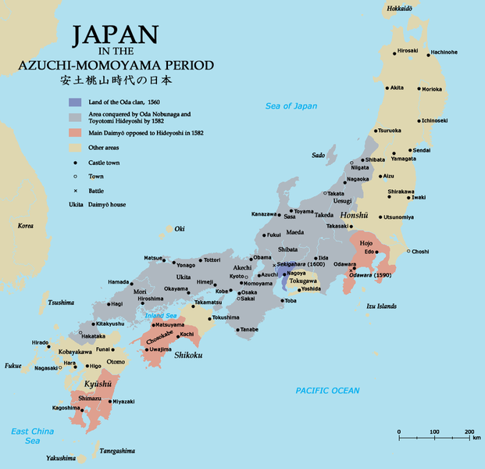

Slide 5
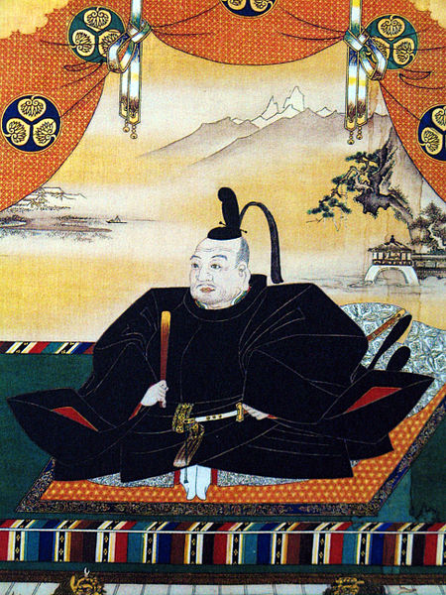
Tokugawa
1600: Tokugawa Ieyasu unites Japan
1693: Becomes Shogun & moves capital to Edo (Tokyo)
Rebellion still prevalent; daimyo must spend time between Edo & homes
Policy brings back central government
Founds Tokugawa Shogunate (lasts until 1867)

Slide 6
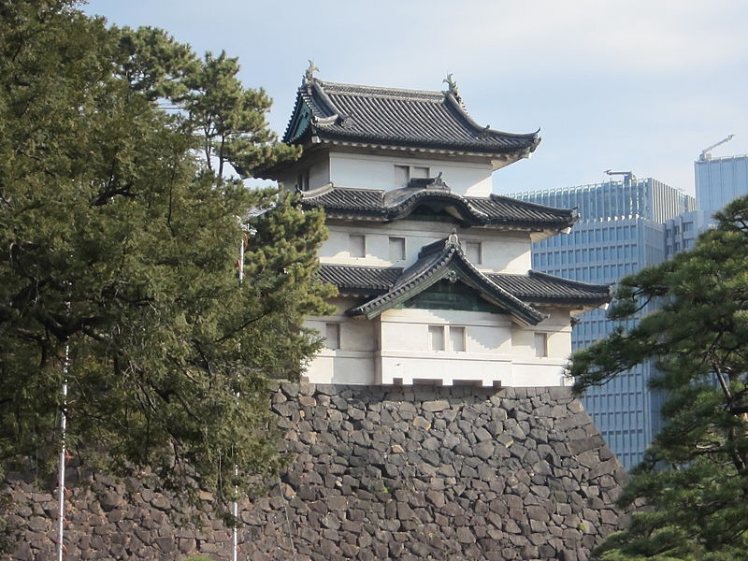
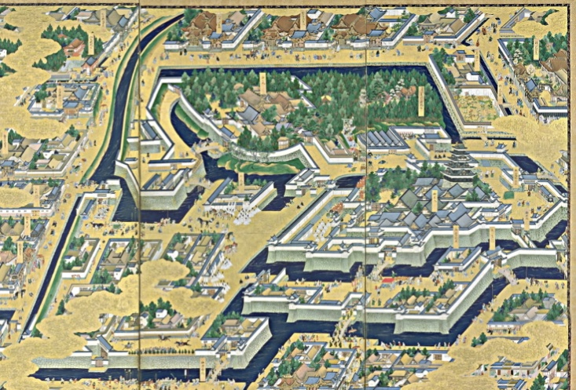
Tokugawa Society
Tokugawa shoguns bring stability & prosperity
Wealth, food, & population rise
Structure:
Shogun, daimyo, samurai, peasants, artisans, then merchants
Practice Confucian ideas
Focused on agriculture
Peasants faced heavy taxes
Mid-1700s: Japan shifting to an urban society

Slide 7
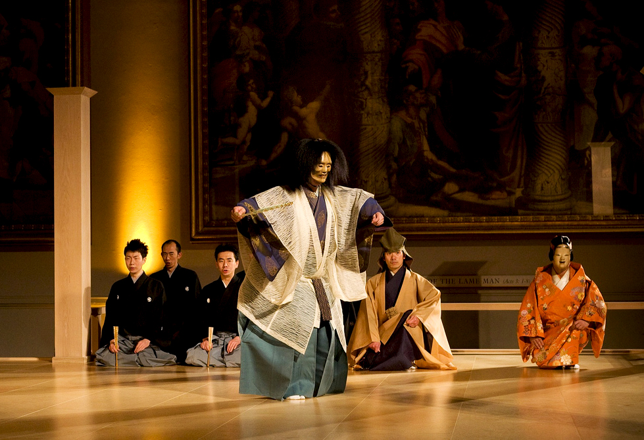
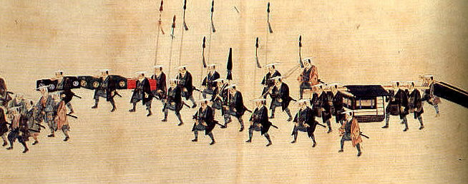
Tokugawa Culture
Maintain traditions
Samurai attend nohs
Ceremonial tragic dramas
Paintings of classical literature were popular
New styles of entertainment developed
Haikus were very popular
P. 544

Slide 8
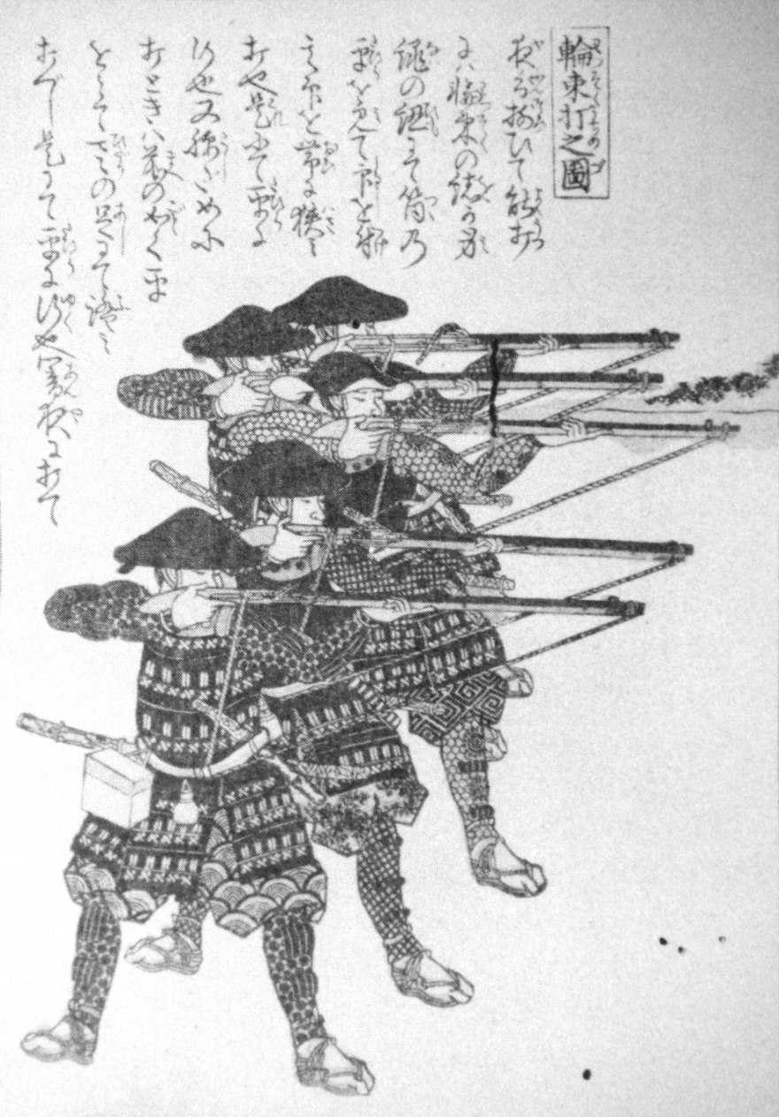
European Contact
Initially, Europeans were welcomed
1543: Portuguese reach Japan
Introduce many new goods
Tobacco, firearms, etc.
Firearms = completely change of Japan
Many forts constructed to combat cannons

Slide 9
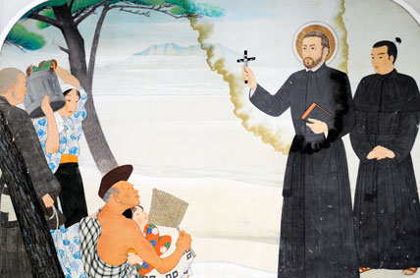
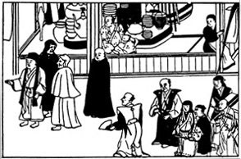
Missionaries
1549: Christian missionaries arrive
Associated w/ European traders = acceptance
Conversions upset Ieyasu
Bans Christianity in 1612
1637: Rebellion put down
Christians held responsible & persecuted
European missionaries exiled or killed
All forced to practice Buddhism

Slide 10
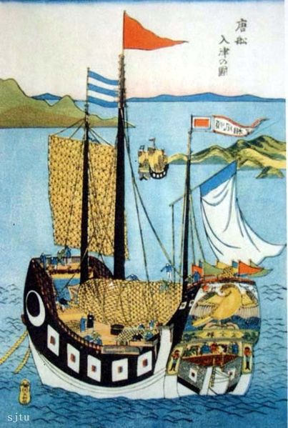
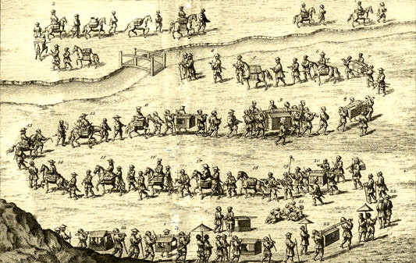
Isolation
Persecution of Christians = control of foreign ideas
1639: “Closed country policy”
Nagasaki remained open to foreign trade
Only Dutch & Chinese allowed
Trade monopoly for shogunate
Remains closed for nearly 200 years
Japanese forbidden to leave as well

