Slide 1
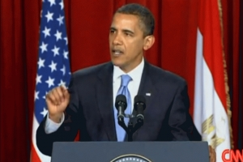
Barack Obama

Slide 2
Obama’s Inheritance
Two US counterinsurgency wars
One global war against radical Islam
Arab Uprising
Rising power in China
US National Security Strategy May 2010

Slide 3
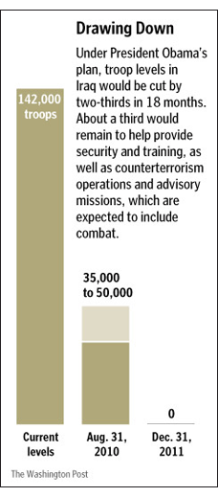
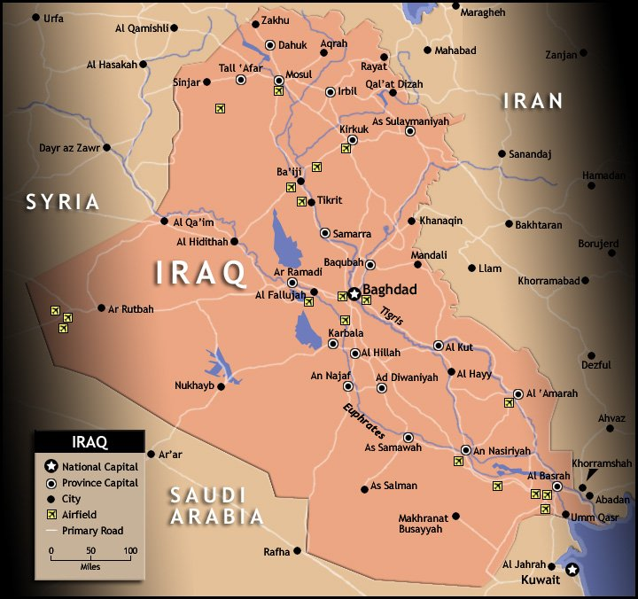
1. Counterinsurgency (COIN) in Iraq
Getting Out: 2/09 Plan
Combat Operations Officially End: 9/10/10

Slide 4
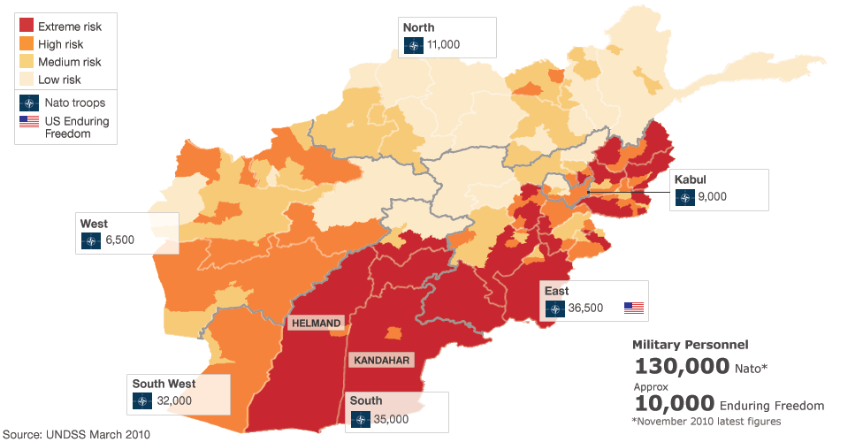
COIN in Afghanistan
December 2009: Additional 33,000 troops
Withdrawal in 2014…2016…

Slide 5
Obama Policy
2/27/09 Speech
Refocus on Afghanistan

Slide 6
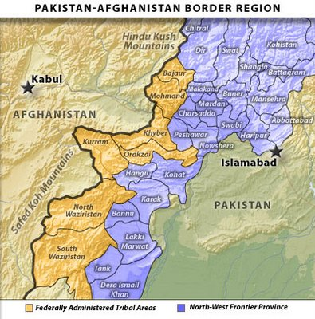
2. Global War against Radical Islam

Slide 7
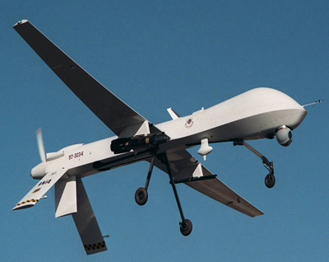
Drone Strikes

Slide 8
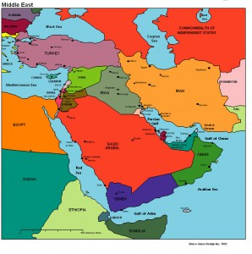
Al-Qaeda in the Arabian Peninsula (AQAP)
Anwar al-Awlaki
Killed by drone strike
9/30/11

Slide 9
Attacks 2009
Nidal Hasan Umar Farouk 11/5/09 Abdulmutallab
Killed 13 at Ft. Hood 12/25/09
Northwest FLT 253
Amsterdam to Detroit

Slide 10
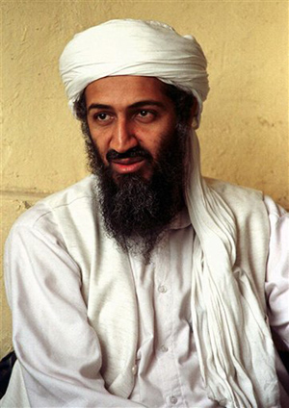
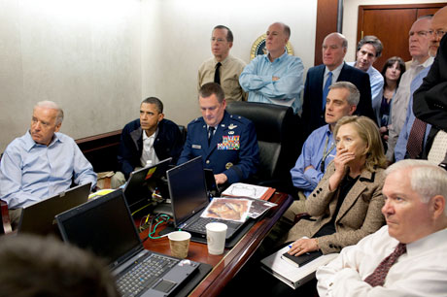
May 1, 2011
Bin-Laden killed

Slide 11
Counterterrorism Strategy
Special Forces
Drone strikes
Criminal cases
Assistance to Afghanistan
Assistance to Iraq

Slide 12
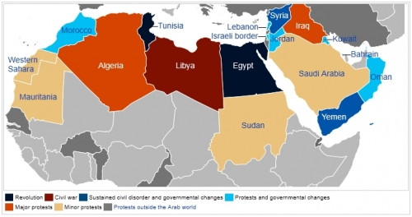
3. Arab Uprising 2010-2011
Timeline

Slide 13
Balancing US interests
counterterrorism
human rights and democracy
OIL
alliance with Israel
Iranian threat
Alliance with Turkey

Slide 14
Country by Country Decisions (for reference only)
Encouraging Egyptian military to oust Mubarak
Trying to salvage Yemeni leaders then helping negotiate their resignations
Trying to salvage Bahraini leaders, but encouraging them to move faster on political reform
Bombing Libya
Diplomacy with Syria then harsh language
Saudi Arabia: silence

Slide 15
The Dilemma
Saudi Arabia vs. Iran
Israel vs. Iran
After dictators fall
Sectarian civil wars?
Theocracies less friendly with US?
Al-Qaeda opportunities?
Are democracies more or less likely to be allies of the US?

Slide 16
Syrian Civil War

Slide 17
Syria Policy
Non-intervention
Warning about using Chemical Weapons
August 20, 2012 “enormous consequences”
Summer 2013:confirmed use of chemical weapons
Pres and Congress agree to take no action

Slide 18
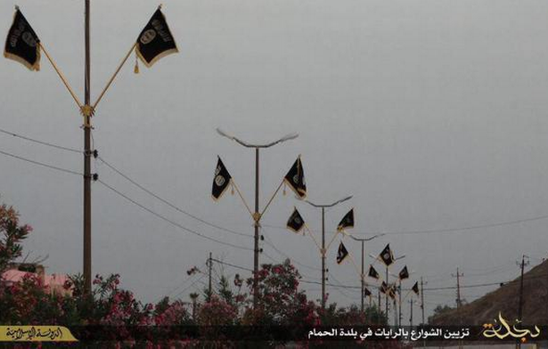
ISIS 2011
Territory controlled in
Syria
Iraq
Allies
Boko Haram
In Libya
In Europe

Slide 19
ISIS 2015

Slide 20
ISIS-Related Attacks: ISIS Global Reach
June 2014—July 2016:
126 attacks, 23 countries, 1,735 deaths
North Africa, Middle East, Central Asia: Afghanistan, Algeria, Bangladesh, Egypt, Jordan, Kuwait, Lebanon, Libya, Saudi Arabia, Tunisia, Turkey, Yemen
Europe: Belgium, Denmark, France, Russia, UK
North America: Canada, US
West Africa: Boko Haram (ISIS ally)

Slide 21
4. Rise of China
One nation catches up to the US
Rising Challenger
Declining hegemon

Slide 22
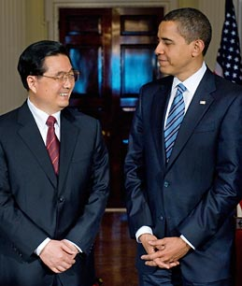
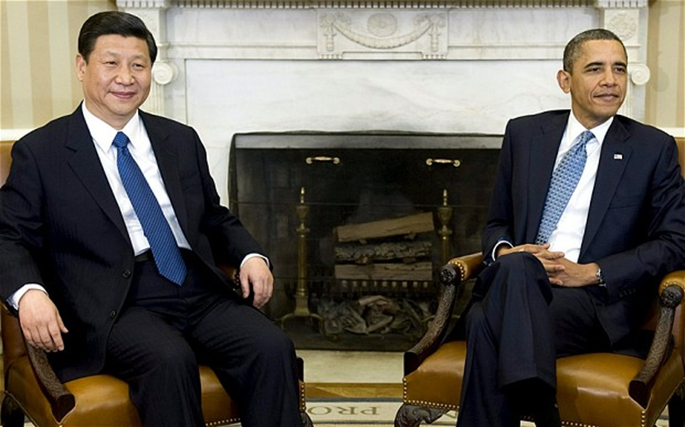
US vs. China
Obama and Pres. Hu Jintao
Obama and Pres. Xi Jinping

Slide 23
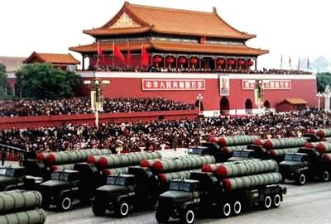
China as Challenger
Rival Power
Ideology
One-Party State vs. Liberal Democracy

Slide 24
Sending a Message?
Obama Administration’s first state dinner
Michelle Obama and Indian PM Singh

Slide 25
Pivot/Rebalancing to Asia
Defense Guidance 2012:
Sustaining U.S. Global Leadership
Priorities for 21st Century Defense
Clinton at East-West Center
“America's Engagement in the
Asia-Pacific” text

