Slide 1
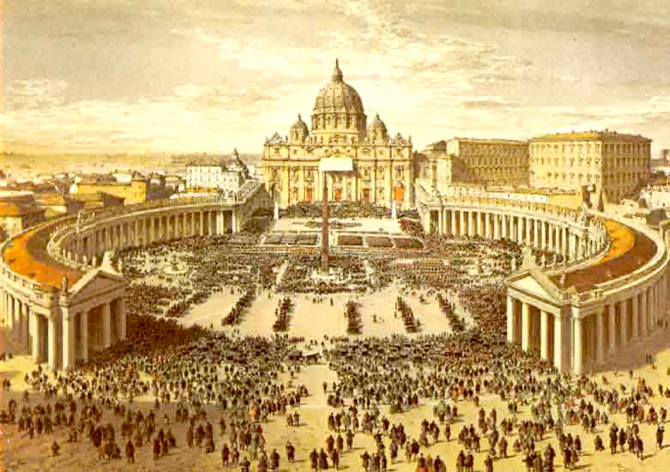
The Power of the Church

Slide 2
Setting the Stage
Conflict between church & state
Pope Gelasius I: “There are two powers by which this world is chiefly ruled: the sacred authority of the priesthood and the authority of kings.”
The Pope: Control Religious Matters v. the Emperor/Kings: Control Political Matters
The Church and various rulers will compete for ultimate authority

Slide 3
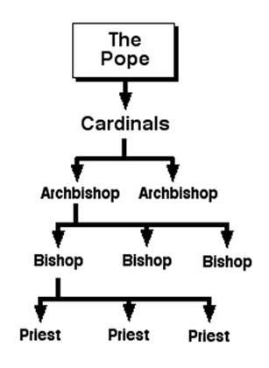
The Church: Structure
Power based on status
Head of the Church = The Pope
Authority over all bishops & priests (Clergy)
Bishops supervised priests (lowest level)
Bishops settle disputes over practices & teachings
Local Priests = Main contact with the Church

Slide 4
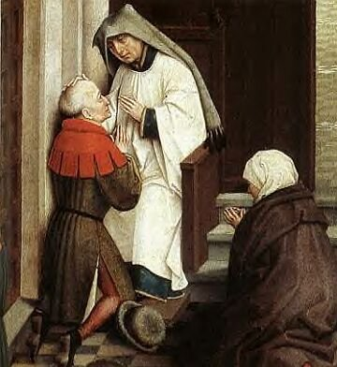
A Unifying Force
The Church unified the division made by feudalism
A stable force during a time of upheaval
People live harsh lives, but could achieve salvation
The Sacraments
Locally: The Church was the religious and social center

Slide 5
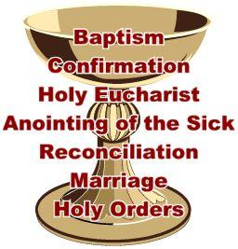

Slide 6
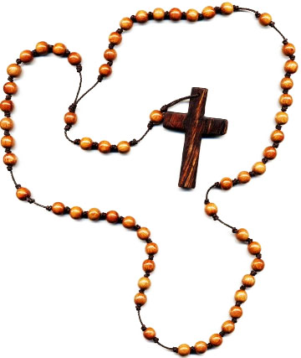
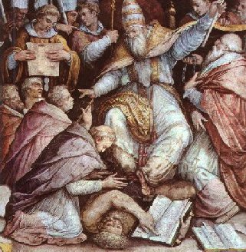
Church Law
Church law = Canon Law
Marriage & Religion
Courts established to carry law out
Punishments: excommunication & interdict
Popes use excommunication (denial of salvation) to control kings
Continued disobedience by a king = the interdict
The Sacraments & religious services could not be performed in said king’s lands
Laws give the Church near ultimate authority

Slide 7
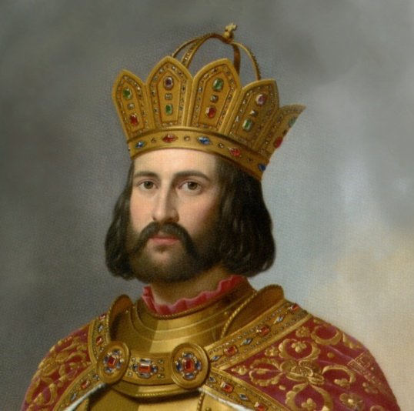
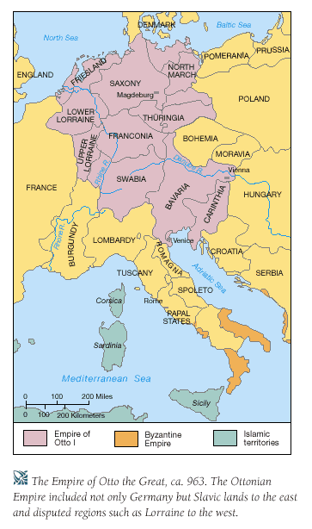
Otto I
Germany: Otto I allies with the Church
Uses the Church to check fellow nobles
Builds a power base through bishops & abbots = monasteries
Invades Italy for the Church = crowned emperor by the pope

Slide 8
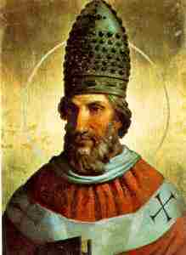
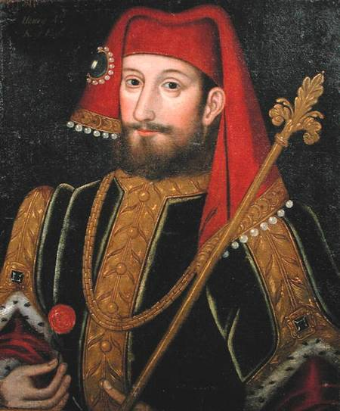
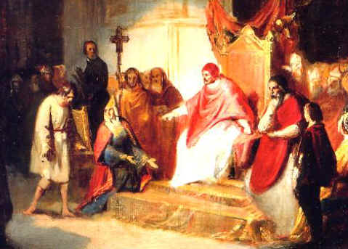
The Church v. The Holy Roman Empire
Problems: Popes & Italian nobles resent German power in Italy
The Church dislikes lay investiture = kings appoint church officials
1075: Pope Gregory VII bans process
Emperor Henry IV orders Gregory to step down; Henry excommunicated
1077: Henry meets Gregory at Canossa, make-up, & is re-instated

Slide 9
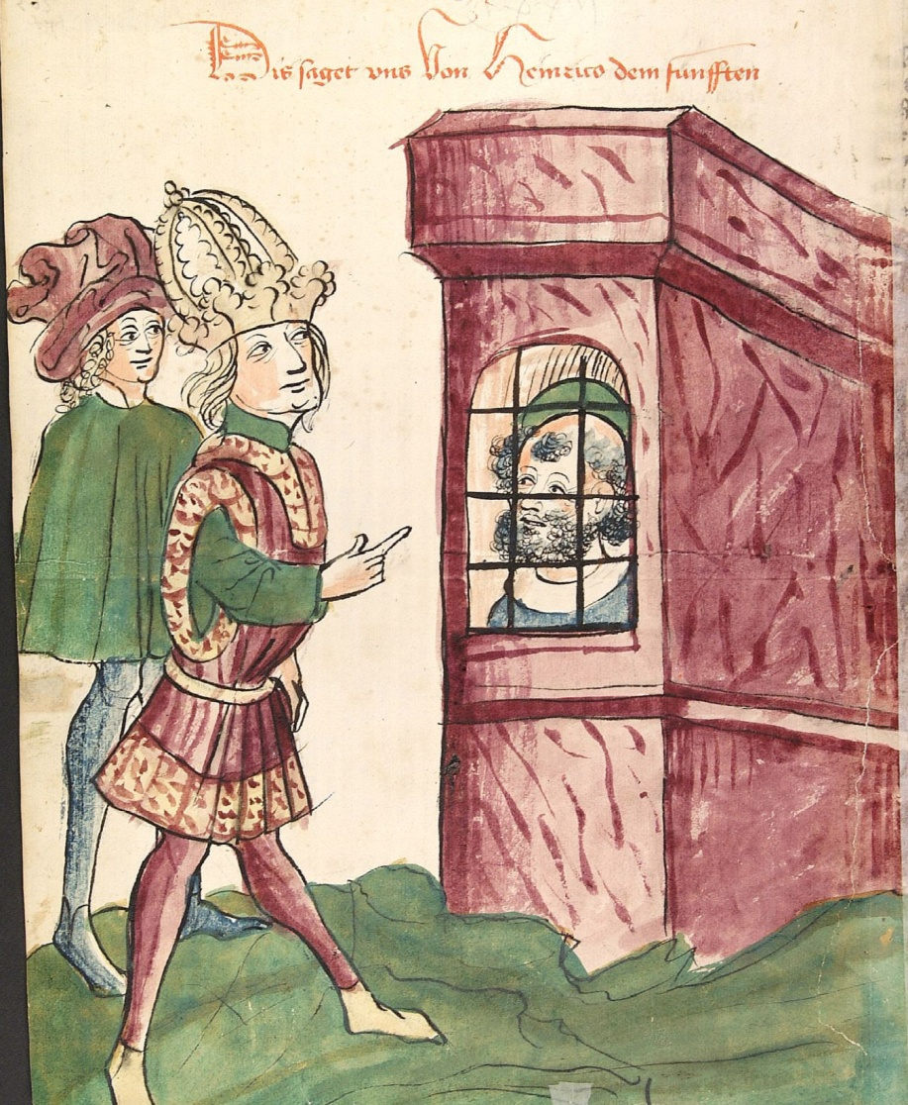
Concordat of Worms
Popes & Kings continued to fight over lay investiture
1122: The Emperor & church officials meet at Worms, Germany
Compromise:
The Church appoints bishops
Emperor could veto appointment

Slide 10
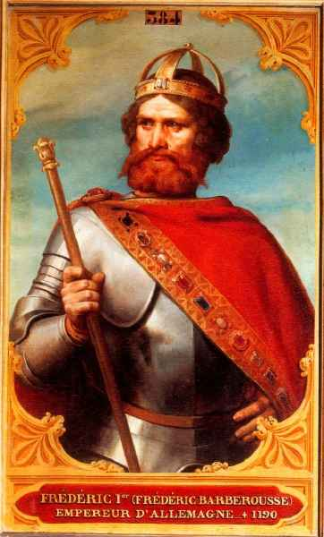
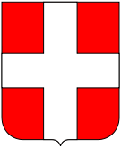
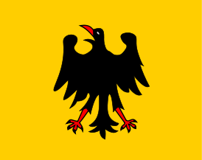
Frederick I (Barbarossa)
1st emperor to officially call lands “Holy Roman”
Lands a patchwork of feudal territories
Invades rich cities of Italy & angers the pope
Lombard League forms to combat Frederick
Pope & Italian cities
1176: Battle of Legnano – Frederick defeated by Italians & their crossbows
1190: Frederick I dies while on Crusade
Empire shatters into pieces

Slide 11
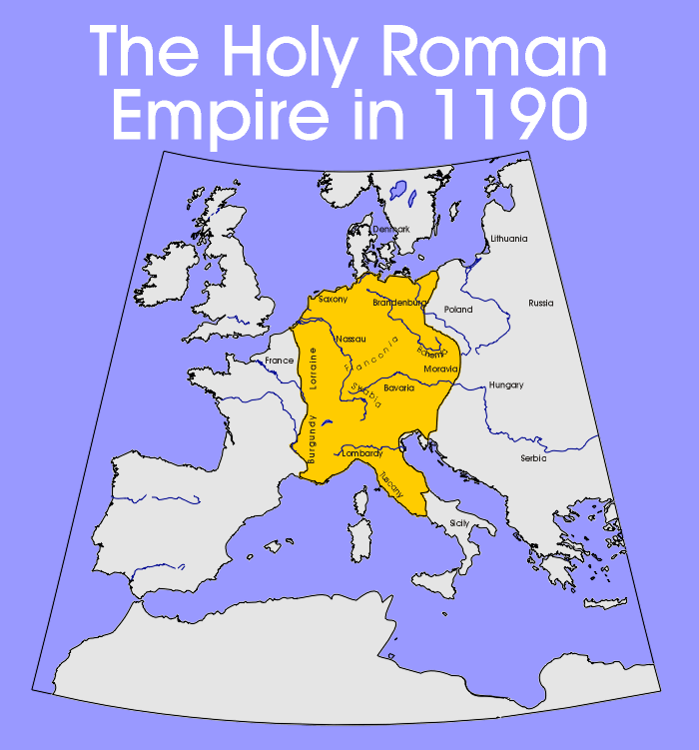
Separation of German States
German kings try to rebuild the empire
Problems with Revival:
Multiple clashes with Italian cities and the pope
Election of the king through princes (weak authority)
Problems lead to a control fewer and weaker lands to establish power

Slide 12
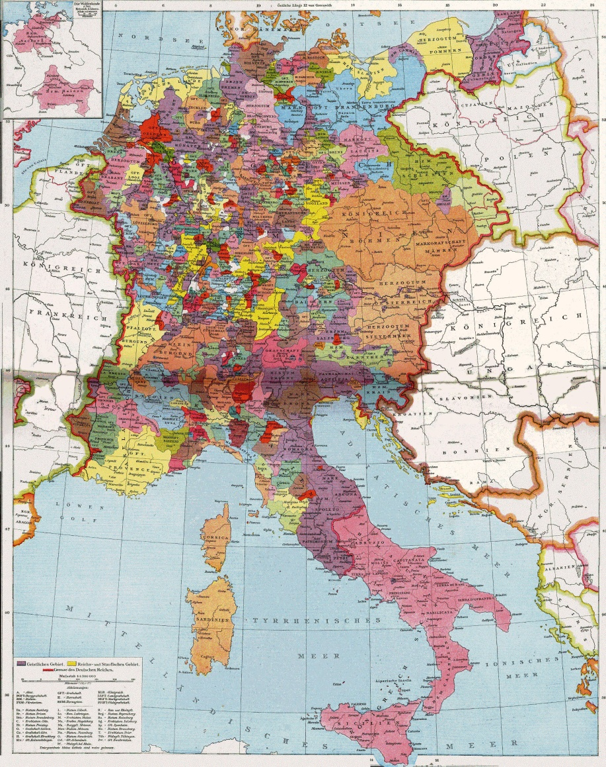
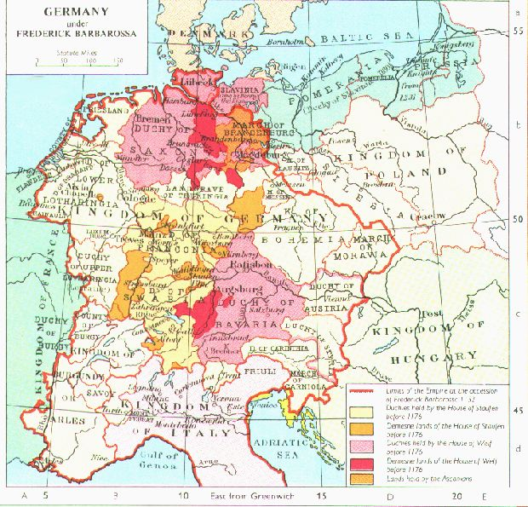
Division of the Holy Roman Empire

