Slide 1
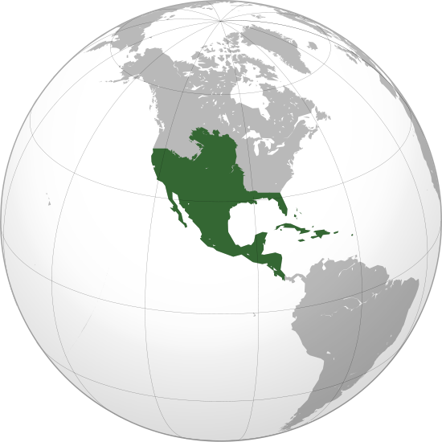
Spain’s American Empire

Slide 2
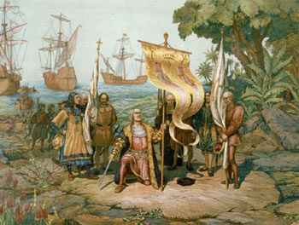
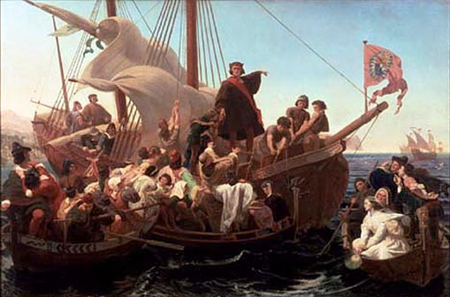
Columbus
8/1492: Set sail w/ the Nina, Pinta, & Santa Maria
Spot land in October
Believed to have reached the East Indies – Identify locals as Los Indios
Lands in the Bahamas & claims land for Spain
San Salvador (“Holy Savior”)
Looking for gold, doesn’t find it = claims other island
Beginning of Spanish colonies in the Americas

Slide 3
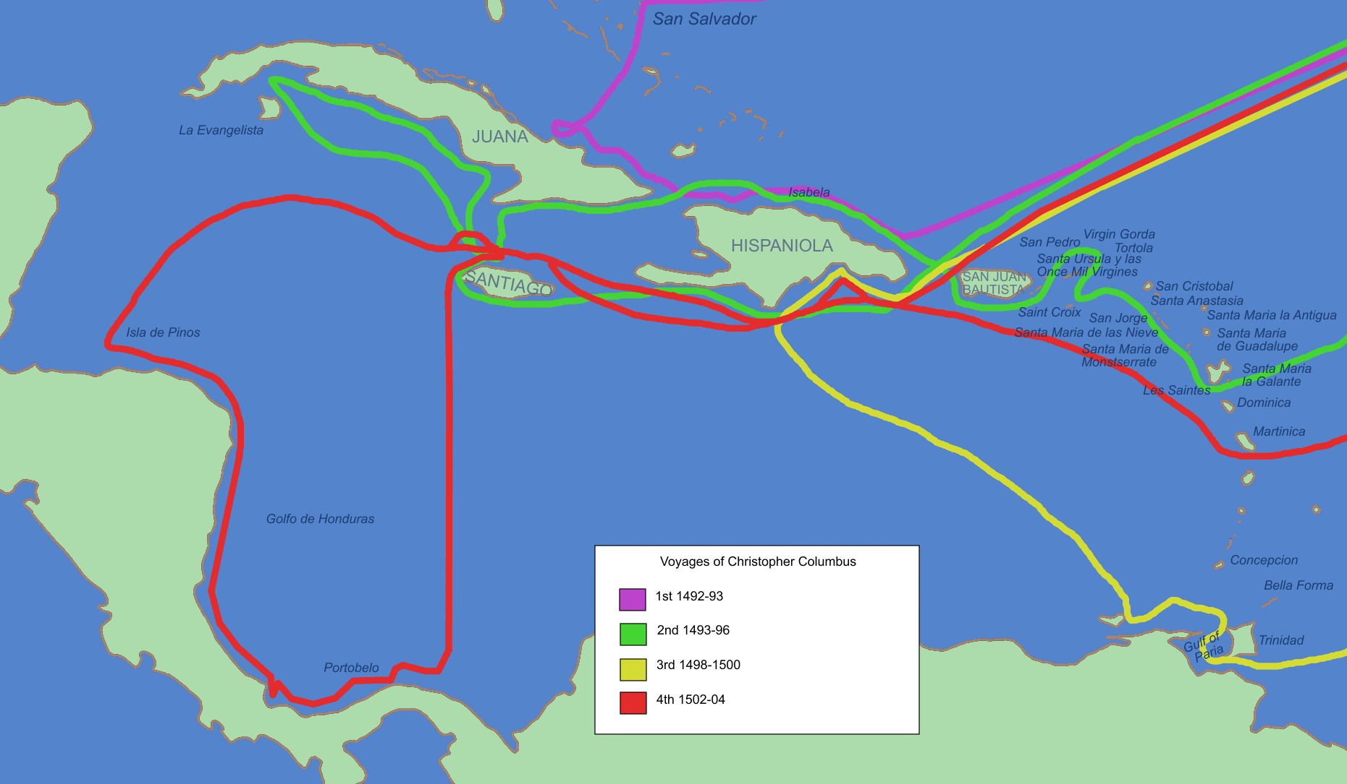
Voyages of Columbus

Slide 4
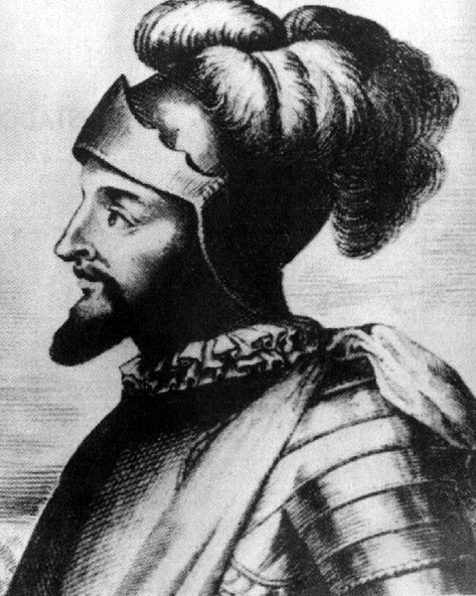
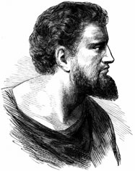
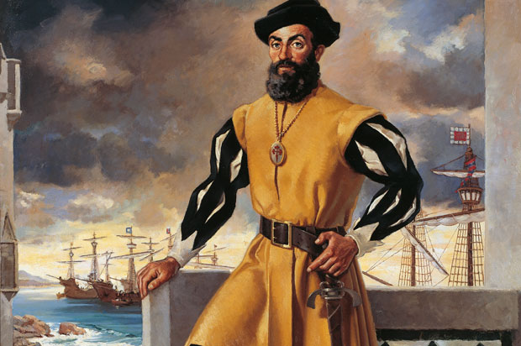
Others
1500: Cabral claims Brazil for Portugal
Amerigo Vespucci identifies lands as the “New World”, not Asia
Named America in 1507
Balboa (S) – Crosses Isthmus of Panama
1519-22: Ferdinand Magellan sails around the world – 1st to circumnavigate the globe
Killed in the Philippines

Slide 5
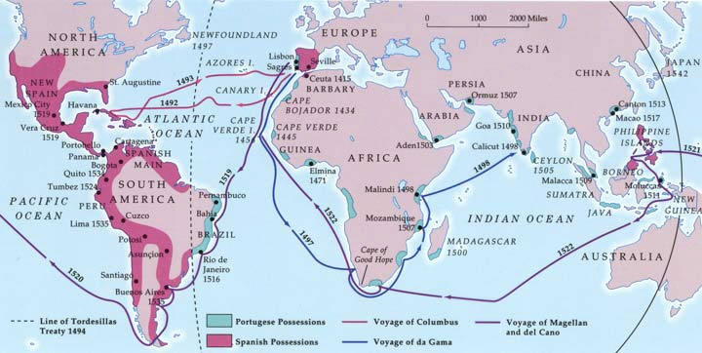
Magellan’s Voyage

Slide 6
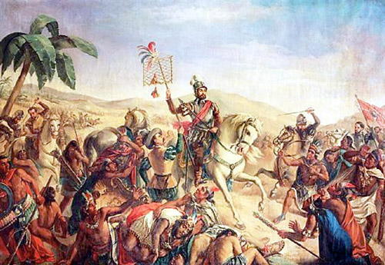
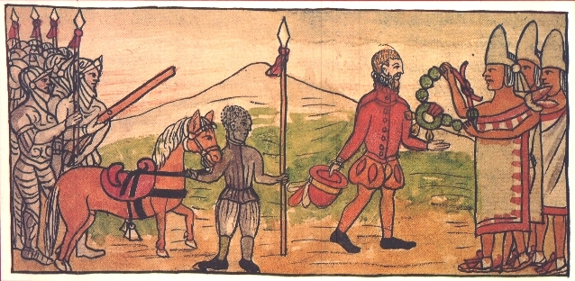
Spain & Mexico
1519: Hernando Cortés lands in Mexico
Claims mainland in search of gold & silver
Spain: 1st settlers in the Americas
Run into the Aztecs & believed to be gods
Montezuma II gives Cortés share of Aztec gold
6/1520: Aztecs rebel & kick out Spanish

Slide 7
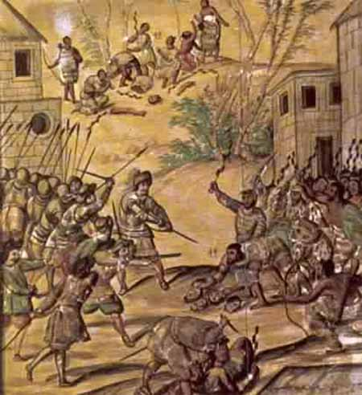
Mexico (cont.)
Cortés strikes back & conquers the Aztecs (1521)
Greatly outnumbered, but two great advantages:
1) Weapons: Guns & Cannons
2) Native Allies
Biggest help: Disease
Measles, mumps, smallpox, & typhus
Aztec population decimated
No built up immunities

Slide 8
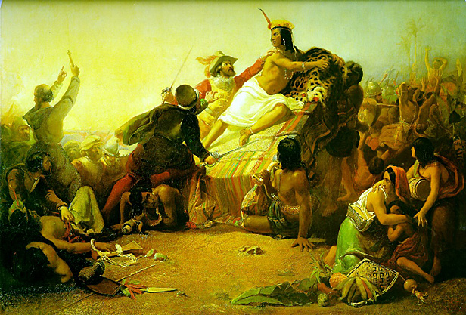
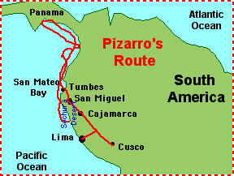
Peru & Others
1532: Francisco Pizarro conquers the Inca
Ambushes Inca at Cajamarca, kidnaps Atahualpa (leader)
Atahualpa gives gold & silver as ransom for release = Spanish strangle him to death
1533: Captures Cuzco (Incan capital)
Spanish also conquer the Maya
mid-1500s: American Empire created

Slide 9
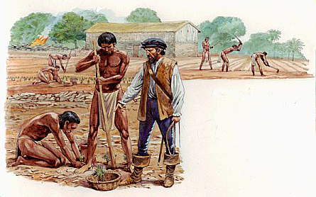
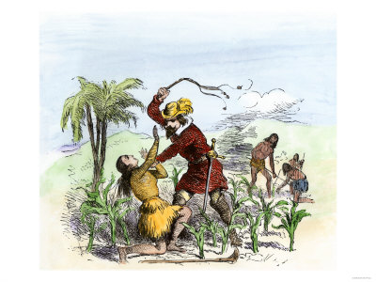
Patterns
Use techniques from the Reconquista
Live among natives, but oppressive
Impose culture on natives
Peninsulares (male settlers) & Native women = mestizoes
Goal: Exploit lands resources = Encomienda system
Natives gather goods for Spanish rulers
Poor conditions; many worked to death

Slide 10
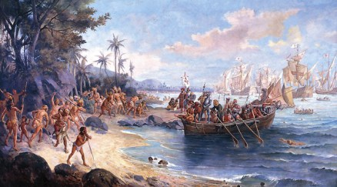
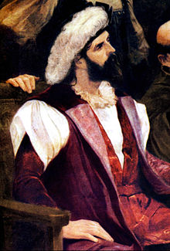
Brazil
Under Portuguese control – Cabral
1530s: Colonists begin settlement of coast
Grow sugar on giant plantations
High demand in Europe = $$$
Expand production of sugar, leads to Atlantic Slave Trade

Slide 11
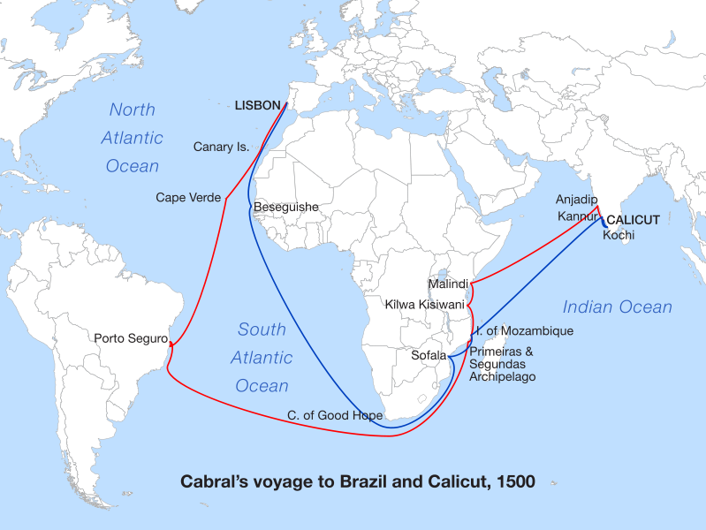

Slide 12
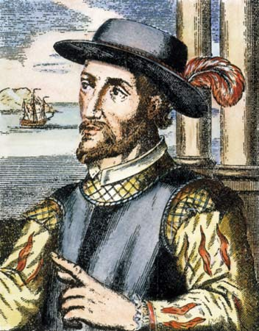
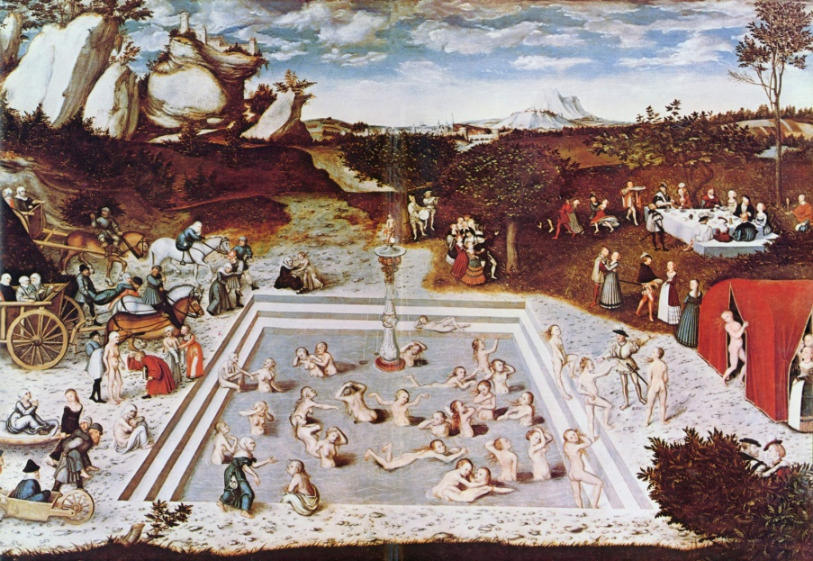
Influence
Spain’s colonies = world’s most powerful
Golden age of art & culture
Protection: Create a powerful army & navy
Push territory north into US
1513: Ponce de Leon into Florida (“the Fountain of Youth”)
1540-41: Coronado settles the Southwest
Spanish priests spread Catholicism as conquistadors expand colonies

Slide 13
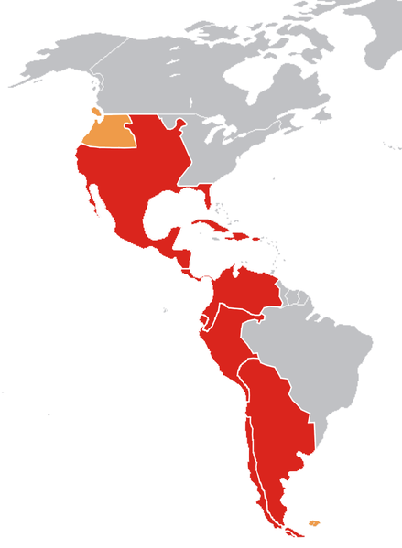
Opposition
Priests spread religion & push for better treatment of natives
Criticize the Encomienda (1542: abolished)
Abolition leads to African slavery
Natives fight Spanish throughout colonial rule
1680: Popé leads rebellion in New Mexico; pushes Spanish back to New Spain
Spanish regain region after 12 years

