Slide 1
Ancient Civilizations
The Sumerians
3200 BC- 1800BC

Slide 2
Where did they live?
Fertile Crescent
Mesopotamia
Modern day Iraq
Biblical site of Garden of Eden
Included city-states of Ur, Erech, Kish, and Babylon

Slide 3
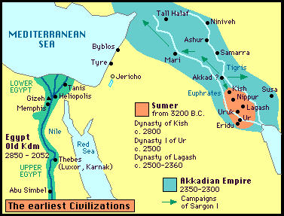

Slide 4
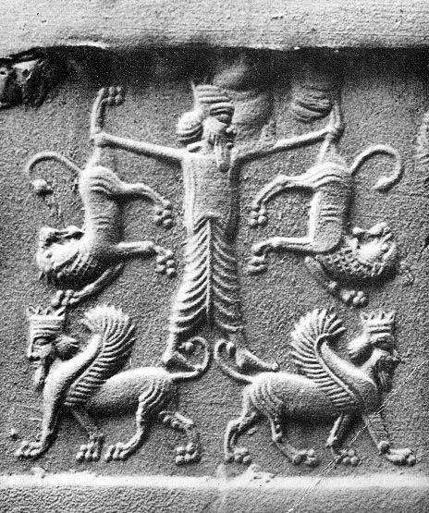
Who were the Sumerians?

Slide 5
They were …
the oldest civilization known to historians
resourceful
builders
artisans
traders
warriors
communicators
religious

Slide 6
Resourceful
They speared fish from slender wooden boats, herded water buffalo and fashioned fantastic vaulted houses from the few building materials the marshes had to offer: reeds, clay and buffalo dung.

Slide 7
Builders
Ziggurats
Irrigation Systems
Bazaars- Ancient’s version of malls
Roads
Canals
Built with earth/water

Slide 8
Artisans
One look at the ancient Sumerian "Treasures from the Royal Tombs of Ur" and you will think to yourself, They just don’t make gold, silver and copper ornaments of anthropomorphic goats like they used to. These 4,500-year-old artifacts, swiped from a burial site in Mesopotamia (present-day Iraq), were crafted with mind-blowing precision.

Slide 9
Traders
Traders brought riches to cities and sailed along the rivers or risked the dangers of desert travel to carry goods to distant regions.
Sumerians made the first wheeled vehicles.

Slide 10
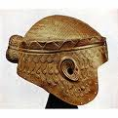
Warriors
Constantly at war with their neighboring city-states
Weapons includes spears, chariots, used basic armor

Slide 11
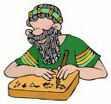
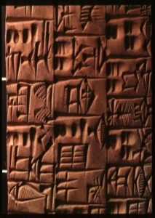
Communicators
First writing system
Cuneiform
Used a reed stylist on clay tablets
Used for accounting purposes; to record harvests, storage of grain, etc.

Slide 12
Religious
Polytheistic- gods controlled nature, behaved like ordinary folk
Believed their highest duty was to KEEP the GODS HAPPY!
Believed at death they went to underworld

Slide 13
Why Important?
Authors of Epic of Gilgamesh
Invented first wheeled carts
First writing system
Created basic algebra/geometry
Experimented with 60minute hour
Invented the Sail

Slide 14
What happened to Sumerians?
No natural defenses allowed others (Assyrians) to take over the area and adopt what they learned from the Sumerians. Knowledge spread throughout the Middle East.
Later the Middle East was conquered first by the Greeks and then later the Romans.
Spread of knowledge is called Cultural Diffusion!

