Slide 1
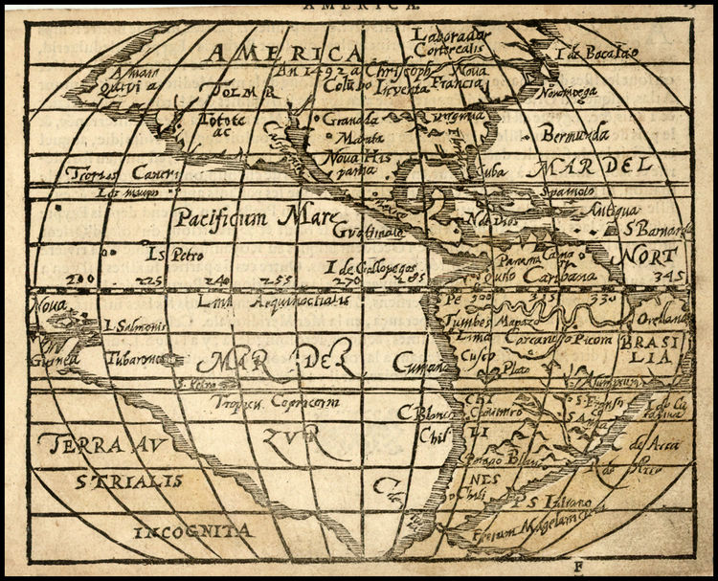
The Columbian Exchange

Slide 2
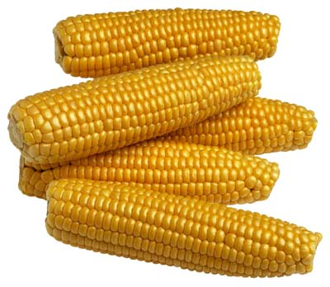
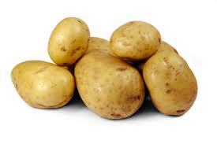
Exchange
Global transfer of foods, plants, & animals
Americas ⬄ Europe, Africa, & Asia
Most Important:
Corn & Potatoes
Inexpensive, nutritious
Help people live longer = population boost
Diseases have greatest effect on American populations

Slide 3
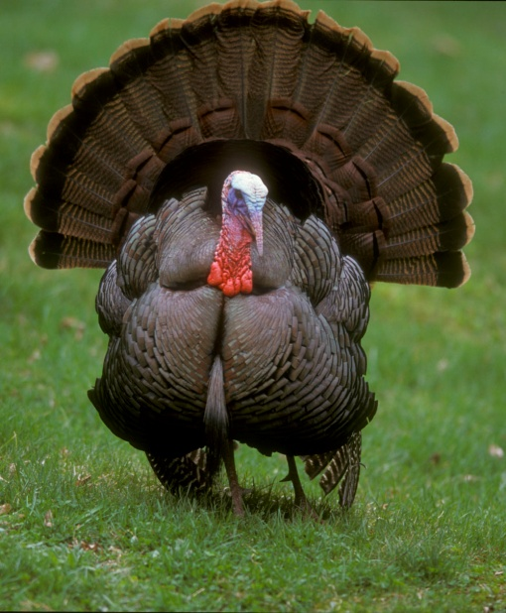
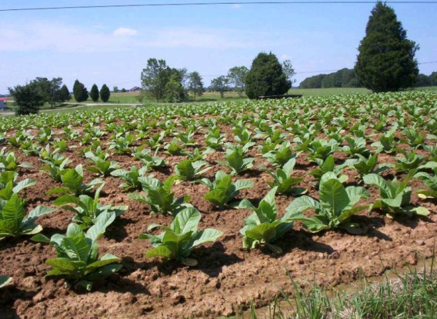
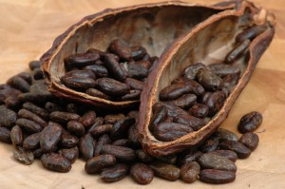
New to Old
Crops
Animals
Produce: Tomatoes, Squash, Corn, Potatoes, Pumpkin, Sweet Potatoes, Cassava, Peppers, Peanuts, Beans, Cacao, Vanilla, Paprika, Pecans, Sunflowers
Fruit: Pineapple
Tobacco
Quinine
Rubber
Turkey
Llama
Alpaca
Diseases
Syphilis
Chagas’ Disease

Slide 4
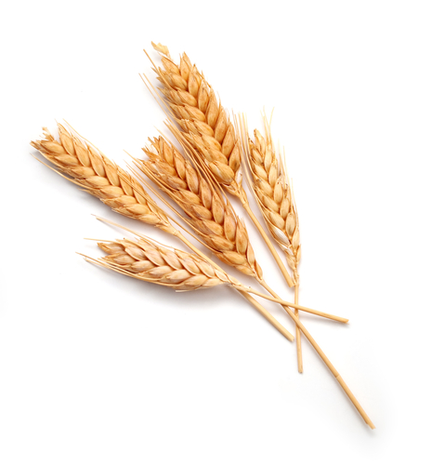
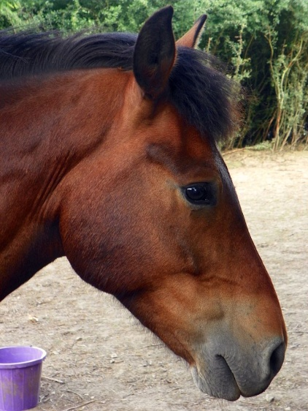
Old to New
Crops
Animals
Fruits: Bananas, Citrus, Grapes, Peaches, Pears, Apples, Mangoes
Produce: Onions, Olives, Turnips, Yams, Black Eyed Peas
Grains: Wheat, Rice, Barley, Oats
Sugarcane, Honey, Coffee Beans
Horses, Mules, Donkeys
Cattle
Sheep & Goats
Pigs
Dogs & Cats
Chickens
Diseases
Smallpox, Influenza, Typhus, Measles, Malaria, Diphtheria, Whooping Cough, Yellow Fever

Slide 5
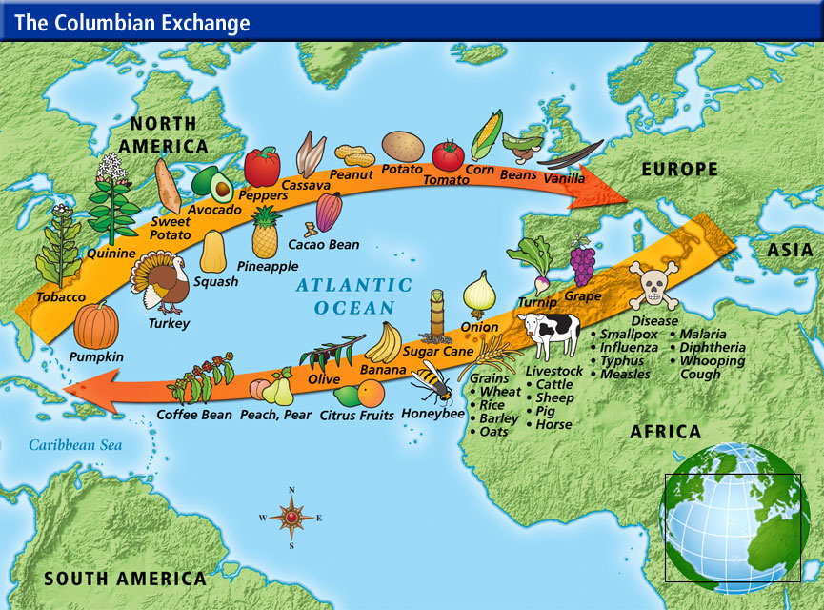

Slide 6
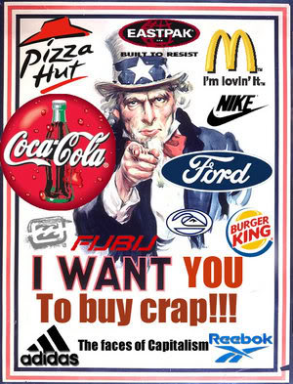
Global Trade
Goods + Trade = Wealth
Roots of economic change in Europe
Capitalism – ownership & investment for profit
Governments no longer sole owners of wealth
Merchants gain huge sources of wealth & invest = growth of business
Economic activity = rise in $ supply = inflation

Slide 7
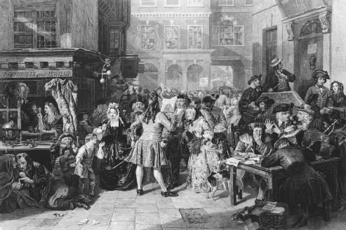
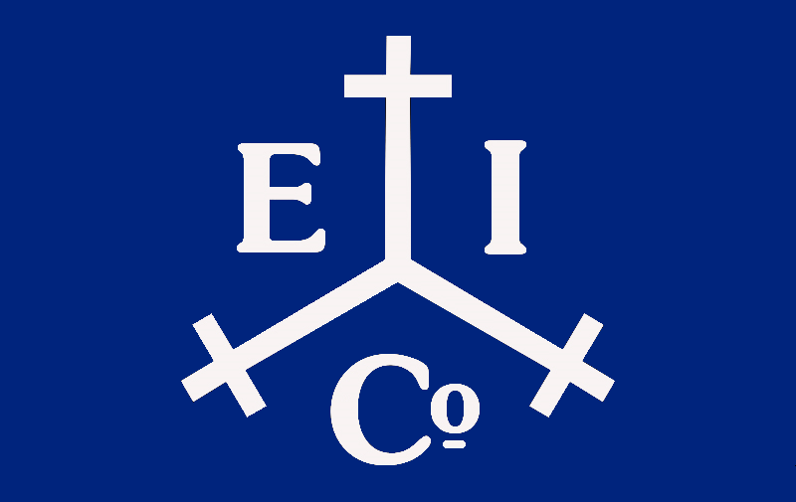
Joint-Stock
Made up of a group of investors for a common purpose/venture
1500-1600s: Goal was American colonization
Need for lots of money = high risk
Joint-Stocks allow investors to only incur minimal risk & huge rewards

Slide 8
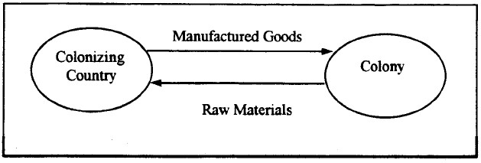
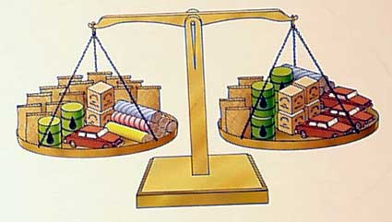
Mercantilism
Theory: Country’s power ⬄ wealth
Wealth allows countries to build navies, armies, & buy goods
Goal: Get as much wealth as possible
Increase wealth in two ways:
1) Gold & Silver
2)Balance of Trade: Sell more than buy
Ultimate Goal = Self-Sufficiency
Colonization allows this to happen, or helps

Slide 9
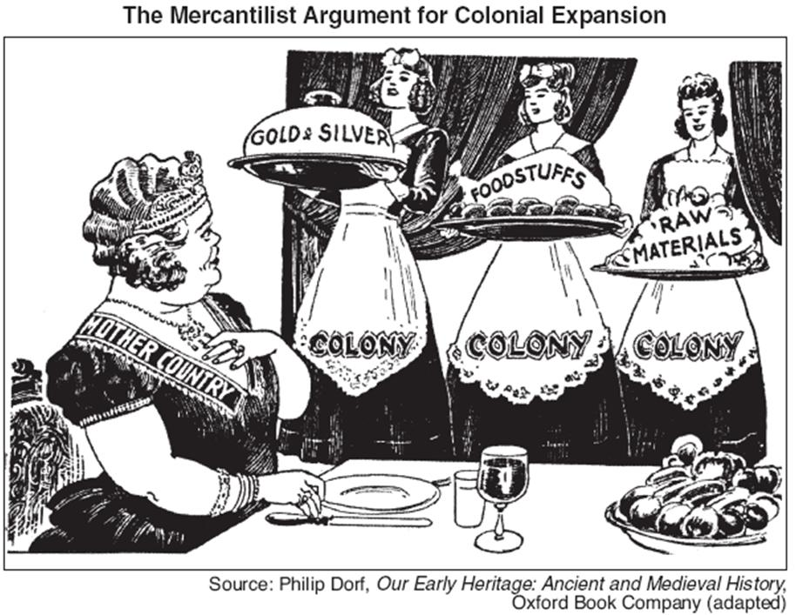

Slide 10
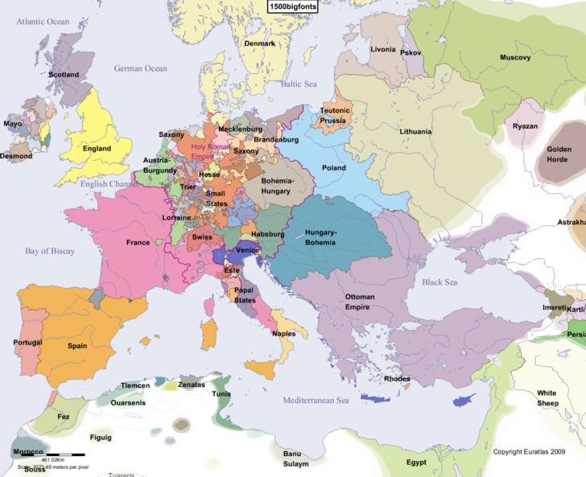
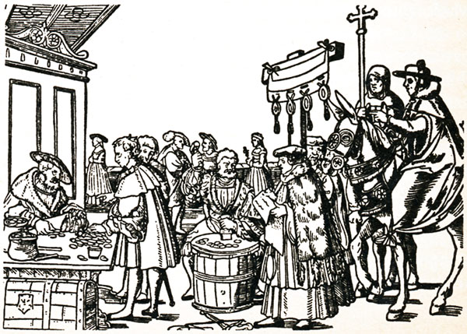
Revolution & Change
Economic changes = Societal changes
Towns and cities grow rapidly
Merchants rise to control great amounts of wealth
Much of Europe remains rural & poor
Wealth of European nations increases greatly

