Slide 1
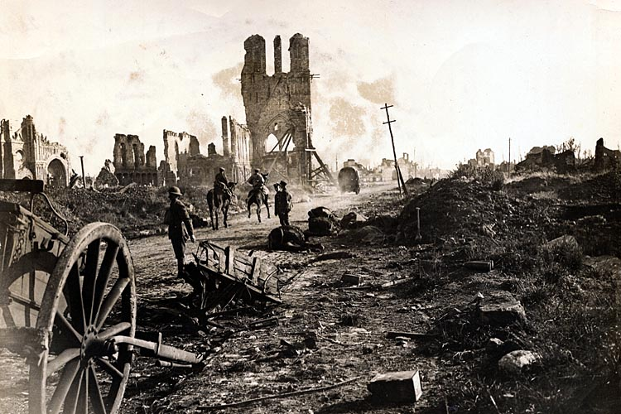
The Great War (World War I) 1914-1918

Slide 2
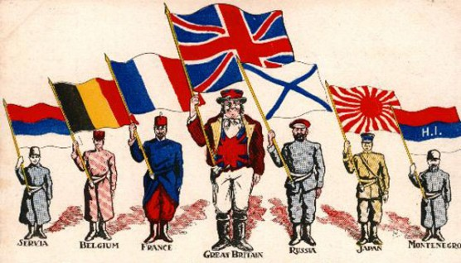
Moving Towards War
Several developments that would help push Europe towards war.
Nationalism: Deep devotion to one’s nation.
Imperialism: Control of lands by another country; Caused many people to rebel.
Militarism: Growth of military might by several countries. (Sign of strength)

Slide 3
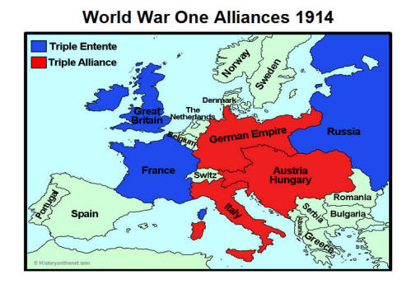
Alliances
Militarism caused a lot of distrust between European countries.
Formed alliances as a result.
Triple Alliance: Italy, Germany, Austria-Hungary
Triple Entente: Britain, France, Russia

Slide 4
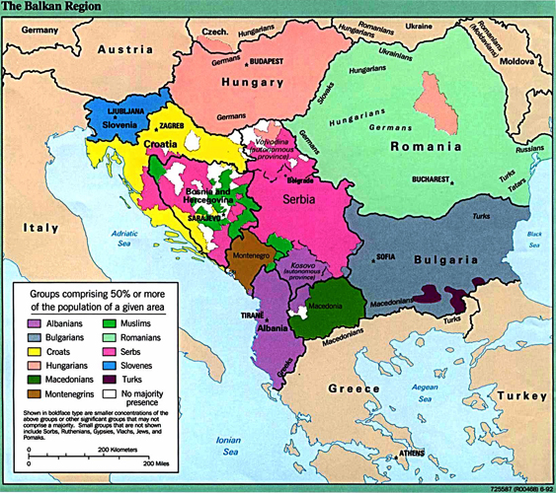
Balkans Crisis
Peninsula in southeastern Europe
Many nationalist uprisings there
1908, Austria-Hungary tried to annex (take over) Bosnia and Herzegovina. Serbia opposed this takeover, which led to rising tensions.

Slide 5
Shot Heard Around the World
Heir to the Austrian-Hungarian throne, Archduke Franz Ferdinand, visited Bosnia with his wife.
Both were assassinated by a Serbian nationalist.
Austria declared war on Serbia.
Alliance system caused many countries to go to war, as they were bound to help their allies.

