Slide 1
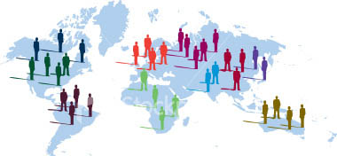
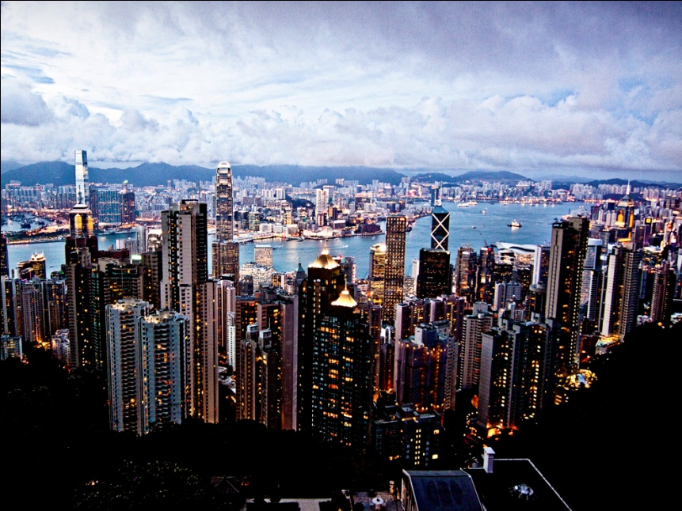
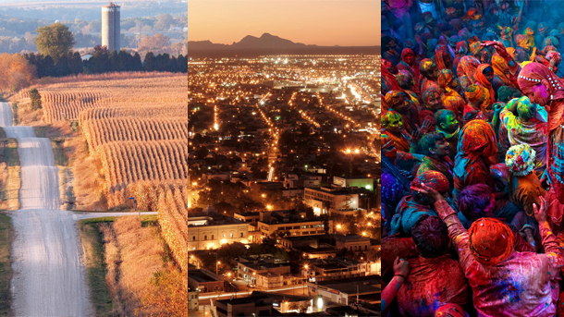
Introduction to Human Geography

Slide 2
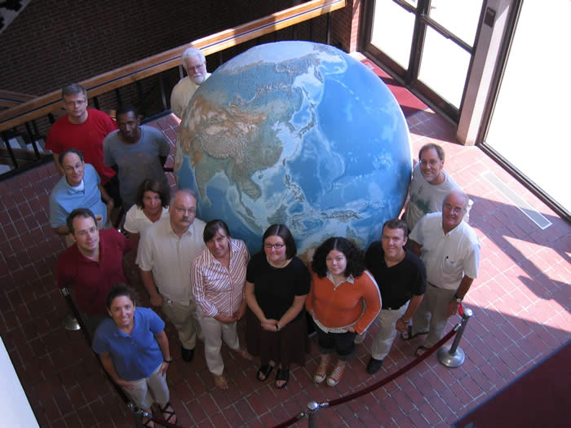
What is Human Geography?
Focuses on:
How people make places.
How people organize space and society.
How people interact with each other in places and across space.
How people make sense of others and themselves in localities, regions, and the world.

Slide 3
What is Human Geography?
Advances in communication and transportation technologies are making places and people more interconnected.
Economic globalization and the rapid diffusion of elements of popular culture, such as fashion and architecture, are making many people and places look more alike.

Slide 4
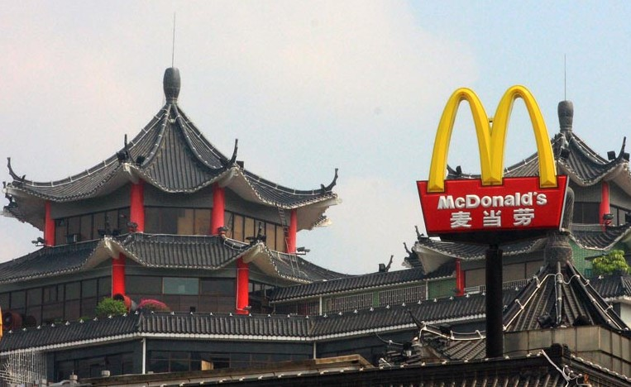
What is Human Geography?
Globalization – A set of processes that are increasing interactions, deepening relationships, and accelerating interdependence across national borders.
Also includes the outcomes from these.

Slide 5
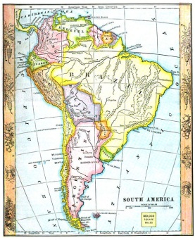
What is Human Geography?
Geographers employ the concept of scale to understand individual, local, regional, national, and global interrelationships.
What happens at the global scale affects the local, but it also affects the individual, regional, and national. Similarly, the processes at these scales influence the global.

Slide 6
What are Geographic Questions?
Geographers study:
Human phenomena such as language, religion, and identity.
Physical phenomena such as landforms, climate, and environmental change.
Interactions between humans and environment.

Slide 7
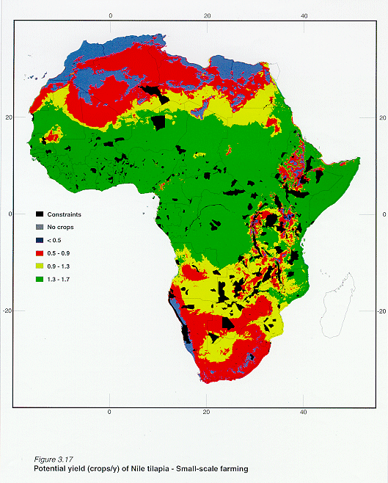
What are Geographic Questions?
Human Geography is the study of the spatial and material characteristics of the human-made places and people found on Earth’s surface.

Slide 8
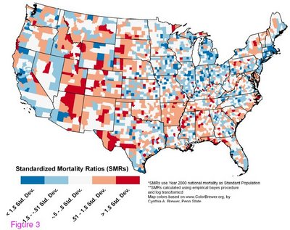
Spatial Perspective
Studying spatial arrangement of places and phenomena.
How they are laid out, organized, and arranged on Earth, and how they appear on the landscape.
Studying distribution and patterns.

Slide 9
EXAMPLE – Spatial Perspective
Maps in the Time of Cholera Pandemics
Medical geography: Mapping the distribution of a disease is the first step to finding its cause.
Dr. John Snow, a noted anesthesiologist in London, mapped cases of cholera in London’s Soho District in 1854 and found a link to contaminated water.

Slide 10
EXAMPLE – Spatial Perspective
Cholera:
An ancient disease associated with diarrhea
and dehydration
Was confined to India until 1816
Spread to China, Japan, East Africa, and Mediterranean Europe in the first of several pandemics: worldwide outbreaks
Second pandemic: 1826–1837: North America
Third pandemic: 1842–1862: England and North America

Slide 11
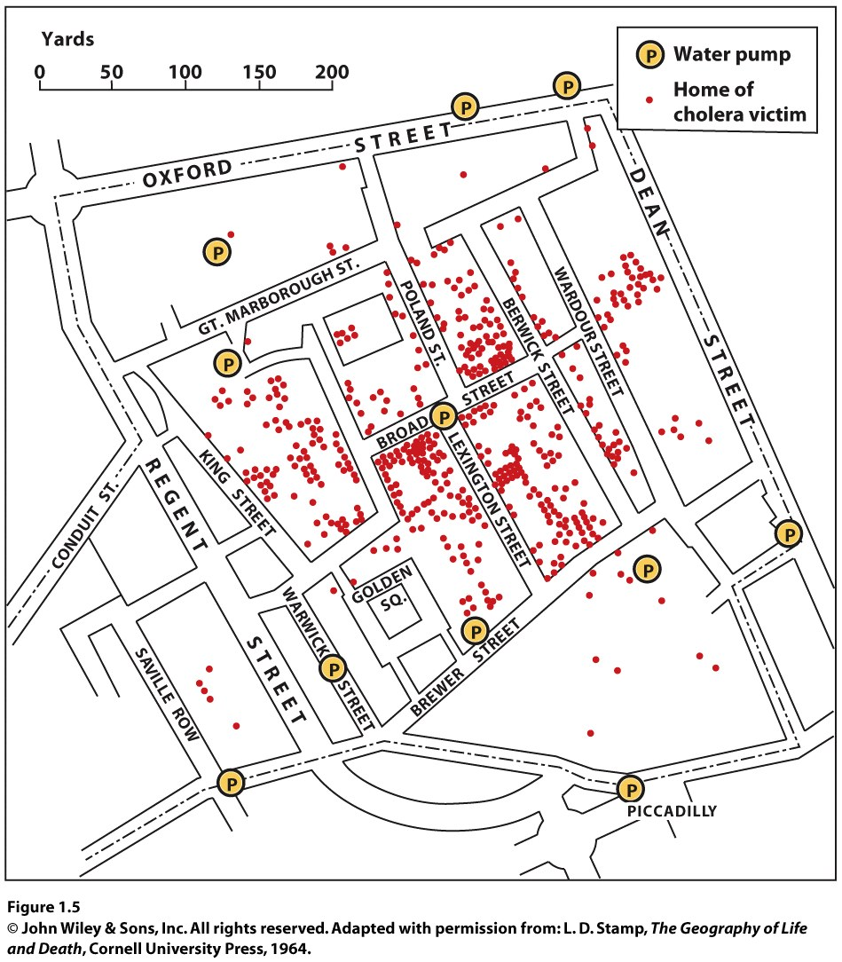
EXAMPLE – Spatial Perspective
Cholera has not been defeated completely.
We expect to find cholera in places that lack sanitary sewer systems and in places that are flood prone.

Slide 12
Spatial Perspective
Immanuel Kant: We need disciplines focused not only on particular phenomena (such as economics and sociology) but also on the perspectives of time (history) and space (geography).
The 5 themes of geography
Cultural landscape

Slide 13
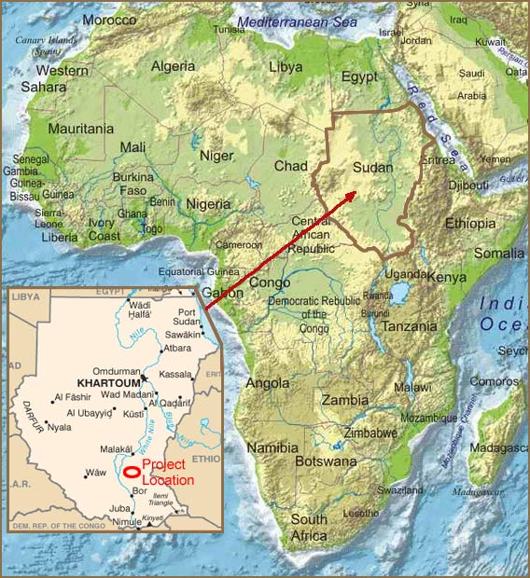
Spatial Perspective
First theme: Location
Highlights how the geographical position of people and things on Earth’s surface affects what happens and why
Helps to establish the context within which events and processes are situated

Slide 14
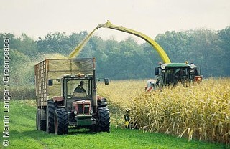
Spatial Perspective
Second theme: Human-environment interactions
A spatial perspective invites consideration of the relationship between humans and the physical world.
Asking locational questions often means looking at the reciprocal relationship between humans and environments.

Slide 15
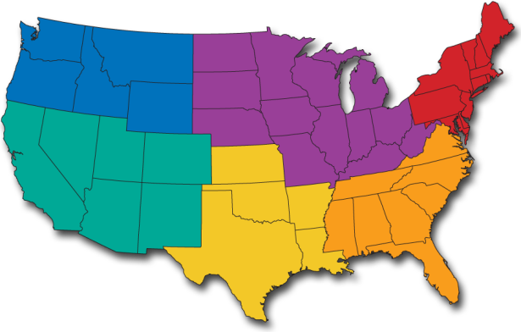
Spatial Perspective
Third theme: Region
Features of the Earth’s surface tend to be concentrated in particular areas, which we call regions.
Understanding the regional geography of a place allows us to make sense of much of the information we have about places.

Slide 16
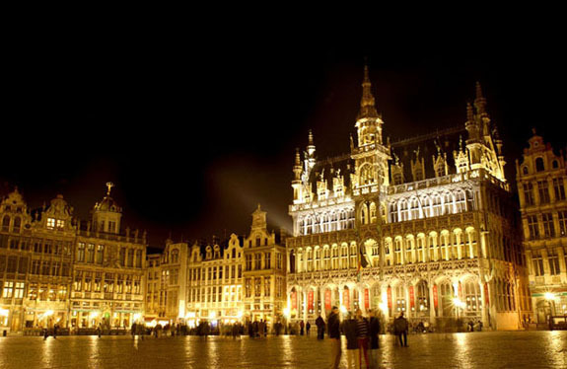
Spatial Perspective
Fourth theme: Place
People develop a sense of place by infusing a place with meaning and emotion.
We also develop perceptions of places where we have never been through books, movies, stories, and pictures.

Slide 17
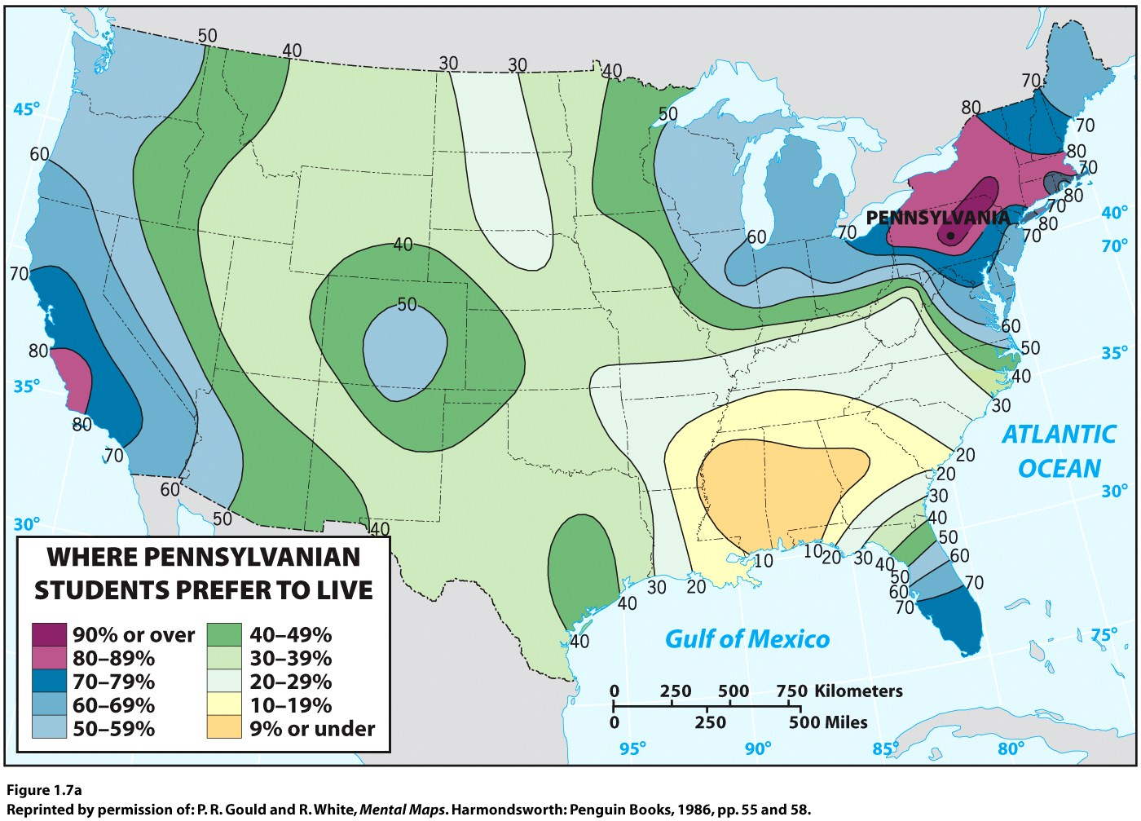

Slide 18
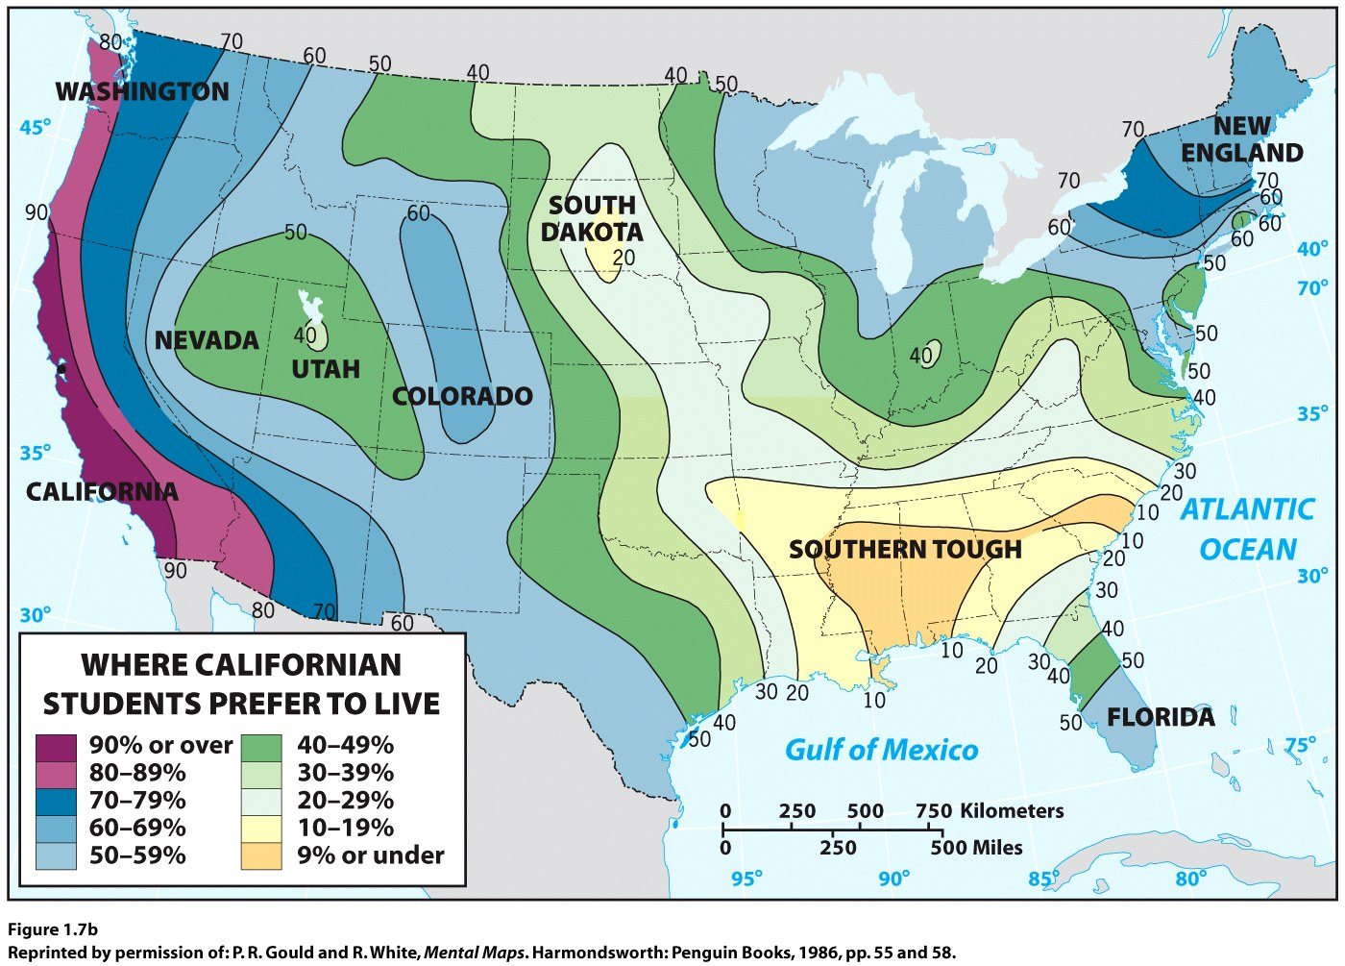

Slide 19
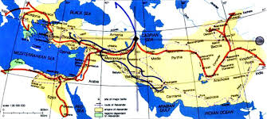
Spatial Perspective
Fifth theme: Movement
Movement refers to the mobility of people, goods, and ideas across the surface of the planet.
Spatial interaction between places depends on:
The distances among places
The accessibility of places
The transportation and communication connectivity among places

Slide 20
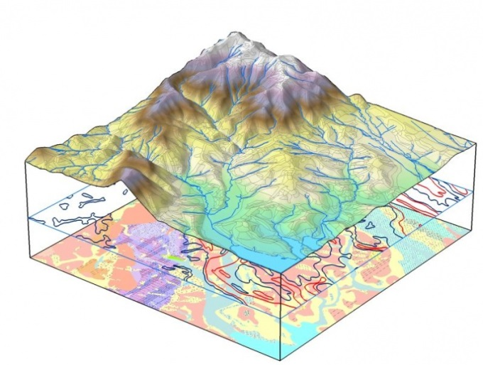
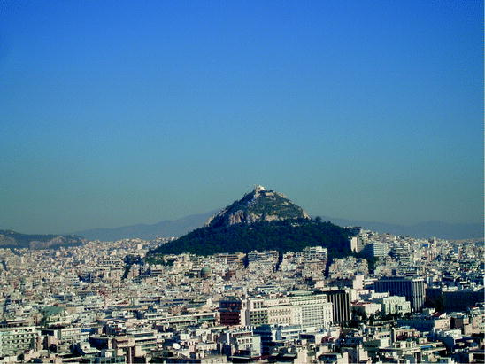
Landscape
In addition to the 5 themes, landscape is a core element of geography.
The material character of a place, the complex of natural features, human structures, and other objects that give a place a particular form.

Slide 21
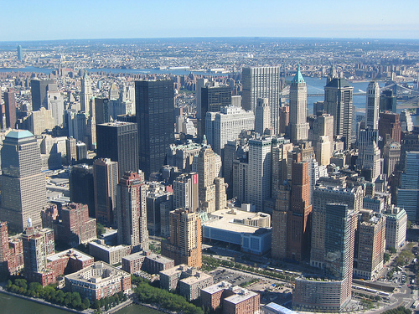
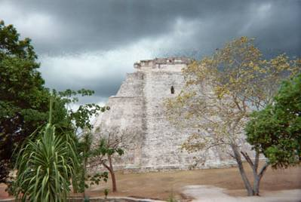
Cultural Landscape
Visible imprint of human activity on a landscape.
Layers of buildings, roads, memorials, churches, fields, homes, etc.
Layers from gradual change over time.

Slide 22
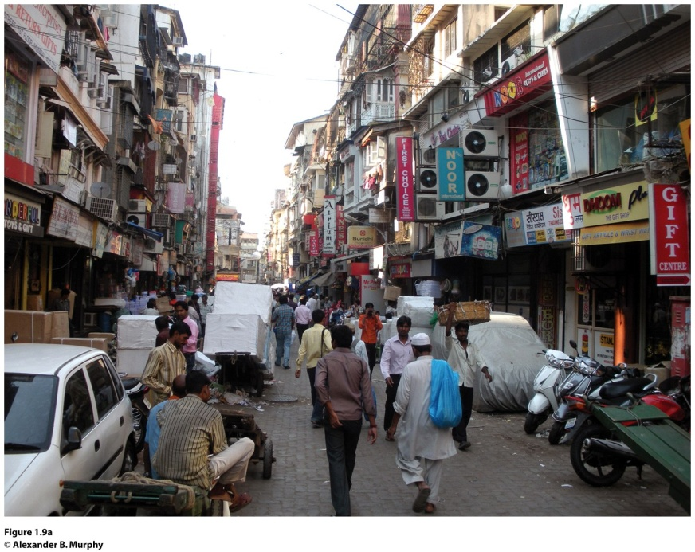
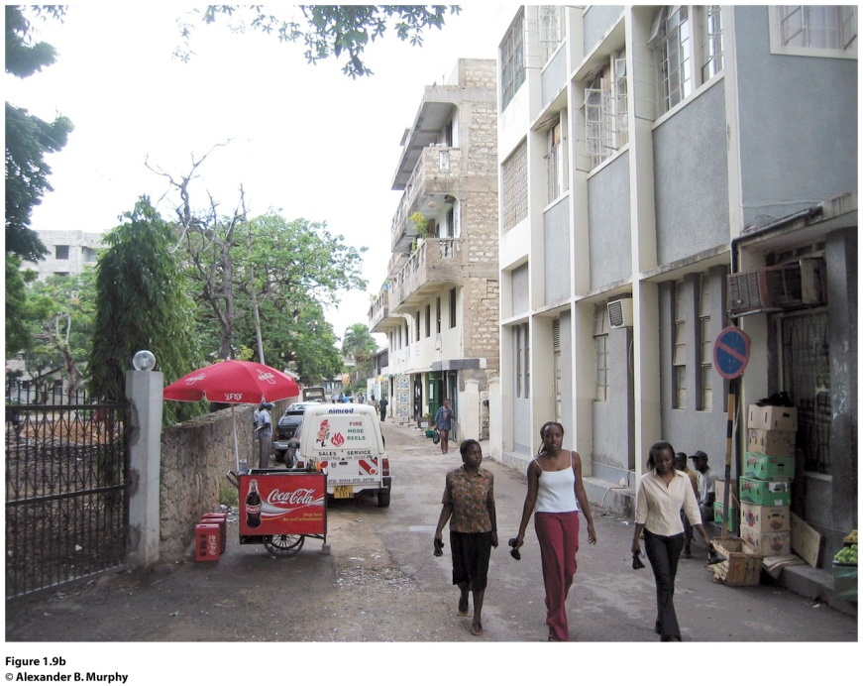
Sequent occupance refers to sequential imprints of occupants, whose impacts are layered one on top of the other, each layer having some impacts on the next.
Mumbai, India (left) and Dar-es-Salaam, Tanzania (right). Apartment buildings throughout Mumbai (formerly Bombay), India, are typically four stories with balconies. In Dar-es-Salaam, Tanzania, this four-story walkup with its laundry and other household items festooned on balconies and in doorways (right) stands where single-family African dwellings once stood, reflecting the sequential occupance of the city. © Alexander B. Murphy.
Notes:
Figure 1.9

Slide 23
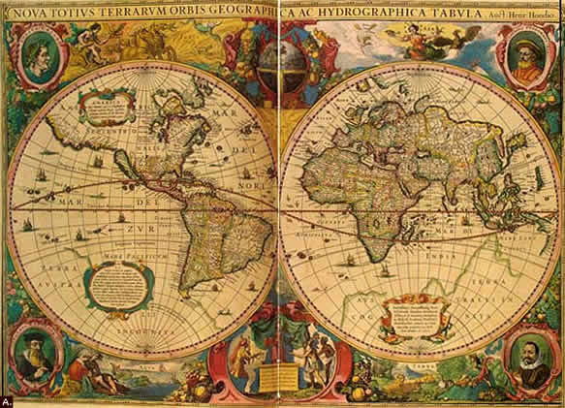
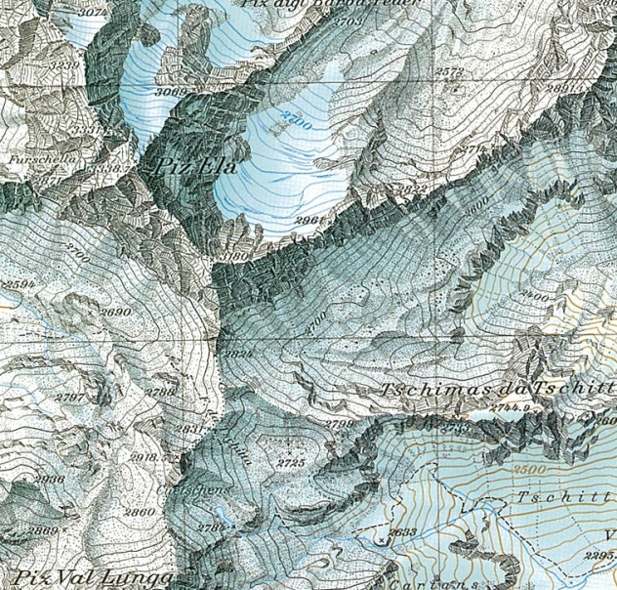
Use of Maps
Necessary in geography
Cartography: Art and science of making maps.
Countless purposes

Slide 24
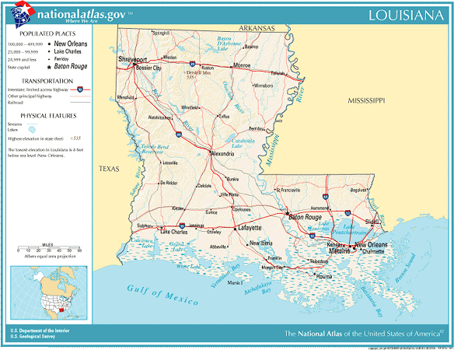
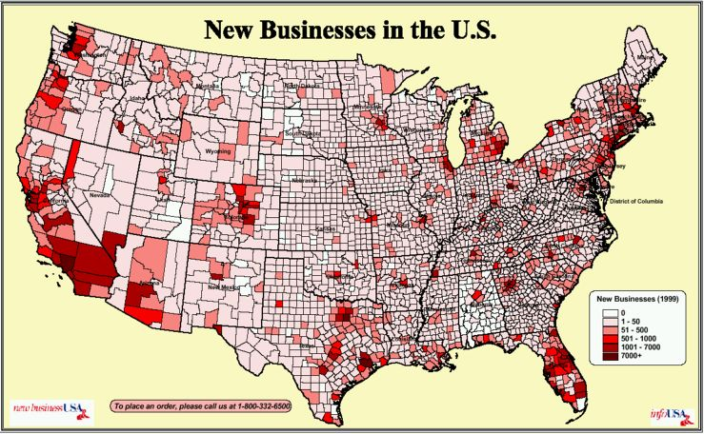
Use of Maps
Reference maps: Show locations of places and geographic features.
Thematic maps: Tell stories, typically showing the degree of some attribute or the movement of a geographic phenomenon.

Slide 25
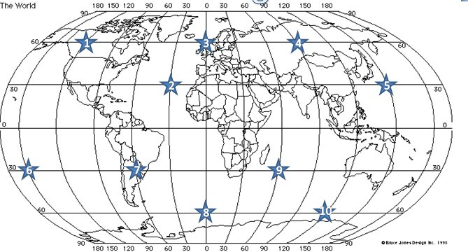
Reference Maps
Focus on accuracy.
Absolute location of places using a coordinating system that allow for the precise plotting of where on Earth something is.
Exact spot on a map. (Will never be moved)

Slide 26
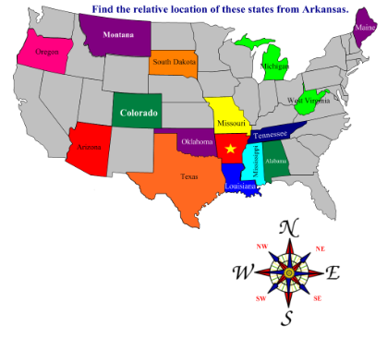
Relative Location
Location of a place in relation to other human and physical features.
“Next to…”
Many people define their lives using relative location.
Constantly modified and changed over time.

Slide 27
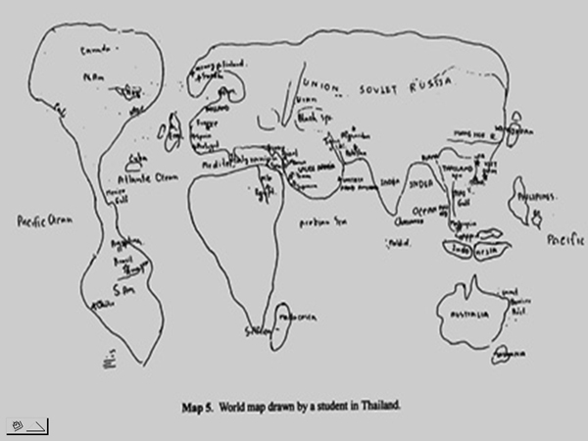
Mental Maps
Combination of places we have been and places we have heard of.
Activity spaces: Places we travel to routinely in our rounds of daily activity.
Geographers who study human-environment behavior have made extensive studies of how people develop mental maps.

Slide 28
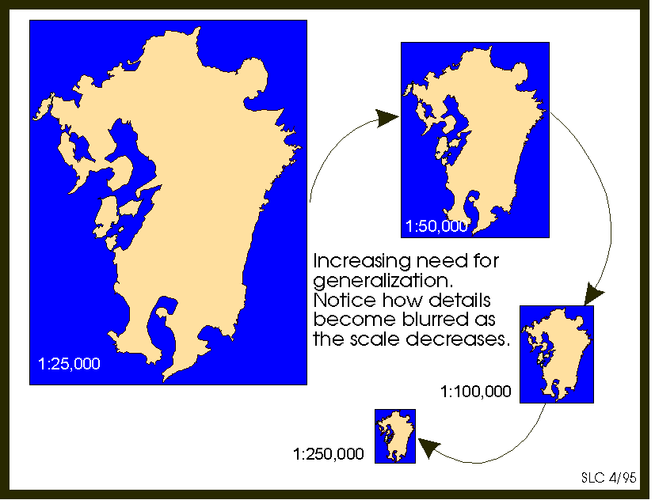
Generalization of Maps
All maps simplify the world.
Cartographers generalize maps as they cannot fit everything on one map.
Generalized maps help us see trends.
Example: Map specifically showing precipitation information.

Slide 29
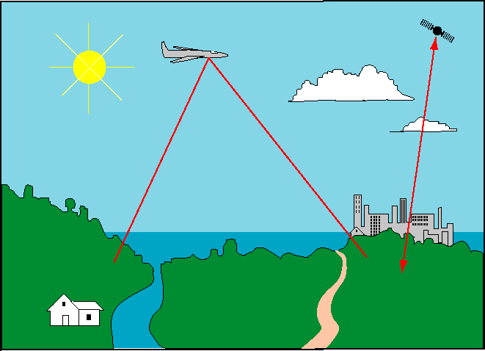
Remote Sensing
Technology that gathers data at a distance from Earth’s surface.
Date collected by satellites and aircraft and is often almost immediately available.
Hurricanes, earthquake damage, etc.
Google Earth

Slide 30
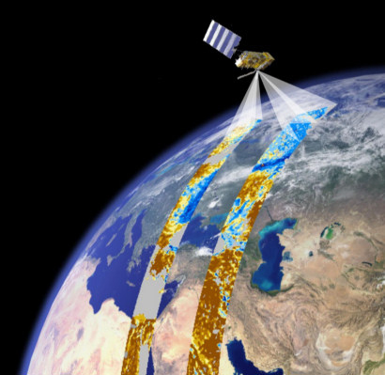
Remote Sensing
Images can be incorporated in a map, and absolute locations can be studied over time by plotting change in remotely sensed imagery over time.

Slide 31
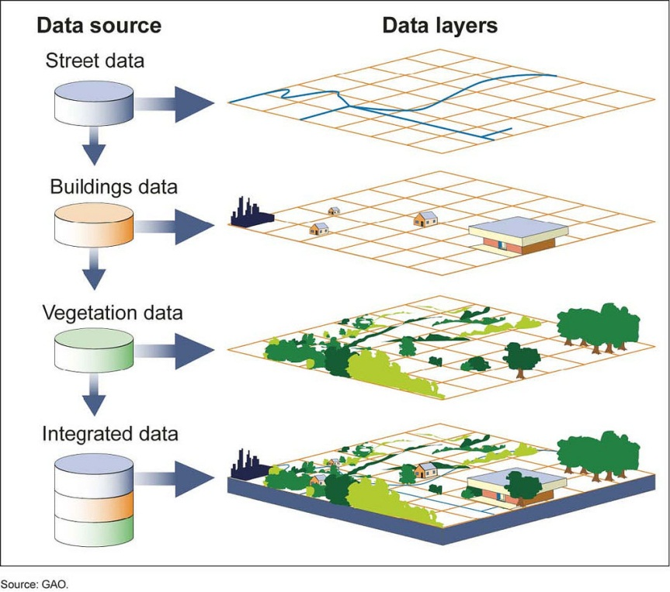
Remote Sensing and GIS
GIS (geographic information systems) compare spatial data by creating digitized representations of the environment, combining layers of spatial data and creating maps in which patterns and processes are superimposed.

Slide 32
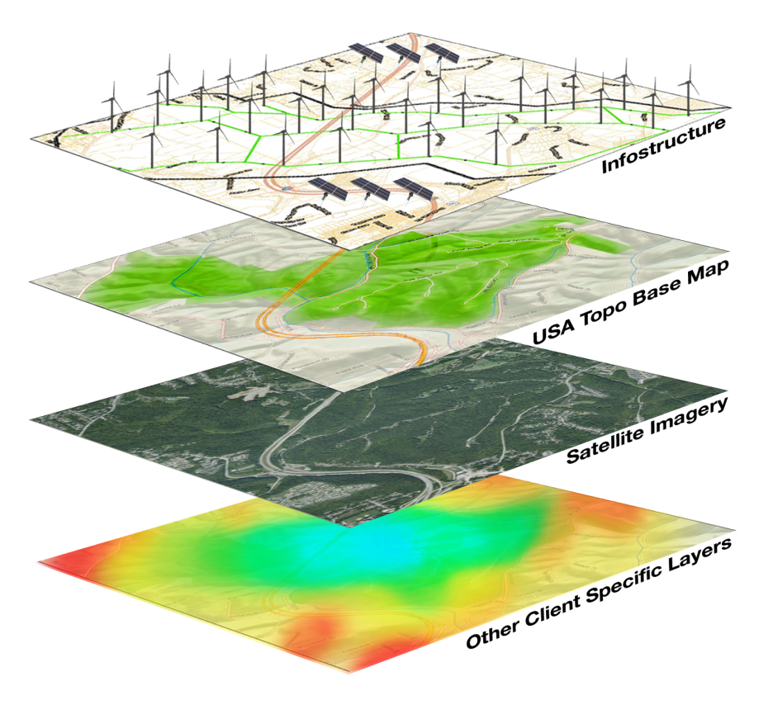
GIS
Geographers also use GIS data to analyze and give insights into geographic patterns and relationships.
Used in both human and physical geographic research.

