Slide 1
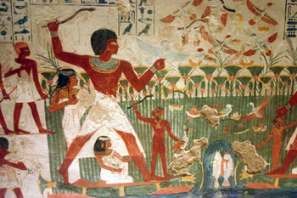
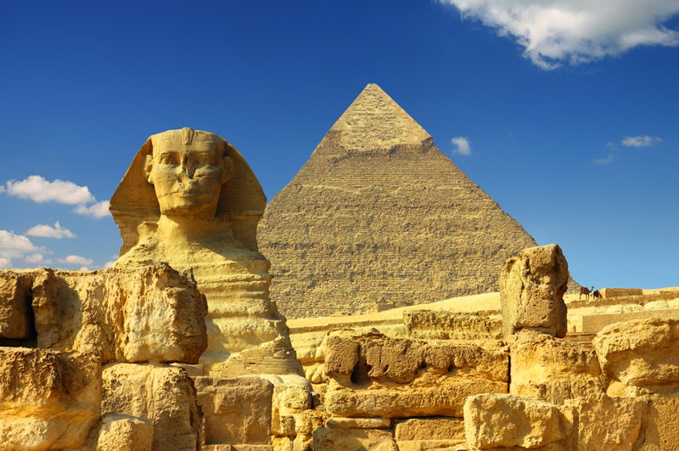
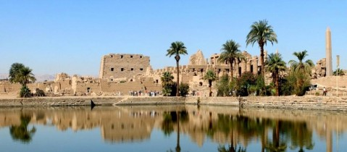
ANCIENT EGYPT
“The Gift of the Nile”

Slide 2
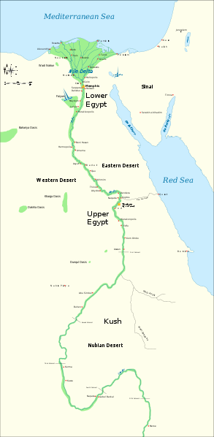
Geography
Nile River
Runs northward for more than 4,000 miles
Longest river in the world
Splits into 2 branches before reaching the Mediterranean Sea.
Triangular delta
Lower Egypt (North): Nile Delta
Upper Egypt (South): Where the Nile begins and flows

Slide 3
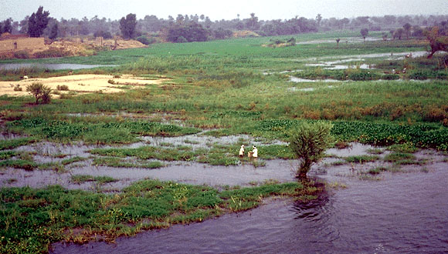
“Miracle” of the Nile
Yearly flooding
Most important feature of the river
Left mud which created a rich soil several miles wide, and was perfect for planting.
Created a surplus of food
Helped Egypt prosper
Also united the land, as the Nile was the fastest source of transportation.

Slide 4
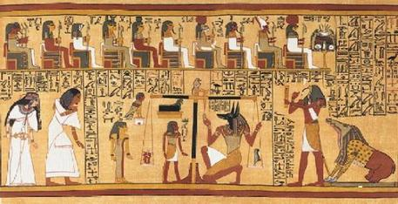
Religion in Egypt
They had no word for religion.
It was always a part of daily life.
Polytheistic
Many gods connected to natural forces.

Slide 5
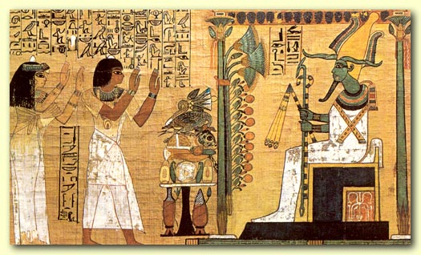
Religion in Egypt
Sun gods and land gods were important.
Sun was seen as the source of life. (“Ra”)
Egyptian ruler was called the “son of Ra,” because he was seen as the earthly form of the god.
Osiris: Symbol of resurrection.
Important for burials.

Slide 6
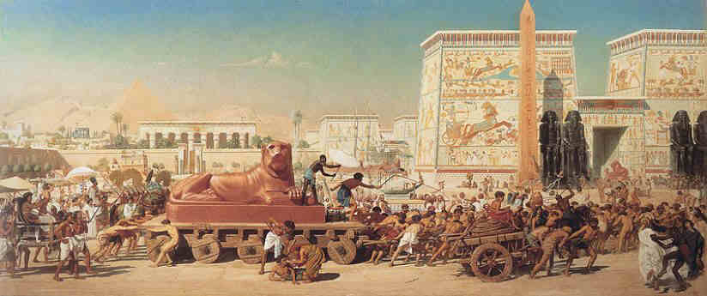
History
Divided into 3 periods
Old Kingdom
Middle Kingdom
New Kingdom
Times of long-term stability
Chaos and invasion between each age

Slide 7
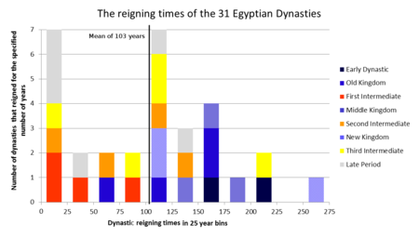
History
Egyptian history begins around 3100 B.C.
Villages of Upper and Lower Egypt were united into one kingdom.
Start of a royal dynasty.
Family of rulers who’s right to rule is passed on within the family.

Slide 8
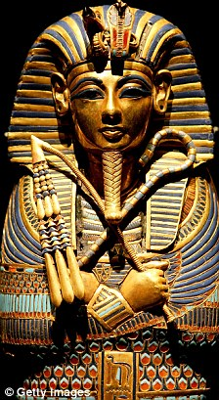
Old Kingdom
From around 2700-2200 B.C.
Age of prosperity
Rulers were powerful
Called the pharaoh.
“Great house” or “Palace”
Believed to be a god himself
Absolute and unlimited power

Slide 9
Old Kingdom
Beginning of bureaucracy
Administrative organization of officials and procedures.
Advisers to pharaoh
Office of vizier
Steward of Egypt (2nd in command)and only pharaoh was more powerful.
Ruled and controlled the bureaucracy.

Slide 10
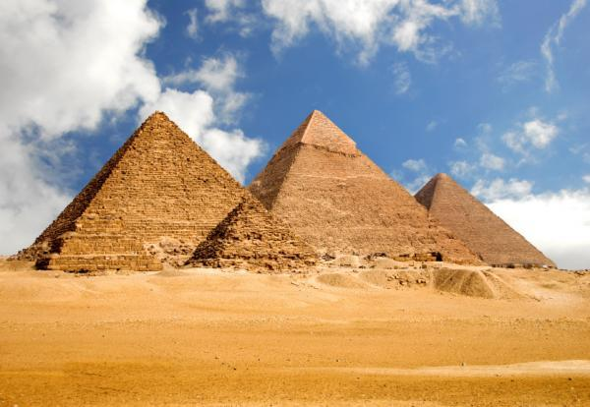
Old Kingdom
Pyramids
Part of a large complex of buildings dedicated to the dead.
Besides a tomb, they also contained rooms with various valuables of the dead ruler.
Largest is the Great Pyramid of Giza

Slide 11
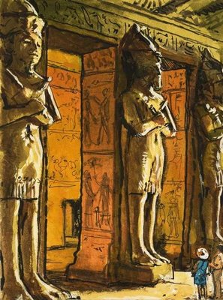
Middle Kingdom
About 150 years of chaos after the collapse of the Old Kingdom.
New rulers created a strong and stable Egypt again, creating the Middle Kingdom.
About 2050-1652 B.C.
Golden age

Slide 12
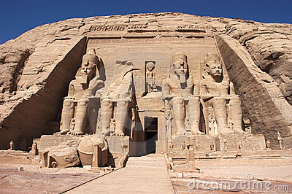
Middle Kingdom
Conquering of other lands and expanding of the Egyptian kingdom.
Nubia
Temporary control of Palestine and Syria.
Trading with Kush, Syria, Mesopotamia, and Crete.

Slide 13
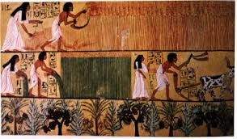
Middle Kingdom
Pharaohs started to actually care for the people, instead of being seen as a god-king who was removed from the people.
Helpful projects to improve the land.

Slide 14
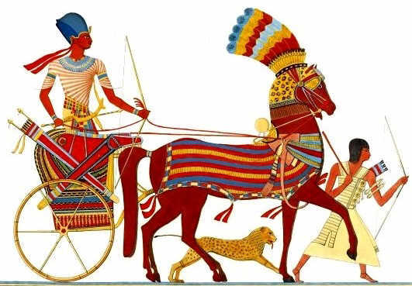
New Kingdom
Middle Kingdom ended with the invasion of Egypt by people from western Asia called the Hyksos.
Used horse-drawn war chariots against the Egyptian army.
Used Hyksos ideas and improved upon them, eventually driving their enemy from Egypt.

Slide 15
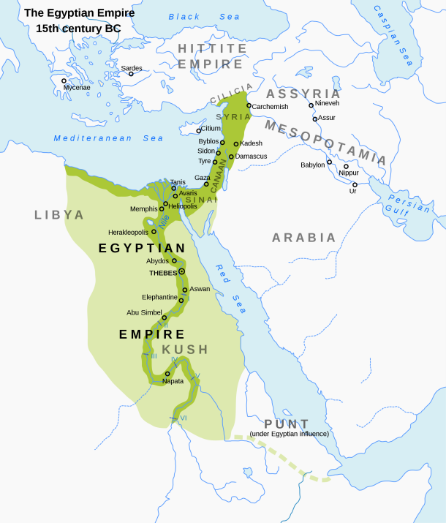
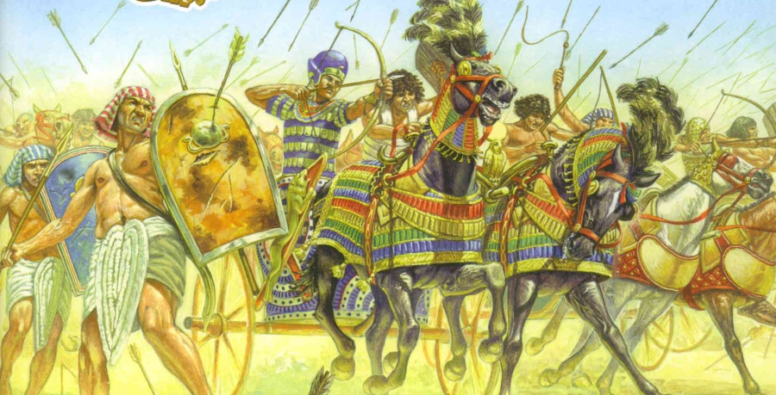
New Kingdom
1567-1085 B.C.
Egypt reunited
Path of empire
Most powerful rulers of Southwest Asia
Massive wealth

Slide 16
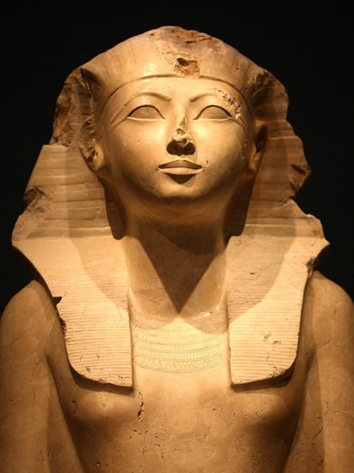
New Kingdom
Building of new temples to show the power and wealth of Egypt.
Hatshepsut (first woman ruler of Egypt) built many great temples.
Empire expanded all the way to the Euphrates River in Asia.
Notes:
i

Slide 17
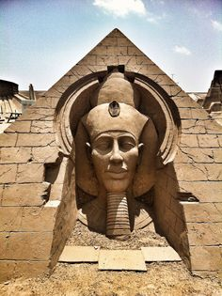
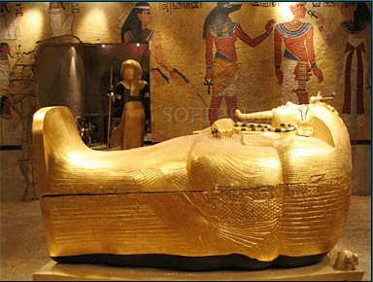
New Kingdom
Also had time of trouble.
Pharaoh Amenhotep IV – Worship of Aton, god of the sun disk.
Monotheistic religion which closed the temples of other gods.
Return to worship of many gods by his nephew, Tutankhamen.

Slide 18
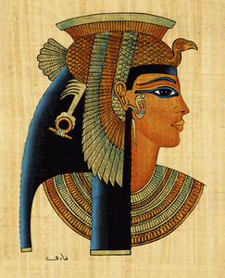
New Kingdom
Eventually dominated by other kingdoms.
Persians
Macedonians
Alexander the Great
Rome
Queen Cleopatra VII attempted to restore Egyptian independence, but failed.

Slide 19
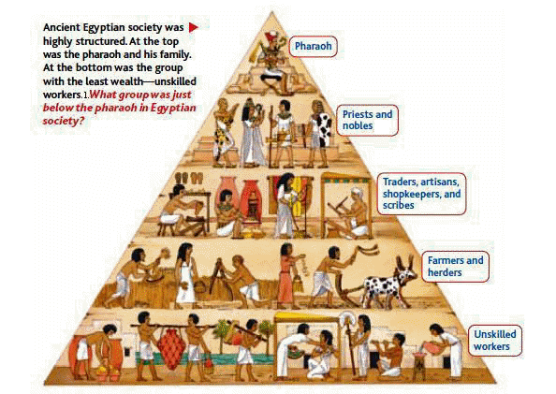
Society Order
Pharaoh
Nobles and priests
Merchants, artisans, tax collectors
Workers of the land
Mostly slaves and peasants

Slide 20
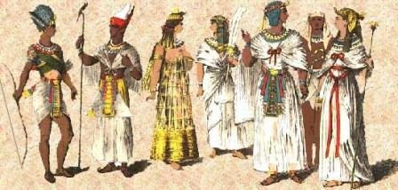
Daily Life
Monogamy
Marriage to one wife was the general rule.
Husbands were the master of the house, but women were respected.
Women could keep their property, even after being married.

Slide 21
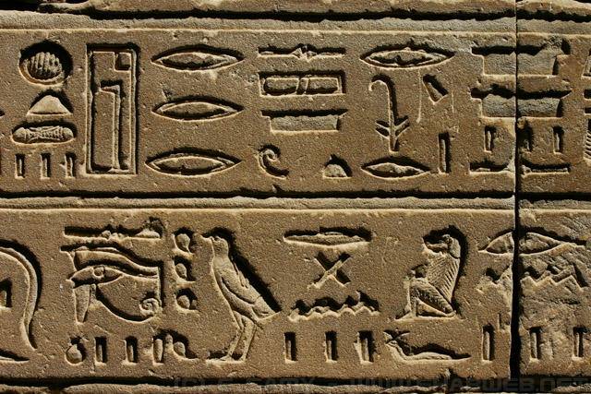
Writing and Education
Hieroglyphics: Picture system of writing.
Upper class mostly the educated people of Egypt.

