Slide 1
Babylonia and Assyria

Slide 2
The Two Empires of Mesopotamia
After the Sumerians were defeated, Mesopotamia had two main empires: Babylonia and Assyria. An empire is an area of many territories and people that are controlled by one government.
The Babylonian empire lasted from around 1800 BC to 1600 BC.
The Assyrian empire lasted from around 665 BC to 612 BC.

Slide 3
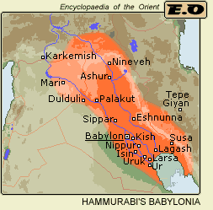
Babylon - “Gate of God”
As we recall from earlier, the Sumerians were conquered by the Babylonians. The king of Babylon was Hammurabi. Hammurabi united the cities of Sumer and then expanded his empire all the way to Asia Minor

Slide 4
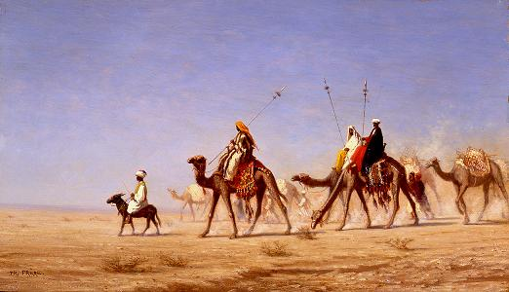
A Crossroads of Trade
Babylon’s location made it a good place for trade. Groups of travelers, called caravans, traveled back and forth from the Sumerian cities in the south to the city of Akkad in the north. Along the way, they always stopped in Babylon to trade.
Babylon had special markets, called bazaars, that people could go to to buy cotton cloth from India. They could also buy spices from Egypt there. Babylon became rich due to trade.

Slide 5
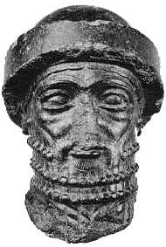
Hammurabi’s Code
Hammurabi was the king who united most of Mesopotamia and conquered the Sumerians. He developed a “code” of laws. The laws were numbered from 1 to 282. Law number 196 states: If a man put out the eye of another man, his eye shall be put out. Some people summarize Hammurabi’s code by saying “an eye for an eye.”
Law number 195 states: If a son strike his father, his hands shall be hewn off. There are many, many more laws like this in Hammurabi’s Code.
A statue of Hammurabi

Slide 6
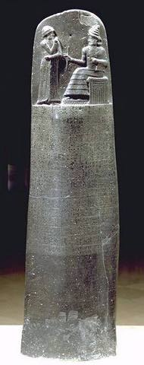
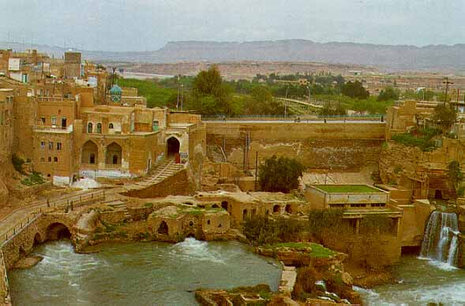
On the left is a stela, which has all 282 of Hammurabi’s laws engraved on it. This stela is located in the Louvre Museum in Paris, France.
The Hammurabi stela was discovered in 1909, in Susa, Elam, which is now Khuzestan. Khuzestan is a province of southern Iran.
Susa

Slide 7
Babylonia is Conquered
Hammurabi conquered many of the neighboring cities, and he kept expanding his empire. Hammurabi would often go to war against his allies as well. When the city of Elam attacked Larsa, Hammurabi helped Larsa defend themselves. Once Elam was conquered, Hammurabi turned right around and conquered Larsa! Each time that Babylon would conquer another city, Hammurabi would take the city’s chariots, weapons, tools, and all their riches. Trading helped Babylon get rich, and so did conquest.
Though Hammurabi formed a large and rich empire, the people that ruled after him could not keep it together. The empire kept getting smaller and smaller until eventually it was destroyed.

Slide 8
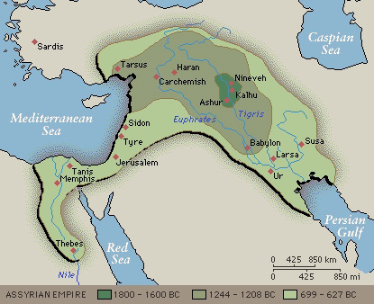
The Assyrians Rise to Power
Assyria was a small kingdom of walled cities that was located north of Babylon. Their city was located in open land that was easily attacked, and they had to constantly defend themselves against invaders. Therefore, they became skilled warriors.
At around 1365 B.C., the Assyrians decided that the best defense they had was to attack other countries first, before they could attack them. By 650 B.C., Assyria had conquered a large empire. King Sargon II was a successful and ruthless Assyrian ruler.

Slide 9
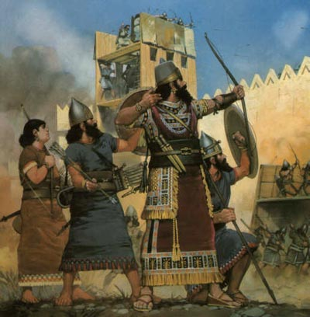
The Assyrian War Machine
The Assyrians were geniuses at waging war. They invented the battering ram, which they used to pound down city walls. They used catapults to throw rocks at enemies, and they protected their archers (people who use a bow and arrows) with helmets and armor.

Slide 10
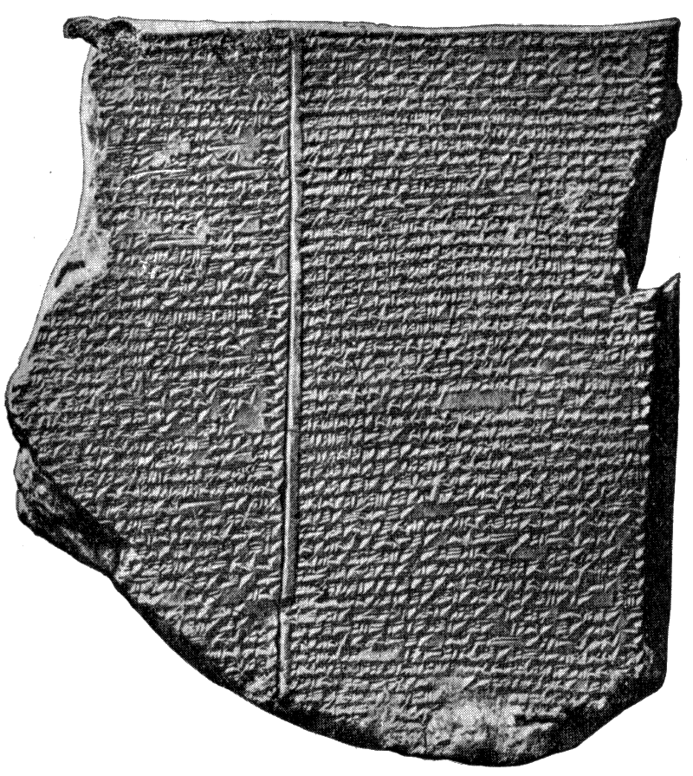
Assyrian Learning
Capital city: Nineveh.
Became a great city of learning
Famous library
Held thousands of clay tablets with writings from Sumer and Babylon.

Slide 11
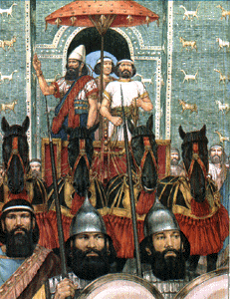
Assyria Overthrown
The people that the Assyrians conquered were constantly rebelling against Assyrian rule.
Most of the time, the Assyrians crushed the people who tried to fight them. However,
In 612 B.C., two groups joined together to smash the Assyrian empire.
Medes and the Chaldeans.

Slide 12
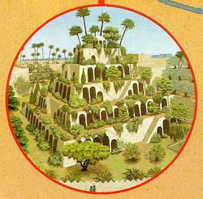
The New Babylonian Empire
The Chaldeans created a new empire, centered at Babylon after they defeated the Assyrians in 612 BC.
Greatest king of Babylon was Nebuchadnezzar II.
Rebuilt Babylon with massive walls around the city to protect it.
He also built a great palace with hanging gardens.

Slide 13
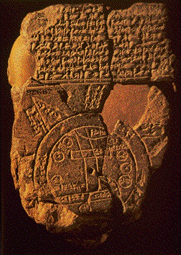
A New Center for Learning
Under the Chaldeans, the New Babylonian empire became a center of learning and science.
Charted stars
Measured the correct length of the year
Many people came to Babylon to share ideas and discoveries.
This clay tablet shows the world that was known to the Babylonians

Slide 14
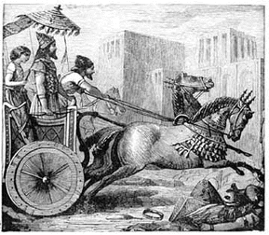
The Fall of the 2nd Babylonian Empire
The second Babylonian empire came under attack and was defeated by the Persians, who were led by Cyrus, in 539 BC. Though the Chaldeans were defeated, the city of Babylon was spared from destruction.

