Slide 1
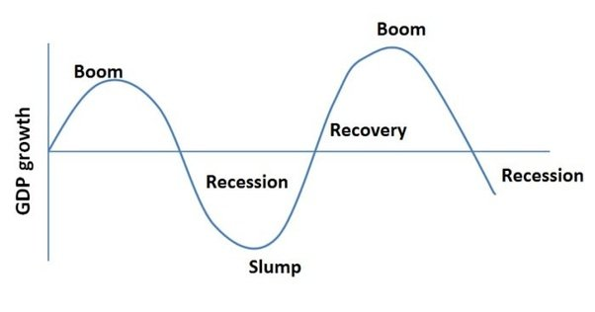
Business Cycles: The Ups and Downs of the Economy

Slide 2
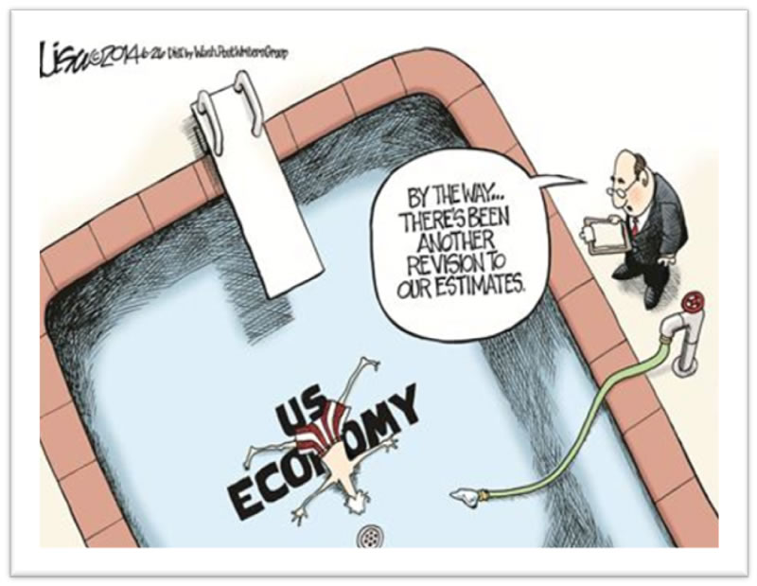
What is the business cycle?
Highs and lows of the economy
The periodic changes in the level of the nation’s business activity.
One business cycle includes a period of economic expansion followed by a period of economic decline.

Slide 3
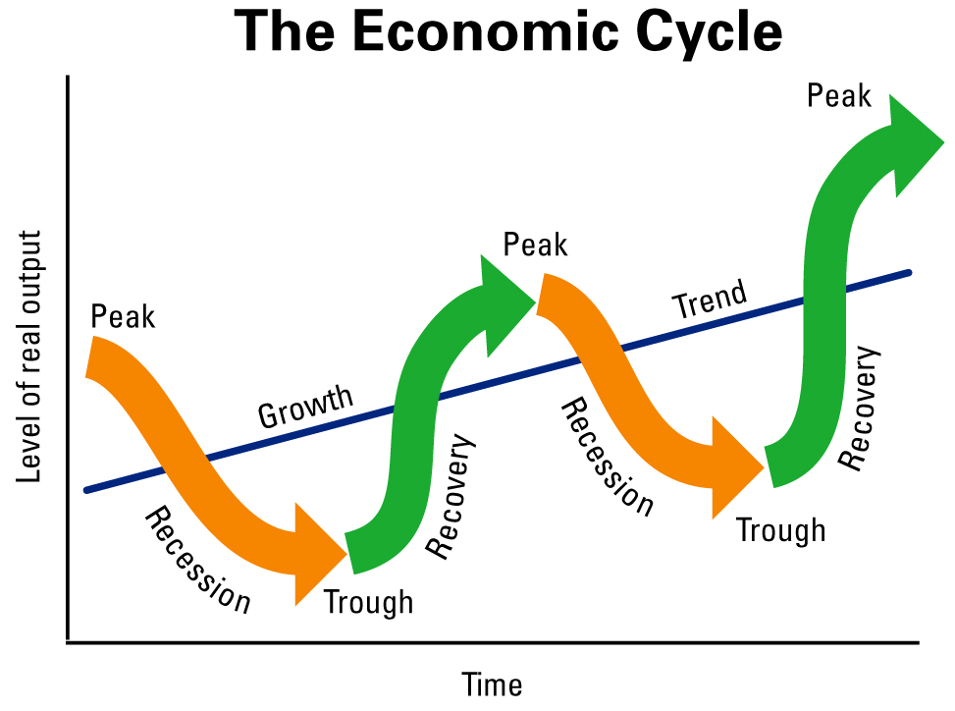
Parts of the Business Cycle
4 parts/phases
Recession
Trough (bottom)
Expansion (recovery)
Peak

Slide 4
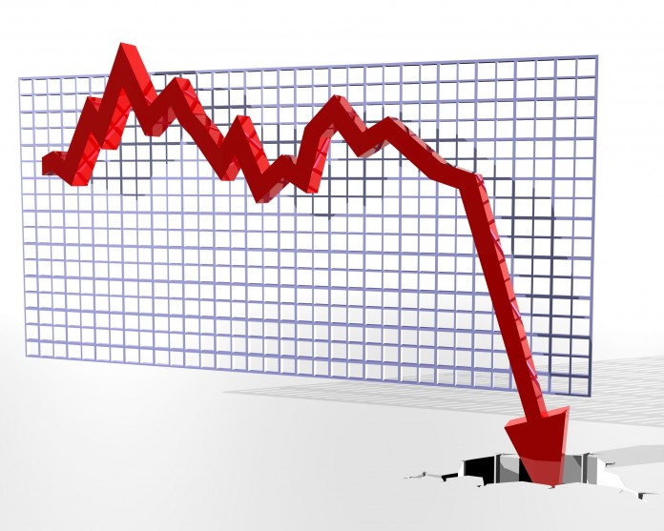
Recession
“Feed on themselves”
Business people spend less than they once did.
Since sales are falling during a recession, businesses do what they can do reduce their spending.
Lay off workers
Buy less merchandise
Postpone plans to expand
Suppliers also protect themselves
Lay off workers
Reduce spending
Workers earn less, spend less, and business income/profits decline more.
Laying off of more workers
Economy continues to slide

Slide 5
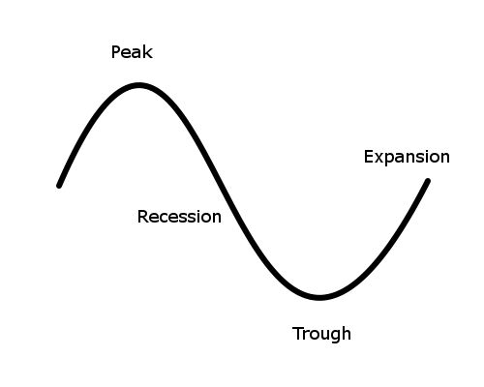
Trough
Bottom of the cycle
How long it remains in the trough can vary from a matter of weeks to many months.

Slide 6
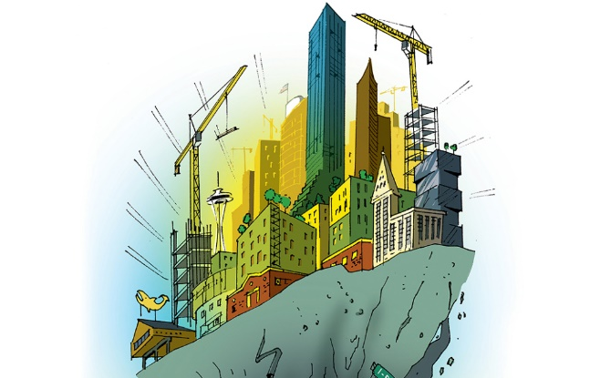
Expansion
Time of recovery
After some improvement…
Hiring of more workers
Increase of orders on materials from suppliers
Increased orders lead to more production (rehire workers)
More employment
More consumer spending leads to more business activity and still more jobs

Slide 7
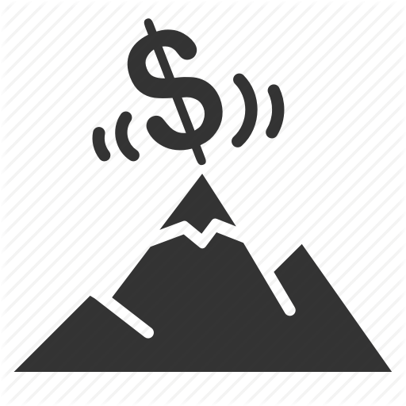
Peak
Business end upward climb
Employment, consumer spending, and production hit highest levels
Like a depression, can last a short time or a long period of time
When a long time, it is called a period of prosperity
One of the dangers of peak periods is inflation
Higher demand leads to rising prices
More available money

Slide 8
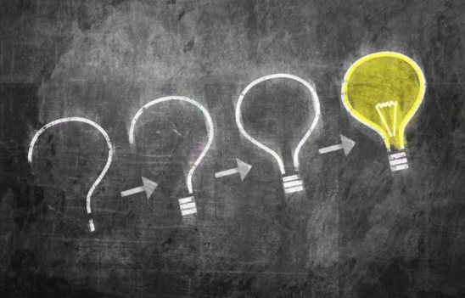
How to Keep Track of the Business Cycle
Economists ask the following questions:
In what phase of the business cycle is our economy at the present time?
Where is the business cycle heading?

Slide 9
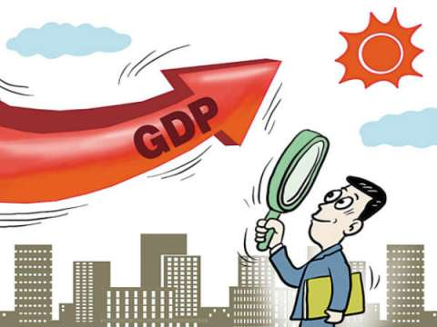
Economic Indicators
These statistics tell about:
Business production
Number of people who have jobs
People’s earnings
Other important economic factors
GDP, personal income, stock market averages, unemployment rate, etc.

Slide 10
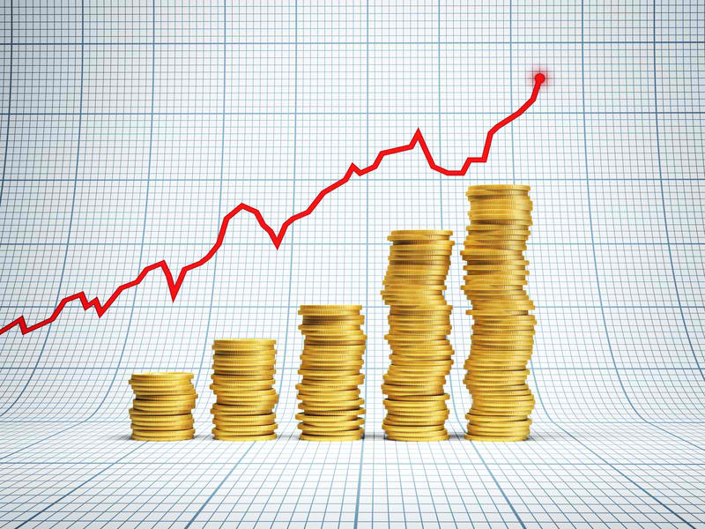
What causes business cycles?
Internal factors (within the economy)
Business spending/investment
Investment causes expansion leading to jobs/profit
Higher levels in business cycle
When investment is declining, reverse occurs
Pushes business cycle downward
Government spending
Federal, state, and local
Increase adds to both business and consumer income (vice versa with decrease)
Government policies
Consumer spending
Psychological factors
Way individuals/groups think about the future

Slide 11
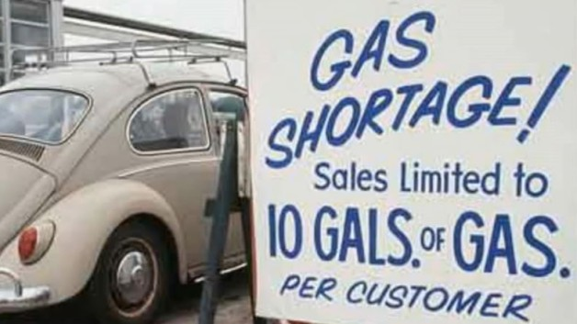
What causes business cycles?
External factors (outside the economy)
Certain events
Wars, attacks, embargoes, bad weather, etc.

