Slide 1

Local Culture, Popular Culture, and Cultural Landscapes
Notes:
Figure 4.14
Beijing, China. RenRen, the Facebook of China, is a popular social network among college students. It now has over 165 million registered users. Wang Xing, who launched and sold Renren, has since launched Chinese versions of Twitter and Groupon. © Alamy Limited.

Slide 2
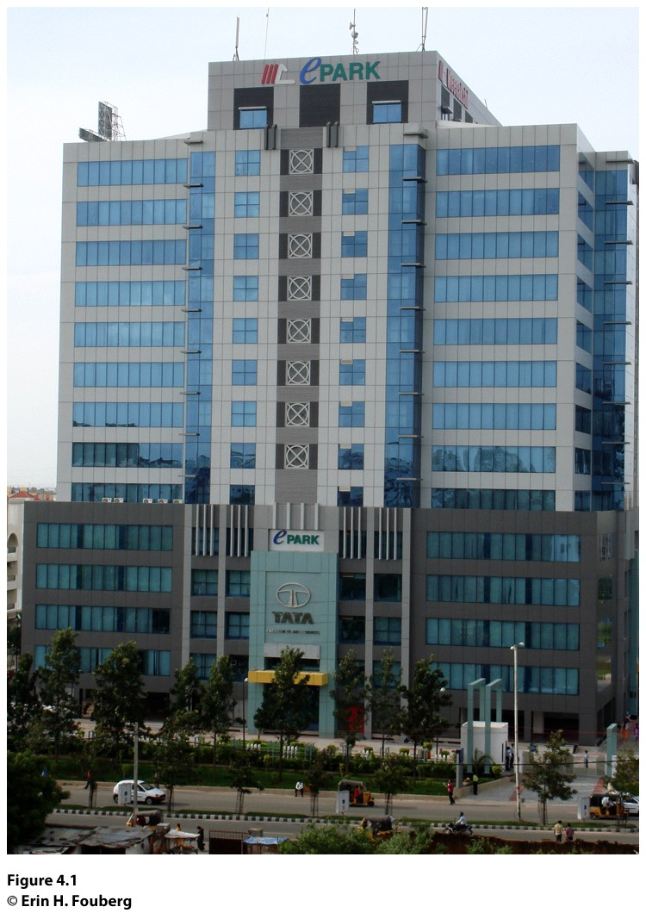
Field Note:
Preserving Culture
“The signs with the Tata Corporation’s logo were everywhere on the landscape of the city of Hyderabad in India (Fig. 4.1): a Tata corporate building across the street from our flat; Tata emblazoned on the grill of trucks through out the city; Tata sky satellite dishes bringing television into homes; Tata International consulting buildings in the high-tech district of the city. I asked my host what the Tata Corporation was and where the name came from. He explained, “Tata is a family name. The Tata family are members of the Parsi religion, and they own many businesses throughout India and the world.”
“
Notes:
Figure 4.1
Hyderabad, India. A Tata Corporation building in Hyderabad, India.
© Erin H. Fouberg.

Slide 3
Key Question
What are local and popular cultures?

Slide 4
What Are Local & Popular Cultures?
A culture is a group of belief systems, norms, and values practiced by a people.
A group of people who share common beliefs can be recognized as a culture in one of two ways:
  The people call themselves a culture.
  Other people (including academics) can label a certain group of people as a culture.

Slide 5
What Are Local & Popular Cultures?
Folk culture is small, incorporates a homogeneous population, is typically rural, and is cohesive in cultural traits.
Popular culture is large, incorporates heterogeneous populations, is typically urban, and experiences quickly changing cultural traits.

Slide 6
What Are Local & Popular Cultures?
A local culture is a group of people in a particular place who see themselves as a collective or a community, who share experiences, customs, and traits, and who work to preserve those traits and customs in order to claim uniqueness and to distinguish themselves from others.
Material culture of a group of people includes things they construct, such as art, houses, clothing, sports, dance, and food.
Nonmaterial culture includes beliefs, practices, aesthetics (what they see as attractive), and values of a group of people.

Slide 7
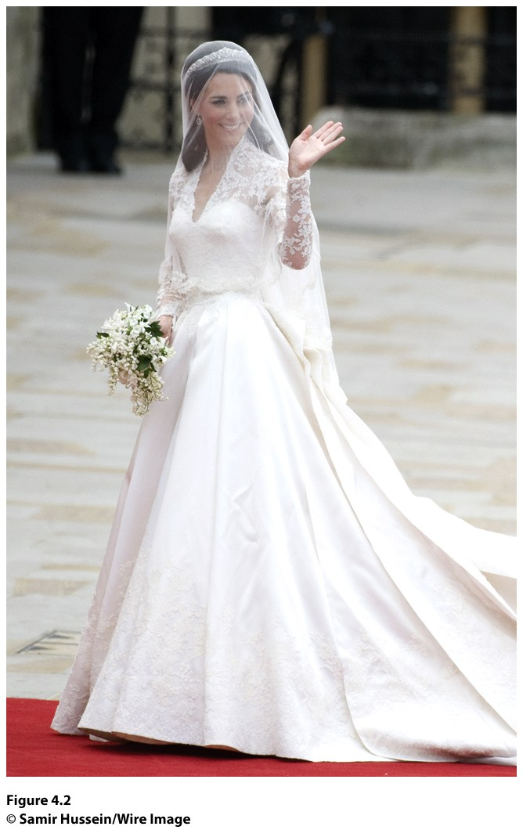
Hierarchical diffusion:
Can occur through a hierarchy of places
The hearth is the point of origin
Figure 4.2
London, United Kingdom. Catherine Middleton, Duchess of Cambridge, enters Westminster Abbey in a wedding gown reminiscent of Grace Kelly’s. Sarah Burton of the House of Alexander McQueen designed the gown. Members of the Royal School of Needlework hand cut and sewed the intricate lace. The sewers washed their hands every 30 minutes and replaced needles every 3 hours to keep the dress pristine and the work exact. © Samir Hussein/Wire Image.

Slide 8
Key Question
How are local cultures sustained?

Slide 9
How Are Local Cultures Sustained?
Assimilation: process by which a person or a group's language and/or culture come to resemble those of another group.
A policy of the U.S. government in the 1800s and into the 1900s to assimilate indigenous peoples into the dominant culture in order to make American Indians into “Americans” rather than “Indians.”
Canadians, Australians, Russians, and other colonial powers adopted similar policies toward indigenous peoples.
American Indians in the United States are working to push back assimilation and popular culture by reviving the customs of their local cultures.

Slide 10
How Are Local Cultures Sustained?
Local cultures are sustained through customs, practices that a group of people routinely follow.
A local culture can also work to avoid cultural appropriation, the process by which other cultures adopt customs and knowledge and use them for their own benefit.
Local cultures desire to keep popular culture out, keep their culture intact, and maintain control over customs and knowledge.

Slide 11
Rural Local Cultures
How Are Local Cultures Sustained?
Members of local cultures in rural areas often have an easier time maintaining their cultures because of their isolation.
When a local culture discontinues its major economic activity, it faces the challenge of maintaining the customs that depend on the economic activity and sustaining its culture.
Today, when a local culture decides to reengage in a traditional economic activity or other cultural custom, it can no longer decide in isolation.

Slide 12
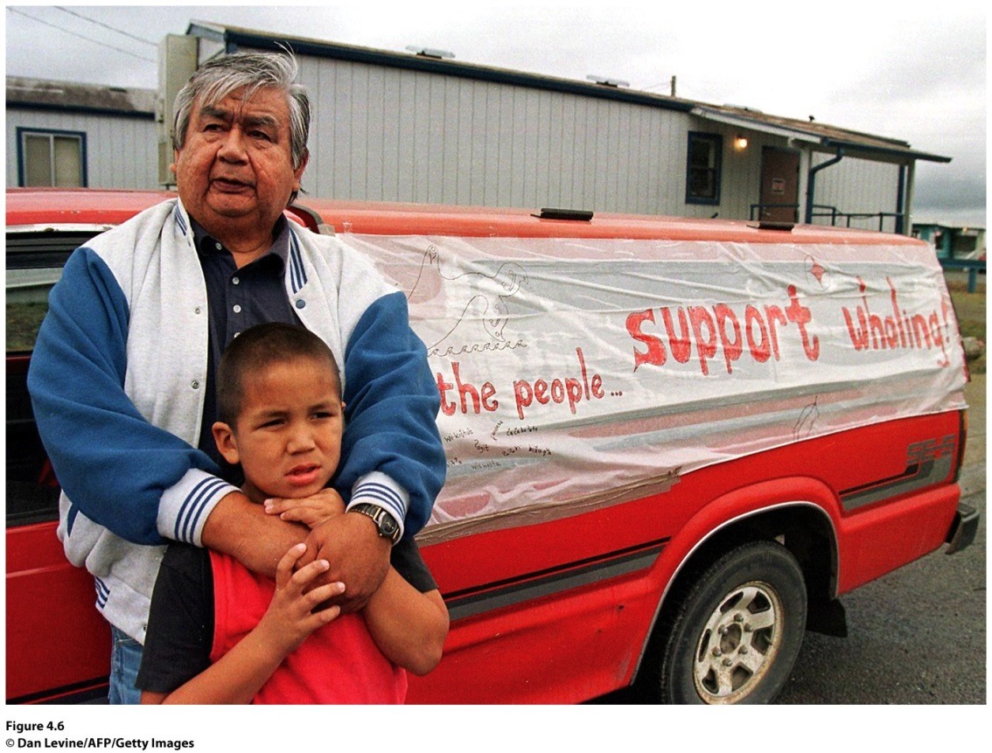
The Makah American Indians
How Are Local Cultures Sustained?
Hunted whales for 1,500 years, but the U.S. government stopped them in the 1920s; the gray whale had become endangered.
1994, NOAA removed the eastern North Pacific gray whale from the endangered list.
Notes:
Figure 4.6
Neah Bay, Washington. Makah American Indians show their support for the return of the
whale hunt. ©

Slide 13
How Are Local Cultures Sustained?
Little Sweden, USA
The residents of Lindsborg, Kansas, proclaim their town Little Sweden, U.S.A.
The townspeople began to celebrate their Swedish heritage in the 1950s, highlighting the “everyday existence” (the local culture) of the Swedes who immigrated to Lindsborg.
Geographer James Shortridge refers to this as neolocalism, seeking out the regional culture and reinvigorating it in response to the uncertainty of the modern world.

Slide 14
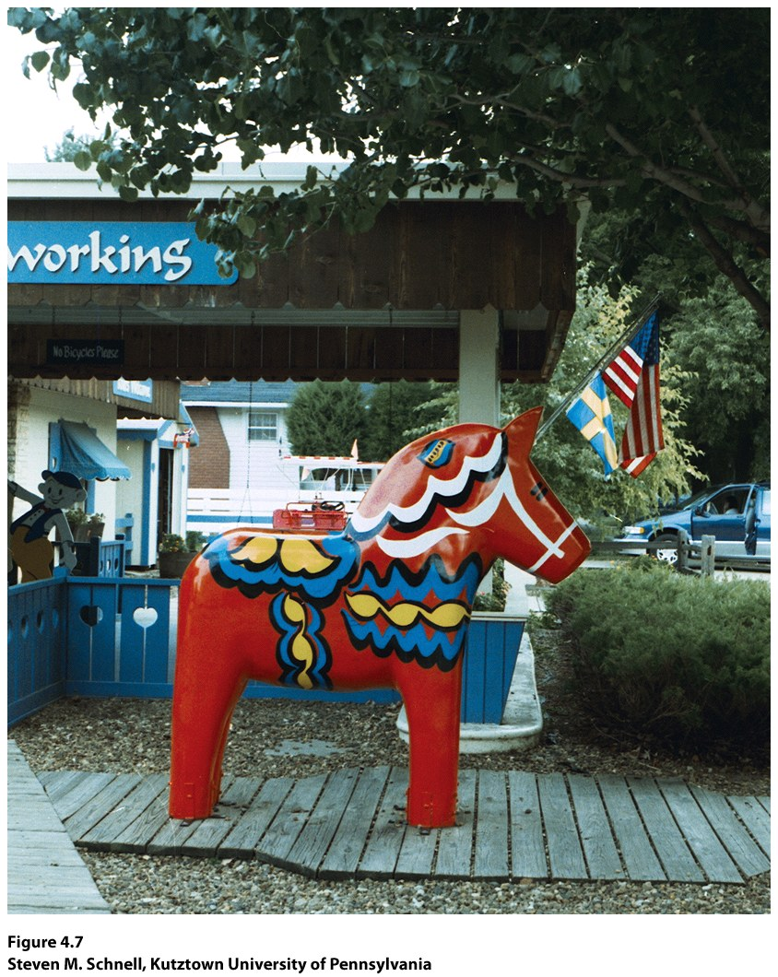
Guest Field Note:
Lindsborg, Kansas
“Lindsborg, Kansas, founded by Swedish Lutherans in 1869, has remade itself in recent decades as ‘Little Sweden, U.S.A.’ Swedish gift shops, restaurants, and ethnic festivals, along with faux-Swedish storefronts, all attract visitors interested in the Swedish American heritage.”
Notes:
Credit: Steven M. Schnell, Kutztown
University of Pennsylvania

Slide 15
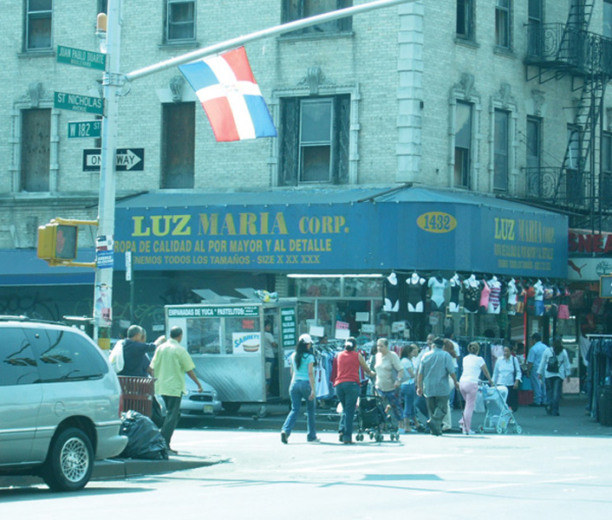
Urban Local Cultures
How Are Local Cultures Sustained?
Ethnic neighborhoods
Concept Caching: Washington Heights, NY
© Ines Miyares

Slide 16
Local Cultures and Cultural Appropriation
How Are Local Cultures Sustained?
Commodification is the process through which something that previously was not regarded as an object to be bought or sold becomes an object that can be bought, sold, and traded in the world market.
Question of authenticity follows.

Slide 17
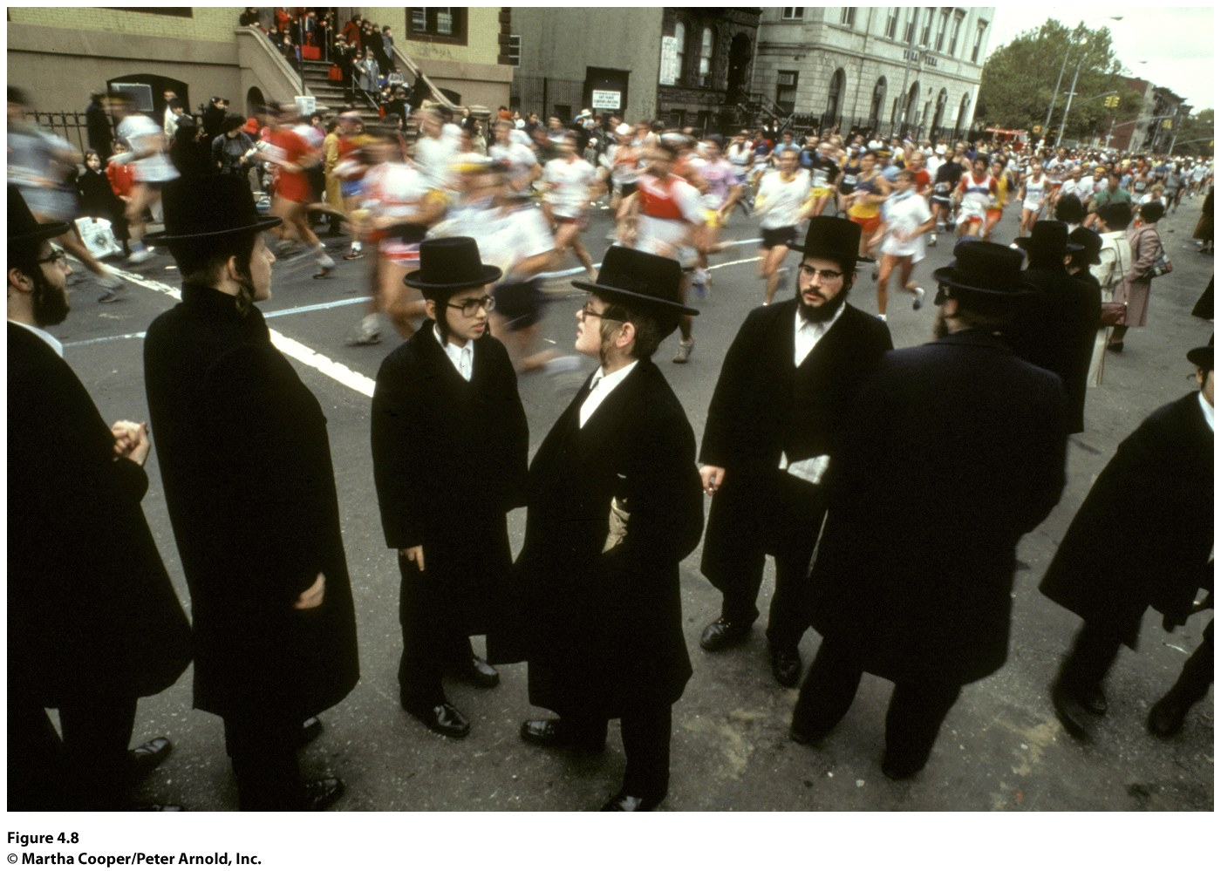
Field Note
“One of the most amazing aspects of running the New York City marathon is seeing the residents of New York’s many ethnic neighborhoods lining the streets of the race. Running through the Hasidic Jewish neighborhood in Williamsburg, Brooklyn was striking: even before noticing the traditional dress of the neighborhood’s residents, I noticed the crowd was much quieter—the people were not yelling, they were clapping and quietly cheering.”
Notes:
Figure 4.8
Williamsburg, Brooklyn, New York. © Martha Cooper/Peter Arnold, Inc.

Slide 18
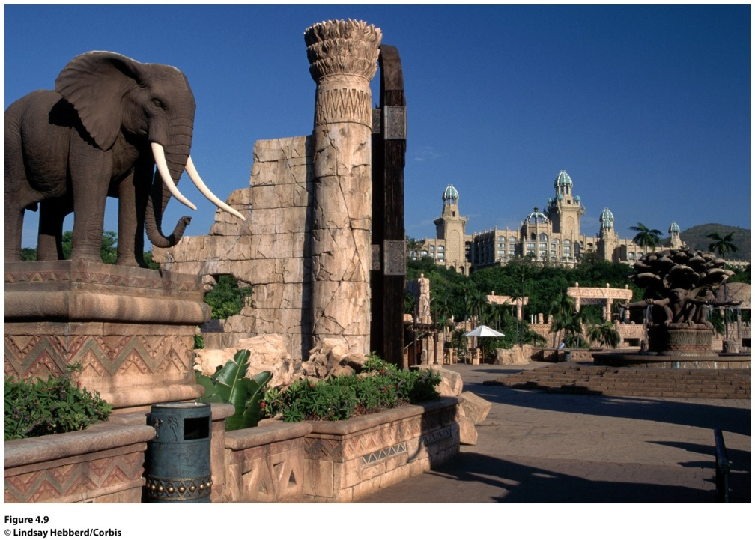
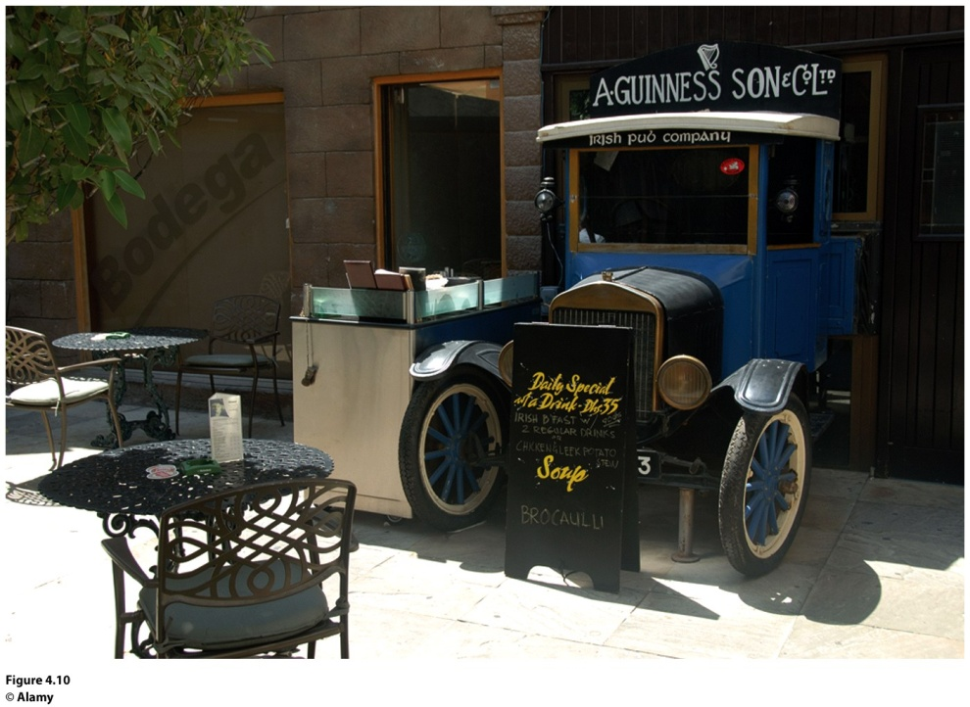
Authenticity of Places
How Are Local Cultures Sustained?
Guinness and the Irish Pub Company
The Lost City
Figure 4.9
Sun City, South Africa. The Lost City resort in Sun City evokes the mystical images of Africa described in a legend. © Lindsay Hebberd/Corbis.
Figure 4.10
Dubai, United Arab Emirates. An old Irish truck marks the entrance to an Irish Pub Company pub in Dubai. © Alamy.

Slide 19
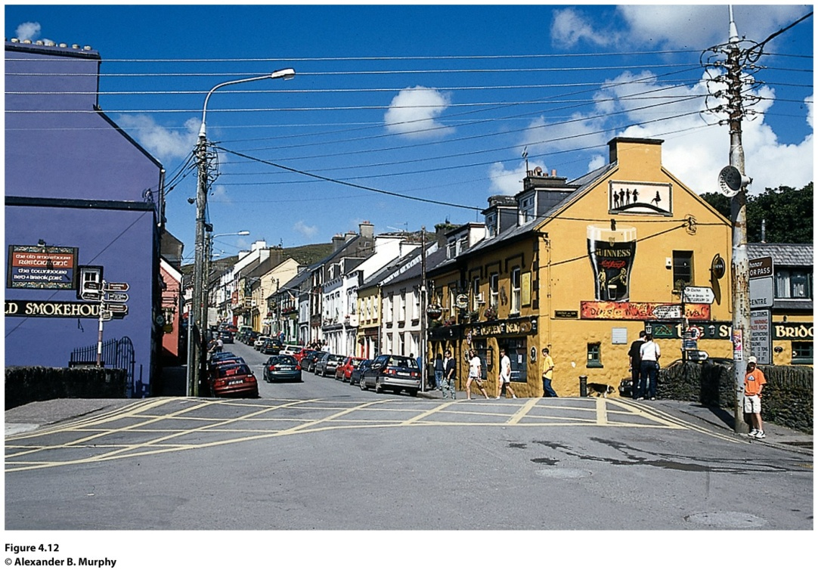
Field Note
“The Dingle Peninsula in Ireland was long one of the more remote parts of the country, and even its largest town, Dingle, was primarily an agricultural village just a few decades ago. As I walked through the streets of town, I noticed the colorful inns and houses of the older town. The ‘Little Bridge Pub’ on the corner of this intersection in the older town is an ‘authentic’ pub, the kind that the Irish Pub Company works to replicate.”
Concept Caching:
Mount Vesuvius
Figure 4.12
Dingle, Ireland © Alexander B. Murphy.
Notes:
*Could be an audio file.

Slide 20
What is the last place you went to or the last product you purchased that claimed to be “authentic?” What are the challenges of defending the authenticity of this place or product while refuting the authenticity of other similar places or products?

Slide 21
Key Question
How is popular culture diffused?

Slide 22
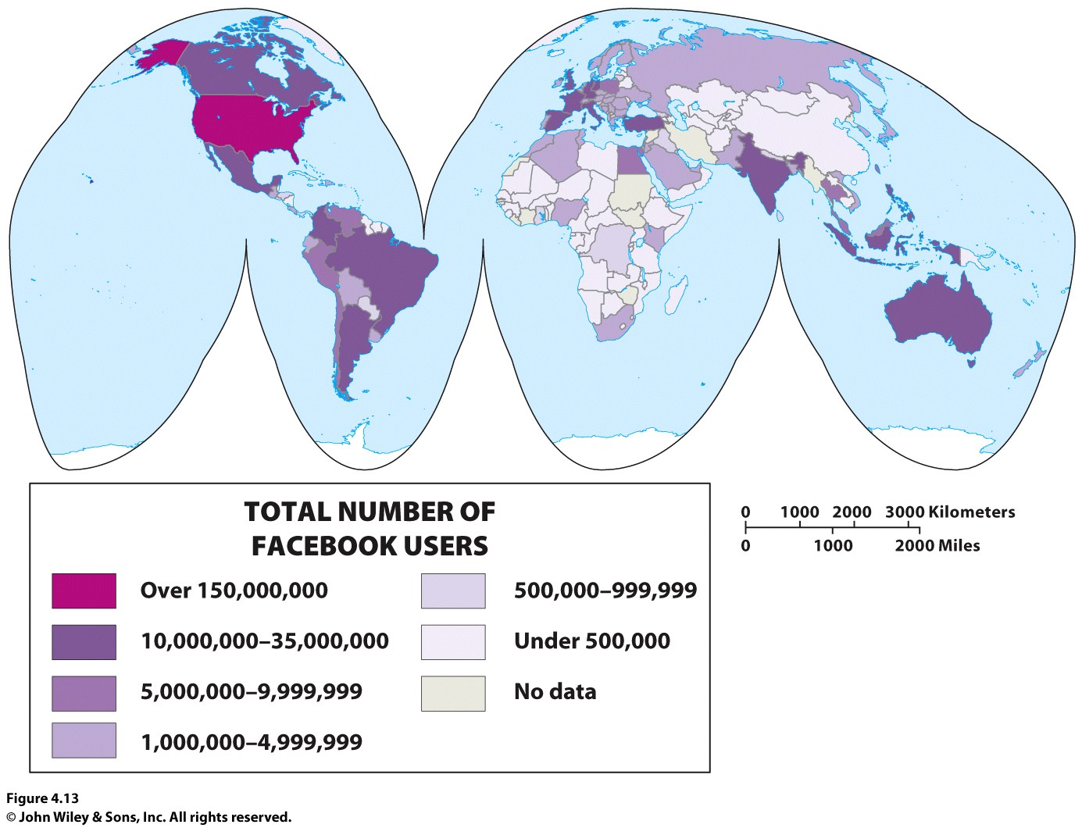

Slide 23
How Is Popular Culture Diffused?
Distance decay vs. time-space compression:
With distance decay, the likelihood of diffusion decreases as time and distance from the hearth increases.
With time–space compression, the likelihood of diffusion depends on the connectedness (in communications and transportation technologies) among places (geographer David Harvey).

Slide 24
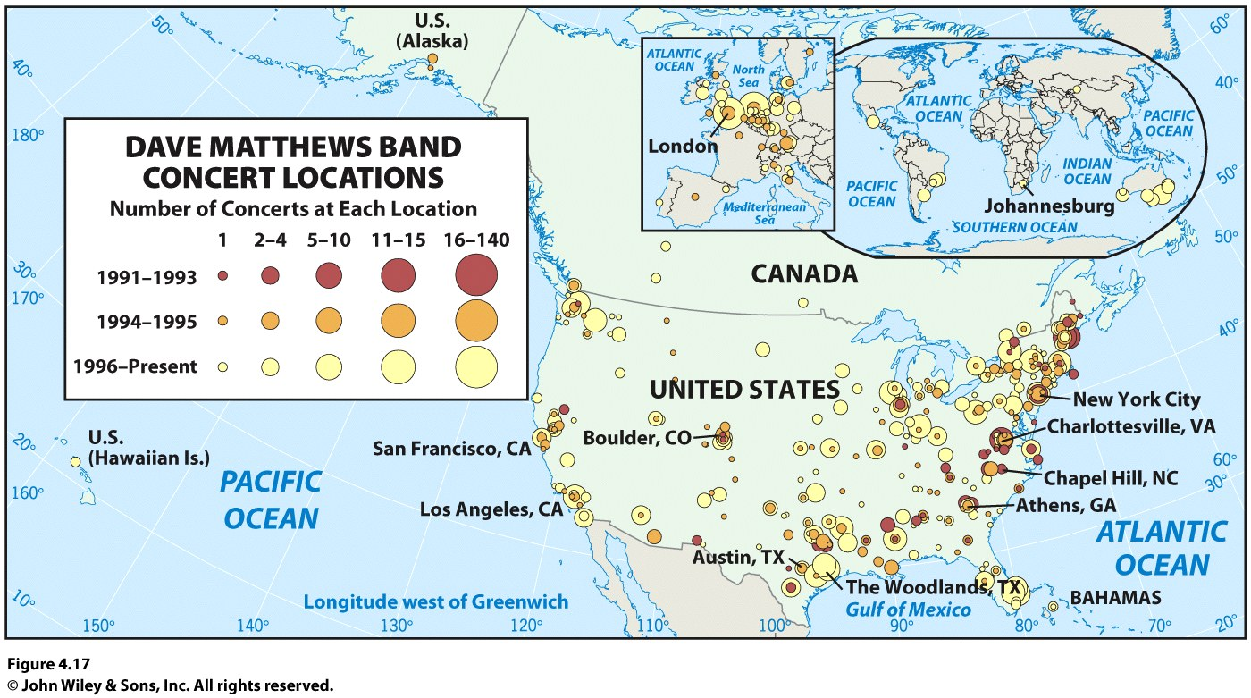
Hearths of Popular Culture
How Is Popular Culture Diffused?
Establishing a Hearth
Contagious diffusion and hierarchical diffusion
Ex.: the Dave Matthews Band

Slide 25
Hearths of Popular Culture
How Is Popular Culture Diffused?
Manufacturing a Hearth
Reterritorialization of popular culture: a term referring to a process in which people start to produce an aspect of popular culture themselves, doing so in the context of their local culture and place, and making it their own.
Ex.: reterritorialization of hip hop

Slide 26
How Is Popular Culture Diffused?
Replacing Old Hearths with New: Beating out the Big Three in Popular Sports
The Big 3: Football, Basketball, Baseball
Surfing (1960s)
Skateboarding (1970s)
Snowboarding (1980s)
Ultimate Fighting (1990s)
Corporations must create the “new” so that they have something to sell that is “socially desirable.”

Slide 27
Stemming the Tide of Popular Culture—Losing the Local?
At the global scale, North America, western Europe, Japan, India, and South Korea exert the greatest influence on popular culture at present
North America: movies, television, music, sports, and fast food
Japan: children’s television programs, electronic games, and new entertainment technologies
Western Europe: fashion, television, art, and philosophy
South Korea: television dramas, movies, and popular music
India: movies

Slide 28
How Is Popular Culture Diffused?
Stemming the Tide of Popular Culture—Losing the Local?
The rapid diffusion of popular culture can cause consumers to lose track of the hearth of a good or idea.
When popular culture displaces or replaces local culture, it will usually be met with resistance.
Geographers realize that local cultures will interpret, choose, and reshape the influx of popular culture.

Slide 29
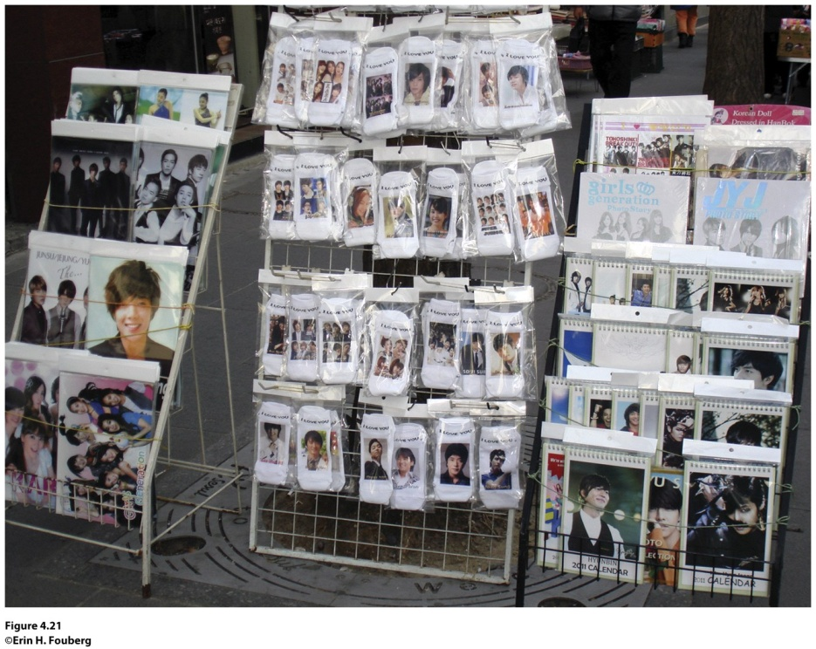
Field Note
“Just days before the Japanese tsunami in 2011, I walked out of the enormous Lotte department store in Seoul, South Korea and asked a local where to find a marketplace with handcrafted goods. She pointed me in the direction of the Insa-dong traditional market street. When I noticed a Starbuck’s sign written in Korean instead of English, I knew I must be getting close to the traditional market. A block later, I arrived on Insadong. I found quaint tea shops and boutiques with handcrafted goods, but the market still sold plenty of bulk made goods, including souvenirs like Korean drums, chopsticks, and items sporting Hallyu stars. Posters, mugs,and even socks adorned with the faces of members of Super Junior smiled at the shoppers along Insa-dong.”
Figure 4.21
Seoul, South Korea
Notes:
*Could be an audio file.

Slide 30

Think about your local community (your college campus, your neighborhood, or your town). Determine how your local community takes one aspect of popular culture and makes it your own.

Slide 31
Key Question
How can local and popular cultures be seen in the cultural landscape?

Slide 32
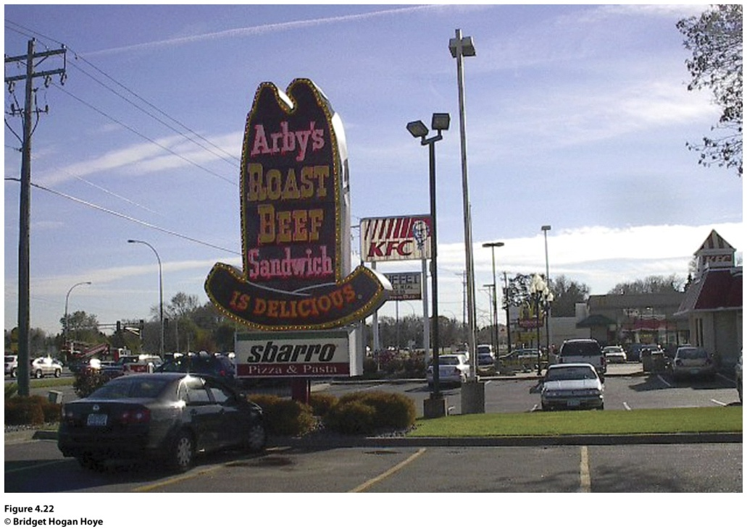
How Can Local and Popular Cultures Be Seen in the Cultural Landscape?
Cultural landscape: visible imprint of human activity on the landscape.
Edward Relph coined the word placelessness to describe loss of uniqueness of place in the cultural landscape to the point that one place looks like the next.
Figure 4.22
Roseville, MN

Slide 33
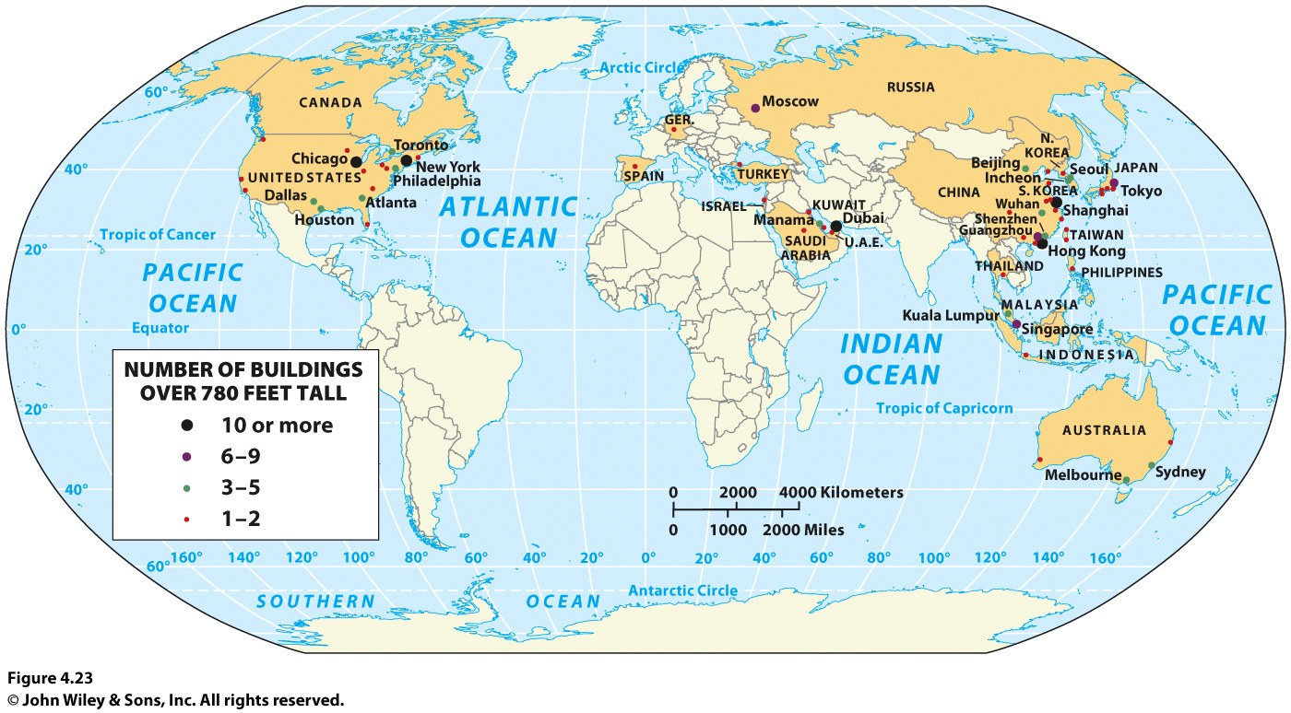
How Can Local and Popular Cultures Be Seen in the Cultural Landscape?

Slide 34
How Can Local and Popular Cultures Be Seen in the Cultural Landscape?
Cultural landscapes blend together in three dimensions:
Particular architectural forms and planning ideas have diffused around the world.
Individual businesses and products have become so widespread that they now leave distinctive landscape stamp on far-flung places.
The wholesale borrowing of idealized landscape images promotes a blurring of place distinctiveness.

Slide 35
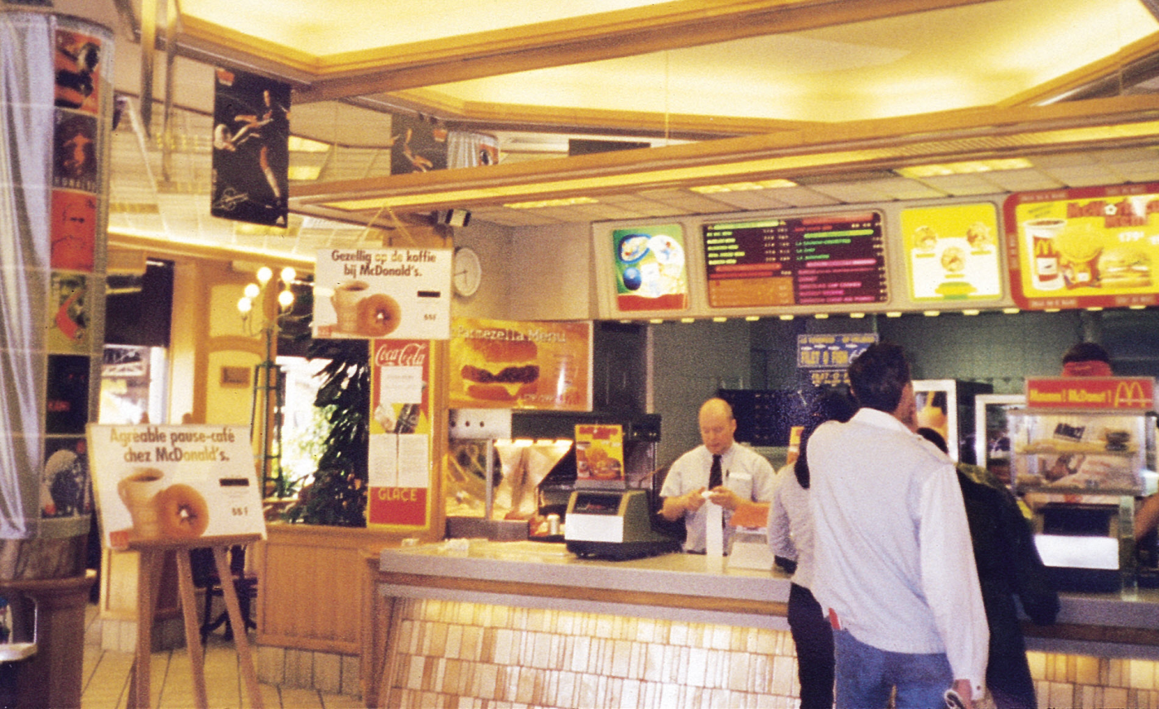
How Can Local and Popular Cultures Be Seen in the Cultural Landscape?
Concept Caching:
Brussels, Belgium
© Erin Fouberg

Slide 36
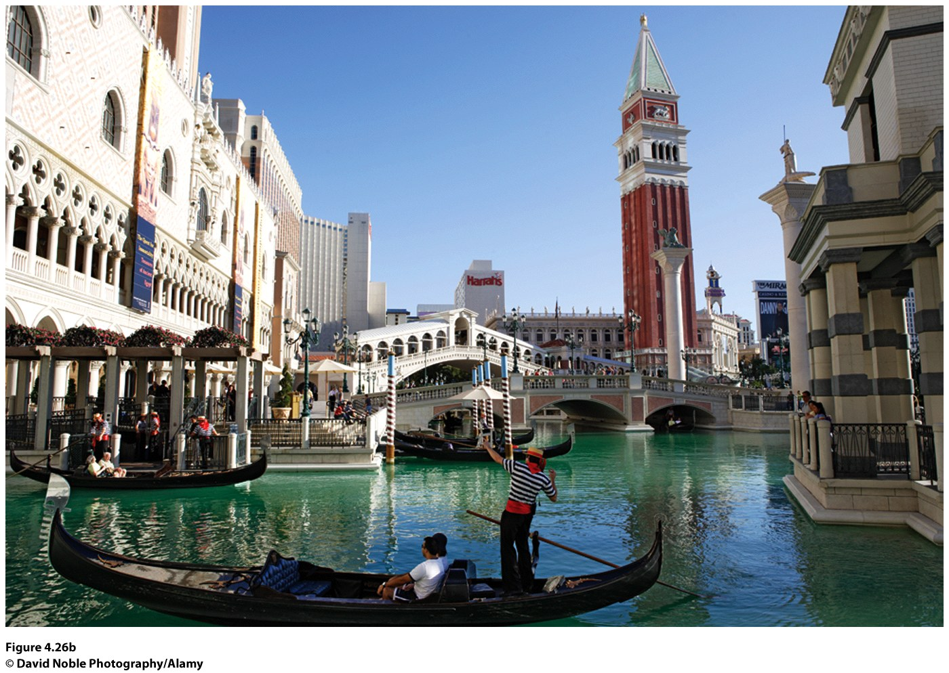
How Can Local and Popular Cultures Be Seen in the Cultural Landscape?
Figure 4.26b
The Venetian Hotel Casino in Las Vegas, Nevada. © David Noble

Slide 37
How Can Local and Popular Cultures Be Seen in the Cultural Landscape?
Global-local continuum concept: emphasizes that what happens at one scale is not independent of what happens at other scales.
People in a local place mediate and alter regional, national, and global processes, in a process called glocalization.

Slide 38
How Can Local and Popular Cultures Be Seen in the Cultural Landscape?
Cultural Landscapes of Local Cultures
The Mormon landscape of the American West:
  Created by founders and early followers of the Church of Jesus Christ of Latter-day Saints as they migrated westward under persecution.
  Early settlers established farming villages where houses clustered together and croplands surrounded the outskirts of the village.

Slide 39
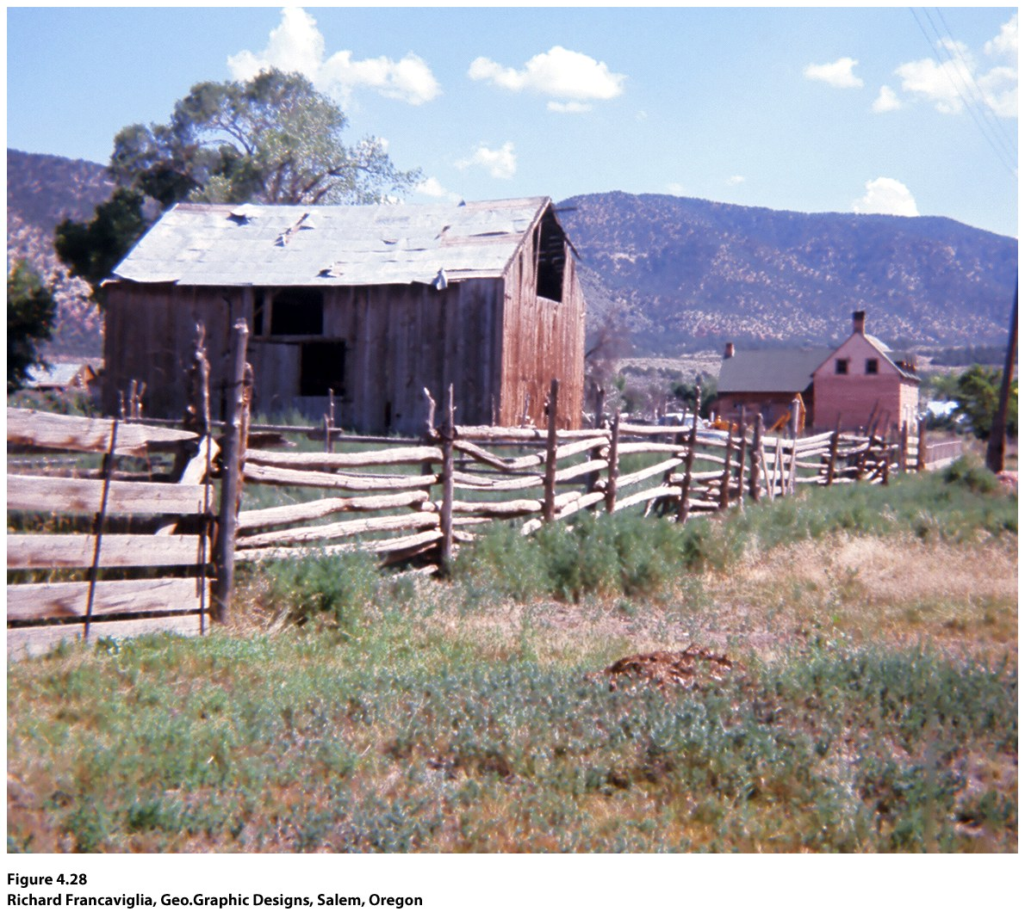
Guest Field Note:
Paragonah, Utah
“I took this photograph in the village of Paragonah, Utah, in 1969, and it still reminds me that fieldwork is both an art and a science. People who know the American West well may immediately recognize this as a scene from “Mormon Country,” but their recognition is based primarily on their impressions of the place.”
Figure 4.28
Paragonah, Utah
Photo taken in 1969
Notes:
Credit: Richard Francaviglia, Geo.Graphic Designs, Salem, Oregon

Slide 40
Focus on the cultural landscape of your school campus. Think about the concept of placelessness. Determine whether your campus is a “placeless place” or whether the cultural landscape of your school reflects the unique identity of the place.

Slide 41
Additional Resources
The Irish Pub Company
www.irishpubcompany.com
The Makah Tribe
www.makah.com
The City of Lindsborg
www.lindsborg.org
The Hutterites
www.hutterites.org

