Slide 1
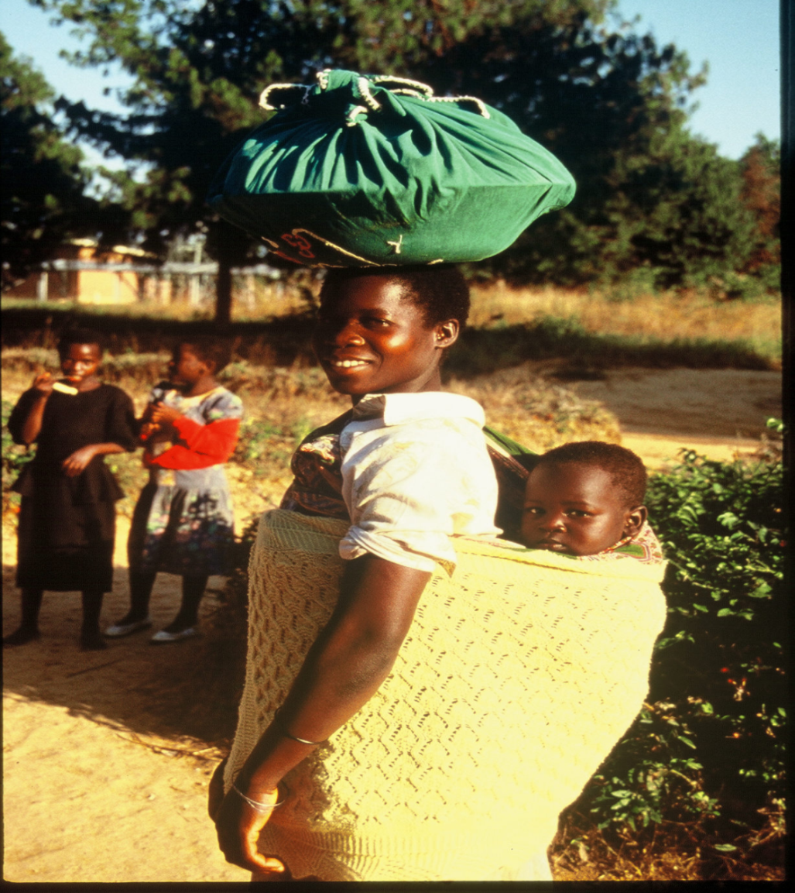
Chapter 5: Identity: Race, Ethnicity, Gender, and Sexuality
Concept Caching: Woman Headload and Baby-Malawi
© Barbara Weightman
Notes:
Concept Caching: Woman Headload and Baby--Malawi

Slide 2
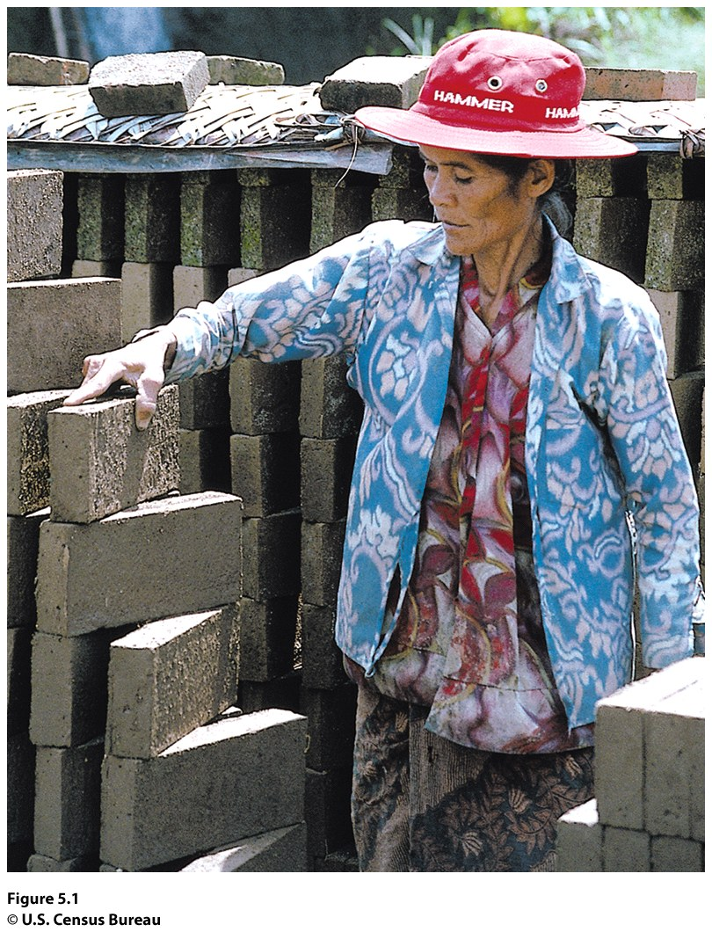
Field Note: Building Walls
“Traveling on the Indonesian island of Bali, I saw a brick-making facility and stopped to visit. Boys and women were building bricks by hand, in the hot sun. I watched young boys scoop wet mud from a quarry by a creek into their wheelbarrows. They poured the mud into wooden forms. Once the bricks began to dry and harden in the sun, someone had to turn the bricks repeatedly to prevent them from cracking. The woman in Figure 5.1 worked ten hours a day, six days a week, turning, stacking, and re-stacking bricks to prevent them from cracking. For her work, she earned about 45 cents (U.S.) per hour.”
“
Notes:
Figure 5.1
Bedugul, Indonesia. This woman working at a brick-making
facility in the village of Bedugul on the Indonesian island of Bali
makes about 45 cents (U.S.) per hour and works 10 hours a day,
6 days a week. © H. J. de Blij.

Slide 3
Key Question
What is identity, and how are identities constructed?

Slide 4
What Is Identity,
and How Are Identities Constructed?
Geographer Gillian Rose defines identity as “how we make sense of ourselves.”
We construct our own identities through experiences, emotions, connections, and rejections
Identifying against other people: define the “Other,” and then we define ourselves in opposing terms

Slide 5
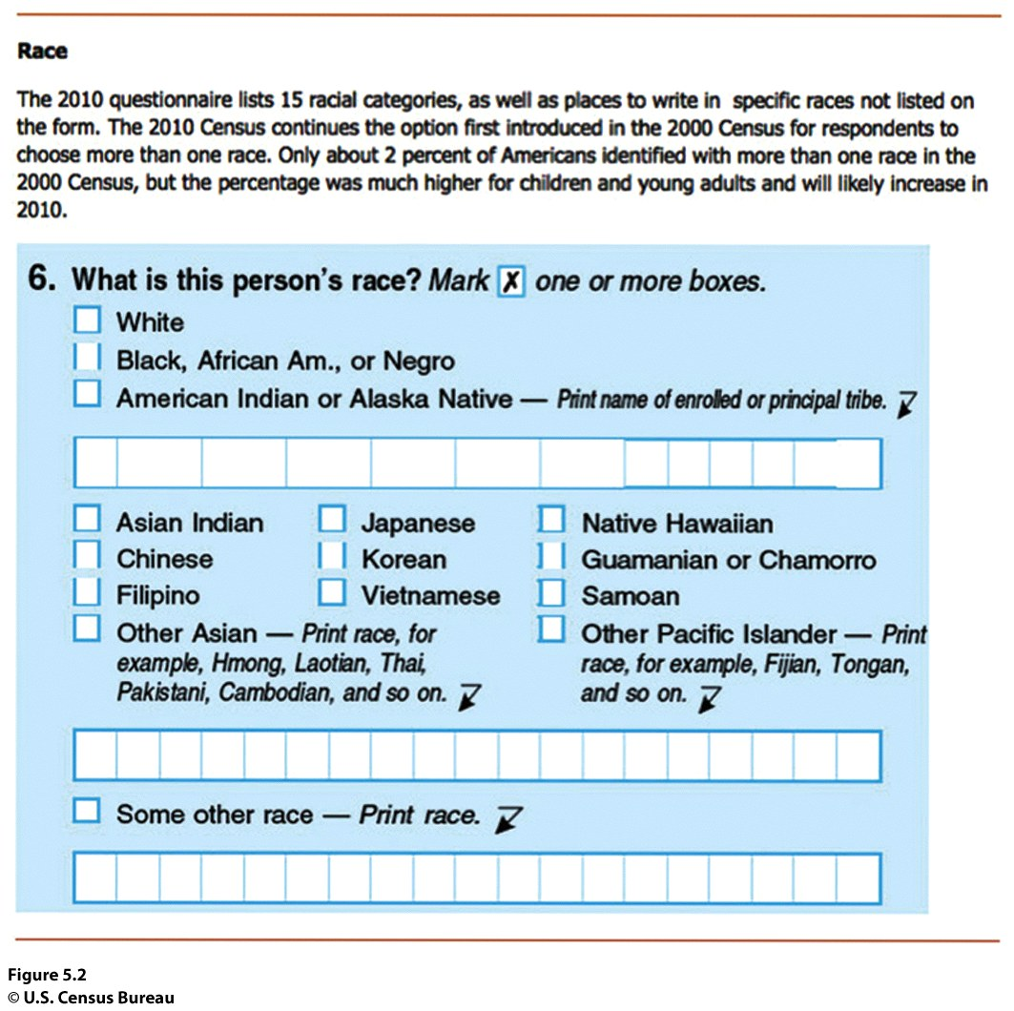
Race
“Races” are the product of ways of viewing minor genetic differences that developed as modern humans spread around the world
Notes:
Figure 5.2
United States. Although biologically there is only one human
race, we are constantly asked to choose race “boxes” for ourselves.
This page of the 2010 United States Census asks the
individual, “What is your race?” and directs the individual to
“Mark one or more races to indicate what you consider yourself to be.” © U.S. Census Bureau

Slide 6
What Is Identity,
and How Are Identities Constructed?
Race
Many of societies’ modern assumptions about race grew out of the period of European exploration and colonialism
Racism
What society typically calls a “race” is in fact a combination of physical attributes in a population
Skin color is not a reliable indicator of genetic closeness

Slide 7
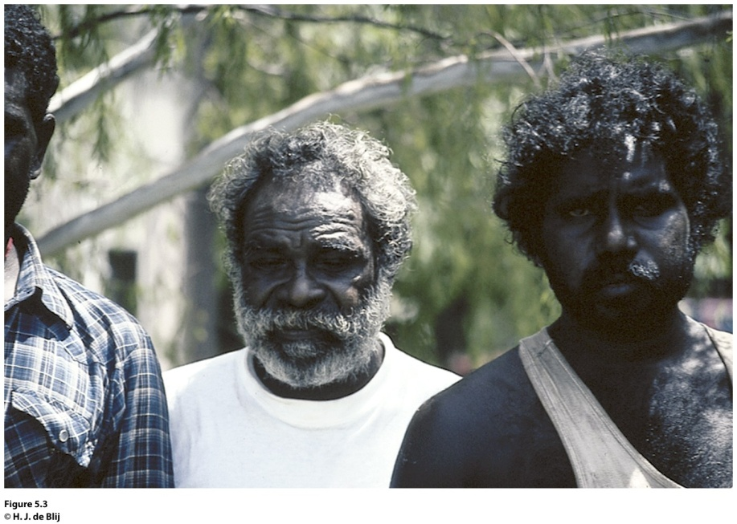
Field Note
Concept Caching:
Fenway Park, Boston, MA
“We were traveling in Darwin, Australia, in 1994 and decided to walk away from the modern downtown for a few hours. Darwin is a multicultural city in the midst of a region of Australia that is largely populated by Aboriginals. At the bus stops on the outskirts of the city, Aboriginals reached Darwin to work in the city or to obtain social services only offered in the city. With a language barrier between us, we used hand gestures to ask the man in the white shirt and his son if we could take their picture. Gesturing back to us, they agreed to the picture. Our continued attempts at sign language soon led to much laughter among the people waiting for the next bus.”
Notes:
Figure 5.3
Darwin, Australia. © H. J. de Blij

Slide 8
What Is Identity,
and How Are Identities Constructed?
Race and Ethnicity in the United States
Unlike a local culture or ethnicity to which we may choose to belong, race is an identity that is more often assigned.
U.S. racial categories are reinforced through residential segregation, racialized divisions of labor, and categories of races recorded by the Census Bureau and other government and nongovernmental agencies.
Because of immigration and differences in fertility rates, the United States is increasingly “nonwhite.”
How Americans define “race” is changing.

Slide 9
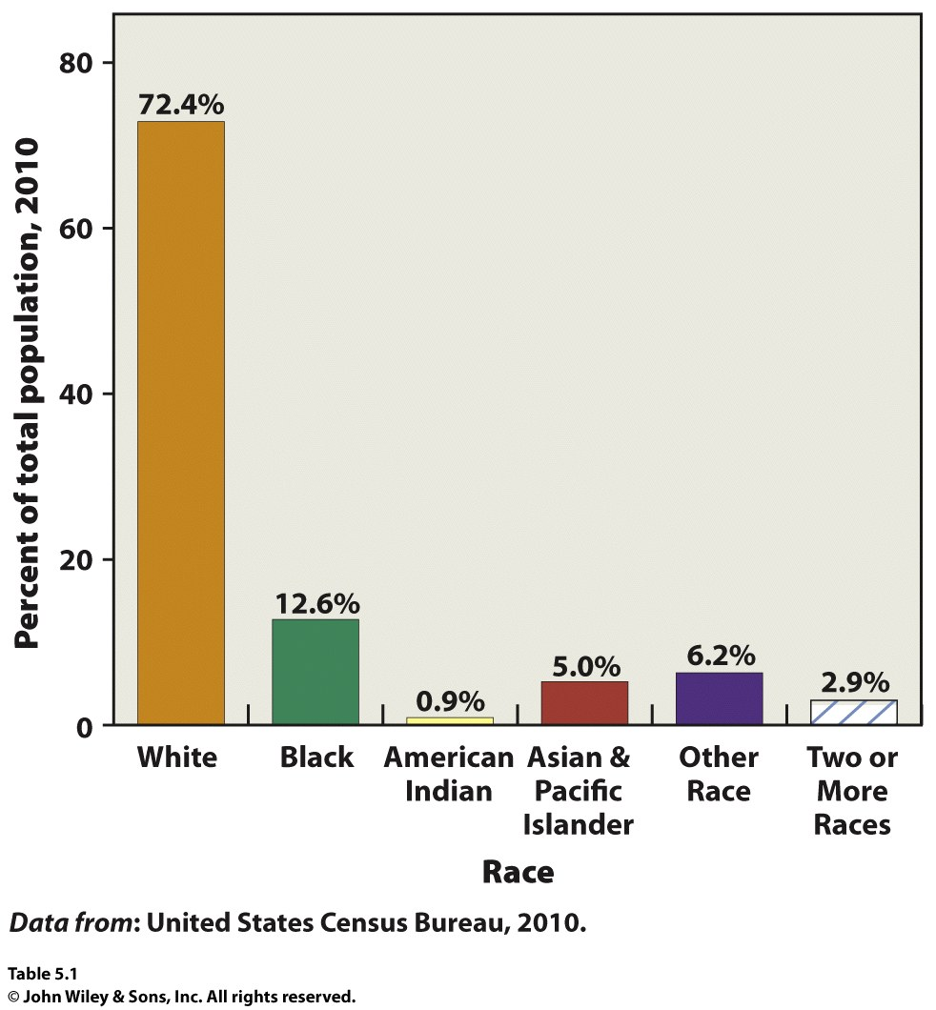
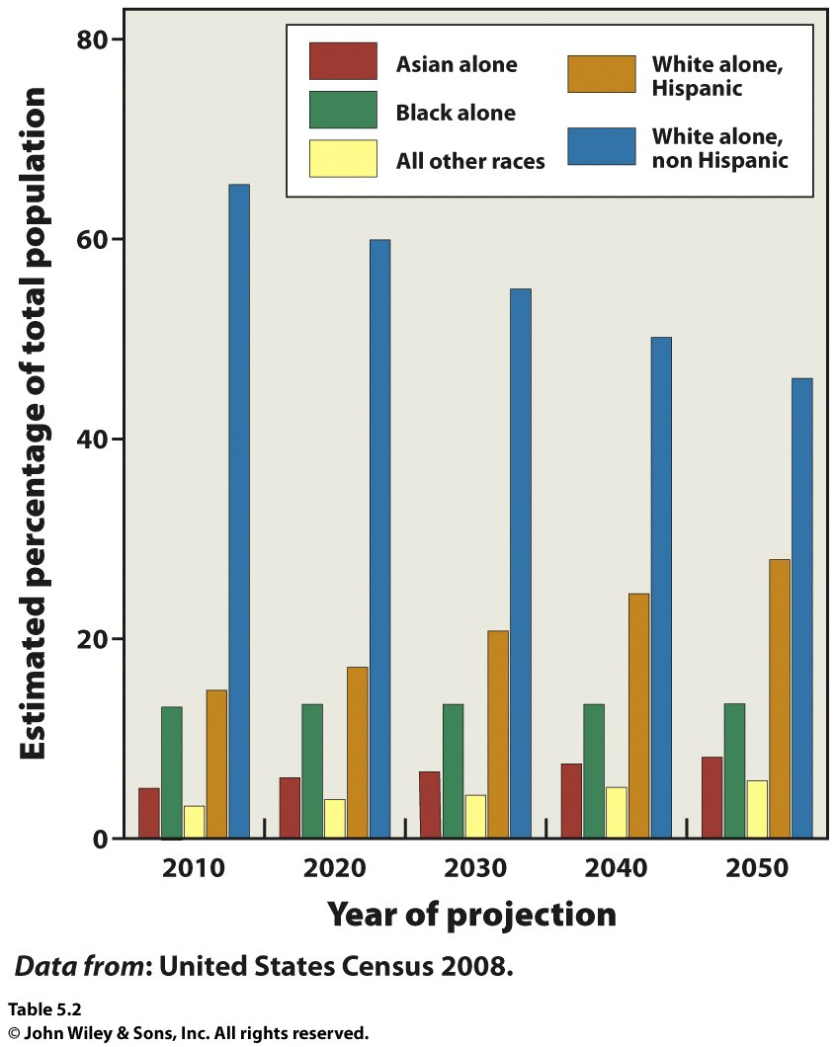

Slide 10
What Is Identity,
and How Are Identities Constructed?
Residential Segregation
Geographers Douglas Massey and Nancy Denton: residential segregation is the “degree to which two or more groups live separately from one another, in different parts of the urban environment.”
Five measures of segregation: evenness, exposure, concentrated, centralized, clustered.

Slide 11
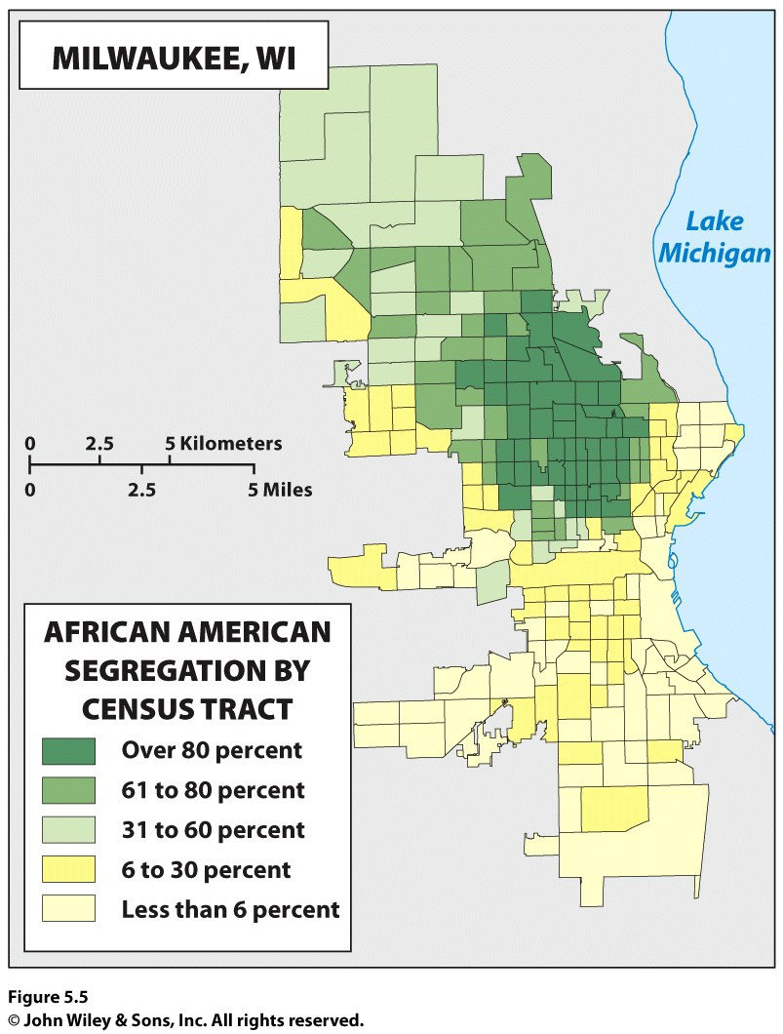
INSERT FIGURE 5.5

Slide 12
What Is Identity,
and How Are Identities Constructed?
Identities across Scales
Different identities at different scales:
Individual: brother, sister, student
Local: residents of a neighborhood
Regional: Southerners
National: American
Global: Western, free
Appropriate identity is revealed at the appropriate scale.

Slide 13
What Is Identity,
and How Are Identities Constructed?
The Scale of New York
New York has a greater number and more diversity of immigrants than any other city in the United States.
Succession: New immigrants to a city often move to low-income areas being slowly abandoned by older immigrant groups.
Many new immigrants focus on the streetscapes, creating businesses to serve their community and reflect their culture.

Slide 14
Recall the last time you were asked to check a box for your race. Does that box factor into how you make sense of yourself
individually, locally, regionally, nationally, and globally? What impact might it have on how other people view you?

Slide 15
Key Question
How do places affect identity, and how can we see identities in places?

Slide 16
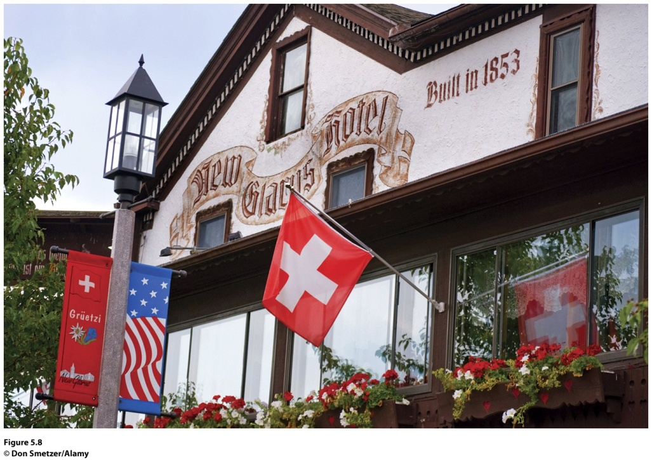
How Do Places Affect Identity, and How Can We See Identities in Places?
Figure 5.8
New Glarus, Wisconsin. The town of New Glarus was
established by immigrants from Switzerland in 1845. The Swiss American town takes pride in its history and culture, as the flags at the New Glarus Hotel Restaurant demonstrate. © Don Smetzer/Alamy

Slide 17
How Do Places Affect Identity, and How Can We See Identities in Places?
Geographer Gillian Rose: “Developing a sense of place”
Ethnicity and Place
Ethnicity: people are bounded in a certain place over time.
ethnos = “people”
Ethnic identity is greatly affected by scale and place.

Slide 18
Chinatown in Mexicali
How Do Places Affect Identity, and How Can We See Identities in Places?
Mexicali Chinatown was crucible of Chinese ethnicity in the Mexicali Valley throughout much of the twentieth century.
Now plays an important symbolic and functional role in preserving group identity and consciousness.

Slide 19
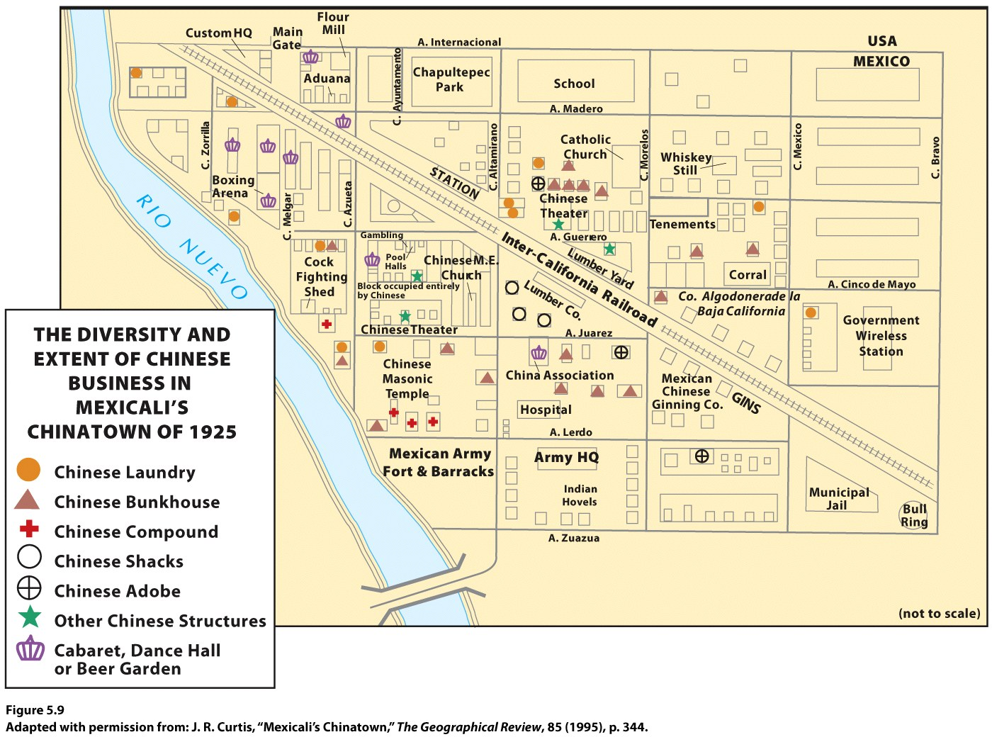

Slide 20
How Do Places Affect Identity, and How Can We See Identities in Places?
Identity and Space
Space: “social relations stretched out”
Place: “particular articulations of those social relations as they have come together, over time, in that particular location.”
Gendered places

Slide 21
Key Question
How Does Geography Reflect and Shape Power Relationships Among Groups of People?

Slide 22
How Does Geography Reflect and Shape Power Relationships Among Groups of People?
Power relationships can subjugate entire groups of people, enabling society to enforce ideas about the ways people should behave or where people should be welcomed or turned away
Jim Crow Laws
Belfast, Northern Ireland

Slide 23
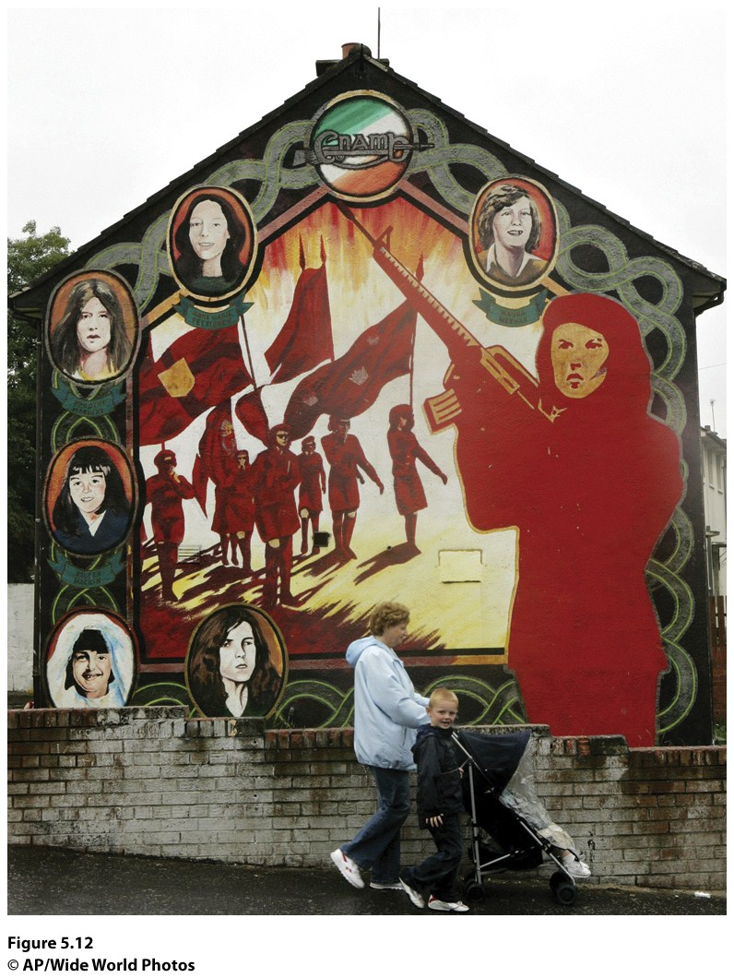
How Does Geography Reflect and Shape Power Relationships Among Groups of People?
Figure 5.12
Belfast, Northern Ireland. Signs of the conflict in Northern Ireland mark the cultural landscape throughout Belfast. In the Ballymurphy area of Belfast, where Catholics are the majority population, a woman and her children walk past a mural in support of the Irish Republican Army. The mural features images of women who lost their lives in the conflict, including Maureen Meehan, who was shot by the British Army and Anne Parker, who died when the bomb she planned to detonate exploded prematurely. © AP/Wide World Photos.

Slide 24
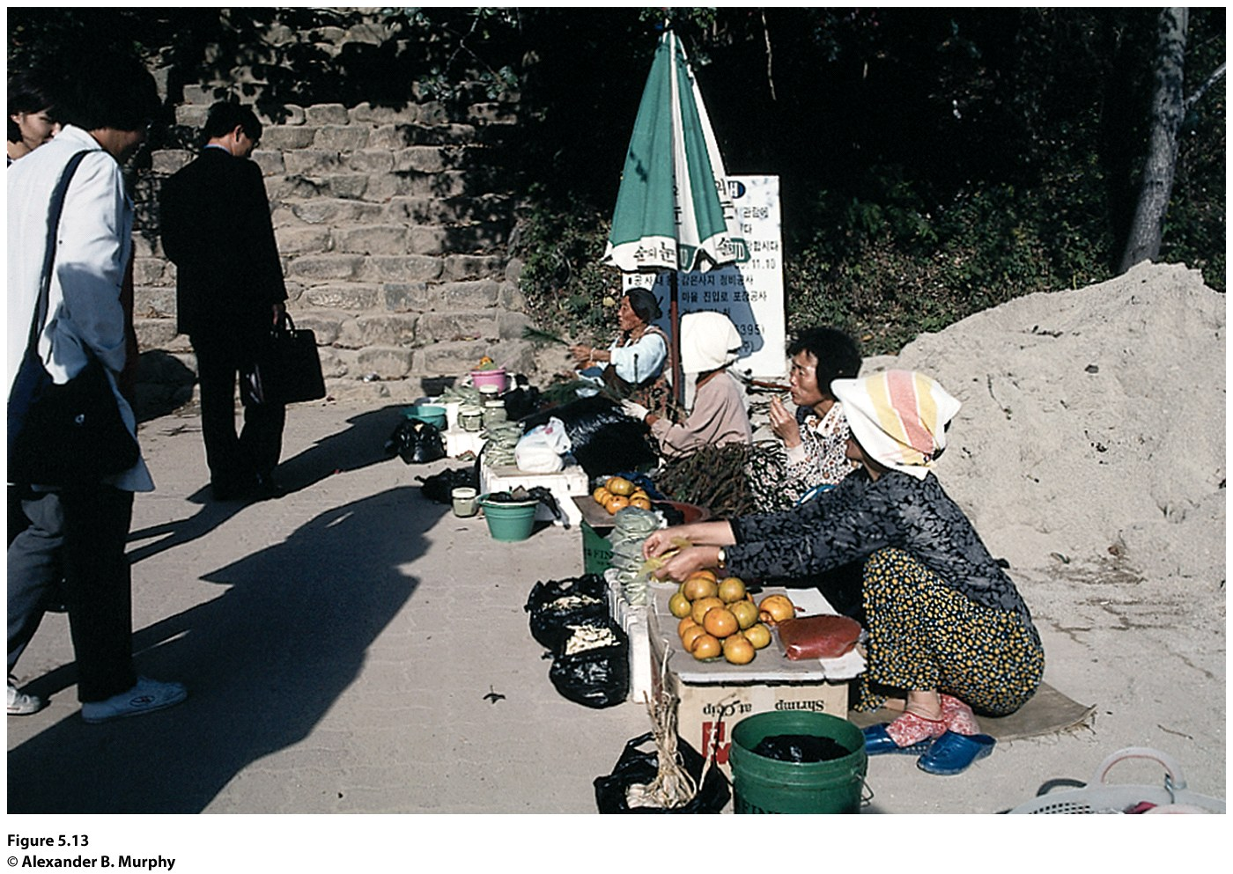
How Does Geography Reflect and Shape Power Relationships Among Groups of People?
Just Who Counts?
Women continue to be paid less than men
The World’s Women 2010: Trends and Statistics
Regional variations in agriculture employment
Figure 5.13
South Korea. The women in this photo sat near one of the ancient temples in southern Korea, selling the modest output from their own market
gardens. This activity is one part of the informal economy, the “uncounted” economy in which women play a large role. © Alexander B. Murphy.

Slide 25
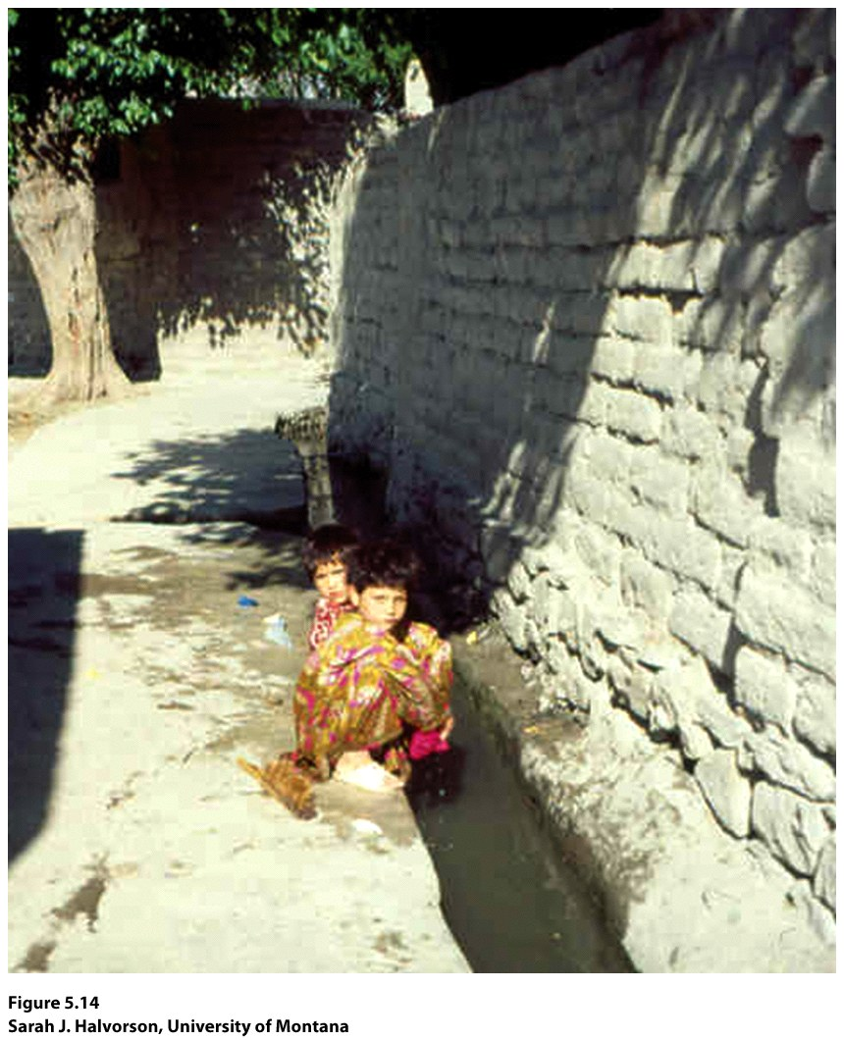
Guest Field Note
“One of the leading causes of mortality and morbidity among children under the age of five in developing countries is waterborne disease. My research has focused on building an understanding of the factors that contribute to the vulnerability of young children to this significant public health problem.”
Concept Caching:
Mount Vesuvius
Notes:
Credit: Sarah J. Halvorson, University of Montana

Slide 26
Vulnerable Populations
Geographers use mapping and spatial analysis to predict and explain what populations or people will be affected most by natural hazards such as earthquakes, volcanoes, hurricanes, and tsunamis or by environmental policies.
Vulnerability is fundamentally influenced by geographically specific social and environmental circumstances.
Through fieldwork and interviews, geographers can see differences in vulnerability within groups of people

Slide 27
Women in Subsaharan Africa
Much of Subsaharan Africa, especially rural areas, is dominated numerically by women.
Women produce an estimated 70 percent of the region’s food, almost all of it without the aid of modern technology.
In East Africa, cash crops such as tea are sometimes called “men’s crops” because the men trade in what the women produce.
Uganda was a leader in affirmative action for women.
Rwanda is the first country in the world where women hold more than 50 percent of the legislative seats.

Slide 28
Gender Inequality
Gender disparity ranges across the globe in different ways.
Geographers must find a way to measure this inequality among genders by region.

Slide 29
Gender Inequality Index
Three ways of measuring
Reproductive Health
Maternal mortality (Number of female deaths per 100,000 live births)
Empowerment
Political, etc.
Labor market
Workplace, economic participation, etc.

Slide 30
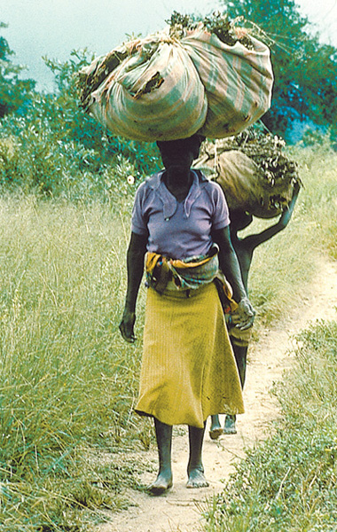
Concept Caching: Kanye, Botswana
© Harm de Blij

Slide 31
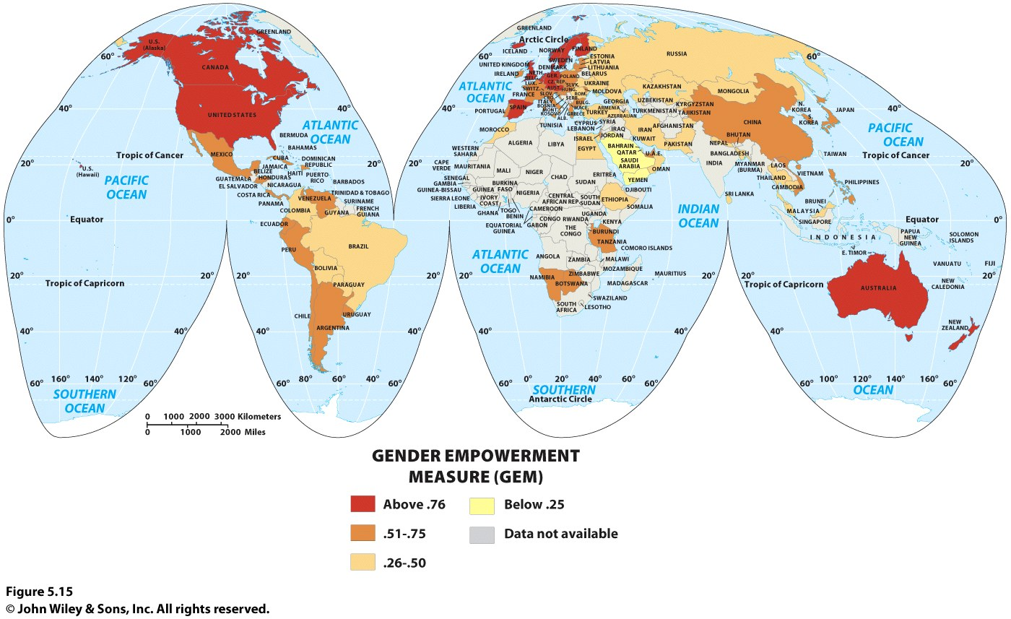

Slide 32
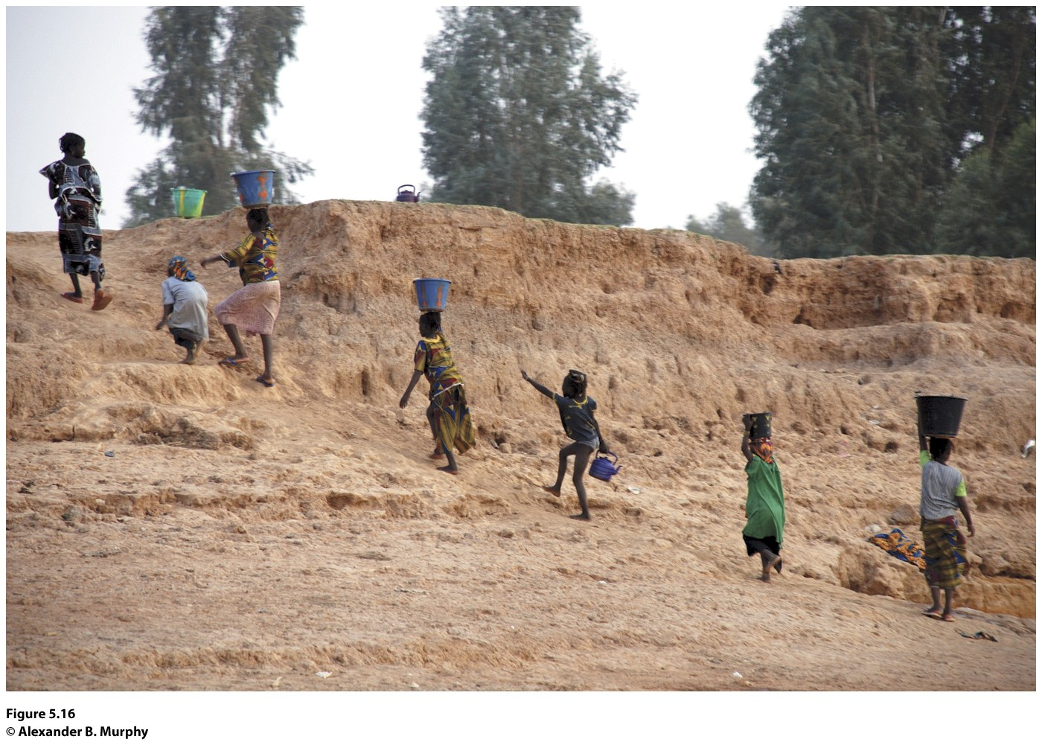
Field Note
“I am filled with admiration for the women carrying water on their heads up the bank from the Niger River. Other women are at the water’s edge, filling their buckets. These women are performing a daily ritual requiring incredible endurance and strength. Once they carry their buckets to their dwellings, they will likely turn to preparing the evening meal.”
Figure 5.16
Along the banks of the Niger River just outside Mopti, Mali. © Alexander B. Murphy

Slide 33
How Does Geography Reflect and Shape Power Relationships Among Groups of People?
Dowry Deaths in India
In an arranged marriage, the dowry is the price to be paid by the bride’s family to the groom’s father.
In extreme cases, disputes over the dowry have led to the death of the bride.
Power relationships place women below men in India.
Family Courts Act passed in 1984 to provide support for women who feared dowry death.

Slide 34
Dowry Deaths in India
The practice of dowry deaths is not declining in India.
The number of love marriages is on the rise and many couples in love marriages are meeting online.
The number of divorces is also on the rise, with 1 in 1,000 marriages ending in divorce in India today.
Just as some statistics point to an improving place of women in Indian society, other statistics confirm India still has a preference for males overall.

Slide 35
Shifting Power Relations among Ethnic Groups
Urban geographers, John Frazier, Florence Margai, and Eugene Tettey-Fio: Race and Place: Equity Issues in Urban America
Areas with multiple ethnicities often experience a decrease of unacceptance and a flow of acceptance over time.

Slide 36
Shifting Power Relations among Ethnic Groups
In California and in much of the rest of the United States, the “Asian” box is drawn around a stereotype of what some call the “model minority.”
The myth of the model minority: “paints Asians as good, hardworking people who, despite their suffering through discrimination, harassment, and exclusion, have found ways to prosper through peaceful means.”

Slide 37
Power Relations in Los Angeles
Shifting Power Relations among Ethnic Groups
Geographer James Curtis: southeastern Los Angeles County is today “home to one of the largest and highest concentrations of Latinos in Southern California.”
Barrioization: describes a change that saw the Hispanic population of a neighborhood jump from 4 percent in 1960 to over 90 percent in 2000.
April 29–30, 1992: Riots in Los Angeles after the verdict in the Rodney King case led to deaths, injuries, and about $1 billion in property loss.

Slide 38
