Slide 1
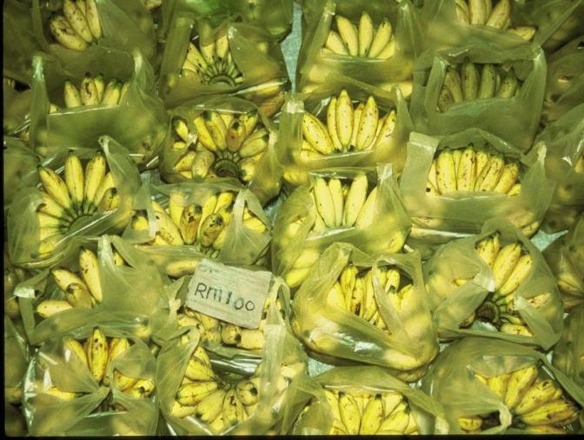
Agriculture
Concept Caching:
Banana Production-Malaysia

Slide 2
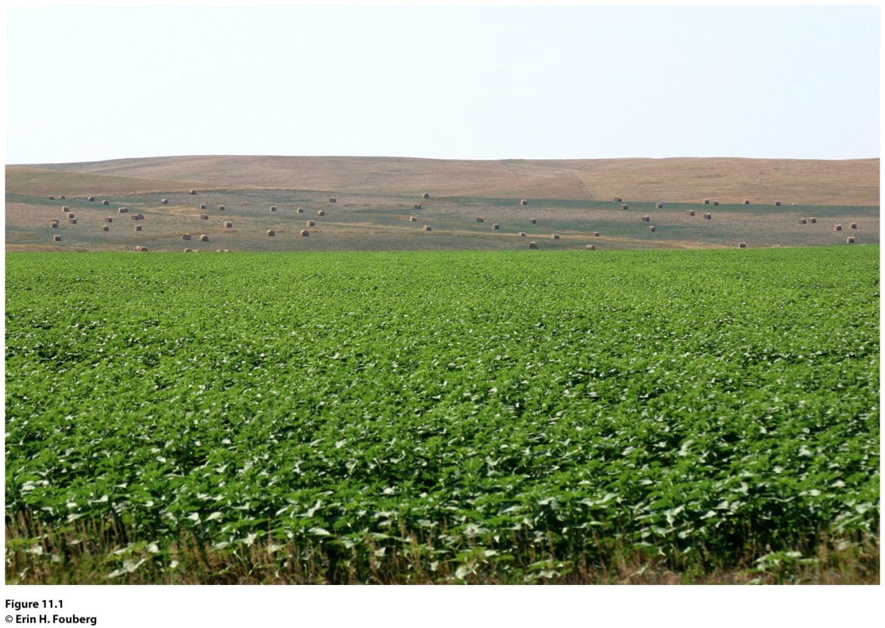
Field Note: Changing Greens
“Driving across the semiarid ranchlands of western South Dakota, I noticed the presence of a crop in the landscape that was recently found only in the eastern,
moister region of the state: soybeans. I called a colleague who works in agriculture at South Dakota State University to ask, “When did the cattle ranchers of western South Dakota start growing soybeans?” He replied, “When the soy biodiesel plants started popping up in Nebraska and Kansas and when genetically modified soybeans made it possible to grow the
crop here.”
Notes:
Figure 11.1
Presho, South Dakota. Soybeans growing in the semiarid ranchlands of western South
Dakota. © Erin H. Fouberg.

Slide 3
Key Question
What is agriculture, and where did agriculture begin?

Slide 4
Agriculture is the deliberate tending of crops and livestock to produce food, feed, fiber, and fuel.
Primary economic activities: Economic activities that involve the extraction of economically valuable products from the earth, including agriculture, ranching, hunting and gathering, fishing, forestry, mining, and quarrying.
Secondary economic activities: Activities (e.g., manufacturing) that take a primary product and change it into something else such as toys, ships, processed foods, chemicals, and buildings.
Tertiary economic activities are those service industries that connect producers to consumers and facilitate commerce and trade or help people meet their needs.

Slide 5
Some analysts separate specialized services into quaternary and quinary economic activities, distinguishing between those services concerned with information or the exchange of money or goods (quaternary) and those tied to research or higher education (quinary).
In the United States, less than 2 percent of the workforce is involved in agricultural production.
In the United States, total agricultural production is at an all-time high, but the proportion of the labor force in agriculture is at an all-time low.
The drive toward economic efficiency has meant that the average size of farms (acres in production) in the United States has been growing, regardless of the kind of agricultural good produced.

Slide 6
What Is Agriculture, and
Where Did Agriculture Begin?
National Research Council of the U.S. National Academy of Sciences identifies four major issues that affect food security worldwide:
Varying abilities to balance production and consumption across regions and countries
Accelerating conversions of agricultural land to urban uses
Increasingly energy-intensive food production methods in a world of shrinking fossil fuel resources
Expanding use of food crops for biofuel production

Slide 7
What Is Agriculture, and
Where Did Agriculture Begin?
Concept Caching:
Fenway Park, Boston, MA
Hunting, Gathering, and Fishing
Before the advent of agriculture, hunting, gathering, and fishing were the most common means of subsistence throughout the world.
The size of hunting and gathering clans varied
according to climate and resource availability.
Hunting and gathering communities in areas of abundance could support larger populations.

Slide 8
Terrain and Tools
The first tools used in hunting were simple clubs—tree limbs that were thin at one end and thick and heavy at the other.
The use of bone and stone and the development of spears made hunting far more effective.
The first opportunities to control fire were offered by natural conditions.
In addition to hunting game on land, humans harvested shellfish, trapped fish by cutting small patches of standing water off from the open sea, and invented tools to catch fish, including harpoons, hooks, and baskets.
Using tools and fire, human communities altered their environments, which helped to establish more reliable food supplies.

Slide 9
The First Agricultural Revolution
Geographer Carl Sauer: the experiments necessary to establish agriculture and settle in one place would occur in lands of plenty.
Sauer suggested that Southeast and South Asia may have been where the first tropical plant domestication occurred, more than 14,000 years ago.
Root crops: crops that are reproduced by cultivating either the roots or cuttings from the plants.

Slide 10
The First Agricultural Revolution
What Is Agriculture, and
Where Did Agriculture Begin?
Seed crops: plants that are reproduced by cultivating seeds.
The cultivation of seed crops marked the beginning of what has been called the First Agricultural Revolution.
The majority view is that the first domestication of seed plants took place in the Fertile Crescent.

Slide 11
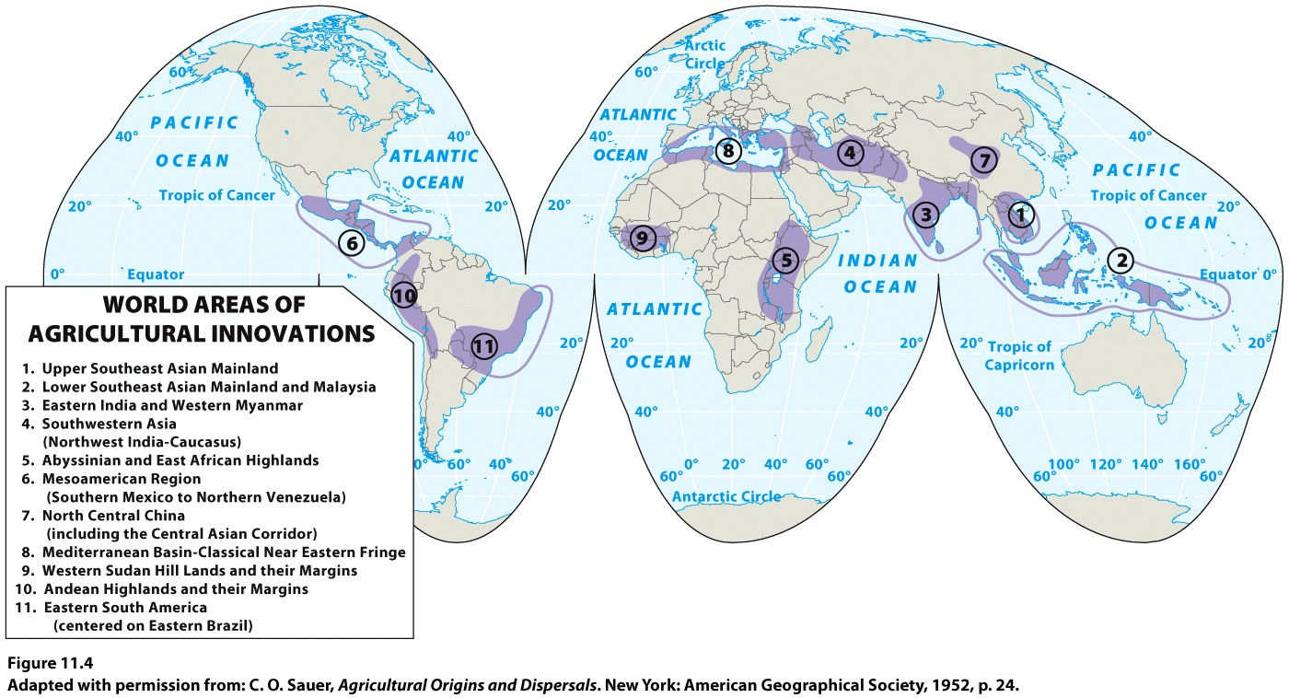

Slide 12
Domestication of Animals
Some scholars believe that animal domestication began earlier than plant cultivation, but others argue that animal domestication began as recently as 8000 years ago—well after crop agriculture.
The advantages of animal domestication—their use as beasts of burden, as a source of meat, and as providers of milk—stimulated the rapid diffusion of this idea among interlinked places and gave the sedentary farmers of Southwest Asia and elsewhere a new measure of security.
Jared Diamond, Guns, Germs, and Steel: only five domesticated mammals are important throughout the world: the cow, sheep, goat, pig, and horse.

Slide 13
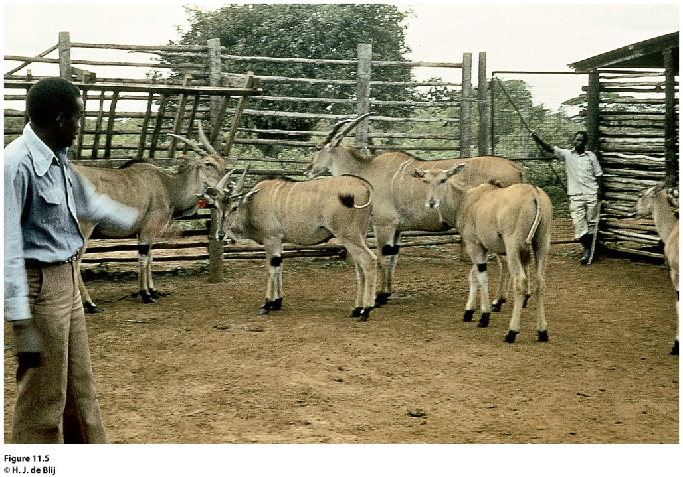
Field Note
“Attempts to tame wildlife started in ancient times, and still continue. At Hunter’s Lodge on the Nairobi-Mombasa road, we met an agricultural officer who reported that an animal domestication experiment station was located not far into the bush, about 10 miles south. On his invitation, we spent the next day observing this work. In some herds, domestic animals (goats) were combined with wild gazelles, all penned together in a large enclosure. This was not working well; all day the gazelles seek to escape. By comparison, these eland were docile, manageable, and in good health. Importantly, they also were reproducing in captivity. Here, our host describes the program.”
Notes:
*Could be an audio file.
Figure 11.5
Nairobi, Kenya. © H. J. de Blij.

Slide 14
Subsistence Agriculture
Subsistence agriculture: growing only enough food to survive; norm throughout most of human history.
Subsistence agriculture is returning in parts of the world where farmers feel production for the global market has not benefited them financially or culturally.
Shifting cultivation: many farmers move from place to place in search of better land.
Found primarily in tropical and subtropical zones, where traditional farmers had to abandon plots of land after the soil became infertile.
Slash-and-burn agriculture: farmers use tools (machetes and knives) to slash down trees and tall vegetation, and then burn the vegetation on the ground. A layer of ash from the fire settles on the ground and contributes to the soil’s fertility.

Slide 15
Key Question
How did agriculture change with industrialization?

Slide 16
Second Agricultural Revolution
Would move agriculture beyond subsistence to generate the kinds of surpluses needed to feed thousands of people working in factories instead of in agricultural fields.
Great Britain’s Enclosure Act: encouraged field consolidation into large, single-owner holdings.
New technologies (i.e., the seed drill).
Mechanical reaper perfected in 1831 by farmer Cyrus McCormick.
Advances in breeding livestock.
Innovations in machinery that occurred with the
Industrial Revolution in the late 1800s and early 1900s helped sustain the Second Agricultural Revolution.

Slide 17
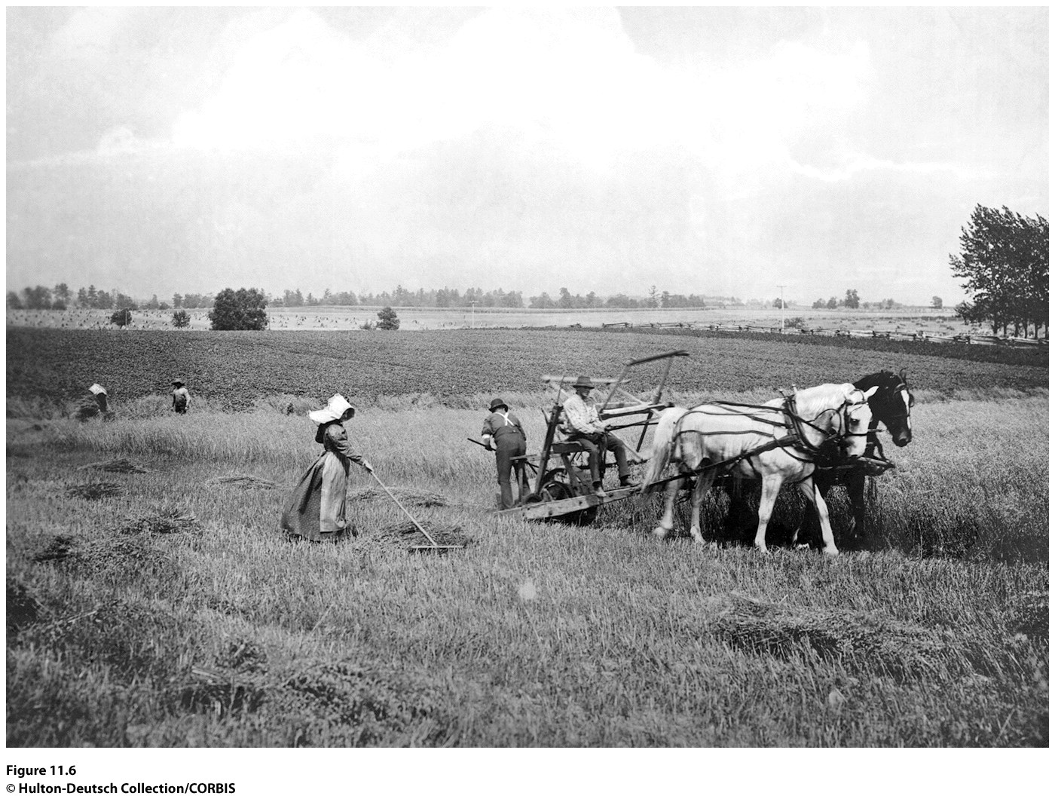
Notes:
Figure 11.6
Midwest, United States. Pioneers in 1870
used the mechanical reaper designed by Cyrus
McCormick to cut and bundle grain on the prairie.
Pulled by horses, the mechanical reaper sped up harvesting
and diffused around the world. © Hulton-
Deutsch Collection/CORBIS.

Slide 18
Understanding the Spatial Layout of Agriculture
Farmer Johann Heinrich von Thünen: As one moved away from the town one commodity or crop gave way to another.
The greater the distance to market, the higher the transport costs that had to be added to the cost of producing a crop or commodity.
The Von Thünen model (including the ring of forest) is often described as the first effort to analyze the spatial character of economic activity.
Even when agricultural production does not conform to the concentric rings of von Thünen’s model, his underlying concern with the interplay of land use and transportation costs frequently still explains agricultural patterns.

Slide 19
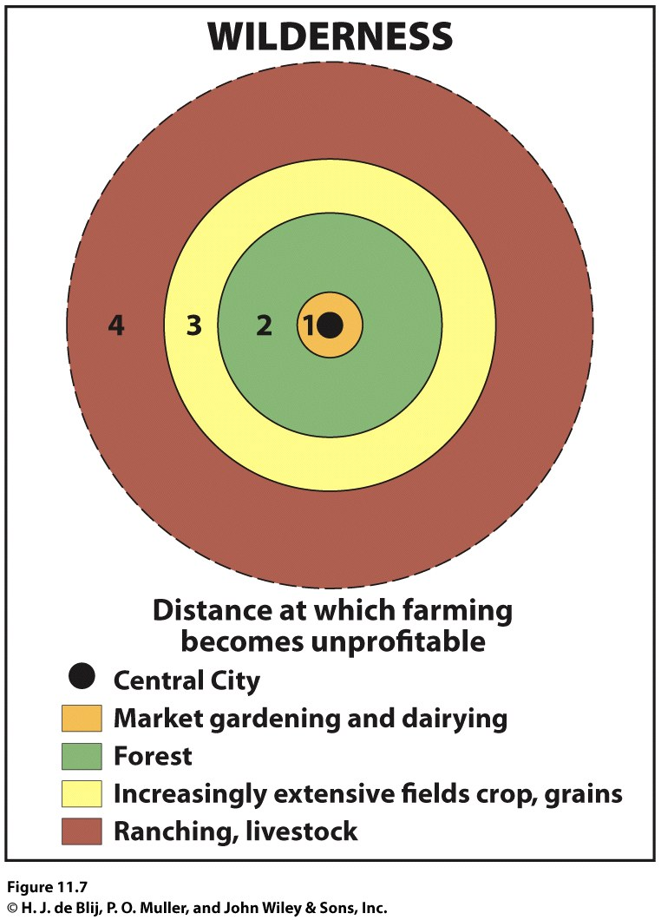
Figure 11.7
Von Thünen’s Model. © H. J. de Blij, P. O. Muller, and John Wiley & Sons, Inc.

Slide 20
The Third Agricultural Revolution
Also called the Green Revolution.
Dates as far back as the 1930s, when agricultural scientists in the American Midwest began experimenting with technologically manipulated seed varieties to increase crop yields.
1960s: the focal point of the Green Revolution shifted to India (IR8).
1982: IR36 was produced, bred from 13 parents to achieve genetic resistance against 15 pests and a growing cycle of 110 days under warm conditions.
The Green Revolution also brought new high-yield varieties of wheat and corn from the United States to other parts of the world, particularly South and Southeast Asia.

Slide 21
Criticism of the Green Revolution
Impacts of pollen dispersal from genetically modified plants and the potential for disease-resistant plants to spur the evolution of super-pests.
The large-scale monocropping that is often part of Green Revolution agriculture can make farms vulnerable to changes in climate or the infestation of particular pests.
Higher inputs of chemical fertilizers, herbicides, and pesticides associated with Green Revolution agriculture can lead to reduced organic matter in the soil and to groundwater pollution.
Has done little to alleviate poverty in areas where most farmers still work small plots of land.
The need for capital from the West to implement Green Revolution technologies has led to a shift away from production for local consumers toward export agriculture.

Slide 22
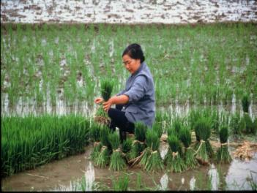
New Genetically Modified Foods
Genetically modified organisms (GMOs) are found in 75 percent of all processed foods in the United States
Many of the poorer countries of the world do not have access to the necessary capital and technology.
Ideological resistance to genetically engineered foods
In regions where seeds are a cultural commodity, reflecting agricultural lessons learned over generations, many resist the invasion of foreign, genetically engineered crops.
Concept Caching:
Planting Rice Seedlings-China
© Barbara Weightman

Slide 23
Regional and Local Change
Shifts from subsistence agriculture to commercial agriculture have had dramatic impacts on rural life.
Dramatic increases in the production of export crops have occurred at the expense of crop production for local consumption.
Environmental, economic, and social changes have affected local rural communities.

Slide 24
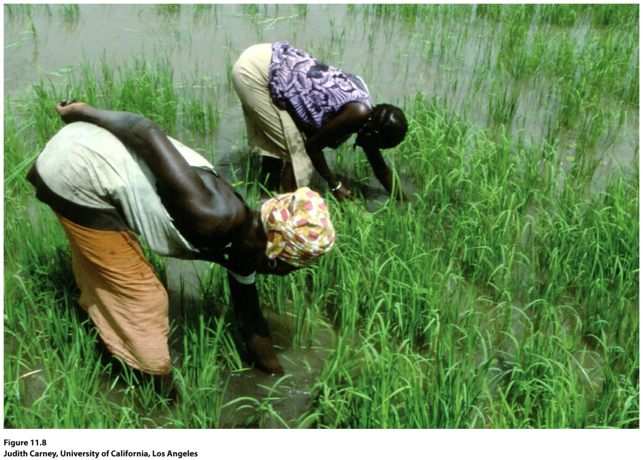
Guest Field Note:
Gambia
“I am interested in women and rural development in Subsaharan Africa. In 1983, I went to Gambia to study an irrigated rice project that was being implemented to improve the availability of rice, the dietary staple. What grabbed my attention? The donors’ assurance that the project would benefit women, the country’s traditional rice growers. Imagine my surprise a few months after project implementation when I encountered hundreds of angry women refusing to work because they received nothing for their labor from the first harvest.”
Notes:
*Could be an audio file.
Figure 11.8
Gambia.
Credit: Judith Carney, University of California, Los Angeles

Slide 25
The Impacts of Agricultural Modernization on Earlier Practices
Unlike hunting and gathering, subsistence farming continues to be a relatively common practice in Africa, Middle America, tropical South America, and parts of Southeast Asia.
From 1500 to 1950, European powers sought to “modernize” the economies of their colonies by ending subsistence farming and integrating farmers into colonial systems of production and exchange.
The colonial powers would demand that farmers pay some taxes.
The colonial powers would conduct soil surveys, build irrigation systems, and establish lending agencies that provided loans to farmers.
Concept Caching:
Mount Vesuvius

Slide 26
Many arguments have been raised about the impacts of the Green Revolution, both pro and con. How might the scale at which the Green Revolution is examined affect the arguments that are made about it? What types of factors are likely to be considered if the question is, “has the Green Revolution been good for Asia” as opposed to “has the Green Revolution been good for a village or a particular agricultural community in India?”

Slide 27
Key Question
What imprint does agriculture make on the cultural landscape?

Slide 28
The cadastral system: the method of land survey through which land ownership and property lines are defined.
Rectangular survey system: The prevailing survey system throughout much of the United States, the one that appears as checkerboards across agricultural fields
The pattern of farms on the landscape in the interior of the United States reflects the township-and-range system, with farms spaced by sections, half sections, or quarter sections.
Metes and bounds survey: natural features were used to demarcate irregular parcels of land.
Long-lot survey system: divided land into narrow parcels stretching back from rivers, roads, or canals.
Primogeniture: the Germanic practice in which all land passes to the eldest son.
In areas where land is divided among heirs, considerable fragmentation can occur over time.

Slide 29
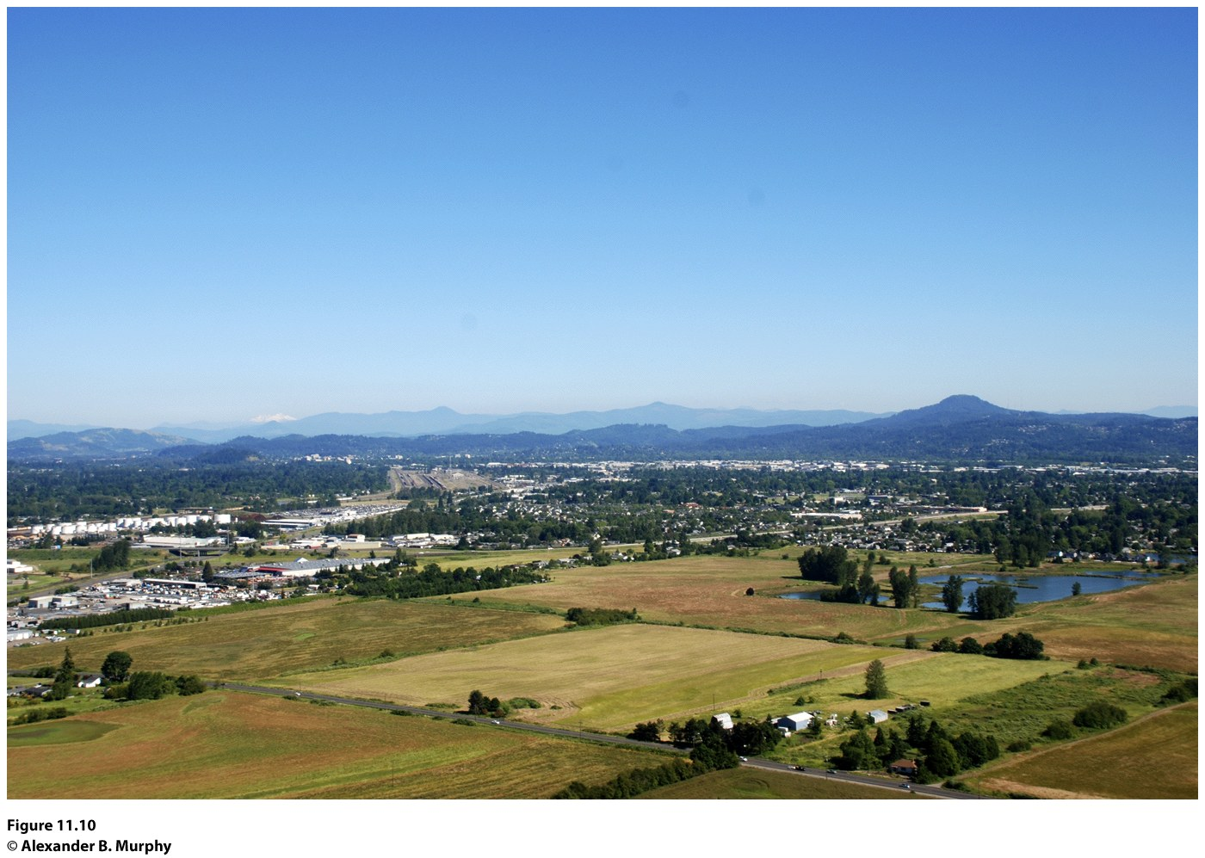
Figure 11.10
Willamette Valley, Oregon. The township-and-range system has left its imprint on the landscape near Eugene, Oregon, where the grid pattern of six mile by six mile townships and the sections of one square mile each are marked by property lines and roads. © Alexander B. Murphy.

Slide 30
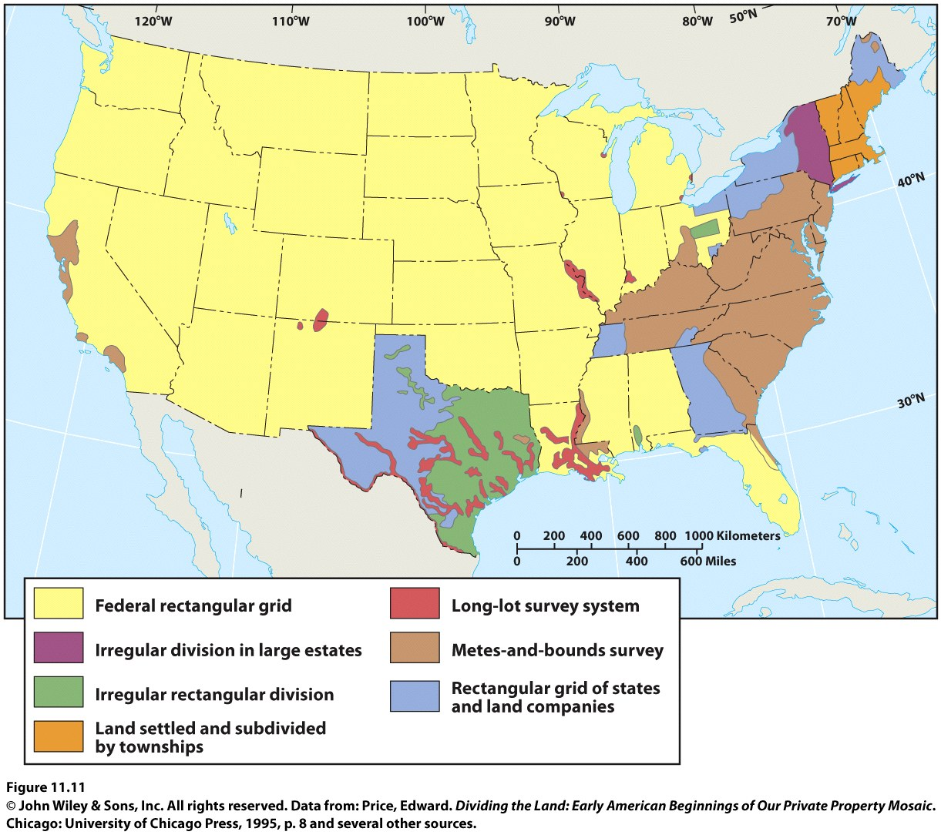

Slide 31
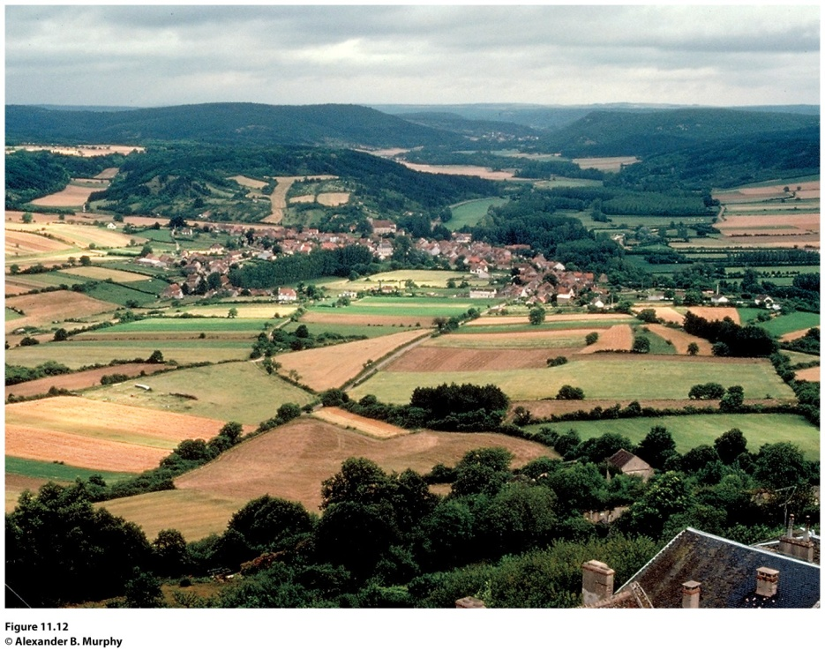
Villages
True farm villages, in which farming or providing services for farmers are the dominant activities, are disappearing
Dispersed settlement pattern: individual farmhouses lie quite far apart and the land is intensively cultivated but by machine rather than by hand Ex: United States Midwest
Nucleated settlement: the most prevalent rural residential pattern in agricultural areas
Figure 11.12
Acquitaine, France. The agricultural landscape of Aquitaine demonstrates three features of rural France: people living in nucleated villages, a highly fragmented land ownership pattern, and land divided according to the French long-lot system.
© Alexander B. Murphy.

Slide 32
Villages
Linear village: In many low-lying areas of Western Europe, villages are located on dikes and levees.
Cluster village may have begun as a small hamlet at the intersection of two roads and then developed by accretion.
Round village or rundling was first used by Slavic farmer-herdsmen in eastern Europe and was later modified by Germanic settlers.
Walled village: as a means of protection.
Grid village: more modern.

Slide 33
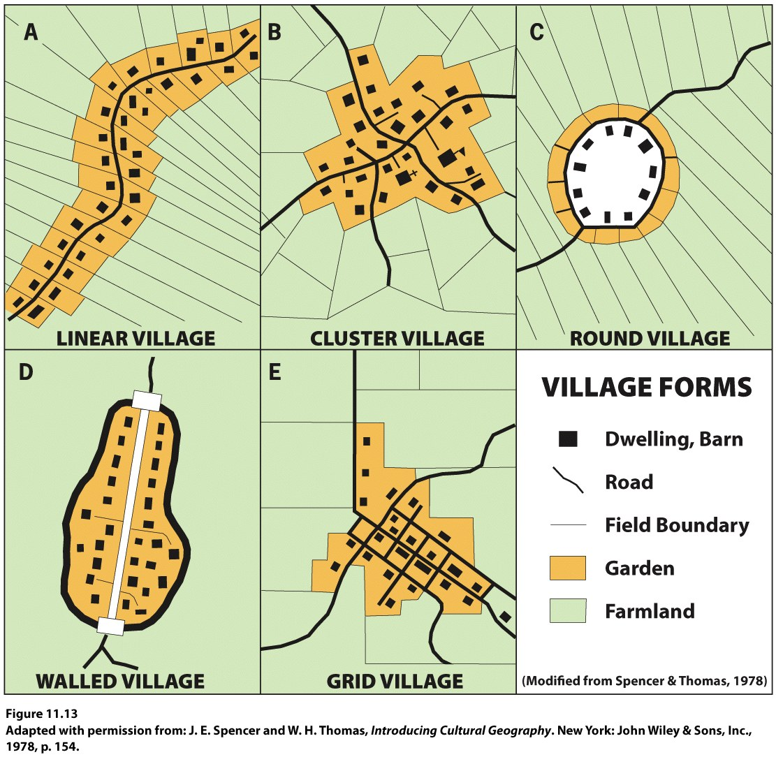
Notes:
Figure 11.13
Village Forms. Five different representative
village layouts are shown here.
Adapted with permission from: J. E. Spencer and
W. H. Thomas, Introducing Cultural Geography. New
York: John Wiley & Sons, Inc., 1978, p. 154.

Slide 34
Functional Differentiation within Villages
Social stratification: reflected in the range in size and quality of houses, representing their owners’ wealth and standing in the community.
The functional differentiation of buildings within farm villages is more elaborate in some societies than in others.
Protection of livestock and storage of harvested crops are primary functions of farm villages.

Slide 35
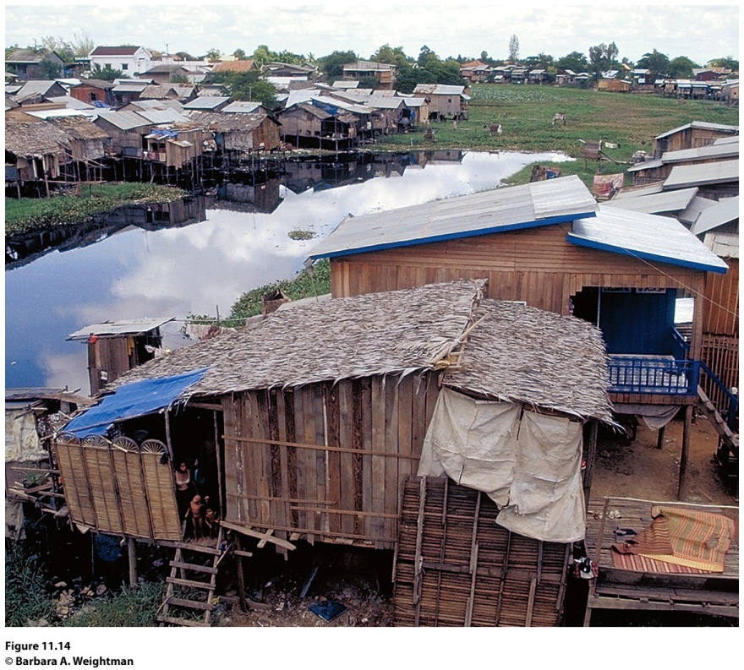
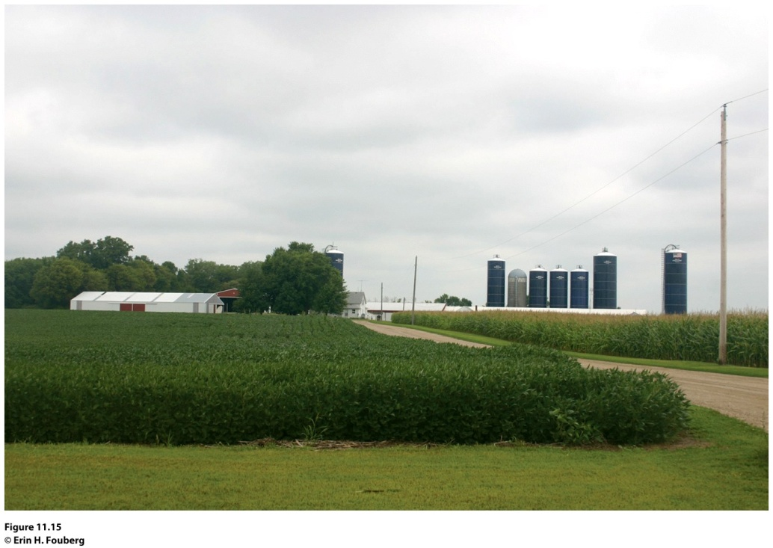
Figure 11.14
Siem Reap, Cambodia. A stilt village in the Mekong Basin of Cambodia. © Barbara A. Weightman
Figure 11.15
Winthrop, Minnesota. The modern American farm typically has a two-story farm house surrounded by several outbuildings. © Erin H. Fouberg.

Slide 36
Key Question
How is agriculture currently organized geographically, and how has agribusiness influenced the contemporary geography of agriculture?

Slide 37
The end of colonial rule did not signal the end of the agricultural practices and systems that had been imposed on the former colonial areas.
Commercial farming has come to dominate in the world’s economic core, as well as some of the places in the semi-periphery and periphery.
Commercial agriculture: began in the eighteenth and nineteenth centuries when Europe became a market for agricultural products from around the world.
Monoculture: dependence on a single agricultural commodity; a major impact of colonial agriculture.

Slide 38
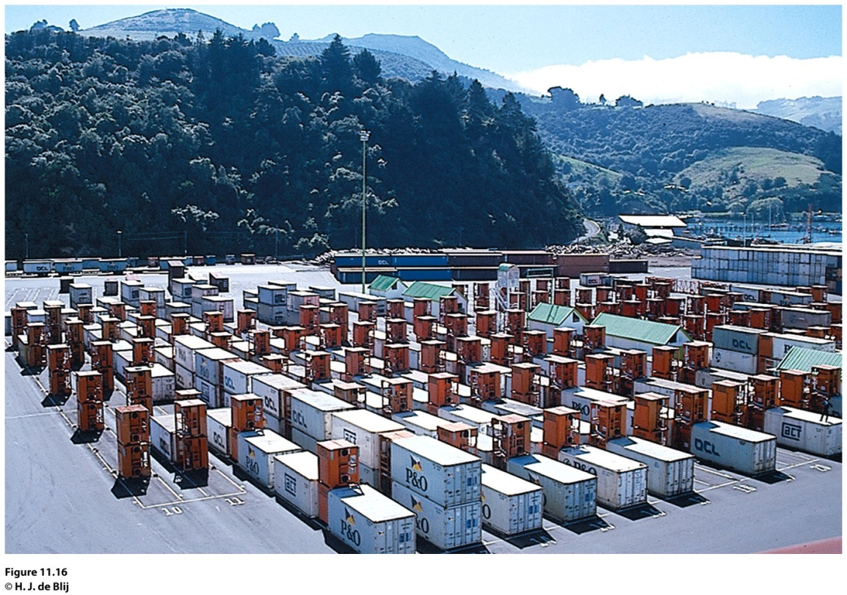
Field Note
“The technology of refrigeration has kept pace with the containerization of seaborne freight traffic. When we sailed into the port of Dunedin, New Zealand, I was unsure of just what those red boxes were. Closer inspection revealed that they are refrigeration units, to which incoming containers are attached. Meats and other perishables can thus be kept frozen until they are transferred to a refrigerator ship.”
Notes:
Figure 11.16
Dunedin, New Zealand. © H. J. de Blij.

Slide 39
The World Map of Climates
Wladimir Köppen: Köppen climate classification system for classifying the world’s climates on the basis of temperature and precipitation.
Köppen’s map provides one means of understanding the distribution of climatic regions (areas with similar climatic characteristics) across the planet.

Slide 40
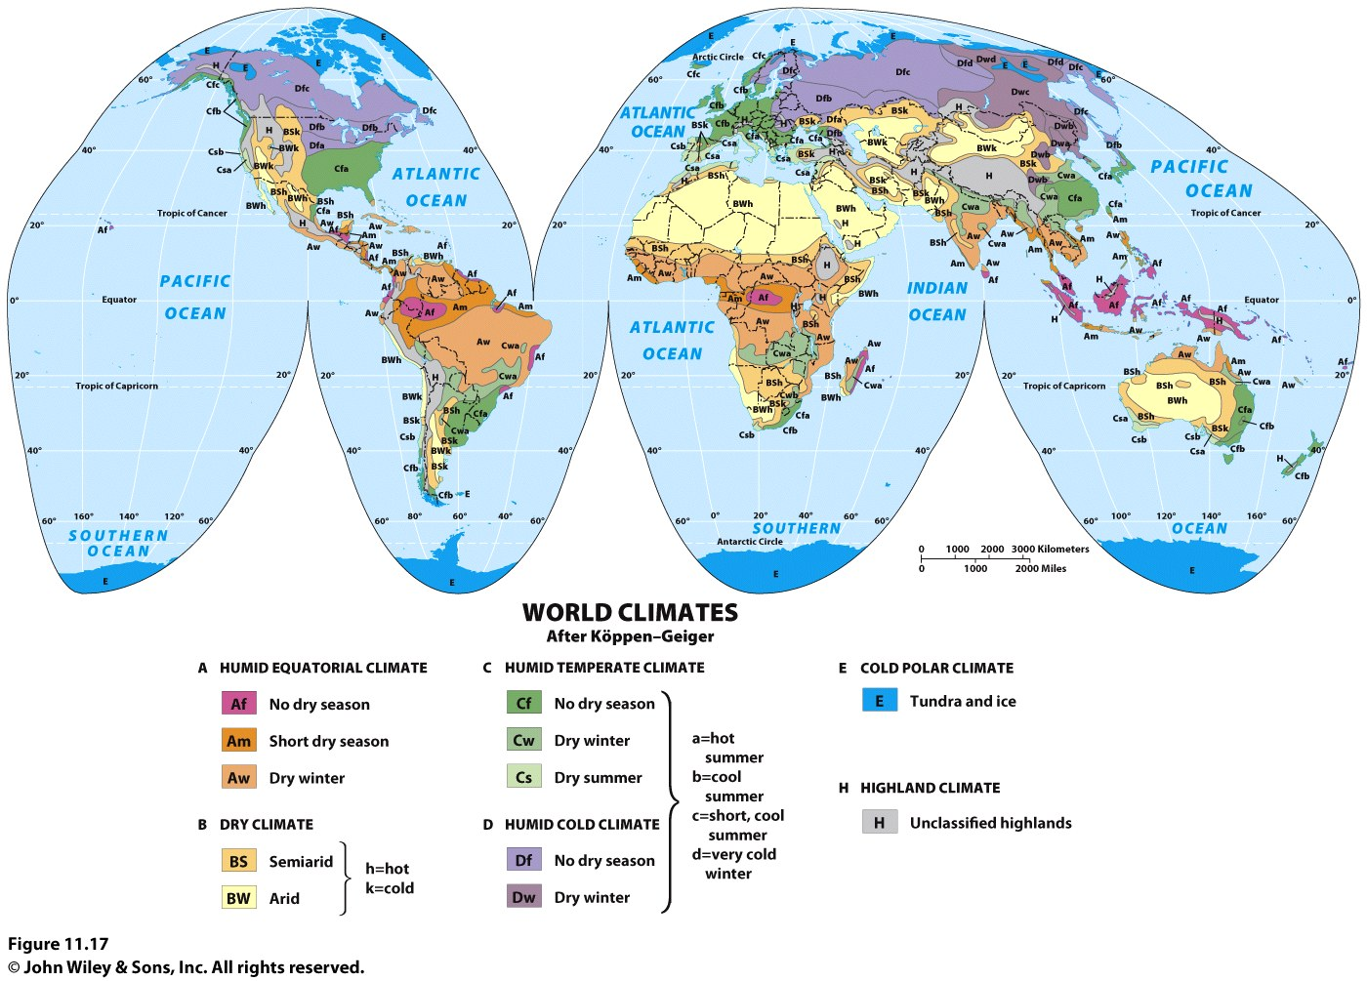
The World Map of Climates
Notes:
Figure 11.17
World Climates. The Köppen map of world climates, as modified by R. Geiger. These are
macroclimatic regions; microclimates are set within these but cannot be shown at this scale.

Slide 41
The World Map of Climates
The “no dry season” (Af) regions are equatorial rainforest regions.
The “short dry season” (Am) climate is known as the monsoon climate.
BW is desert and BS is steppe.
“Dry summer” (C) climates are known as Mediterranean climates.
Polar climates, where tundra and ice prevail, are found poleward of (D) climates.

Slide 42
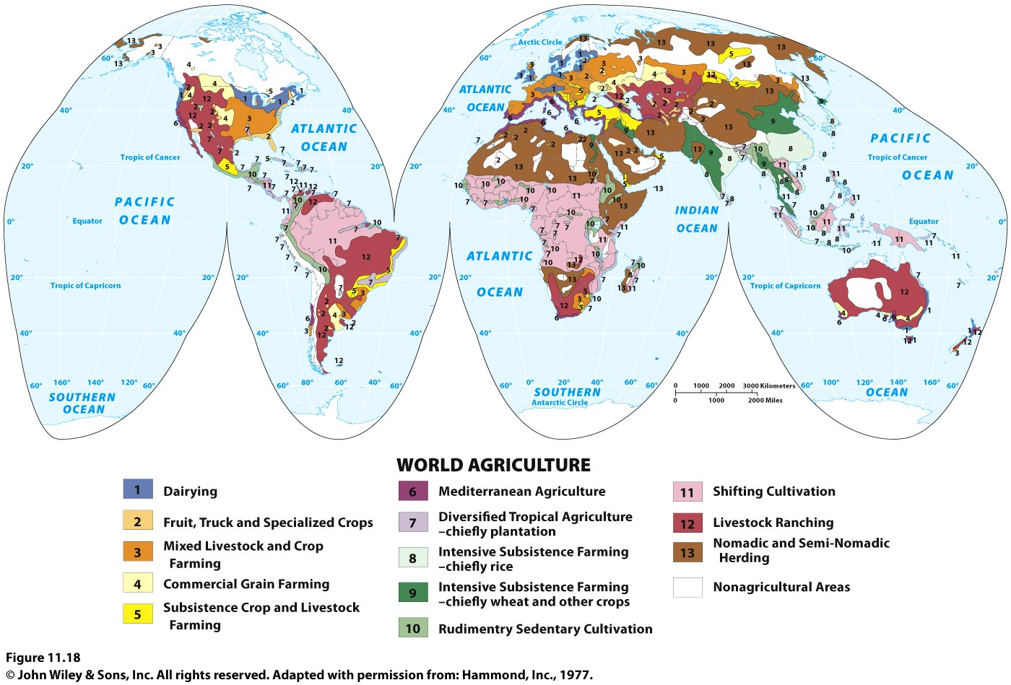
The World Map of Agriculture
INSERT FIGURE 11.18
Notes:
Figure 11.18
World Agriculture. Different kinds of agricultural areas are shown throughout the world.
Adapted with permission from: Hammond, Inc., 1977.

Slide 43
Cash Crops and Plantation Agriculture
The World Map of Agriculture
Cash farming continues to provide badly needed money, even if the conditions of sale to the urban industrial world are unfavorable.
Occasionally, producing countries consider forming a cartel in order to present a united front to the importing countries and to gain a better price, as oil-producing states did during the 1970s.
Plantation agriculture: When cash crops are grown on large estates:
Plantations are colonial legacies that persist in poorer, primarily tropical, countries along with subsistence farming.

Slide 44
Commercial Livestock, Fruit, and Grain Agriculture
Commercial Livestock, Fruit, and Grain Agriculture
Livestock ranching: the raising of domesticated animals for the production of meat and byproducts, such as leather and wool
Subsistence agriculture
Subsistence crop and livestock farming
Intensively subsistence farming (chiefly rice)
Intensively subsistence farming (chiefly wheat and other crops
Mediterranean Agriculture: specialized farming occurs only in areas where the dry summer Mediterranean climate prevails

Slide 45
Drug Agriculture
Because of the high demand for drugs—particularly in the global economic core—farmers in the periphery often find it more profitable to cultivate poppy, coca, or marijuana plants than to grow standard food crops.
Drug cartels that oversee the drug trade have brought crime and violence to the places where they hold sway.
Mexicans now control 11 of the 13 largest drug markets in the United States.

Slide 46
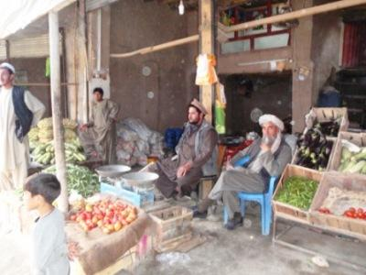
Informal agriculture: Millions of people cultivate small plots of land in and around their homes for domestic consumption or to trade informally with others.
Such practices are encouraged in some places—notably China—but more often they are ignored, or even discouraged.
Concept Caching: Produce bazaar in Ghazni City, Afghanistan
© Barbara Weightman

Slide 47
Political Influences on Agriculture
Cash crop: cotton
Colonial powers established a trading network that led to the globalization of the cotton industry.
Cotton cultivation expanded greatly when the Industrial Revolution produced machines for cotton ginning, spinning, and weaving that increased productive capacity, brought prices down, and put cotton goods within the reach of mass markets.
Even as countries emerged from colonial control, they were left with a legacy of large landholdings owned or controlled by wealthy individuals or business entities.
Tax regulations and subsidies favoring certain land uses.

Slide 48
Socio-cultural Influences on Agriculture
Luxury crops, such as coffee:
In most cases coffee is produced on enormous, foreign-owned plantations, where it is picked by local laborers who are hired at very low wage rates
Fair trade: guarantees coffee producers a “fair trade price” of $1.40 per pound of coffee (plus bonuses of $0.30 per pound for organic)
People’s changing tastes also shape the geography of agriculture (e.g., tea)

Slide 49
Agribusiness and the Changing Geography of Agriculture
Agribusiness: the businesses that provide a vast array of goods and services to support the agricultural industry.
A global network of farm production is oriented to the one-fifth of the world’s population that is highly urbanized, wealthy, and powerful.
Few farmers in distant lands have real control over land-use decisions, for the better off people in the global economic core continue to decide what will be bought at what price.

Slide 50
Environmental Impacts of Commercial Agriculture
Overfishing
Land clearing and deforestation
Concerns over the introduction of chemical fertilizers and pesticides into the environment—as well as soil erosion.
Ecological degradation and desertification
The growth of organic farming and the move toward the use of local foods in some communities can benefit the environment.

Slide 51
The Challenge of Feeding Everyone
Worldwide, about 1 billion people are malnourished.
Inadequate distribution systems and widespread poverty.
Some of the most fertile, productive farmlands are lost to housing and retail developments.
Commercial agricultural areas are converted into regions for second homes.
Population growth and the loss of agricultural land help to explain why global food prices have been on the rise for more than a decade.
Food deserts are areas with limited access to fresh, nutritious foods.

Slide 52
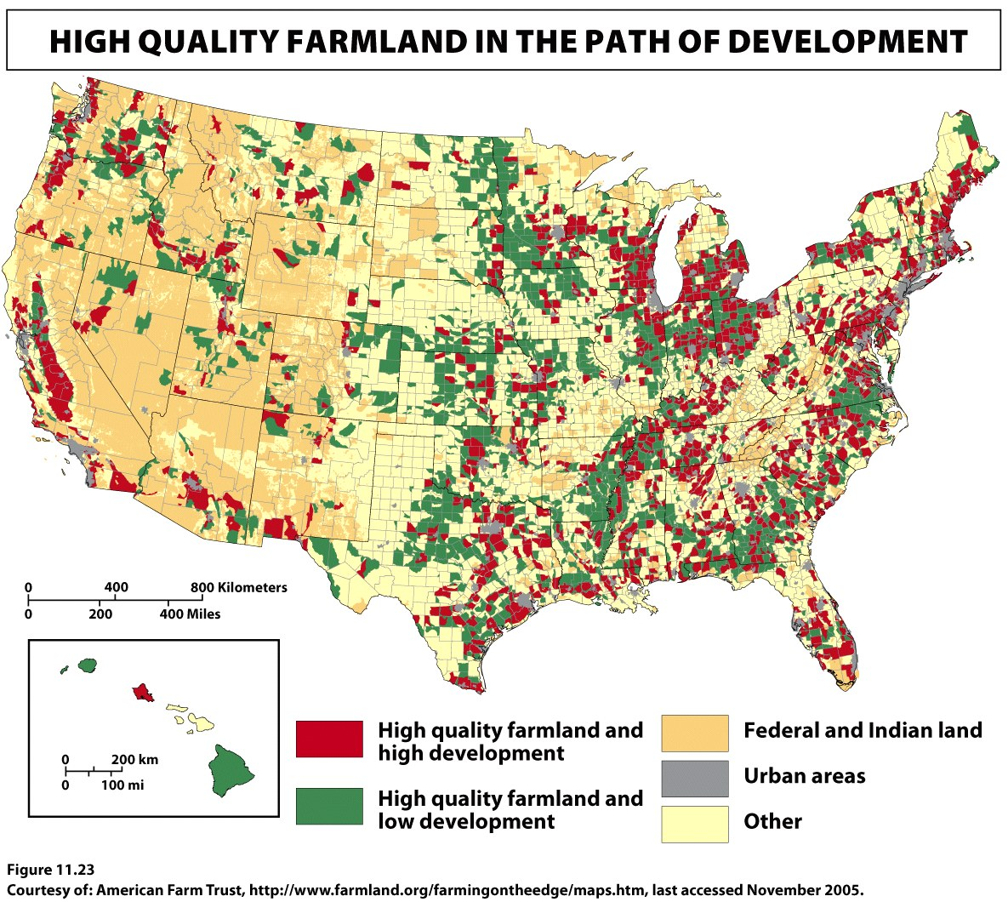
INSERT FIGURE 11.23
Notes:
Figure 11.23
Farming on the Edge: High-Quality Farmland in the Path of Development, 2002. This
map from American Farmland Trust, whose charge is to preserve farmland, highlights farmland
that is endangered of being suburbanized as cities expand into neighboring farmlands. Courtesy of:
American Farm Trust, http://www.farmland.org/farmingontheedge/maps.htm, last accessed November 2005.

