Slide 1
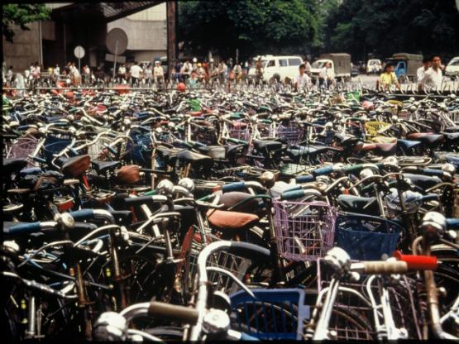
Chapter 12: Industry and Services
Concept Caching: Bicycle Use and Production in China
© Barbara Weightman

Slide 2
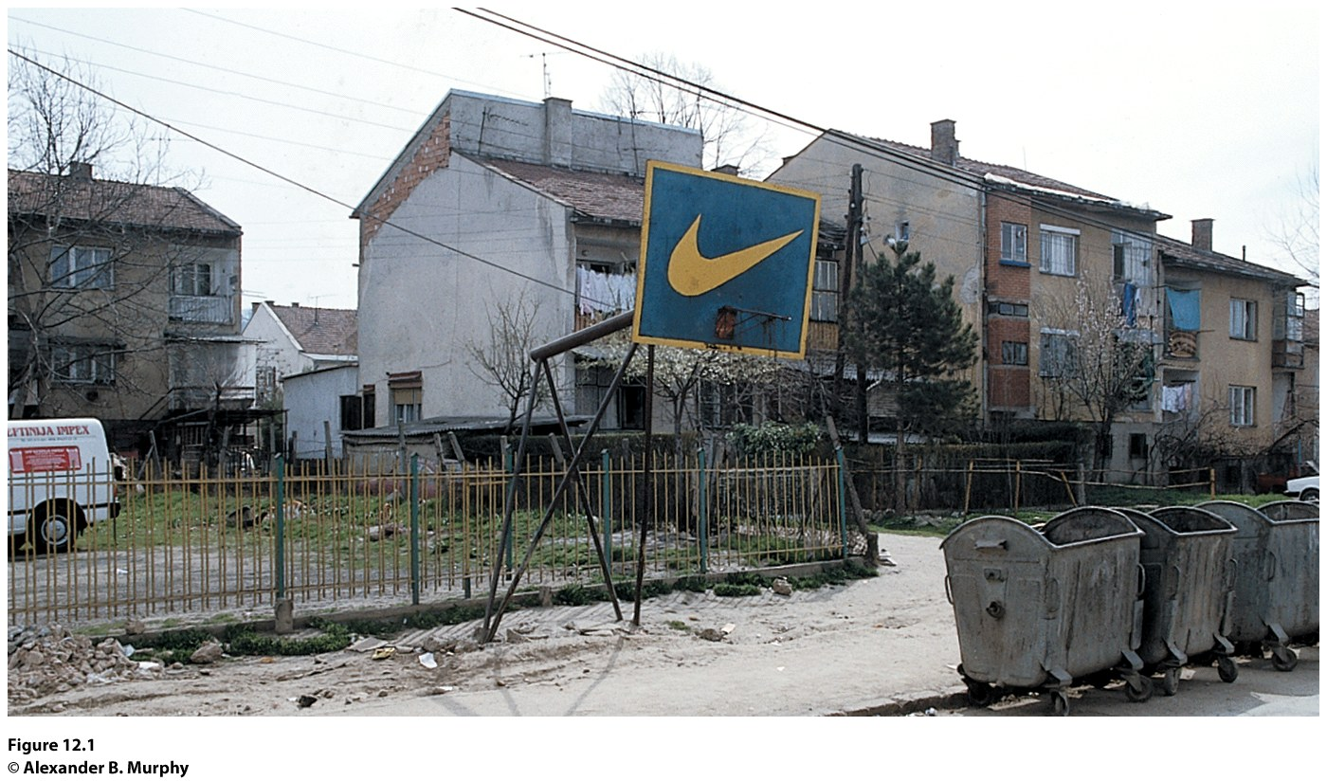
Field Note: Branding the Backboard
“Walking through a relatively poor neighborhood in Skopje, Macedonia, with the midday Muslim call to prayer ringing in my ears, the last thing I expected to see was something from my home State of Oregon (Fig. 12.1). But there it was—the unmistakable Nike swoosh on the backboard of a basketball hoop where the local kids play pick-up games!”
“
Notes:
Figure 12.1
Skopje, Macedonia. The Nike “swoosh” is everywhere—even on the backboard of a ba s ketball
hoop in this relatively poor neighborhood of Skopje, Macedonia. © Alexander B. Murphy

Slide 3
Key Question
Where did the Industrial Revolution begin, and how did it diffuse?

Slide 4
The Industrial Revolution
Eighteenth-century inventions brought new uses for known energy sources (coal) and new machines to improve efficiencies (steam engines).
During the Industrial Revolution, innovations in iron manufacturing enabled the production of the steam engine and a variety of other products.
An expanding trade network focused on Western Europe and brought wealth to those in a position to take advantage of changing circumstances.
With the advent of the railroad and steam ship, Great Britain enjoyed even greater advantages over the rest of the world than it did at the beginning of the Industrial Revolution.

Slide 5
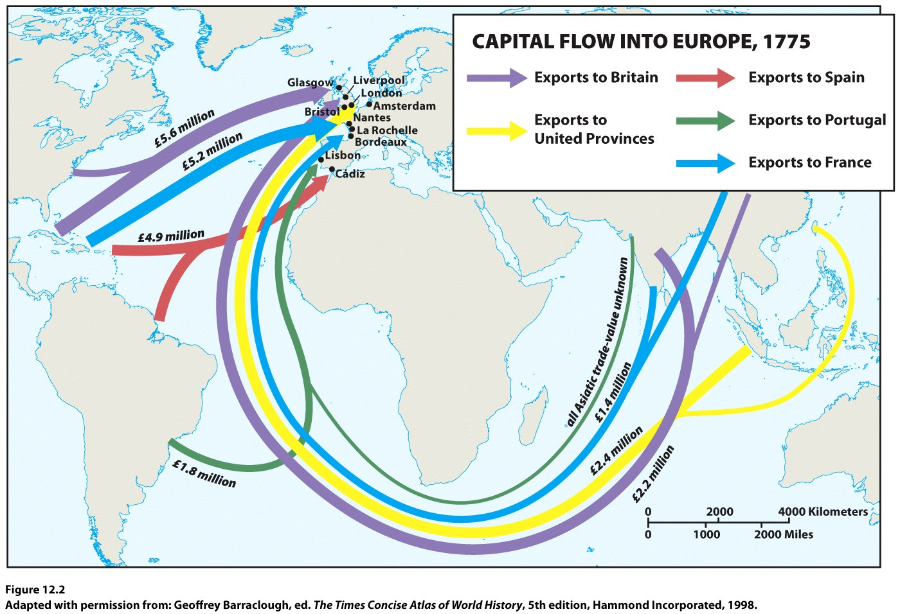

Slide 6
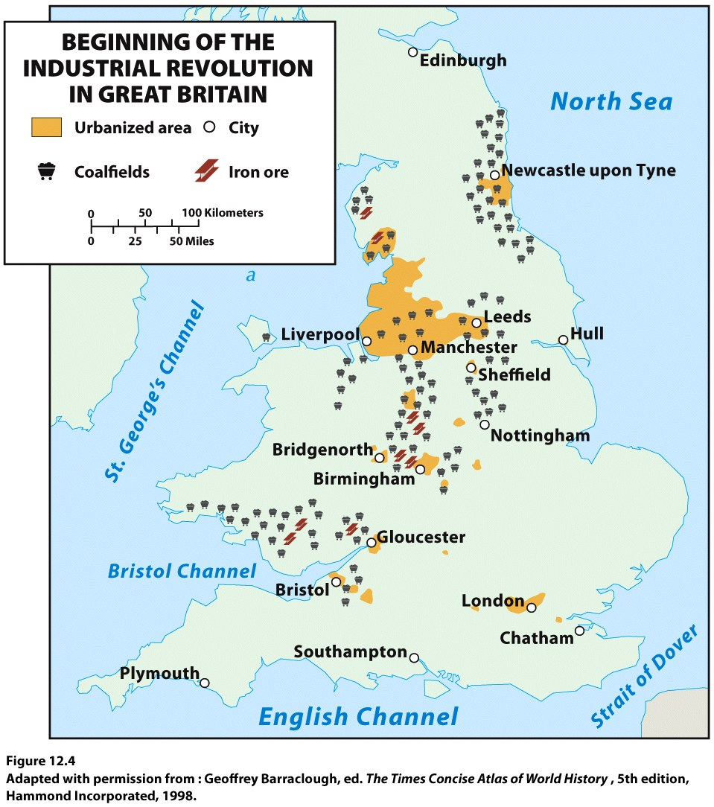

Slide 7
Diffusion to Mainland Europe
Concept Caching:
Fenway Park, Boston, MA
As the innovations of Britain’s Industrial Revolution diffused into mainland Europe, proximity to coal fields and connection via water to a port remained crucial.
Industrial developments in one area changed the port cities to which they are linked.
Once the railroads were well established, some manufacturing moved to or expanded inside of existing urban areas with large markets, i.e. London and Paris.
By the early twentieth century, industry began to diffuse from the original European hearth to northern Italy (now one of Europe’s major industrial regions), Catalonia (anchored by Barcelona) and northern Spain, southern Sweden, and southern Finland.

Slide 8
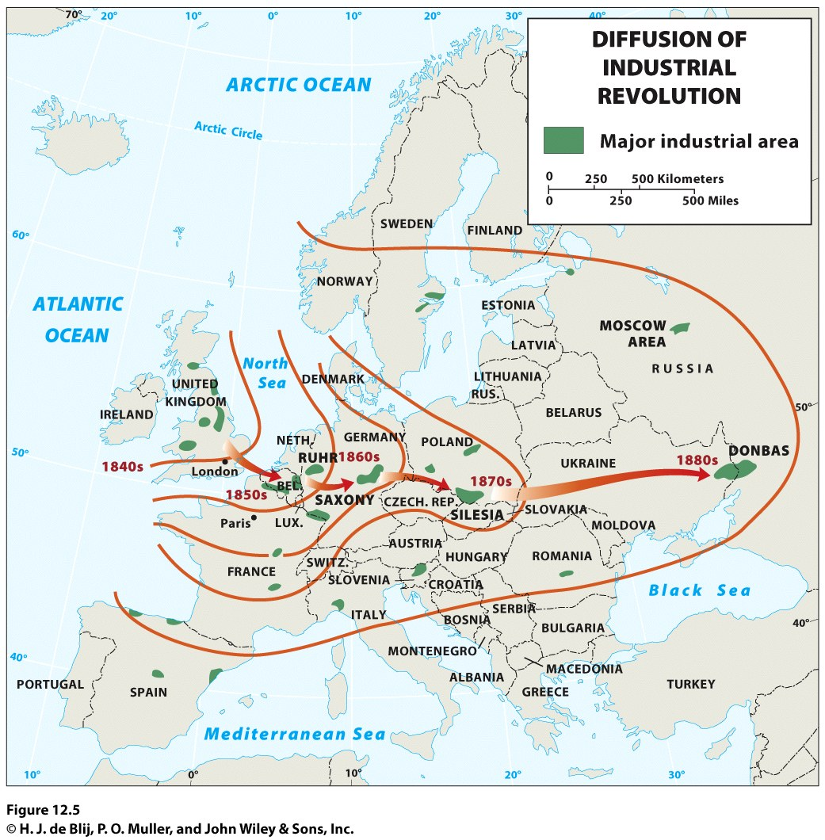

Slide 9
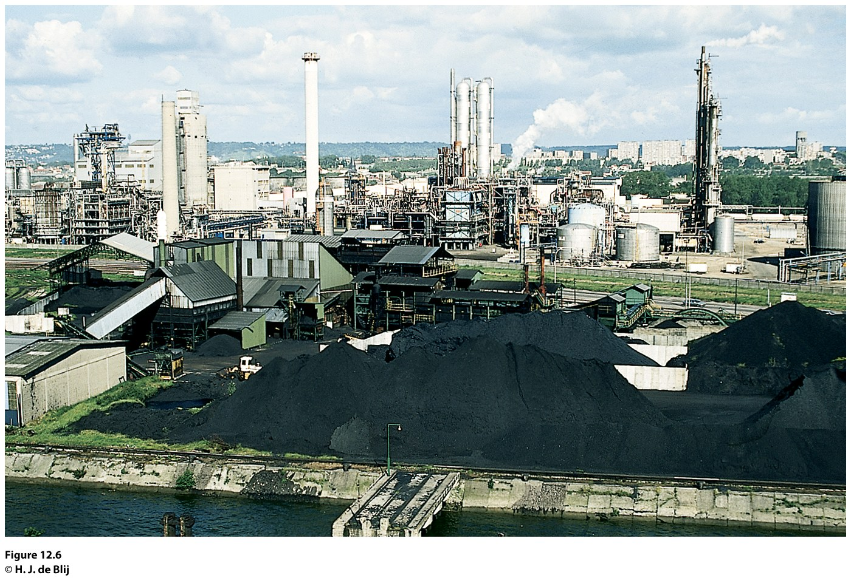
Field Note
“Paris and the Paris Basin form the industrial as well as agricultural heart of France. The city and region are served by the Seine River, along which lies a string of ports from Le Havre at the mouth to Rouen at the head of navigation for oceangoing ships. Rouen has become a vital center on France’s industrial map.”
Figure 12.6
Rouen, France. © H. J. de Blij.
Notes:
*Could be an audio file.
Figure 12.6
Rouen, France. © H. J. de Blij.

Slide 10
Diffusion Beyond Europe
Primary industrial regions: western Europe, eastern North America, western Russia and Ukraine, and East Asia
North America: Manufacturing began in New England during the colonial period; benefited from the ability of its companies to acquire needed raw materials from overseas sources.
Russia and Ukraine: St. Petersburg attracted industries including shipbuilding, chemical production, food processing, and textile making.
East Asia: manufacturing in Japan depended on raw materials imported from other parts of the world; dominant region is the Kanto Plain.

Slide 11
Key Question
How have the character and geography of industrial production changed?

Slide 12
Fordist Production
Fordist production: was the dominant mode of mass production that endured from 1945 to 1970, named for Henry Ford.
The Fordist period is marked by a surge in both mass production and mass consumption.
Vertical integration
Friction of distance: the increase in time and cost that usually comes with increased distance over which commodities must travel.
Ex.: furniture manufacturing

Slide 13
Agglomeration
Fordist Production
British economist Alfred Marshall: localization
Geographer Alfred Weber: least cost theory focused on a factory owner’s desire to minimize three categories of costs:
Transportation
Labor
Agglomeration

Slide 14
Flexible Production and Product Life Cycle
Flexible production systems: Firms can pick and choose among a multitude of suppliers and production strategies in distant places, and then quickly shift their choices in response to adjustments in production costs or consumer demand.
Commodification: Goods that were not previously bought, sold, and traded gain a monetary value and are bought, sold, and traded on the market.
Product life cycle: Changes in the production of a good over time take place.

Slide 15
The Global Division of Labor
Labor is concentrated in the global economic periphery and semiperiphery to take advantage of lower labor costs, whereas research and development is primarily located in the core.
David Harvey: time–space compression.
Just-in-time delivery: Companies keep just what they need for short-term production and new parts are shipped quickly when needed.
Spatial fix: In choosing a production site, location is only one consideration.
Outsourced: moved offshore.

Slide 16
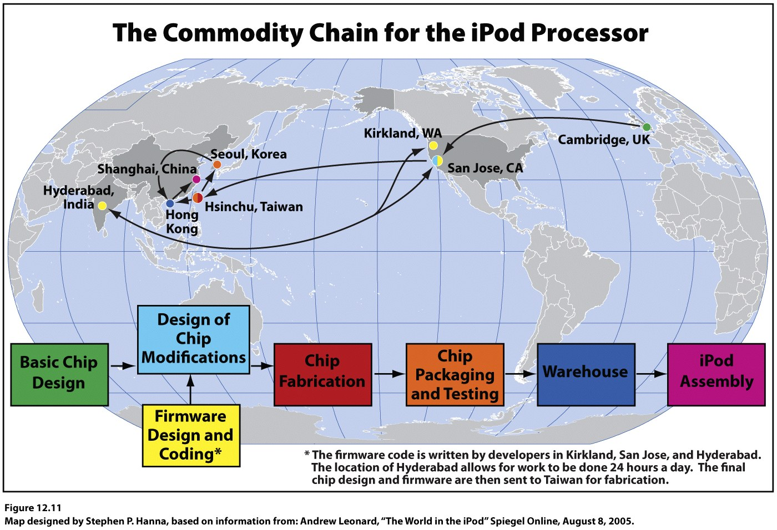
Made in America or Designed in America?
Commodity Chain: Consumption, or purchasing an item, is the end point in a commodity chain that affects places in a variety of ways.

Slide 17
Major Influences on the Contemporary Geography of Manufacturing
Transportation: Intermodal connections, places where two or more modes of transportation meet in order to ease the flow of goods and reduce the costs of transportation.
Regulatory Circumstances: Regional trade organizations such as the North American Free Trade Agreement (NAFTA) and the European Union (EU) have trade agreements that influence where imported goods are produced.
Energy: The role of energy supply as a factor in industrial location decisions has changed over time.

Slide 18
New Centers of Industrial Activity
Deindustrialization is a process by which companies move industrial jobs to other regions.
New industrial regions emerge as shifts in politics, laws, capital flow, and labor availability occur.
East Asia has become a particularly important new region of industrialization.

Slide 19
The Rise of East Asia
New Centers of Industrial Activity
Four Tigers of East and Southeast Asia: South Korea, Taiwan, Hong Kong, and Singapore.
The tigers emerged as the first newly industrializing countries (NICs).
Hong Kong became mainland China’s gateway.
To the world, a bustling port, financial center, and break-of-bulk point, where goods are transferred from one mode of transport to another.

Slide 20
New Centers of Industrial Activity
The Rise of East Asia
The industrial growth of Singapore also was influenced by its geographical setting and the changing global economic division of labor.
In 1997 risky lending practices and government investment decisions caused Thailand’s currency to collapse, followed by its stock market.
By early 1998 one of the Four Tigers, South Korea, required a massive infusion of dollars to prevent economic chaos.

Slide 21
New Centers of Industrial Activity
The Chinese Juggernaut
China’s major industrial expansion occurred during the communist period.
Under state planning rules, the Northeast district became China’s industrial heartland, a complex of heavy industries based on the region’s coal and iron deposits located in the basin of the Liao River.
The second largest industrial region in China, the Shanghai and the Chang Jiang district , developed in and around the country’s biggest city, Shanghai.
Notes:
*

Slide 22
New Centers of Industrial Activity
The Chinese Juggernaut
China’s large labor force has attracted hundreds of international companies.
The Northeast has become China’s “Rust Belt.”
Today, the Chinese government is pushing industrialization into the interior of the country, with new investment flowing into poorer parts of the central and western portions of the country.

Slide 23
New Centers of Industrial Activity
The Chinese Juggernaut
BRICS: Brazil, Russia, India, China, and South Africa; these countries are evidence of a shift in global economic power away from the traditional economic core.
India has recently become the world’s sixth largest economy.
India has no major oil reserves, so it must spend heavily on oil energy.

Slide 24
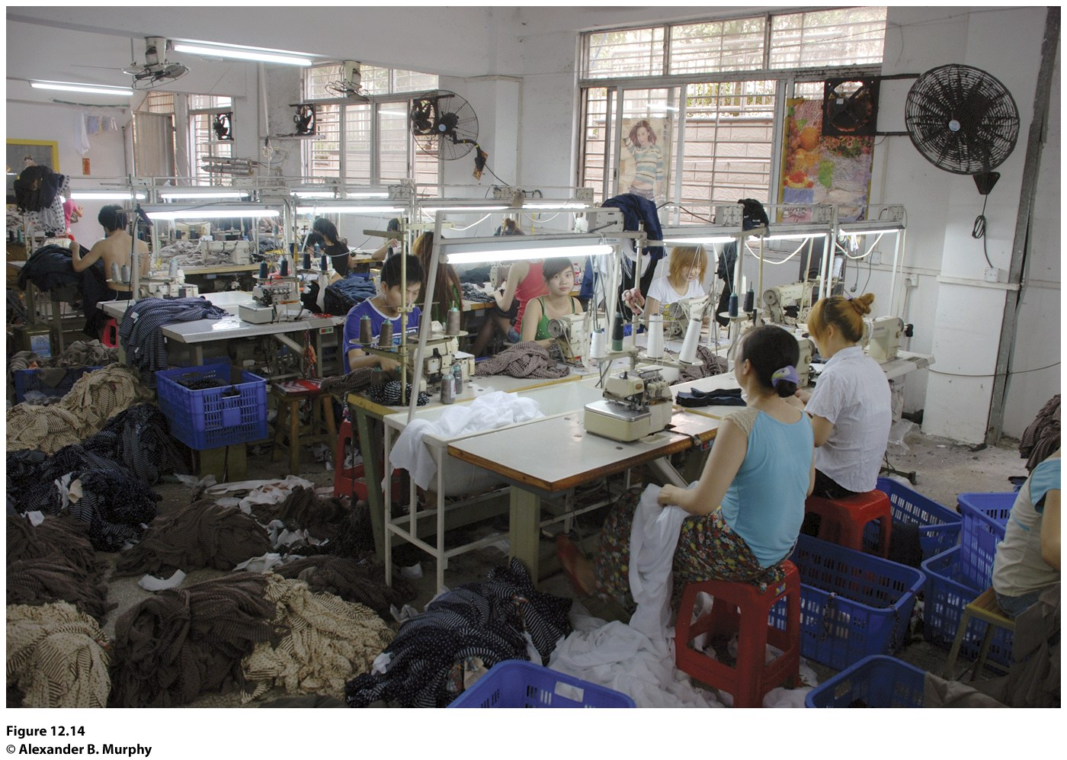
Field Note
“Humen is one of the Pearl River Delta cities that has been transformed by the rise of China. The small textile factory I visited provided insights into the opportunities and challenges that are confronting China today. The 40 or so employees were mostly young, but there were a few older folks. They were making women’s clothes for the French market.”
Notes:
*Could be an audio file.
Figure 12.14
Humen, China. © Alexander B. Murphy

Slide 25
New Centers of Industrial Activity
Where From Here?
It has been suggested that a combination of technological changes and developments in the global economy have reduced the significance of location and made place differences increasingly insignificant.
What is needed is a greater understanding of how places have changed as a result of new production methods, new corporate structures, and new patterns of industry.

Slide 26
Key Question
How have deindustrialization and the rise of service industries altered the economic geography of production?

Slide 27
How Have Deindustrialization and the Rise of Service Industries Altered the Economic Geography of Production?
Service industries (tertiary industries) encompass the range of services that are found in modern societies.
Quaternary industries: the collection, processing, and manipulation of information and capital.
Quinary industries: activities that facilitate complex decision making and the advancement of human capacities.

Slide 28
Geographical Dimensions of the Service Economy
Deindustrialization did little to change the basic disparities between core and periphery that have long characterized the global economy.
The industrial zone of the northeastern United States (around the Great Lakes) lost much of its industrial base and is now commonly called the Rust Belt.
The Sun Belt is a secondary industrial region that has made the transition to a viable service economy fairly successfully.
Concept Caching:
Mount Vesuvius

Slide 29
Geographical Dimensions of the Service Economy
New Patterns of Economic Activity
Technologies such as GIS can help to model the best locations for new businesses, office complexes, government centers, or transportation connections.
Major retailers change the economic prospects and physical landscapes of the places where their headquarters are located. Ex.: Walmart
The locational influences on quaternary services are more diverse.
Those who work in the quinary sector tend to be concentrated around governmental seats, universities, and corporate headquarters.

Slide 30
Guest Field Note Fayetteville, Arkansas
“For most geographers, the simple act of daily observation of the world around them becomes a profoundly satisfying habit. For the last 17 years, my daily observations have been of the rapidly changing urban/economic landscape of northwest Arkansas, one of the fastest growing metropolitan areas in the United States.”
Credit: Fiona M. Davidson, University of Arkansas
Figure 12.18
Fayetteville, Arkansas.
Notes:
Figure 12.18
Fayetteville, Arkansas.
Credit: Fiona M. Davidson, University of Arkansas

Slide 31
High-Technology Clusters
The goal of a high-technology corridor is to attract designers of computers, semiconductors, telecommunications, sophisticated medical equipment, etc. Ex.: California’s Silicon Valley
Growth pole spurred economic development in the surrounding area.
Technopole: an area planned for high technology where agglomeration built on a synergy among technological companies occurs.
High-technology industries have become such an important symbol of the postindustrial world that local, regional, and national governments often aggressively pursue firms in this sector.

Slide 32
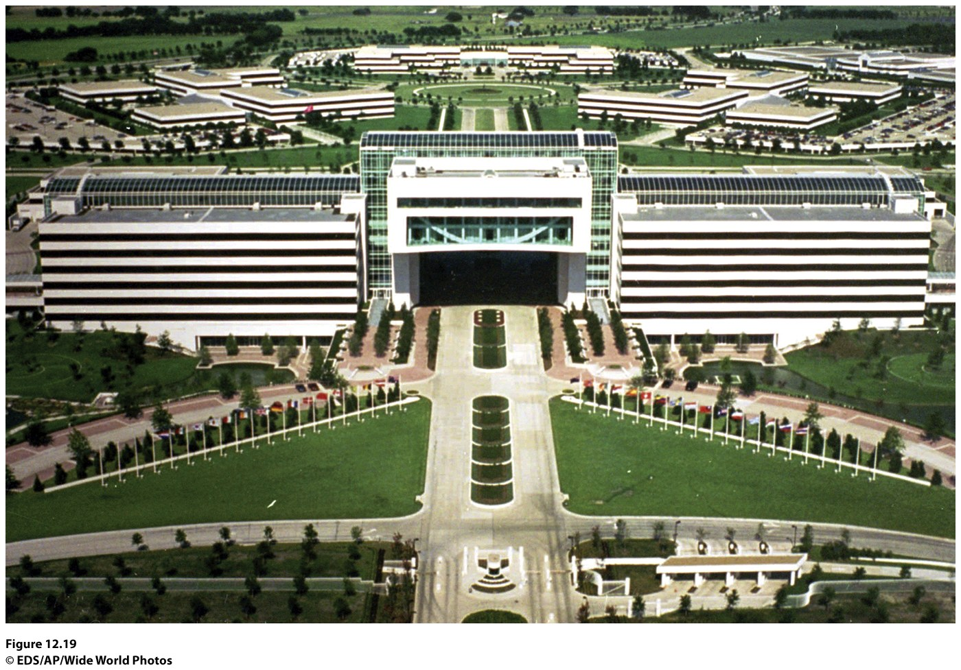
Figure 12.19 Plano-Richardson, Texas. The Plano-Richardson Telecom Corridor is located just north of Dallas and is home to telecom corporate headquarters, such as Electronic Data Systems Corporation’s headquarters in this photograph. © EDS/AP/Wide World Photos.

Slide 33
Tourism Services
The tourism boom began in the global economic core as incomes and leisure time increased for a rapidly expanding segment of the population.
Tourism is likely to continue to expand despite dips in travel at the beginning and end of the first decade of the twenty-first century.
The economic impacts of tourist-related development are far-reaching.

Slide 34
Place Vulnerabilities in a Service Economy
Mechanization can have a negative impact on service jobs.
Places dominated by the service sector cannot exist without extensive connections with other places because those living in such places still need food and material products.
Economic decision making in a globalized economy can easily become disconnected from the fate of individual places and regions.
Ex.: the financial services industry

