Slide 1
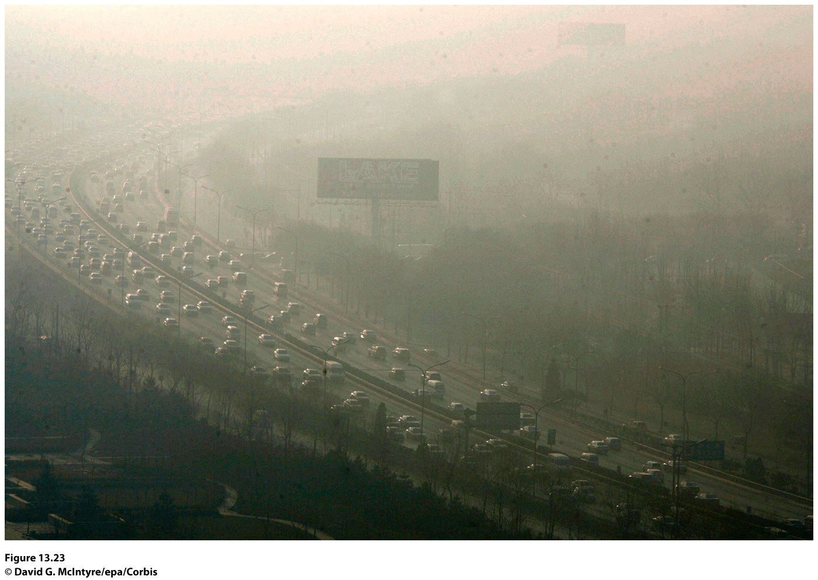
Chapter 13: The Humanized Environment
Notes:
Figure 13.23
Beijing, China. Smog covers the traffi c on
a motorway in the central business districts of
Beijing just a few months before the opening
of the 2008 Olympics in Beijing. © David G.
McIntyre/ epa /Corbis

Slide 2
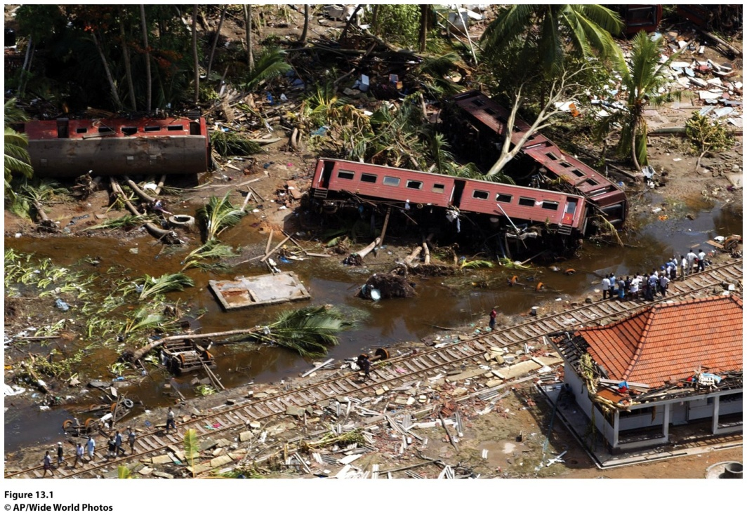
Field Note: Disaster along Indian Ocean Shores
“Watching the horrors of the tsunami of December 26, 2004 unfold on screen, I found it quite eerie to see such devastation in places where earlier I walked and drove and rode—like that Sri Lankan train on which I took a group of students in 1978 including my own children—now smashed by the waves, the carriages toppled, killing more than a thousand passengers, some of them tourists. And the beaches near Phuket in Thailand, so serene and beautiful in memory, now proved a fatal attraction leading to disaster for thousands more, tourists and workers alike.”
Notes:
*Could be an audio file. Figure 13.1
Galle , Sri Lanka. The December 26, 2004 Indian Ocean Tsunami destroyed this passenger train
in Sri Lanka, ripping apart tracks and killing more than a thousand people. © AP/Wide World Photos.

Slide 3
Key Question
How has Earth’s environment changed over time?

Slide 4
How Has Earth’s Environment Changed over Time?
Humans have always altered their environment.
Now, the combined impact of humanity’s destructive and exploitative actions is capable of producing environmental changes at the global scale.
The twentieth-century surge in the size of the human population, combined with a rapid escalation in consumption, magnifies humanity’s impact on Earth in unprecedented ways.
Anthropocene: the incredible role humans play in shaping Earth’s environment.

Slide 5
Tectonic Plates
Alfred Wegener’s continental drift hypothesis.
Pangaea: supercontinent that broke apart into what we now know as Africa, the Americas, Eurasia, and Australia.
At plate boundaries, tectonic plates either diverge (spread apart), converge (come together) or transform (slide past one another).
Subduction zone: When an oceanic plate converges with a continental plate; earthquakes are common.
Transform plate boundary: two tectonic plates are moving past each other; earthquakes are common.

Slide 6
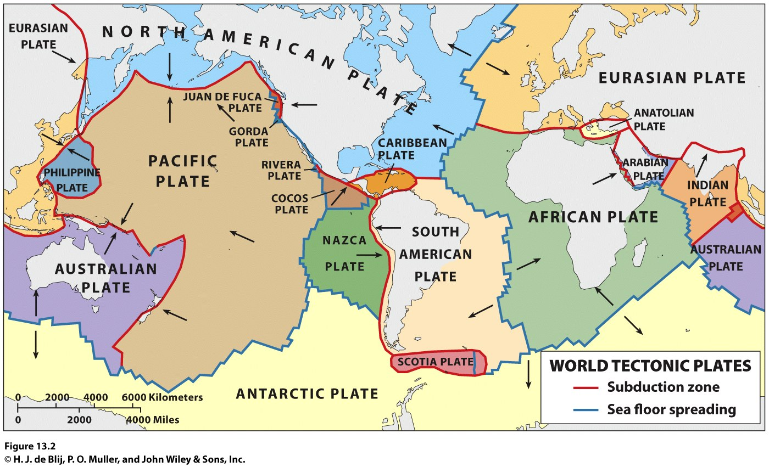

Slide 7
Ocean and Atmosphere
Concept Caching:
Fenway Park, Boston, MA
Earth = the Blue Planet
Several hypotheses exist about the Earth’s acquisition of so much water, including the comet hypothesis.
Uncertainty about how the atmosphere formed.
Photosynthesis: The conversion of carbon dioxide and water into carbohydrates and oxygen through the absorption of sunlight.
The protozoa: the first single celled animals.

Slide 8
Fire and Ice
Volcanic activity has led to mass depletions (loss of diversity through a failure to produce new species).
Volcanic activity has contributed to the three mass extinctions (mass destruction of most species) known to have occurred over the past 500 million years.
Pacific Ring of Fire: an ocean-girdling zone of crustal instability, volcanism, and earthquakes.

Slide 9
Fire and Ice
When Pangaea still was a supercontinent, an Ice Age cooled the Earth and may have contributed to, if not caused, the greatest known extinction crisis in the history of life on Earth.
The Pleistocene epoch was marked by long glaciations and short, warm interglacials.
The Wisconsinan Glaciation left its mark on much of the Northern Hemisphere.
Human communities—fishing, hunting and gathering, and using increasingly sophisticated tools exploited the milder times to expand their frontiers, then hunkered down when it got cold again.

Slide 10
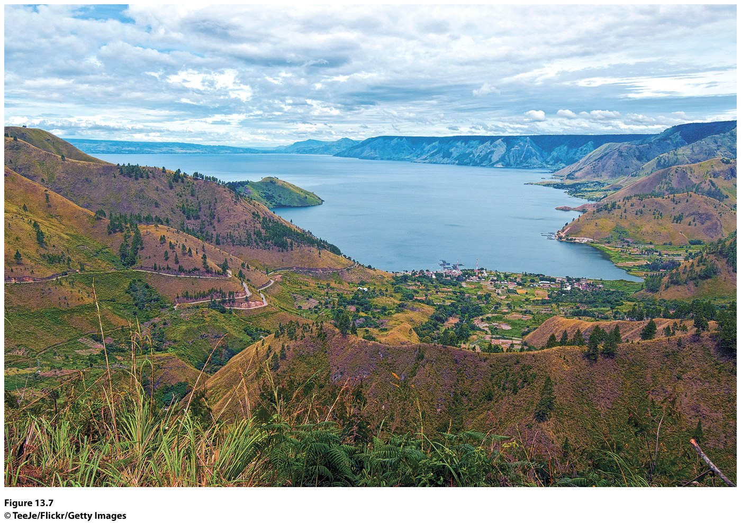
Figure 13.7
Mount Toba, Indonesia. The lake in this photo fills in the gigantic caldera left from the eruption of Mount Toba on the island of Sumatra in Indonesia. © TeeJe/Flickr/Getty Images.
Notes:
Figure 13.7
Mount Toba , Indonesia. The lake in this
photo fills in the gigantic caldera left from
the eruption of Mount Toba on the island of
Sumatra in Indonesia. © TeeJe/Flickr/Getty Images .

Slide 11
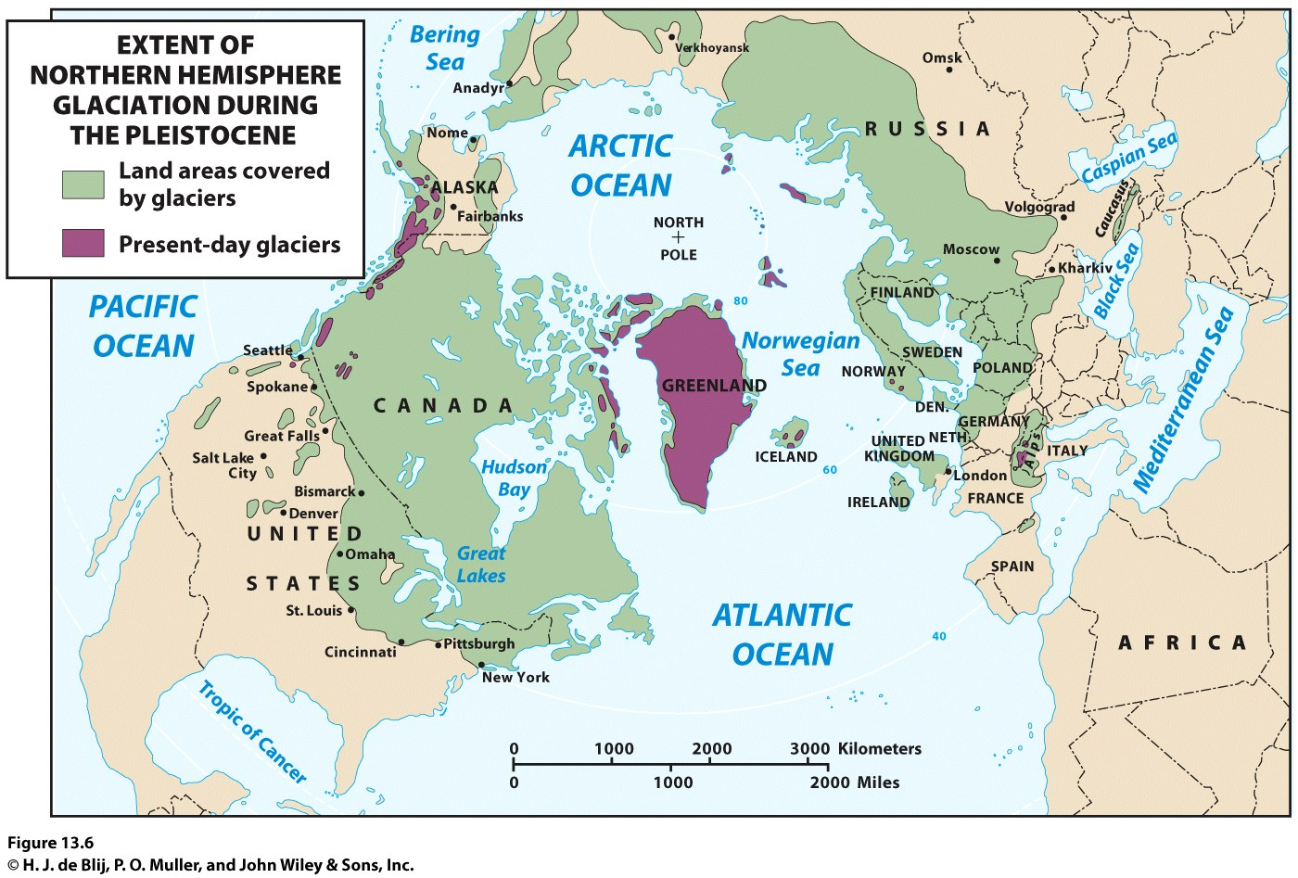
Fire and Ice
Wisconsinan Glaciation eventually gave way to a full-scale interglacial, the current warm interlude that has been given its own designation, the Holocene.

Slide 12
The Little Ice Age in the Modern Era
The Little Ice Age helps explain why the Jamestown colony collapsed so fast.
The Jamestown area experienced a seven-year drought between 1606 through 1612.
April 5, 1815, the Tambora Volcano on the island of Sumatra erupted.
The island’s entire population of 12,000 was killed (26 survived).

Slide 13
The Little Ice Age in the Modern Era
What causes alternating cycles of global warming and cooling?
How large is the human contribution to the associated greenhouse effect (that results when greenhouse gases trap heat and raise temperatures)?

Slide 14
Key Question
How have humans altered Earth’s environment?

Slide 15
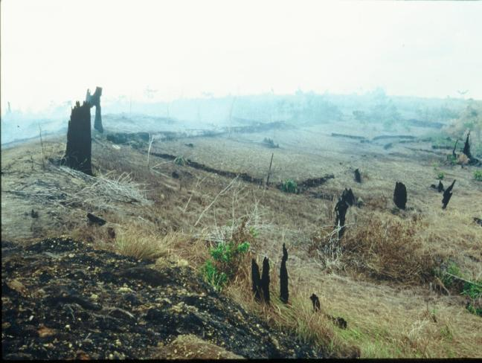
Environmental stress: natural environment is being modified and stressed by human activity.
Concept Caching: Forest Fires/Borneo
Concept Caching:
Deforestation in Para, Brazil
© Barbara Weightman

Slide 16
Water
Renewable resources are replenished even as they are being used, e.g., water.
Nonrenewable resources are present infinite quantities.
Water-holding rocks called aquifers provide millions of wells with steady flows.
In many areas of the world, people have congregated in places where water supplies are insufficient, undependable, or both.

Slide 17
Water
Nearly three quarters of all the fresh water used annually is consumed in farming, not in cities
Industries use another 20 percent of the world’s water supply, contributing heavily to pollution when the used water is returned to streams, lakes, and aquifers
Hydrologic cycle: where water from oceans, lakes, soil, rivers, and vegetation evaporates, condenses, and then precipitates on landmasses.
Physical geographer Jamie Linton argues that the hydrologic cycle does not take into account the role of humans and culture and the norms of water in arid regions of the world

Slide 18
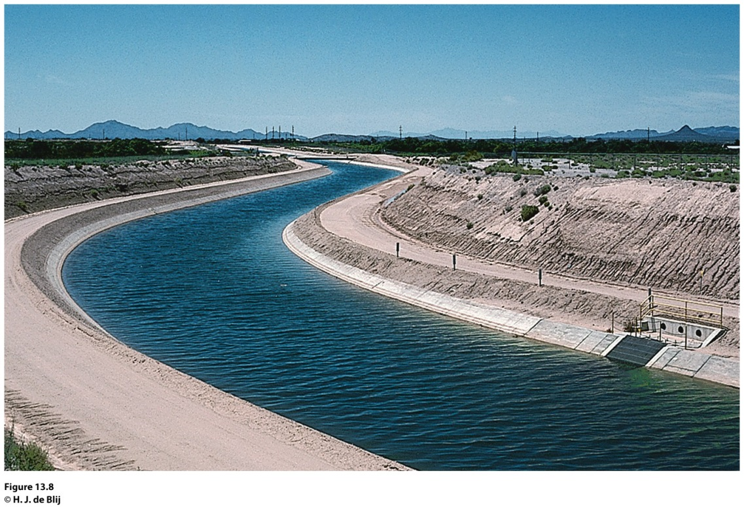
Field Note
“We drove north on Route 89 from Tucson, Arizona, across the desert. Drought rules the countryside here, and dams conserve what water there is. Snaking through the landscape are lifelines such as this, linking Coolidge Dam to distant farms and towns. In the vast, arid landscape, this narrow ribbon of water seems little more than an artificial brook—but to hundreds of thousands of people, this is what makes life possible in the Southwest.”
Notes:
*Could be an audio file.
Figure 13.8
Tucson, Arizona. © H. J. de Blij .

Slide 19
Water
Water security: When relations between countries and peoples are problematic, disputes over water can make them even worse.
Water and Politics in the Middle East
Water supply is a particularly difficult problem affecting relations among Israel and its neighbors.
The water supply complicates the relationships between Israel and its Palestinian neighbors in the West Bank and Gaza.
The water issue will complicate any hoped-for settlement of territorial disputes among Israel and its neighbors.

Slide 20
Atmosphere
Earth’s atmosphere is a thin layer of air lying directly above the lands and oceans.
Scientists are concerned that human pollution of the atmosphere will result in longer lasting, possibly permanent, damage.
The United States remains the world’s largest per capita leader in terms of pollutants generated.

Slide 21
Climate Change
Atmosphere
Growing populations and increased human activity are having an unprecedented impact on the atmosphere.
An overwhelming majority of climate scientists have concluded that tropospheric pollution from anthropogenic (human) sources is causing the Earth to retain increasing amounts of heat.
Climate change is sometimes called global warming.

Slide 22
Atmosphere
Extreme Weather Events
The Little Ice Age
Atmospheric scientists are investigating the relationship between current changes in the climate and extreme weather events.
Acid Rain
A byproduct of the enormous volume of pollutants spewed into the atmosphere is acid rain.
Although acid rain usually consists of relatively mild acids, it is caustic enough to harm certain natural ecosystems.
The geography of acid rain is most closely associated with patterns of industrial concentration and middle- to long-distance wind flows.

Slide 23
The Land
Deforestation
The destruction of vast tracts of forest
The rate of deforestation worldwide declined in the last decade.
Deforestation has been going on for centuries, and the motivations for deforestation vary vastly.
Soil Erosion
The loss of potentially productive soil to erosion has been called a “quiet crisis” of global proportions.
Soil erosion is caused by a variety of factors: Grazing livestock destroy the natural vegetation; lands too dry to sustain farming are plowed, and wind erosion follows.

Slide 24
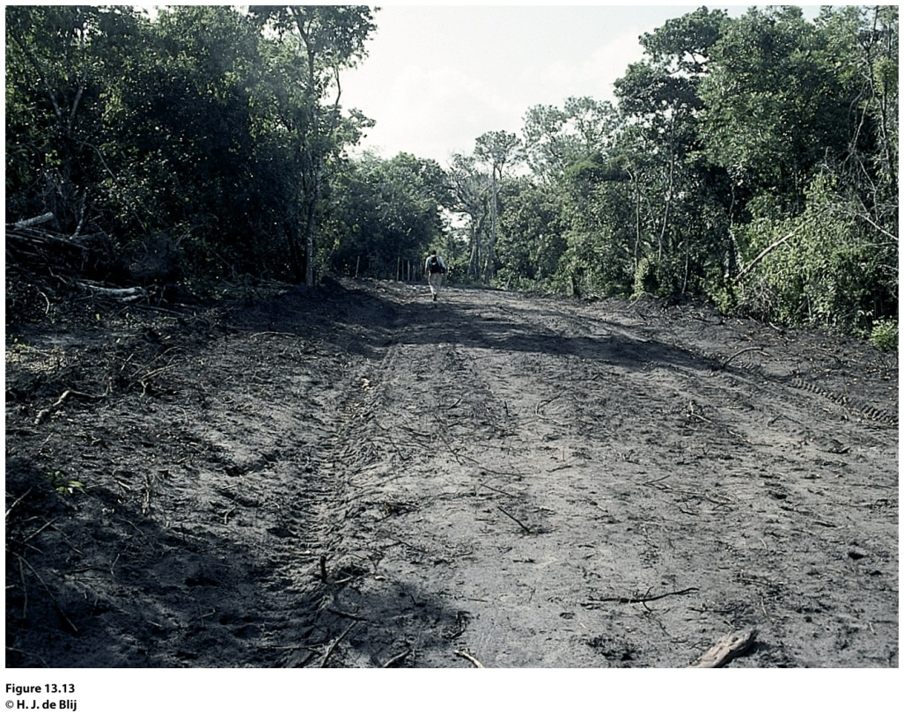
Field Note
“This was one of the most depressing days of this long South American field trip. We had been briefed and had seen the satellite pictures of the destruction of the rainforest, with ugly gashes of bare ground pointing like rows of arrows into the woods. But walking to the temporary end points of some of these new roads made a lot more impact. From the remaining forest around came the calls of monkeys and other wildlife, their habitat retreating under the human onslaught.”
Notes:
*Could be an audio file.
Figure 13.13
Para, Brazil. © H. J. de Blij

Slide 25
The Land
Waste Disposal
The United States, the world’s largest consumer of resources, is also the largest producer of solid waste.
The number of suitable sites for sanitary landfills is decreasing.
Toxic wastes: the danger is caused by chemicals, infectious materials, and the like.
Radioactive wastes: low-level and high-level radioactive wastes.
Transportation of waste.
The dimensions of the waste-disposal problem are growing and globalizing.

Slide 26
Biodiversity
Biodiversity: the diversity of all aspects of life found on the Earth.
Where is biodiversity most threatened?
Threat of extinction depends on the range of the species, its scarcity, and its geographic concentration.
Human impacts on biodiversity have increased over time.

Slide 27
What is the greatest environmental concern facing the region where you live, and in what other regions of the world is that concern also present? How do differences between your region and the other regions sharing the concern influence how it is understood and approached?

Slide 28
Key Question
What are the major factors contributing to environmental change today?

Slide 29
Political Ecology
Leslie Gray and William Moseley describe the field of political ecology as a way of considering the roles of “political economy, power and history in shaping human-environmental interactions.”
Political ecologists use scale to consider how attempts to affect environmental change, such as deforestation, differ depending on the level of spatial detail used to examine the issue.

Slide 30
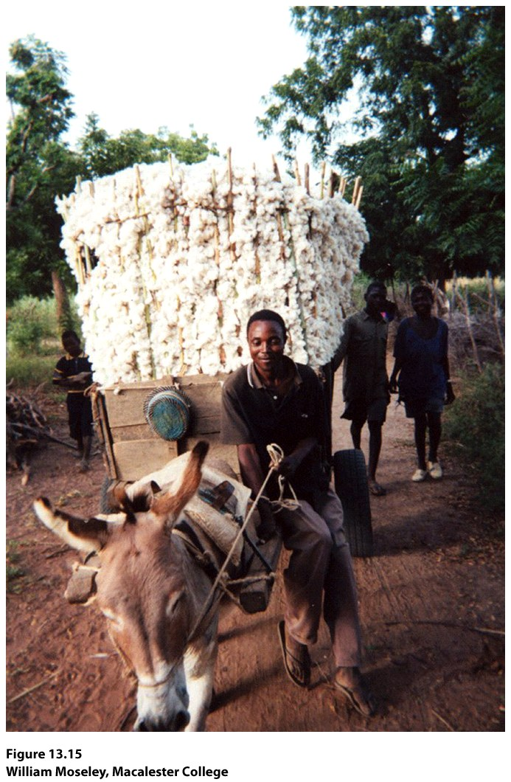
Guest Field Note:
Try, Mali
“In this photo, a young man brings home the cotton harvest in the village of Try in southern Mali. Prior to my graduate studies in geography, I spent a number of years as an international development worker concerned with tropical agriculture—both on the ground in Africa and as a policy wonk in Washington, D.C. I drew at least two important lessons from these experiences. First, well-intentioned work at the grassroots level would always be limited if it were not supported by broader scale policies and economics. Second, the people making the policies were often out of touch with the real impacts their decisions were having in the field.”
Notes:
*Could be an audio file.
Figure 13.15
Try, Mali
Credit: William Moseley, Macalester College

Slide 31
Population
A greater number of people on Earth translates into a greater capacity for environmental change.
Environmental change influences humans differently, depending in part on who they are and where they live.
When a natural disaster hits a wealthier area, the place will more likely be hit financially, whereas, in a poorer area of the world, the place will likely be hit by both financial loss and the loss of lives.

Slide 32
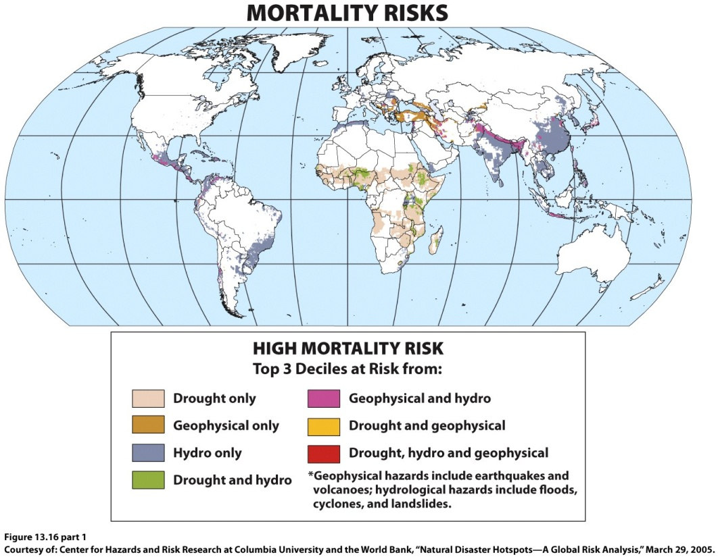
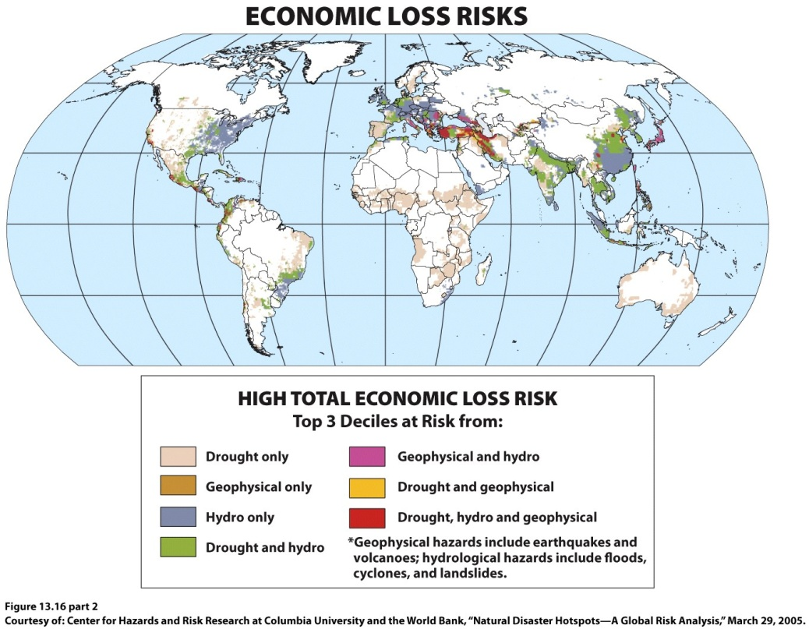
Notes:
Figure 13.16
Natural Disaster Hot Spots. The top map shows the potential mortality risks if major natural
disasters occur in global natural disaster hot spots, and the bottom map shows the potential
economic risks if major natural disa s ters occur in natural disaster hot spots. Courtesy of: Center
for Hazards and Risk Research at Columbia University and the World Bank, “Natural Disaster
Hotspots—A Global Risk Anal y sis,” March 29, 2005.

Slide 33
Patterns of Consumption
Many societies now consume resources at a level and rate that far exceed basic subsistence needs.
The smaller numbers of people in the parts of the world belonging to the global economic core make far greater demands on Earth’s resources than do the much larger numbers in the poorer countries.
Globally, consumption is tied to technology.

Slide 34
Industrial Technology
Resource extraction practices such as mining and logging, which provide the materials to produce technologies, have created severe environmental problems.
Technology has enabled humans to alter large portions of the planet in a short period of time.
Impacts include degradation of the oceans, land surfaces, the biosphere, and the atmosphere.

Slide 35
Transportation
Each innovation in transportation has required increased resource use.
Transportation innovations offer access to remote areas of the planet, which in turn have been altered by human activity.
Advances in transportation have produced significant pollution.

Slide 36
Energy
Much of our energy supply comes from nonrenewable fossil fuels, such as coal, oil, and natural gas.
As populations grow, so does the demand for energy.
Oil is a finite resource. The effects of a shift away from oil will certainly be felt to some degree in the industrial and postindustrial countries.

Slide 37
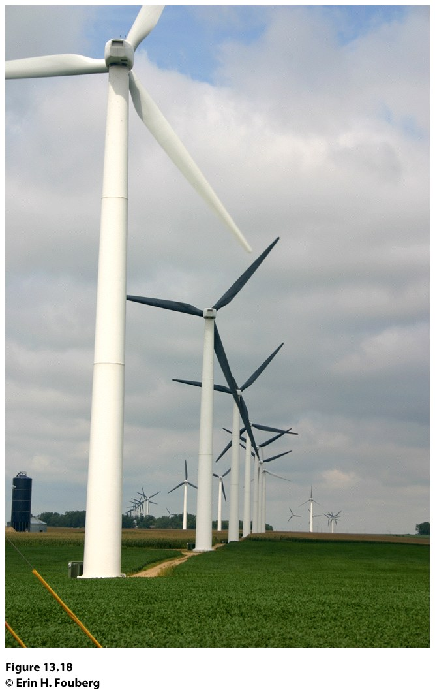
Alternative Energy
Energy
Even alternative energy sources have environmental effects.
At the core of the wind turbines that generate “clean” energy are rare earth minerals, the extraction and processing of which have negative environmental consequences are considered rare earth elements.
Figure 13.18
Lake Benton, Minnesota. The wind park near Lake Benton, Minnesota, was developed beginning in 1994 and now includes more than 600 wind turbines. © Erin H. Fouberg.

Slide 38
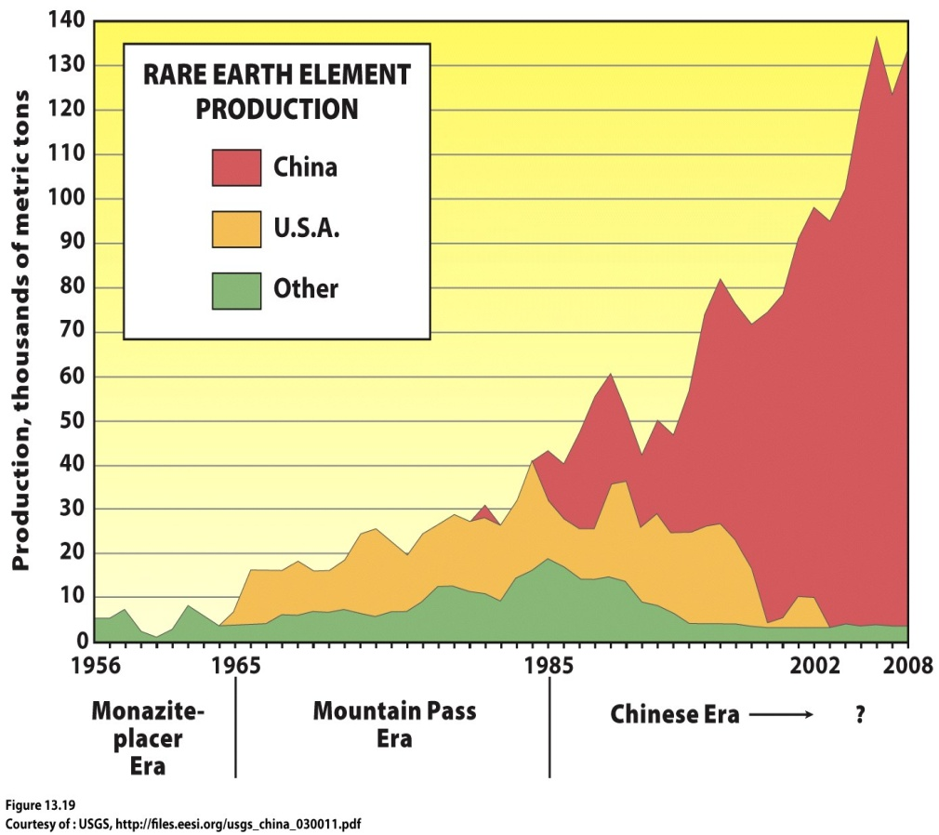
Energy
Alternative Energy
Rare earth elements are in demand because they are used not only in wind turbines but also in alternative energy cars, computers, screens, compact fluorescent light bulbs, cell phones, MRI machines, and advanced weapons systems
The environmental consequences of rare earth element mining have historically been costly enough that production stopped at Mountain Pass Mine in California in 2002
Notes:
Rare earth element production since
1964. Courtesy of : USGS, http://fi les.eesi.
org/usgs_china_030011.pdf

Slide 39
Key Question
What policies are being adopted in response to environmental change?

Slide 40
What Policies Are Being Adopted in Response to Environmental Change?
A major challenge in confronting environmental problems is that many of those problems do not lie within a single jurisdiction.
With the 1972 United Nations Conference on the Human Environment in Stockholm, international governmental organizations began playing a major role in environmental policy.
United Nations Conference on Environment and Development (UNCED).

Slide 41
What Policies Are Being Adopted in Response to Environmental Change?
The delegates to UNCED gave the Global Environment Facility (GEF) significant authority over environmental action on a global scale.
The GEF funds projects related to six issues: loss of biodiversity, climate change, protection of international waters, depletion of the ozone layer, land degradation, and persistent organic pollutants.
Individual states continue to influence decision making in many ways.

Slide 42
Biological Diversity
The biodiversity convention calls for establishing a system of protected areas and a coordinated set of national and international regulations on activities that can have significant negative impacts on biodiversity.
Also provides funding for developing countries that are trying to meet the terms of the convention.
Has proved difficult to implement.

Slide 43
Protection of the Ozone Layer
The ozone layer is of vital importance because it protects Earth’s surface from the sun’s harmful ultraviolet rays.
Studies revealed that the main culprits in ozone depletion were a group of human-made gases collectively known as CFCs (chlorofluorocarbons).
Vienna Convention for the Protection of the Ozone Layer
Montreal Protocol: 1987; phase-out of production and consumption of CFCs

Slide 44
Global Climate Change
Earth Summit: called on developed countries to take measures aimed at reducing their emissions to 1990 levels by the year 2000.
Kyoto Agreement: set a target period of 2008–2012 for the United States, the European Union, and Japan to cut their greenhouse gas emissions.
Neither the United States nor China, the world’s two largest emitters of carbon dioxide, signed the Kyoto Protocol.

Slide 45
Global Climate Change
The United States continues to be the largest producer of carbon dioxide emissions, per person, in the world.
In 2009, the Copenhagen Agreement endorsed the continuation of the Kyoto Accord by stating that the countries agreeing to the accord will work to keep global temperature increases less than 2 degrees Celsius above preindustrial levels.

Slide 46
Additional Resources
Geography and environmental hazards
http://www.bbc.co.uk/scotland/education/int/geog/envhaz/index.shtml
Notes:
http://www.bbc.co.uk/scotland/education/int/geog/envhaz/index.shtml

