Slide 1
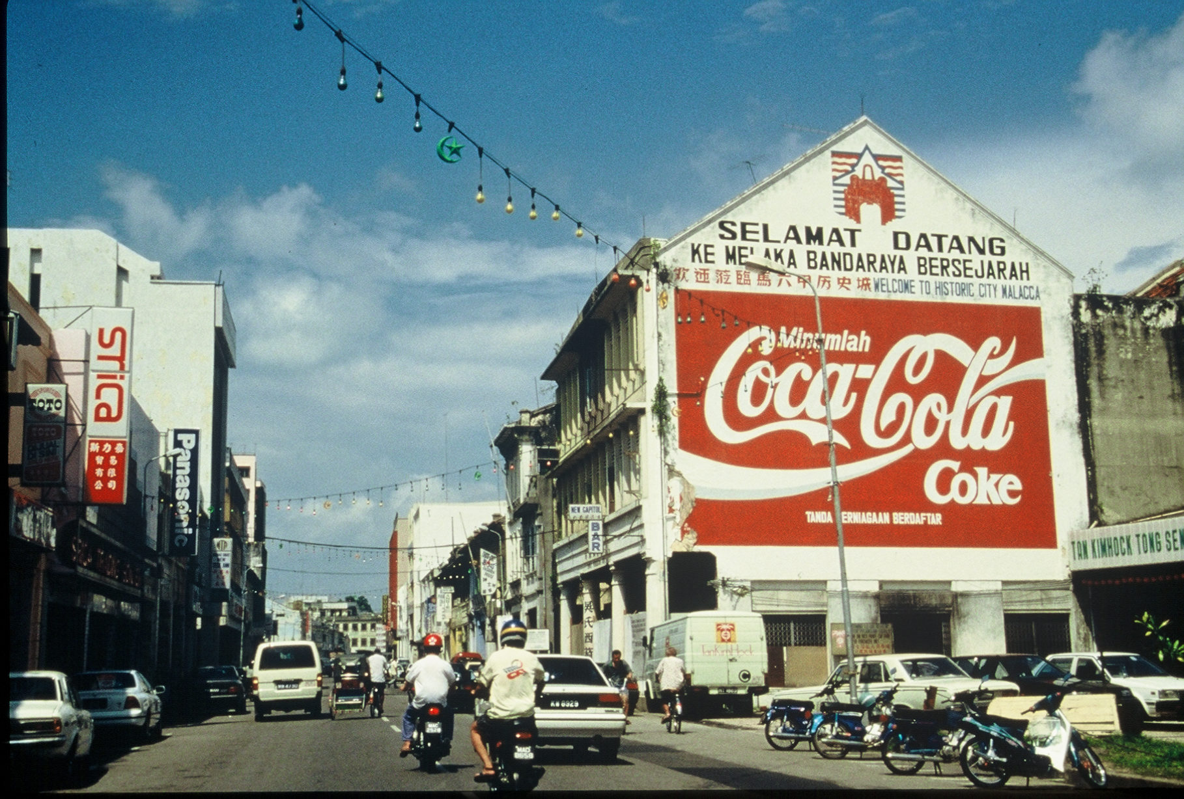
Chapter 14: Globalization and the Geography of Networks
Concept Caching:
Malacca, Malaysia
© Barbara Weightman

Slide 2
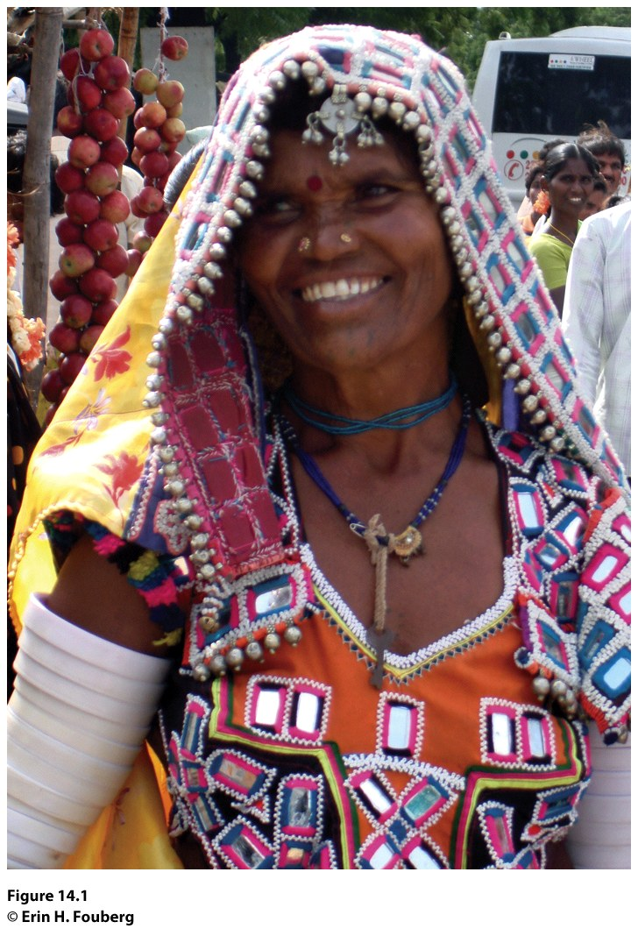
Field Note: Happiness Is in the Eye of the Beholder
“Traveling through a rural village in Andhra Pradesh, India, we stopped to take in a weekend morning market. Women sold spices stored in heaps of colored flakes; a man had a chair set up and was cutting a little boy’s hair; a group of men sold rebar from shops behind vegetable stands. I was used to seeing the colorful sarees and salwar kameez worn by Indian women. Then, an older woman from one of India’s scheduled tribes caught my eye. I first noticed her clothing. The colors were as bright as any saree, but the silver, mirrors, and beads adorning her dress stood out. I looked up at her, our eyes connected, and then she smiled. I asked if I could take her picture, and she nodded yes.”
“
Notes:
*Could be an audio file.
Figure 14.1
Andhra Pradesh, India. A member of a scheduled tribe in
India. © Erin H. Fouberg.

Slide 3
Key Question
How have identities changed in a globalized world?

Slide 4
How Have Identities Changed in a Globalized World?
Globalization networks link us with other people and places, and the flow of information technology is a daily way in which we are interlinked with the globe.
People identify themselves by identifying with or against others at local, regional, and global scales.
As the flow of information continues, many people feel a need to make sense of the world by identifying with people and places.

Slide 5
Personal Connectedness
The idea that people around the world are linked and have shared experiences, such as death, tragedy, sorrow, and even joy, draws from Benedict Anderson’s concept of the nation as an imagined community.
The desire to personalize , to localize, a tragedy or even a joyous event feeds off of the imagined global community in which we live.
In the process of personalizing and localizing, events can be globalized in an effort to appeal to the humanity of all people with the hope that all will feel or experience the loss or joy tangentially.

Slide 6
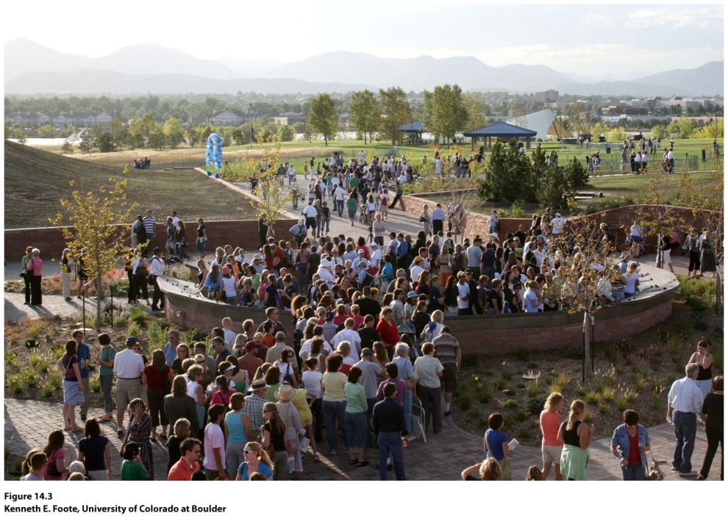
Guest Field Note: Columbine, Colorado
“I took this photo at the dedication ceremony for the memorial to the victims of the Columbine High School shooting of April 20, 1999. Columbine is located near Littleton, Colorado, in Denver’s southern suburbs. The memorial, dedicated on September 21, 2007, provides a quiet place for meditation and reflection in a public park adjacent to the school. Hundreds came to the ceremony to honor those killed and wounded in the attack, one of the deadliest school shootings in U.S. history.”
Notes:
*Could be an audio file.
Figure 14.3

Slide 7
Key Question
What is globalization, and what role do networks play in globalization?

Slide 8
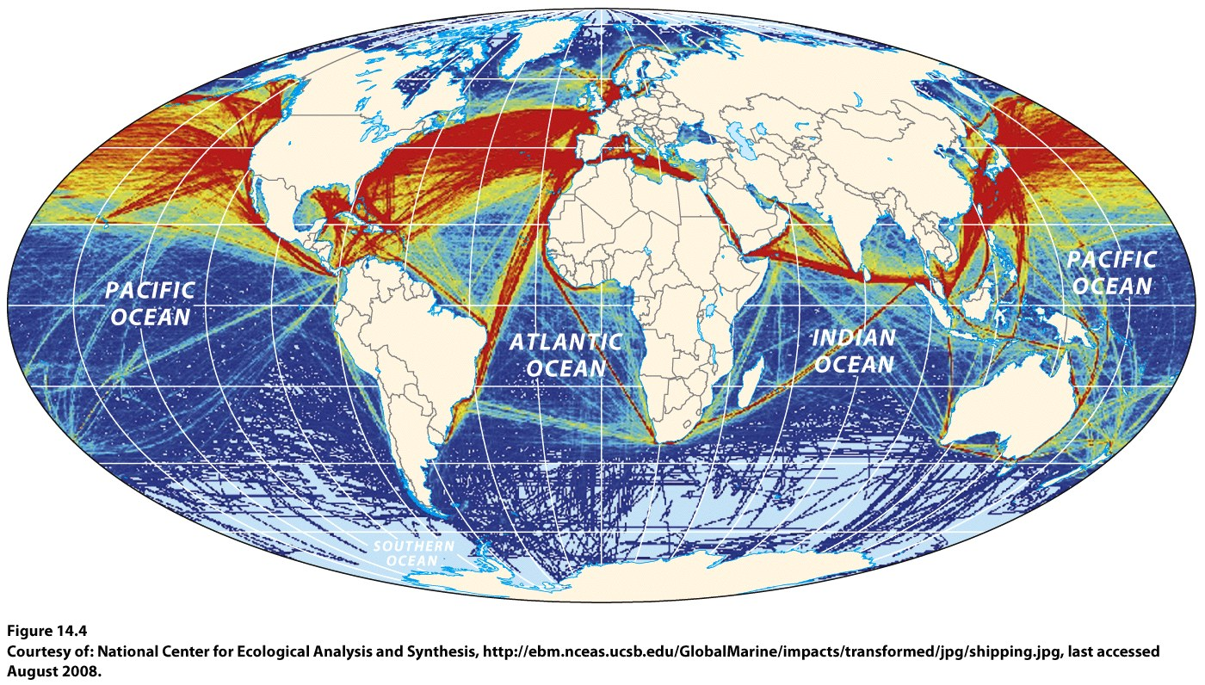
Globalization is a “chaotic” set of processes and outcomes created by people.
The backbone of economic globalization is trade.
Notes:
Figure 14.4
Global Shipping Lanes. The map traces over 3000 shipping routes used by commercial
and government vessels during 2006. The red lines mark the most frequently used shipping
lanes. Courtesy of: National Center for Ecological Analysis and Synthesis, http://ebm.nceas.
ucsb.edu/GlobalMarine/impacts/transformed/jpg/shipping.jpg, last accessed August 2008.

Slide 9
What Is Globalization, and What Role Do Networks Play in Globalization?
The arguments in favor of globalization, as explained by economist Keith Maskus:
“Free trade raises the well-being of all countries by inducing them to specialize their resources in those goods they produce relatively most efficiently” in order to lower production costs.
“Competition through trade raises a country’s long-term growth rate by expanding access to global technologies and promoting innovation.”

Slide 10
What Is Globalization, and What Role Do Networks Play in Globalization?
Washington Consensus: World Bank, the International Monetary Fund, and the World Trade Organization.
The globalizing trends of the last few decades mean that we are, in many respects, living on an unprecedented scale.

Slide 11
Networks
Manuel Castells defines networks as “a set of interconnected nodes” without a center.
A nonhierarchical network is horizontally structured, with power shared among all participants and ideas flowing in all directions.
There are deeply entrenched hierarchies in the networks that knit together the contemporary world.

Slide 12
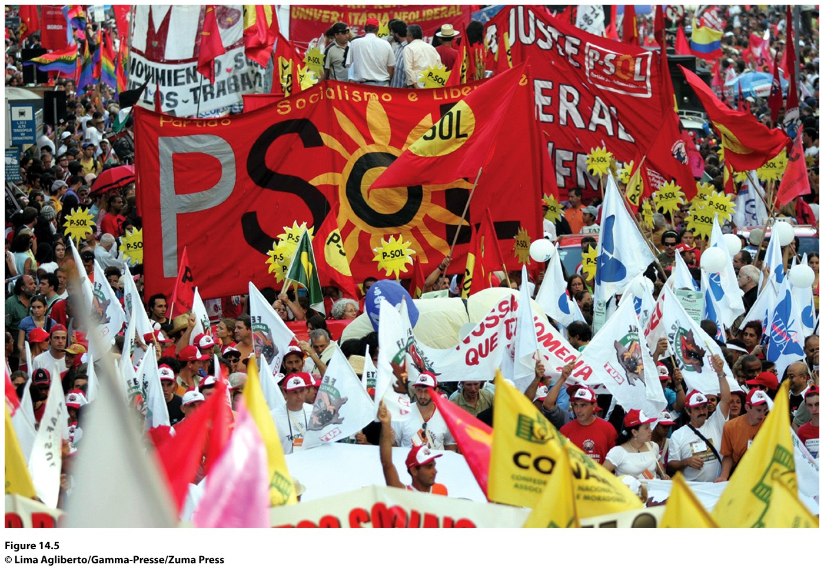
Field Note
“You cannot come to southern Brazil without seeing our biggest city,’ said the vintner who was showing me around the Cooperativa Aurora, the huge winery in Bento Gonçalves , in the State of Rio Grande do Sul . ‘Besides, it’s January, so they’ll be having the big marches, it’s almost like carnival time in Rio!’ So I headed for Porto Alegre , only to find that a hotel room was not to be had. Tens of thousands of demonstrators had converged on the State’s capital, largest port, and leading industrial city—and what united them was opposition to globalization.”
Notes:
*Could be an audio file.
Figure 14.5
Porto Alegre , Brazil. © Lima Agliberto/Gamma-Presse/Zuma Press.

Slide 13
Time-Space Compression
Time–space compression means that certain places, such as global cities (especially in the core), are more interconnected than ever through communication and transportation networks, even as other places, such as those in the periphery, are farther removed than ever.
A major divide in access to information technology—sometimes called the Digital Divide—is both a hallmark of the current world and an example of the uneven outcomes of globalization.
The quickening pace of technological change is another hallmark of globalization and magnifies the global technological divide.

Slide 14
Global Cities
Time-Space Compression
Time–space compression has helped to create and reinforce a network of highly linked global cities.
The linkages among global cities provide insights into the spatial character of the networks that underlie globalized processes.

Slide 15
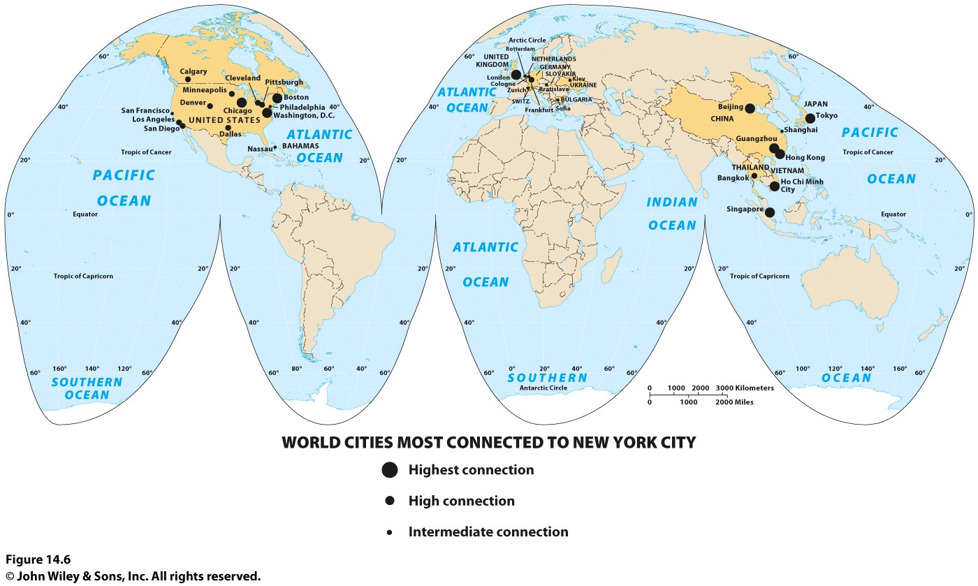
Notes:
Figure 14.6
World Cities Most Connected to New York City. This map shows the 30 world cities that
are the most connected to New York City, as measured by fl ows in the service economy. Data
from : P. J. Taylor and R. E. Lang, “U.S. Cities in the ‘World City Network,’” The Brookings
Institution, Survey Series, February 2005. http://wwwe.brookings.edu/dybdocroot/metro/pubs /
20050222_worldcities.pdf , last accessed September 2005.

Slide 16
Castells claims that the age of information technology is more revolutionary than either the advent of the printing press or the Industrial Revolution. Do you agree with him? Write an argument in support of your position, drawing on your understanding of the role of changing geographical circumstances over the past several hundred years.

Slide 17
Key Question
How do networks operate in a globalized world?
Notes:
Figure 8.6
Kurdish Region of the Middle East. © H. J.
de Blij , P. O. Muller, and John W i ley & Sons.

Slide 18
Networks with a Social Focus
How Do Networks Operate in a Globalized World?
The term network defines any number of interlinkages across the globe, whether transportation, educational, financial, or social.
Social networks, such as Facebook and Twitter are credited with making revolutions in Tunisia and Egypt possible.

Slide 19
Participatory Development
Networks with a Social Focus
Nongovernmental organizations (NGOs) are nonprofit institutions outside of formal governance structures that are established to promote particular social or humanitarian ends.
Each NGO is a social network.
NGO development networks serve as a counterbalance to the power of the major decision makers in the world.

Slide 20
Participatory Development
Networks with a Social Focus
Participatory development—the idea that locals should decide what development means for them and how to achieve it—is another response to top-down decision making.
The World Bank, the International Monetary Fund, and state governments are increasingly embracing the ideal of participatory development, loosening demands for trade liberalization in the periphery and semiperiphery.

Slide 21
Networks and Information
Through a series of mergers and consolidations occurring mostly in the post–Cold War era, global media are controlled largely by six globe-spanning corporations:
Time-Warner
Disney
Bertelsmann
Viacom
News Corporation
Vivendi Universal

Slide 22
Networks and Information
These six media corporations (along with other media corporations) are corporations of vertical integration: those that have ownership in all or most of the points along the production and consumption of a commodity chain.
Miguel Mendes Pereira noted that media companies compete for three things: content, deli very, and consumers.

Slide 23
Networks and Information
Vertical integration also helps media giants attract and maintain customers through synergy, or the cross promotion of vertically integrated goods.
Vertical integration of media changes the geography of the flow of ideas around the globe by limiting the ultimate number of gatekeepers, that is, people or corporations with control over access to information.

Slide 24
Networks and Economic Exchange
Unlike major media corporations that are vertically integrated—with ownership of relevant suppliers and producers—major retail corporations are typically horizontally integrated.
Horizontal integration means that when you shop for similar products in different places or across a mall, your dollars often support the same parent corporation.
Concept Caching:
Malacca, Malaysia
© Barbara Weightman

Slide 25
Community-Supported Agriculture
Networks and Economic Exchange
With the industrialization of agriculture, the distance between farmers and consumers has increased, figuratively and literally.
According to geographer Steven Schnell, one of the reasons the number of farmers in the United States has increased is the growth in the number of community-supported agriculture groups, known as CSAs.

Slide 26
Community-Supported Agriculture
Networks and Economic Exchange
CSAs began in Japan in the 1960s when a group of women “dissatisfied with imported, processed, and pesticide-laden food, made arrangements directly with farmers to provide natural, organic, local food for their tables.”

Slide 27
Additional Resources
Media ownership
Columbia Journalism Review’s Who Owns What Website
www.cjr.org/tools/owners/
The Network of World Cities
http://www.brook.edu/metro/pubs/20050222_worldcities.pdf
World Social Forum
www.forumsocialmundial.org.br/

