Slide 1
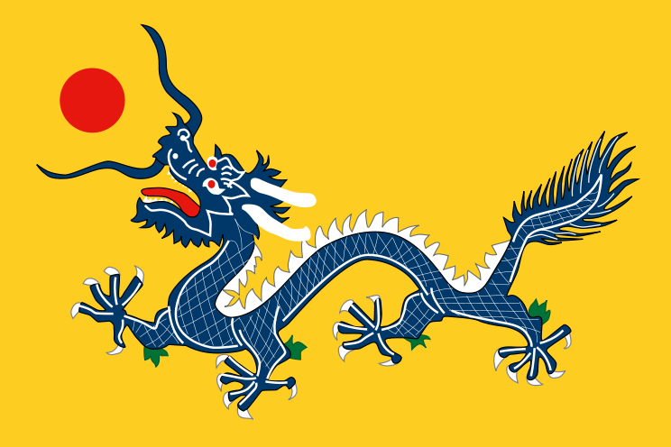
China Limits European Contacts

Slide 2
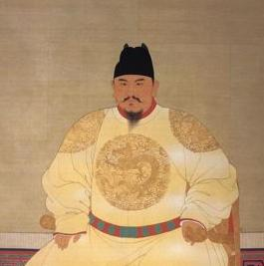
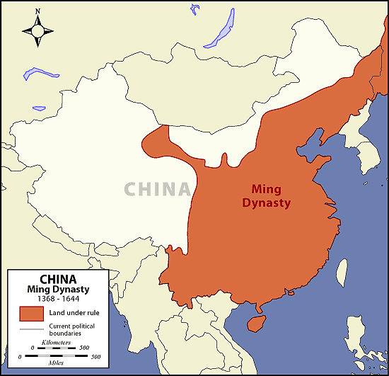
Ming Dynasty
Turn China into a dominant power
Established vassal states in Korea & SE Asia = tributes
1368: Hongwu drives the Mongols out of China = 1st Ming ruler
Restores agriculture & erases Mongol influences
Promotes irrigation, fish farming, & growth of commercial crops for trade

Slide 3
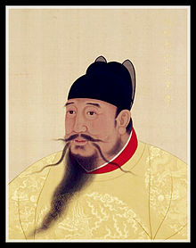
Ming (cont.)
Hongwu encouraged return to Confucian standards
Returns government to merit-based civil exam
Becomes a tyrant late in his rule
1398: Yonglo (son) takes power
Moves court to Beijing
Strived to reach the outside world = 7 voyages to show off China’s power

Slide 4
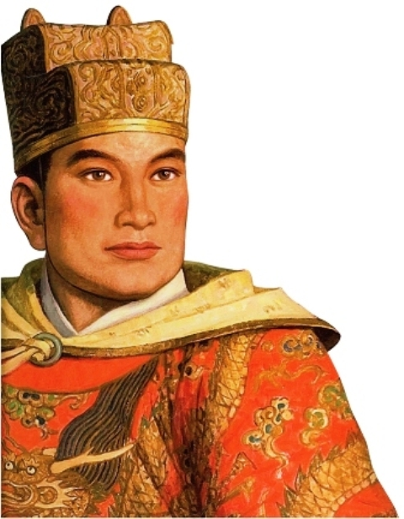
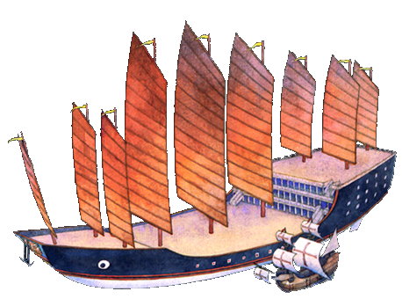
Voyages of Zheng He
Chinese Muslim Admiral
Leads all of Yonglo’s expeditions
Range from SE Asia to E Africa
Massive fleets w/ treasure ships
Distributes gifts to peoples = Chinese power
Gains vast amounts of tribute for China

Slide 5
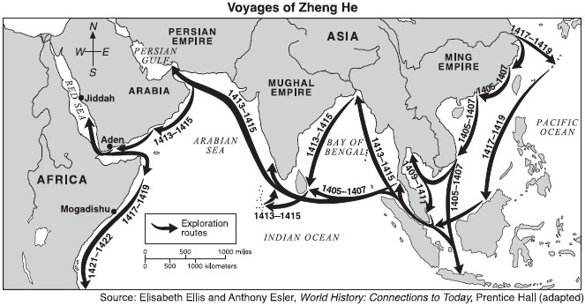

Slide 6
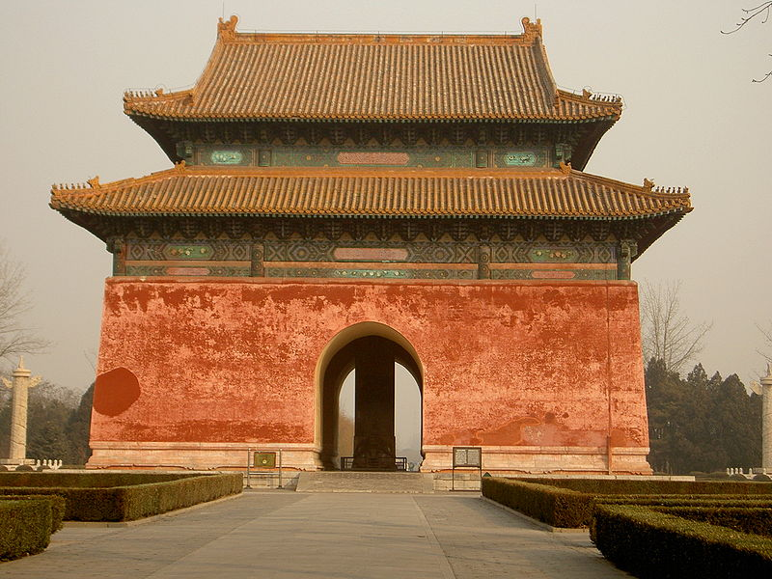
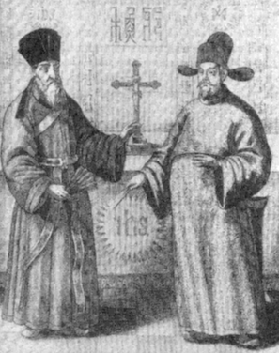
Foreign Relations
China practiced isolation
Foreign trade only by government
Trade remains profitable = smugglers
China doesn’t industrialize
1) Offends Confucian beliefs
2) Favor agriculture
Christian missionaries bring European culture

Slide 7
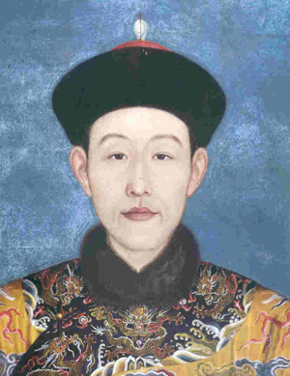
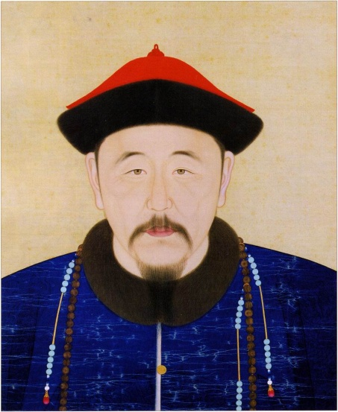
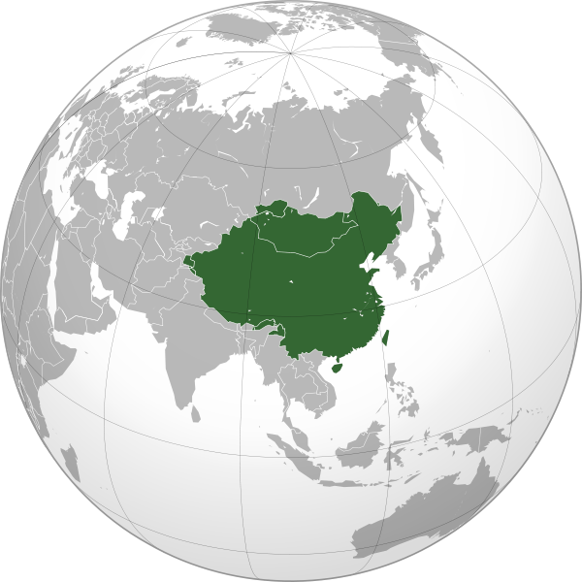
Qing Dynasty
1644: Manchus invade China = Qing Dynasty
Qing not Chinese = rebellions
Keep Confucian beliefs & social structure
Restore prosperity & defend/expand borders
Kangxi – lowers taxes & welcomes Jesuits = advancements
Qian-Long – Rules China at its greatest size & power

Slide 8
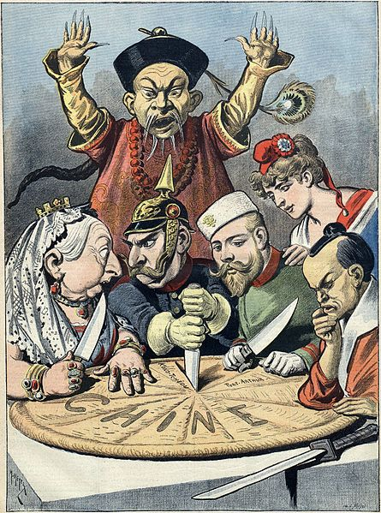
Isolation
China = Cultural Center of the Universe
Foreigners could only trade at special ports & paid tribute
Accepted the Dutch as trade partners
Traded with Britain, but faced problems over tribute/respect
1800s: Europeans chip away until restrictions fall

Slide 9
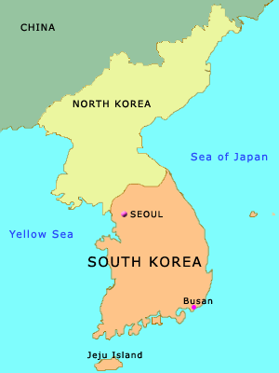
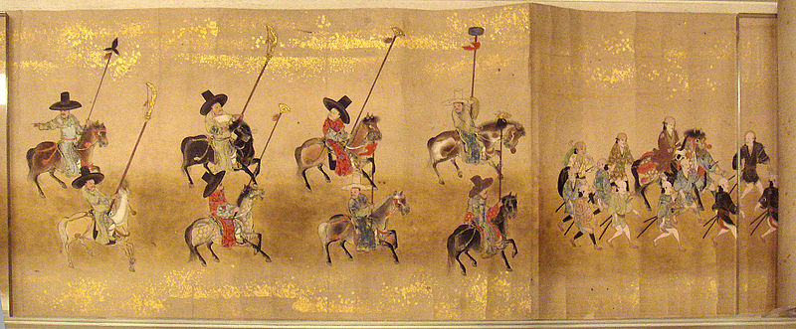
Manchu Korea
1636: Manchus conquer Korea = vassal state
Government organized by Confucian principles
Adopt Chinese tech, culture, and isolation
Nationalist ideals develop from Manchu invasion & Japanese attacks
Want for sovereignty

Slide 10
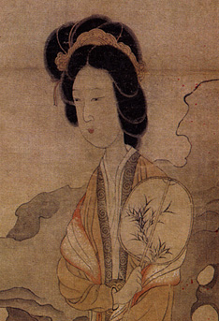
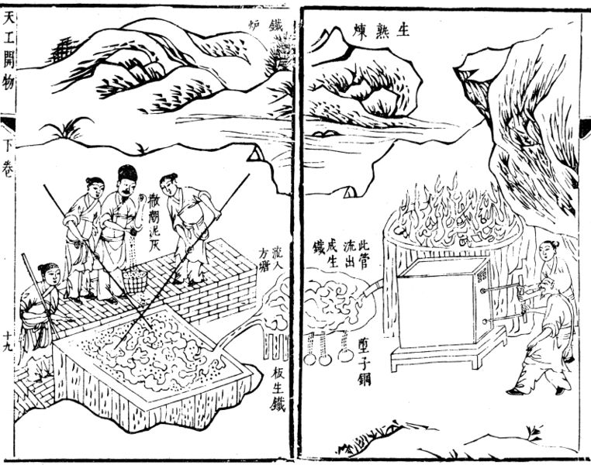
Life in China
1600-1700s: Peace & prosperity
Irrigation & fertilizer increases
Grow more & new crops brought by Europe = population explosion
Corn, potatoes, etc.
Females not valued in China, males favored
Often infants are killed
Ming & Qing culture follow old traditions

