Slide 1
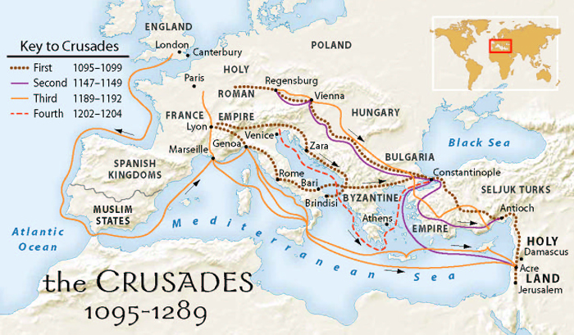
Church Reform, Crusades, and Change

Slide 2
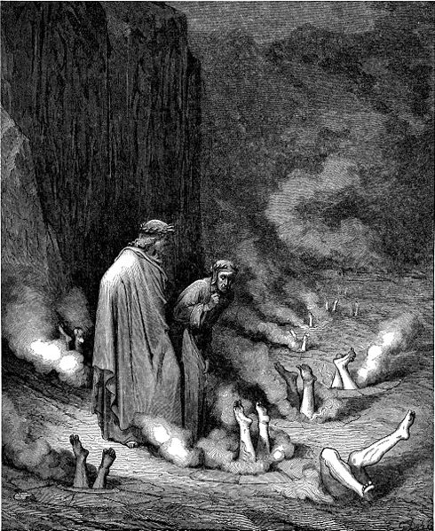
Problems in the Church
Priests were becoming illiterate
Popes of questionable morals
Bishops & abbots concerned w/ feudal riches
Main Problems:
Priests marrying & having families
Bishops sell positions in the church (simony)
Lay investiture

Slide 3
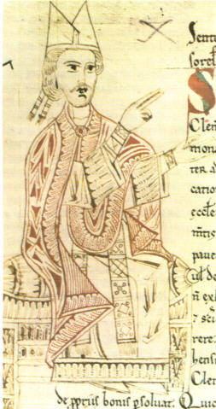
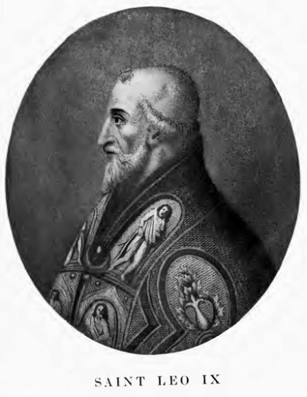
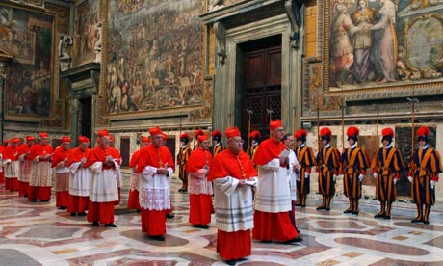
Church Reform
Popes Leo IX & Gregory VII enforce laws against simony & marriage
1100s-1200s – Church structured like a kingdom
Leader = Pope
Court & Advisors = Curia
Developed Canon Law
Papal diplomats settled issues with bishops & kings
Collection of tithes = money
Help for the poor & hospitals

Slide 4
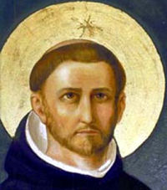
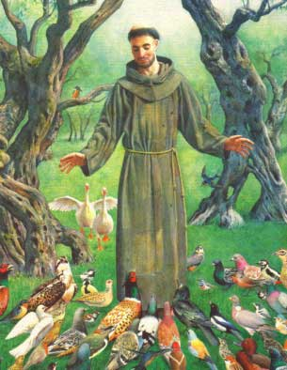
Religious Orders
Early 1200s – monks travel Europe, preaching to the poor
Dominicans (Dominic) – focused on learning
Franciscans (Francis of Assisi) – All creatures were spiritual
Role of women expands – spread religion; work with the sick & poor

Slide 5
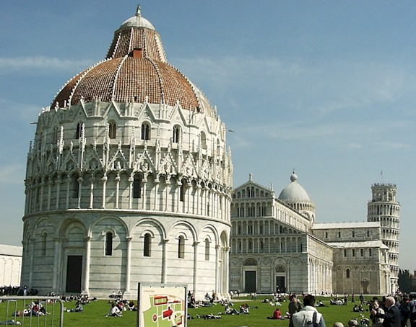
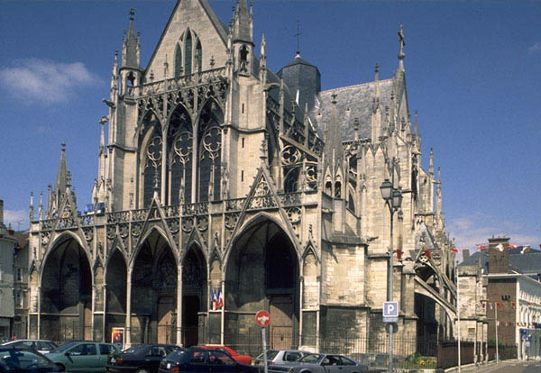
Cathedrals
Representations of the City of God
800-1100: Romanesque Style
Round arches, small windows, little light
New spirit & money = new style (Gothic)
Tall, reaching buildings
Vaulted arches
Large windows = light
Intricate work shows significance of God
Ex: Notre Dame Cathedral

Slide 6
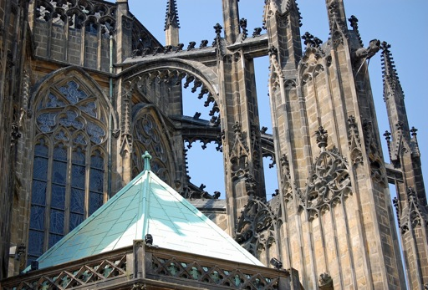
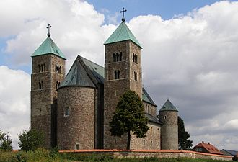
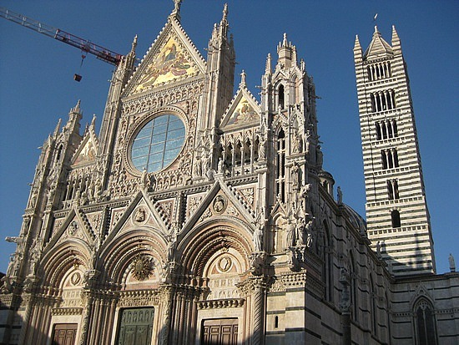
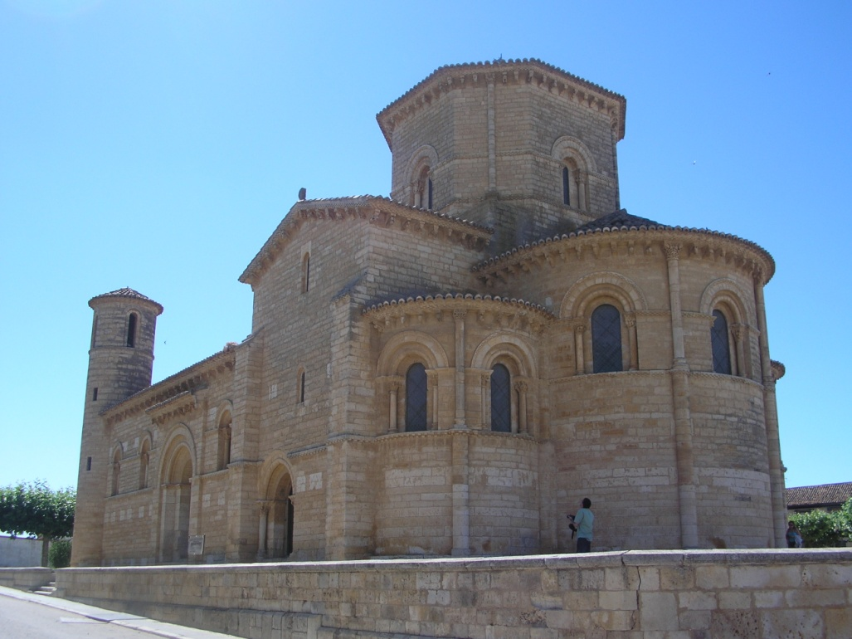

Slide 7
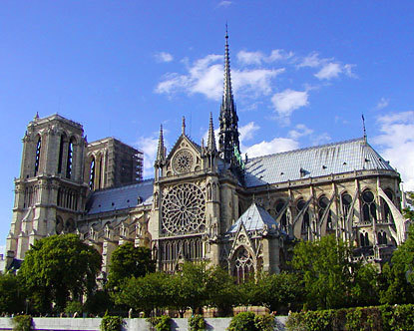

Slide 8
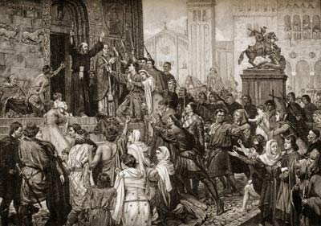
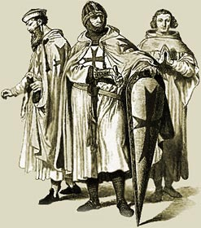
The Crusades
Rise in faith inspires movement to retake the Holy Land
1095: Pope Urban II calls for a Crusade
Goals & Opportunities:
Reclaim Palestine & reunite Christendom
Opportunity to use knights
Strengthen relations with the Byzantines
Merchants: Looking for profit, trade routes to the East
People: Land, riches, salvation

Slide 9
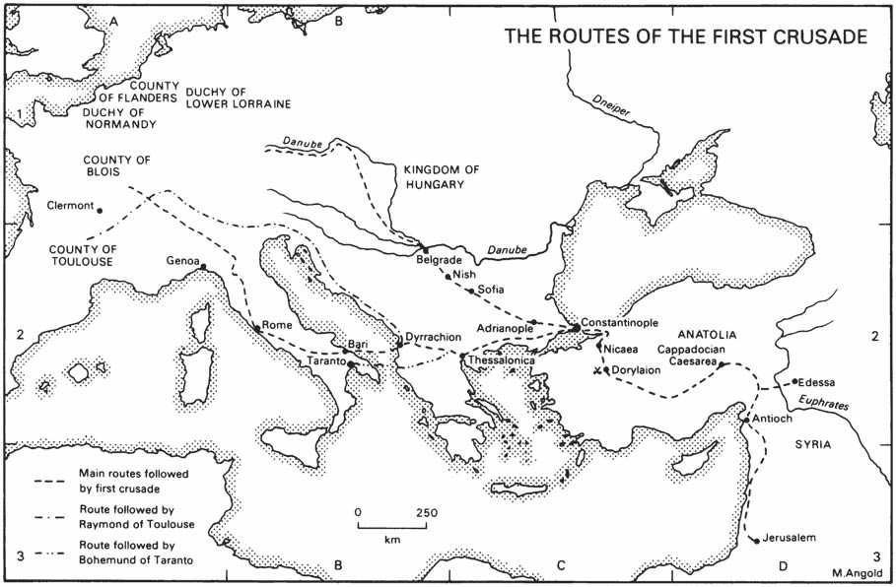
The 1st Crusade

Slide 10
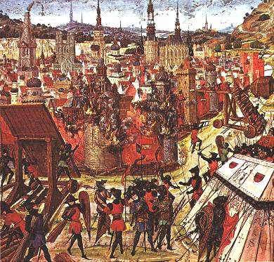
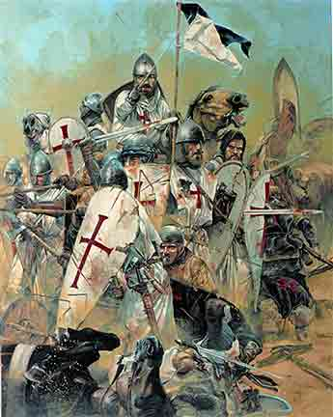
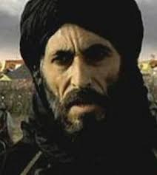
1st & 2nd Crusade
1st Crusade
1097: 3 armies outside Constantinople
Armies ill-prepared and argue amongst each other
1099: Capture Jerusalem
Vulnerable area from Edessa to Jerusalem
2nd Crusade
Organized to recapture Edessa
1187: Saladin recaptures Jerusalem for the Muslims

Slide 11
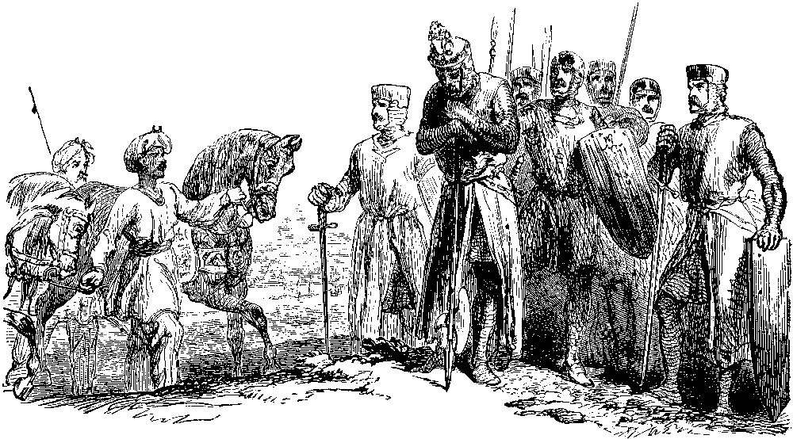
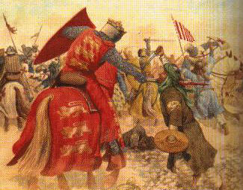
3rd Crusade
Goal: Recapture Jerusalem for Christendom
Led by Phillip II (France), Frederick I (Germany), & Richard the Lionhearted (England)
Phillip goes home & Frederick drowns
Richard & Saladin fight many great battles; call truce in 1192
Jerusalem stays Muslim, but free passage for Christians

Slide 12
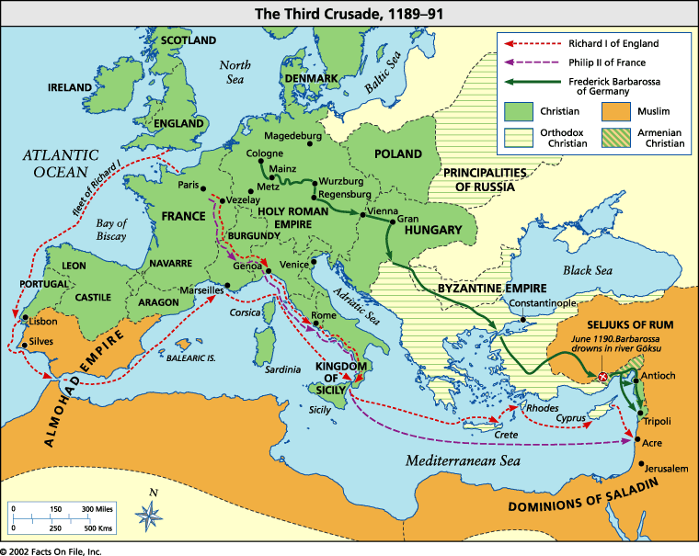

Slide 13
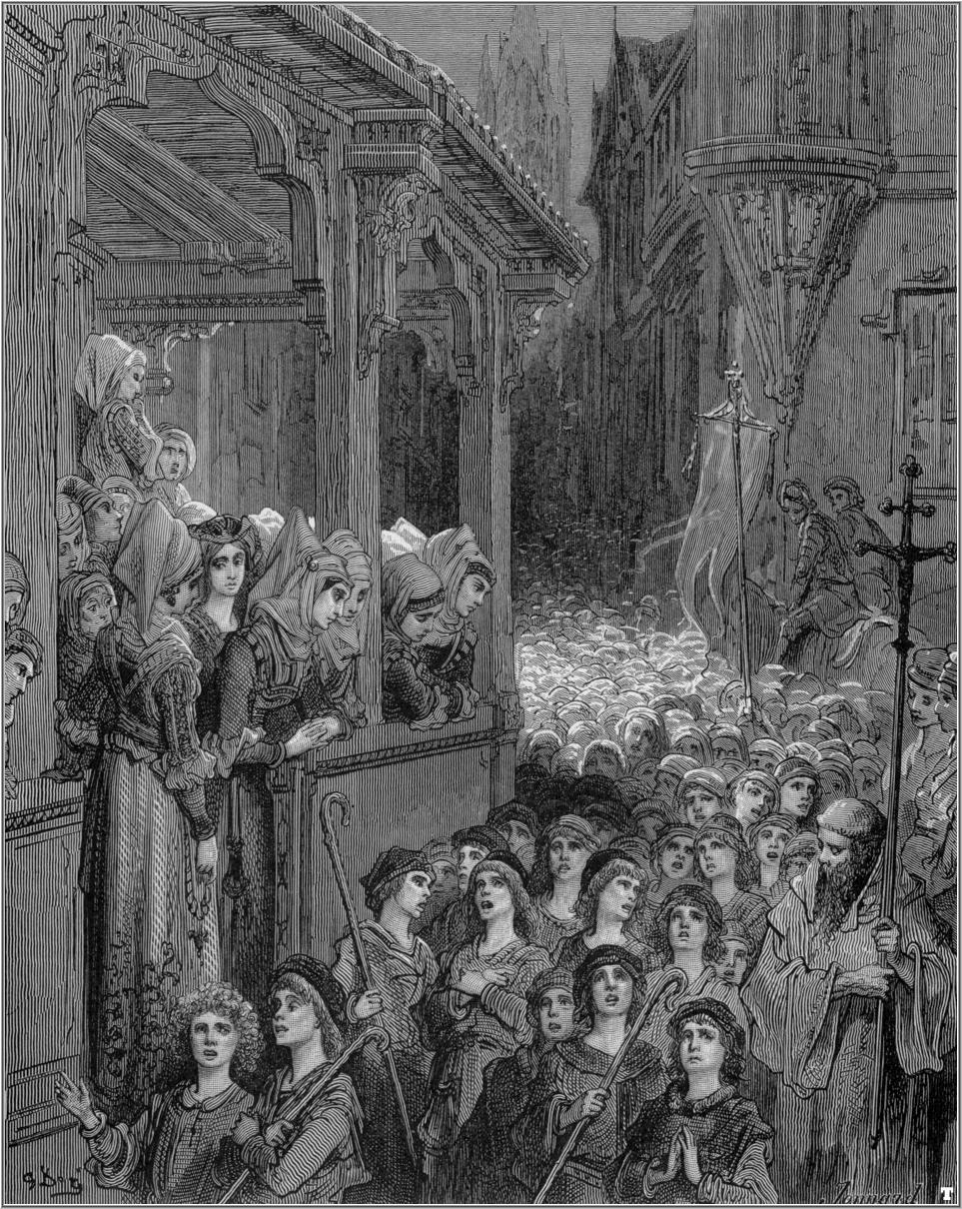
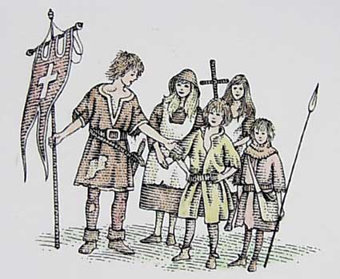
The Children’s Crusade
Subsequent crusades failed to retake Jerusalem
1212: Groups of children try to take Jerusalem
30k from France & 20k from Germany
1000s die from cold & starvation
Most of remainder sold into slavery or drown
Only about 2,000 survive

Slide 14
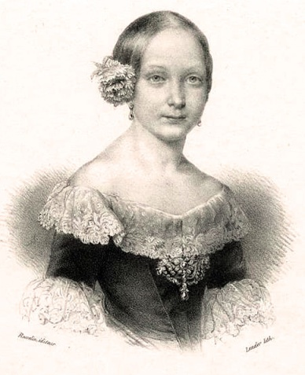
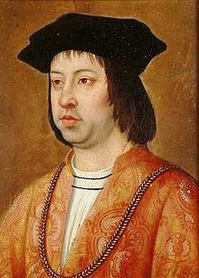
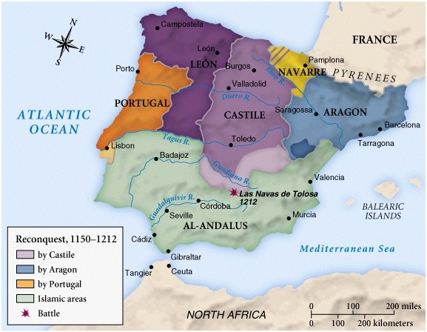
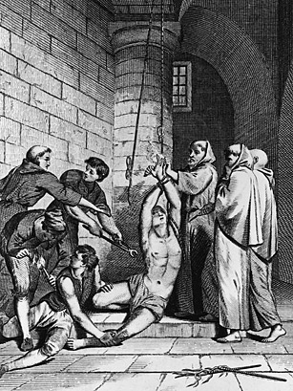
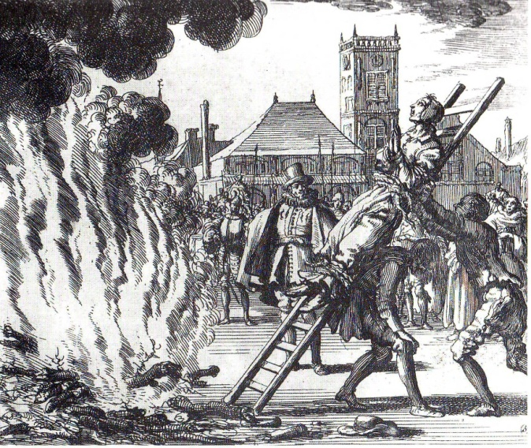
The Reconquista
Most of Spain was controlled by Muslims
Reconquista: Effort to drive Muslims form Spain
1492: Ferdinand & Isabella retake Granada; ends the Reconquista
Beginning of the Inquisition
Court to suppress heresy
Many Jews & Muslims convert to Christianity
Many non-Christians are questioned, tortured, & even burned at the stake

Slide 16
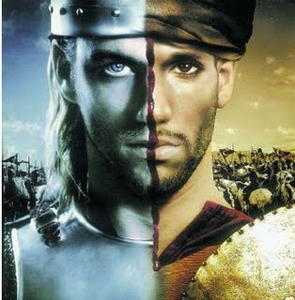
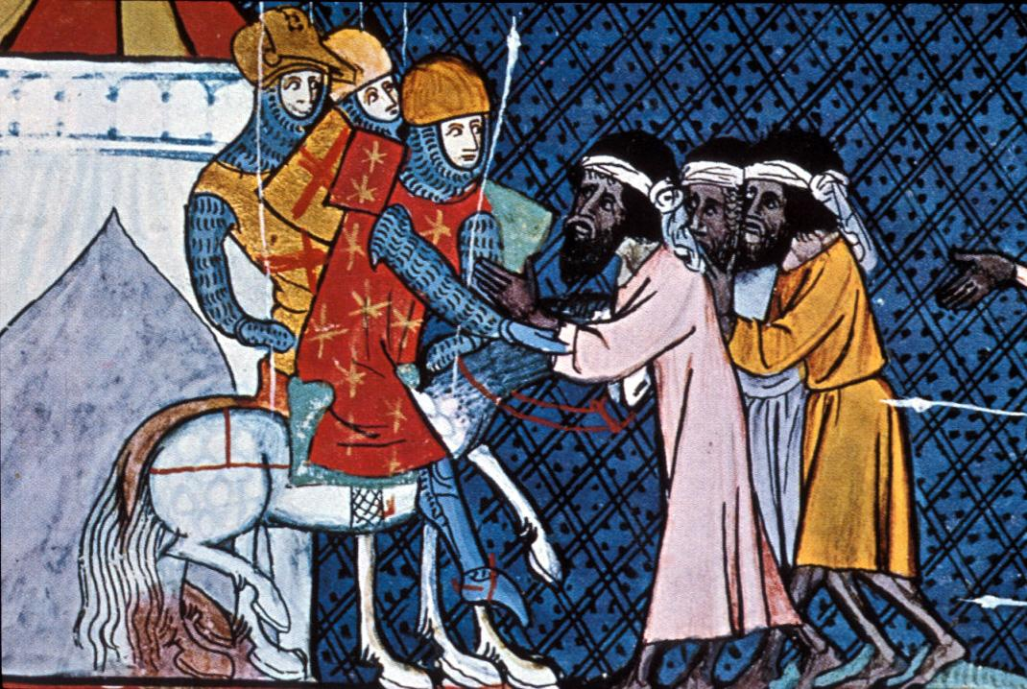
Effects of the Crusades
Example of the power of the Church
1000s leave home to fight for God
Women gain opportunities to manage the estate, businesses
Trade & Learning expands between Europe & Asia
Papal power diminishes; kings flourish
1453: The Byzantine Empire falls
Increased persecution of Jews in Europe
Bitterness between Christian & Muslims

Slide 17
Changes in Medieval Society

Slide 18
Setting the Stage
Towns and cities are growing
Population explosion
Western Europe is expanding rapidly (territorially)
Growth in learning & the university
Cultural Diffusion with Muslims & Byzantines

Slide 19
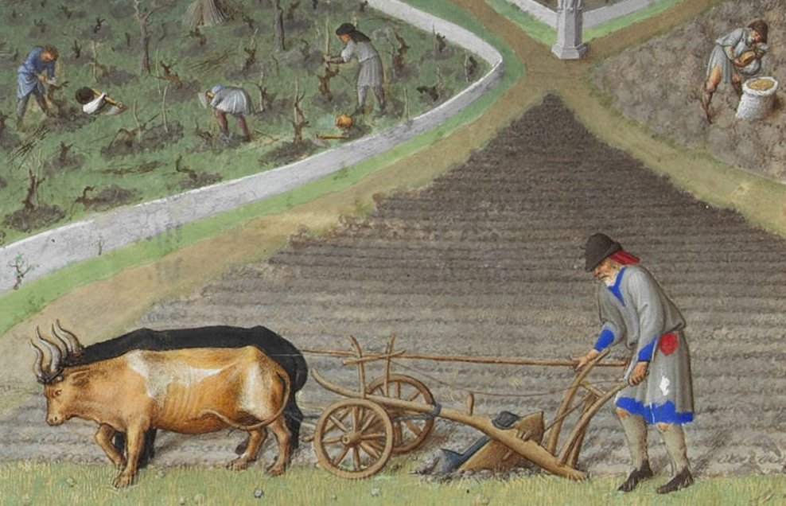
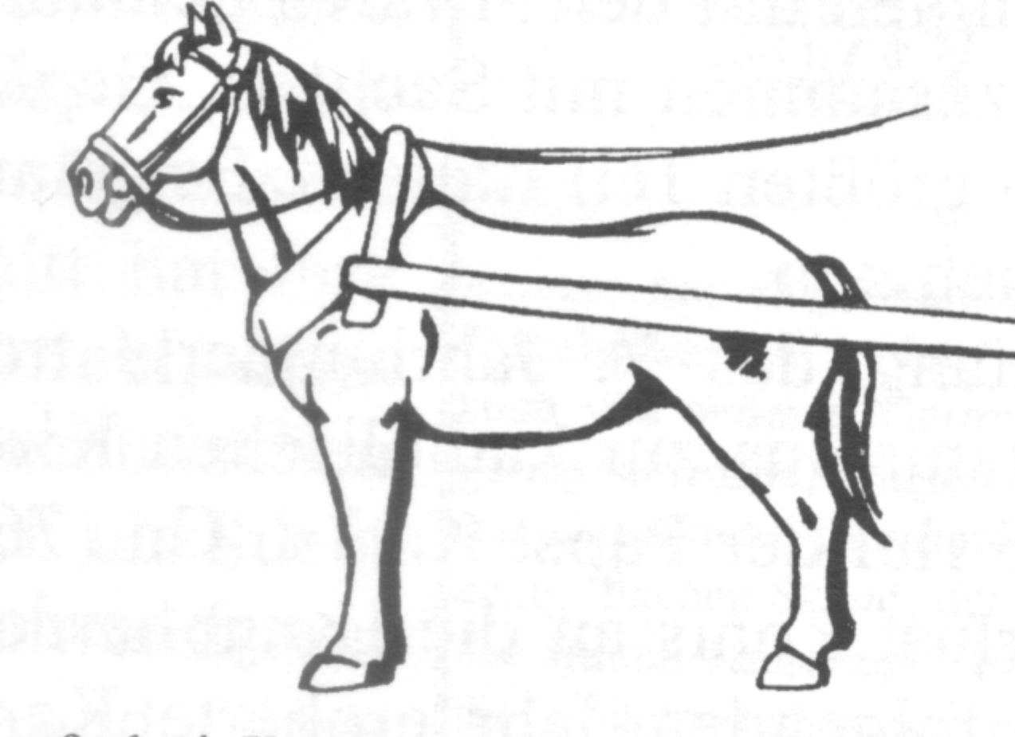
Growth in Farming
Revival exists b/c of advances in farming & warmer climate
New lands open to cultivation (Scandinavia)
Change: Horses plow field (3x faster than oxen)
New Tech: Cross harness – allows horse to plow
Forests cut down for farmland

Slide 20
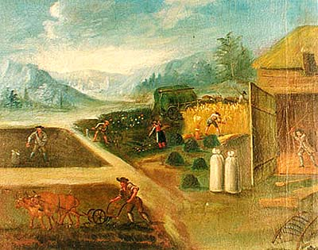
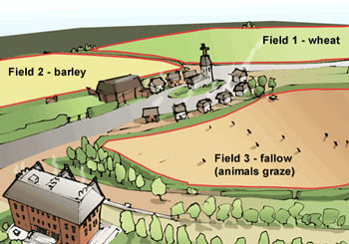
3-Field System
800: Villages begin to farm 3 fields
Farm 2 fields
1 field fallow (resting)
Growth on 2/3s of land, instead of half
Result: Population Increase
Well-fed people
Children hold off disease, live longer

Slide 21
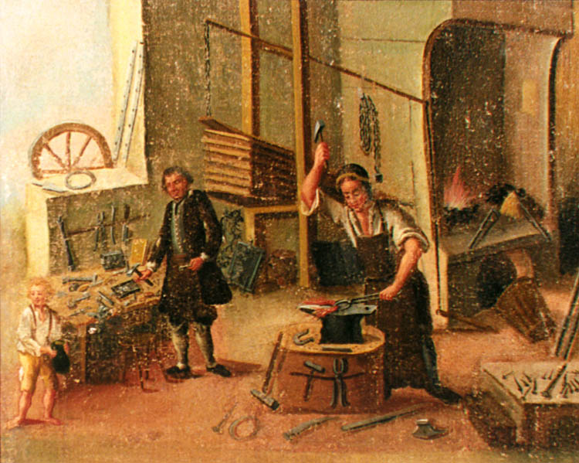
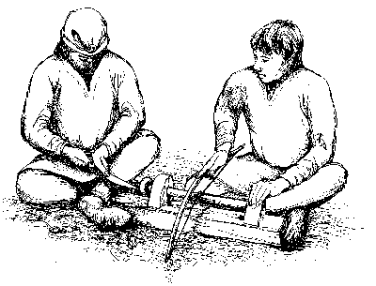
Guilds
Guild: Organization of an occupation working to improve economic conditions
1st Guilds – Merchants
Control Trade
Provide Security
Guilds set standards for work, pay, training, & conditions
Build great wealth & influence

Slide 22
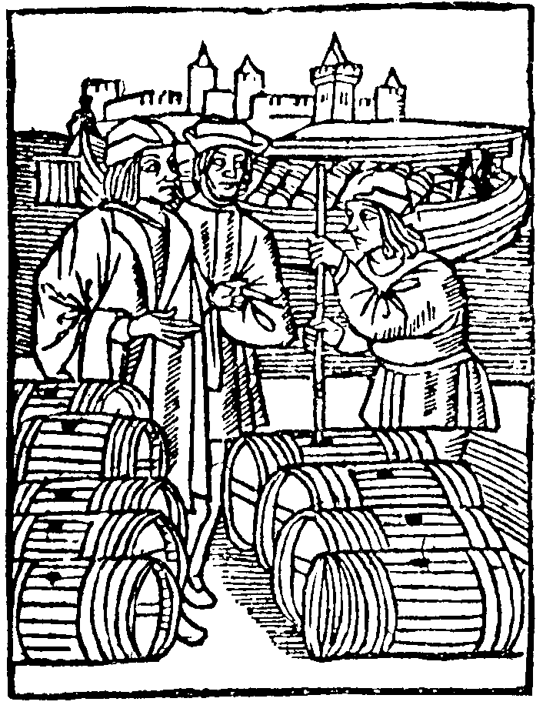
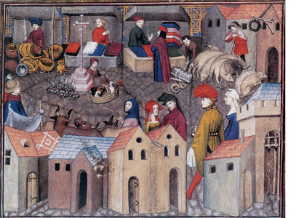
Commercial Revolution
Combo of expansion in trade, farming, & learning
Fairs set-up to conduct trade in towns
Trade: Cloth, salt, dyes, etc.
Markets end the need for the manor-system
Trade routes spread all across Europe = availability of foreign goods

Slide 23
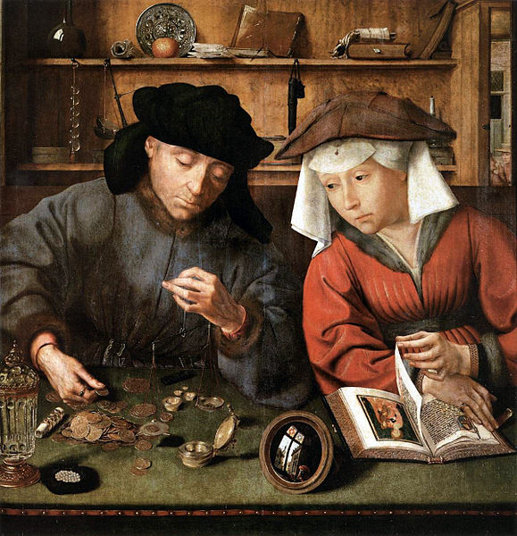
Banking & Society
Advances in trade & markets = need for banks & trading firms
Create exchange rates & lines of credit
Borrowing money @ interest (usury) was forbidden by the church
Softens over time
Change in Society: Big cities develop

Slide 24
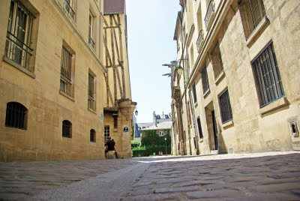
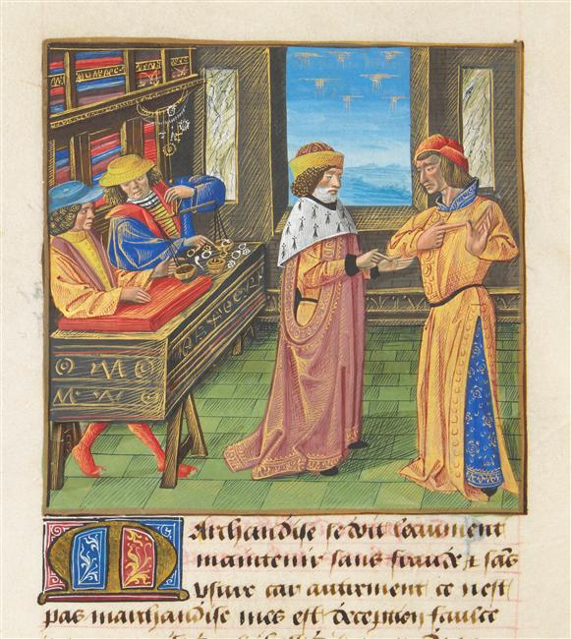
Urban Life
1000-1150: Population rises by 12 million
Paris (60k) largest city
Trade becomes the lifeblood of towns & Europe
Problems
Narrow streets
Animals & their waste
No sewers & bad conditions
Fire hazards
Serfs run away to cities
“Town are makes you free”
Merchant class emerges (Burghers)

Slide 25
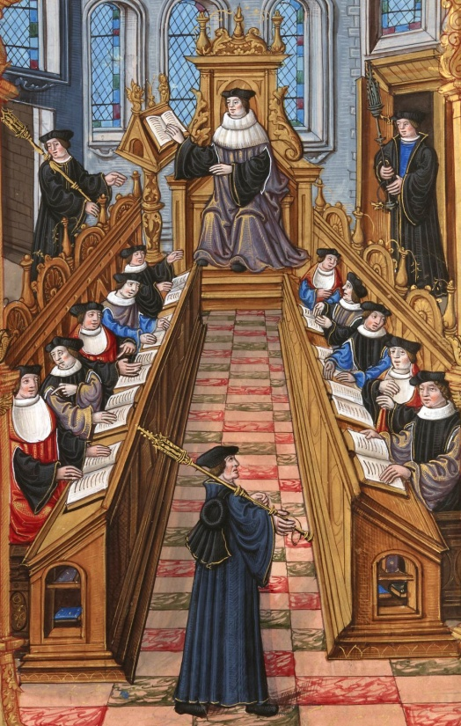
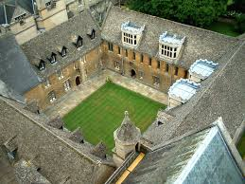
Learning Revival
Contact with the Byzantines & Muslims rekindles learning
Rediscover the knowledge of the Greeks
Science, philosophy, law, math, etc
1st universities develop - Theology
Bachelor’s Degree (5-7yrs)
Master’s Degree (12yrs)

Slide 26
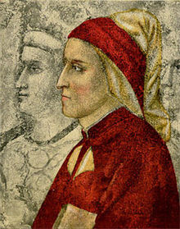
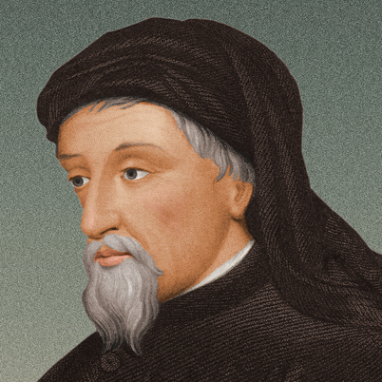
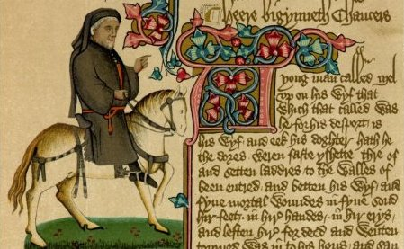
Literature
Learning leads to development of a vernacular
Everyday language
Great works of literature are written
Dante Alighieri – The Divine Comedy
Geoffrey Chaucer – The Canterbury Tales
Books written in vernacular allowed most people to read them

Slide 27
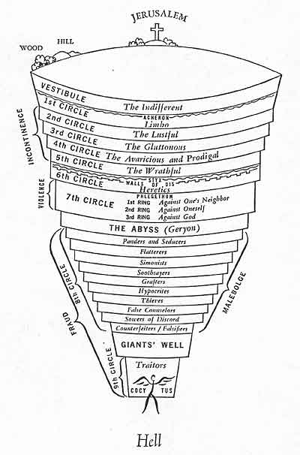

Slide 28
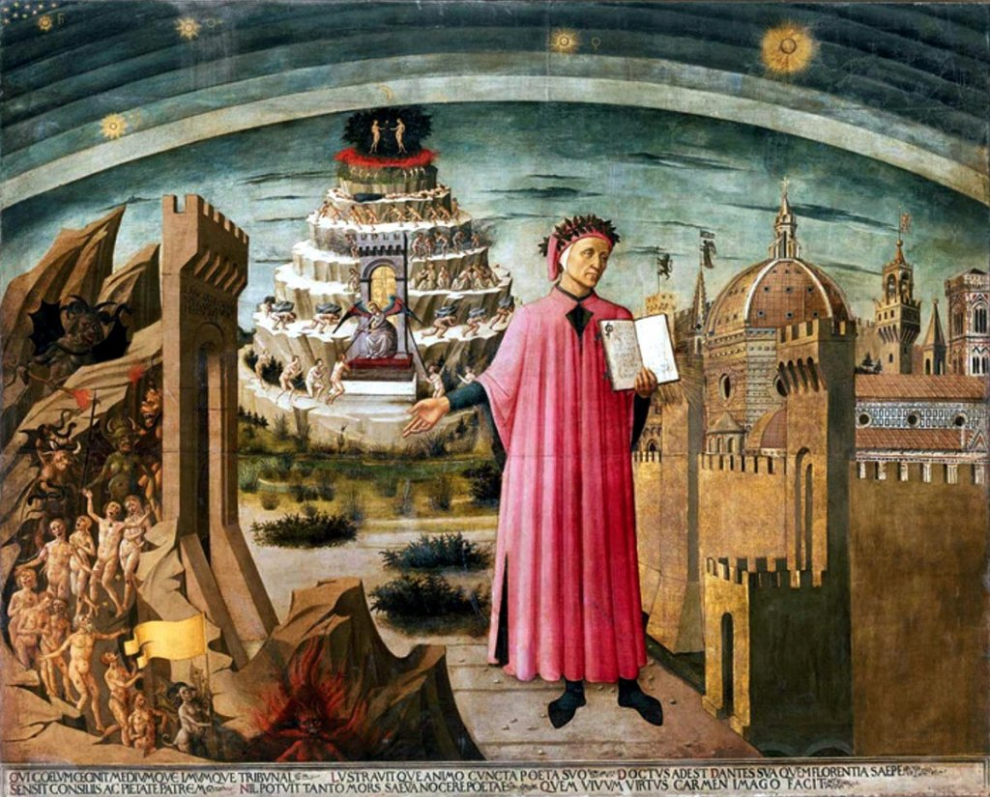

Slide 29
Medieval Philosophy
Philosophers push to improve upon the ideas of the Greeks
Find the logical truth & faith in the Bible
Saint Thomas Aquinas – religion could be proved by logic
Teachings combine religion with the work of Aristotle
Scholastics (schoolmen) – debate issues of the time
Develop democratic institutions

