Slide 1
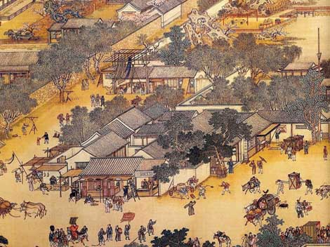
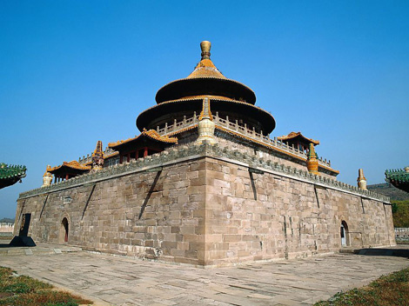
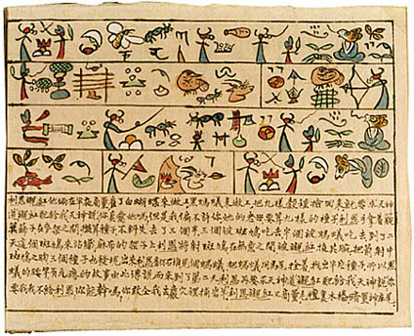
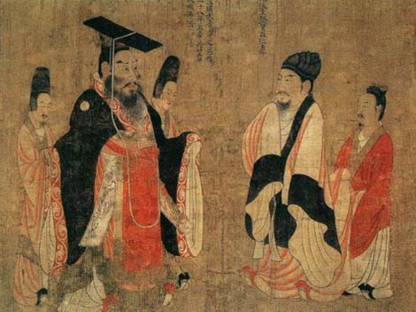
Early Chinese Civilizations

Slide 2
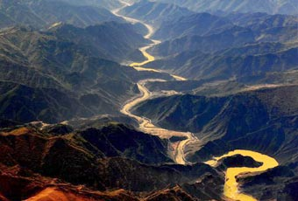
Geography
Huang He (Yellow River), stretches across for more than 2,900 miles.
Brings rich yellow silt perfect for planting
Yangtze River flows for 3,400 miles and empties into the Yellow Sea
One of the greatest food production areas of the ancient world.

Slide 3
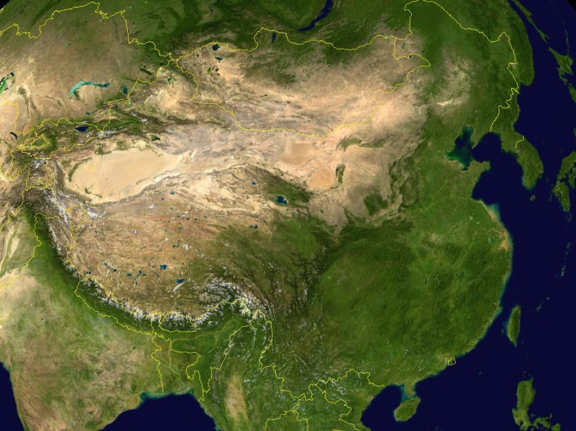
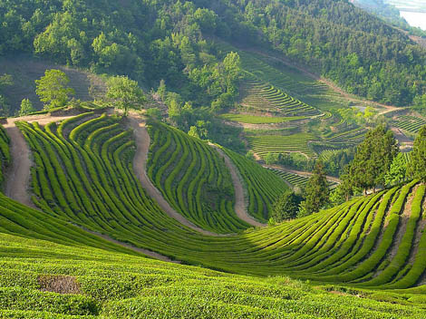
Geography
Only 12% of the land is good for farming.
The rest is full of mountains and deserts.
These barriers helped to isolate the Chinese people from parts of Asia.

Slide 4
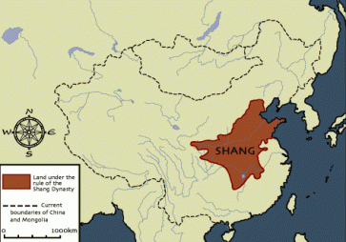
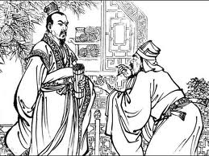
Shang Dynasty
Actually the 2nd dynasty of China.
Little known about the first dynasty
Xia Dynasty
Mostly farming society
Ruled by aristocracy
Upper class with wealth based on land ownership with power passing to each next generation.

Slide 5
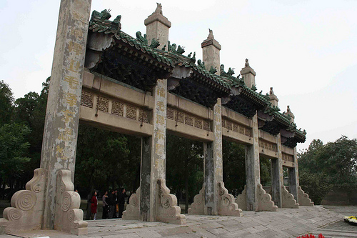
Shang Dynasty
Evidence of huge cities
City walls, palaces, and large royal tombs
King ruled from capital city of Anyang.
Kingdom divided into regions controlled by aristocratic warlords.
King could choose them however.
Royal tombs showed evidence of massive wealth and even royal servants buried with them.

Slide 6
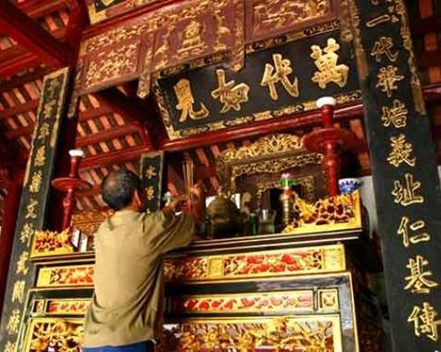
Shang Dynasty
Religion
Believed in life after death
Human sacrifices
Buried with king
Respect and worship of ancestors

Slide 7
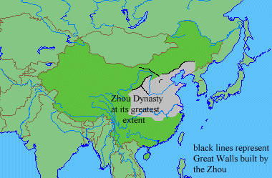
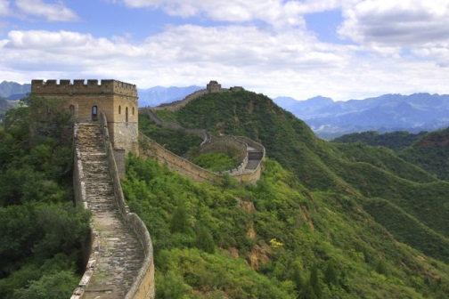
Zhou Dynasty
Revolted against Shang
Established new dynasty
Last almost 900 years
Longest lasting dynasty in Chinese history
Also ruled by a king
Seen as a link between Heaven and Earth
Construction of Great Wall in north

Slide 8
Zhou Dynasty
MANDATE OF HEAVEN
Belief that heaven (by law of nature) kept order in the universe through the Zhou king.
Authority given from heaven
Proper term to rule was called the Dao
Keep the gods happy
A king could be believed to lose his mandate if he was a bad ruler, had corrupt officials, natural disasters happened, famine, etc.

Slide 9
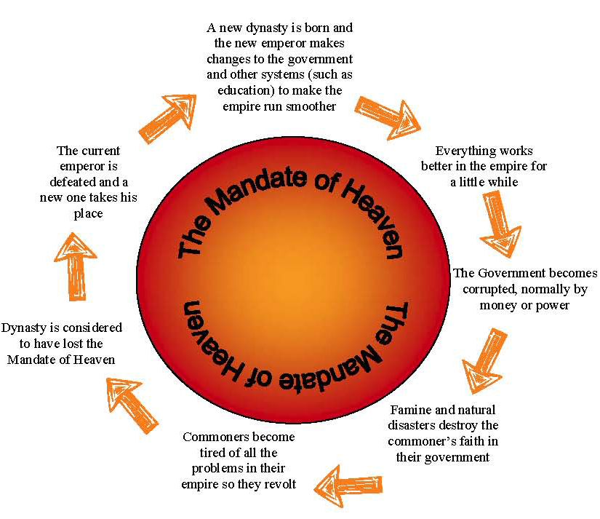
Mandate of Heaven

Slide 10
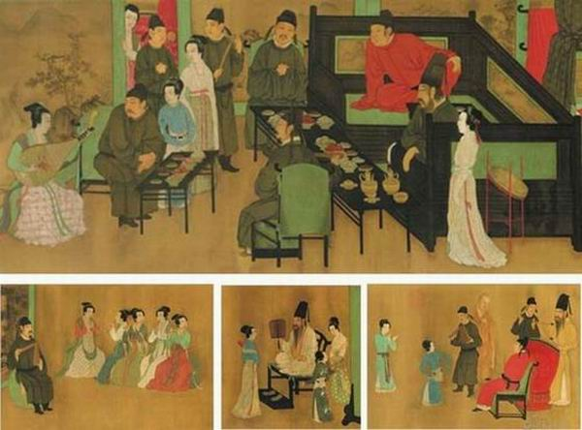
Family in Ancient China
Idea of filial piety
Duty of family members to give up their needs and desires to obey the male head of the family.
Male supremacy in ancient China
Men worked fields, governed, warriors, scholars, etc.
Women were expected to raise children and work in home.
Everyone had a job to do to support the family.

Slide 11
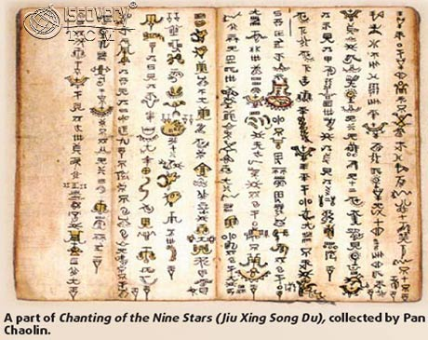
Chinese Written Language
Simple script
Ancestor of highly complex written languages of today
Used pictographs
Picture symbols
Sound given to a picture.

