Slide 1
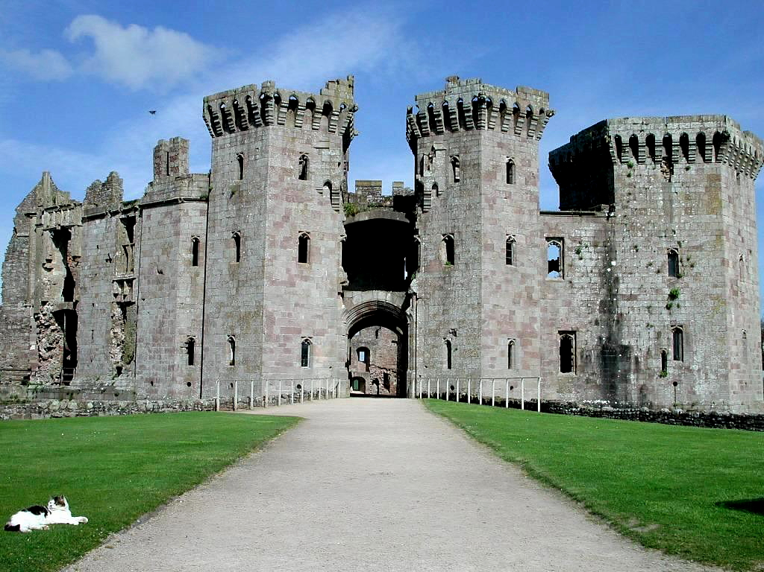
Feudalism

Slide 2
Setting the Stage
Feudalism develops in Europe because:
Fall of the Roman Empire
Split of the Frankish Empire
Constant Warfare
Political Turmoil
Invasions
People live in constant fear & turn to local leaders for security

Slide 3
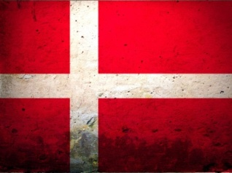
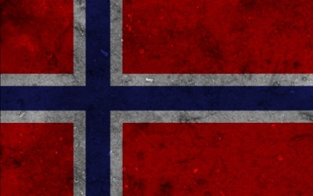
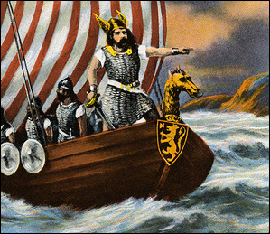
Invasions: Vikings
Germanic people from Scandinavia (NOR, DEN, SWE)
Worshipped warlike gods – Warrior culture
Attack through quick, precise raids
Monasteries – Why?
Also farmers, explorers & traders
Trade with Constantinople
Leif Erikson reaches North America
Stop raiding as temperature warms & acceptance of Christianity

Slide 4
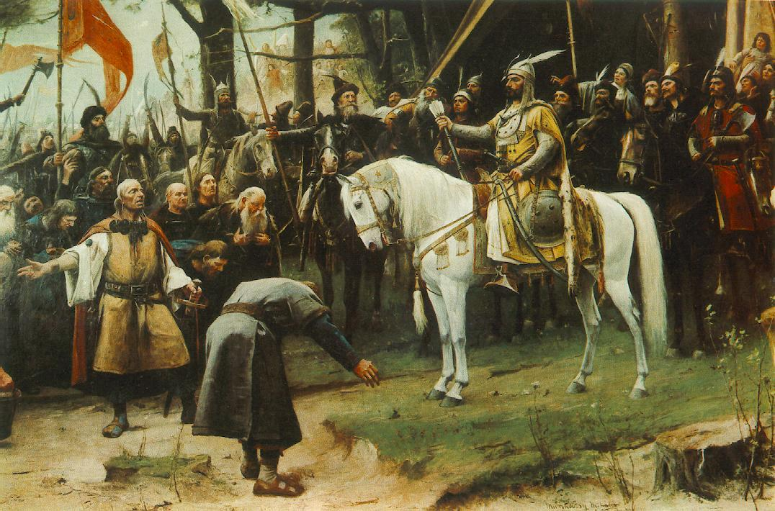
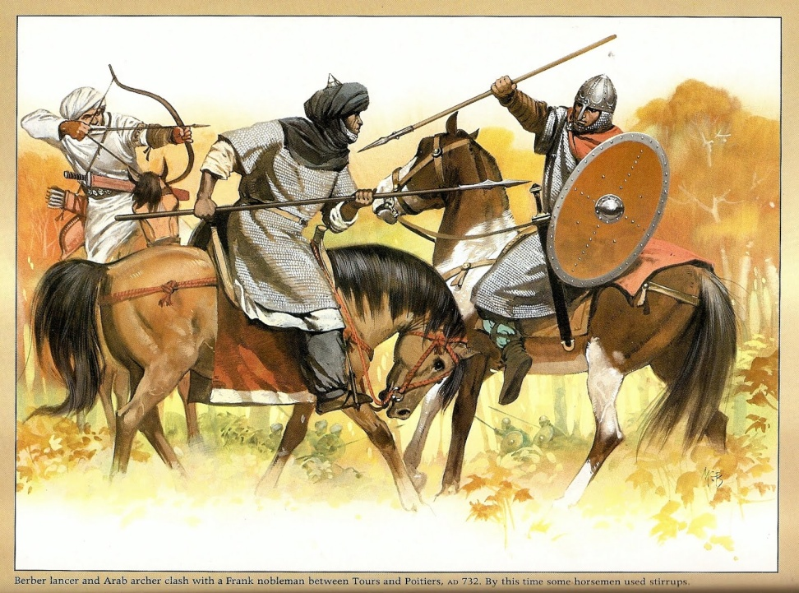
Invasions: Magyars & Muslims
Magyars: Nomadic Horsemen from Hungary
800s: Attack monasteries & villages
Overrun Italy & sell captives into slavery
Muslims: Attack through Spain & Italy
Goals: Conquer Europe (600-700), Plunder (800-900)
Excellent Army & Navy = raids anywhere, anytime

Slide 5
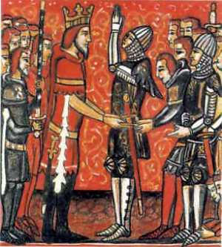
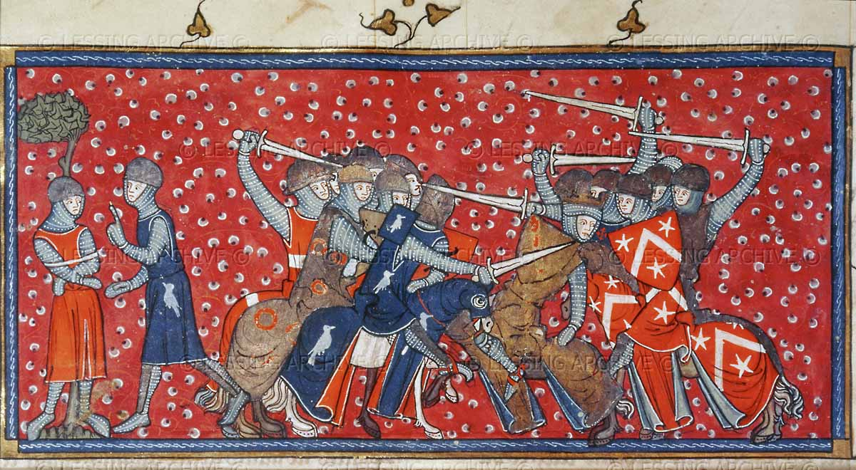
A New Social Order
850-950: Height of invasions = Rulers making deals with invaders
Rollo (vassal), Charles the Simple (lord), & Normandy (fief)
Feudalism develops – based on rights, obligations, & control of land
Lord grants land (fief) to a vassal for protection

Slide 6
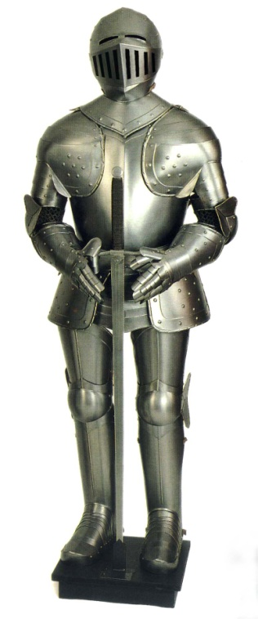
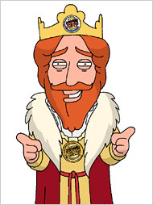
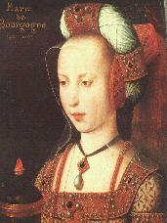
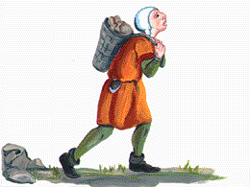
Feudal Structure & Status
Structure:
King
Powerful Vassals (Nobles & Bishops)
Knights
Landless Peasants
Status defined prestige & power
Groups:
1) Those who fight (nobles & knights)
2) Those who pray (Church members)
3) Those who work (peasants)
Majority = Serfs – couldn’t leave land, production belonged to lord, & were not property

Slide 7
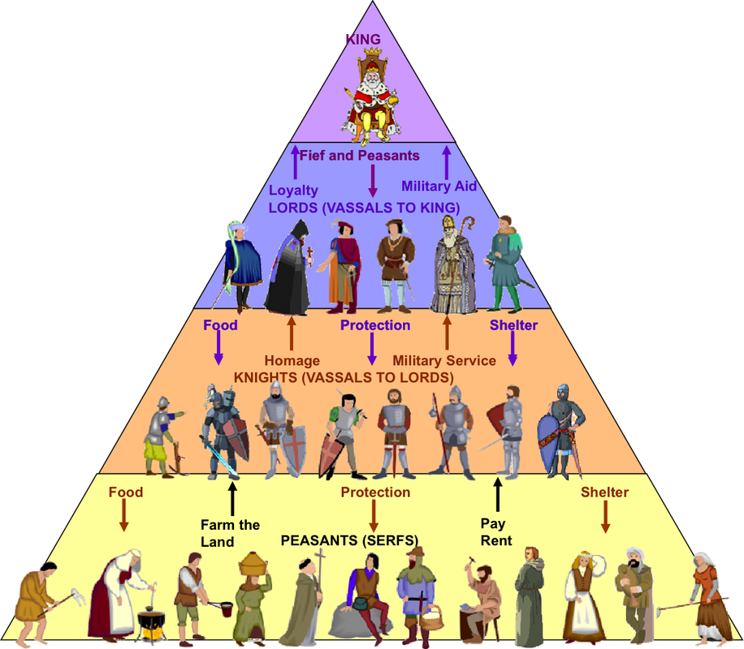

Slide 8
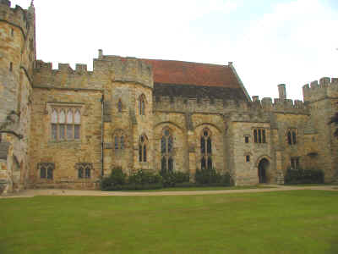
Manors
The Lord’s estate – functions by lord-serf relationship
Lord: Provides housing, land, & protection
Serfs: farm, raise animals, & maintain the estate
All owed portions of crops & days of work in service to their lord

Slide 9
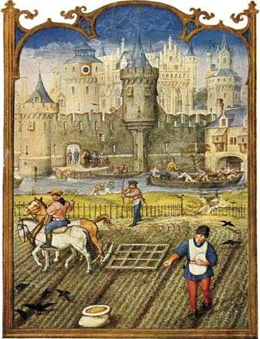
It’s A Small World
People rarely traveled 25 mi from the manor
The Estate
Only a few square miles
Buildings: lord’s manor, church, & workshops
People: 15-30 families
Surroundings: Fields, pastures, woodlands
Self-sufficient community: meat, grains, vegetables, goods

Slide 10
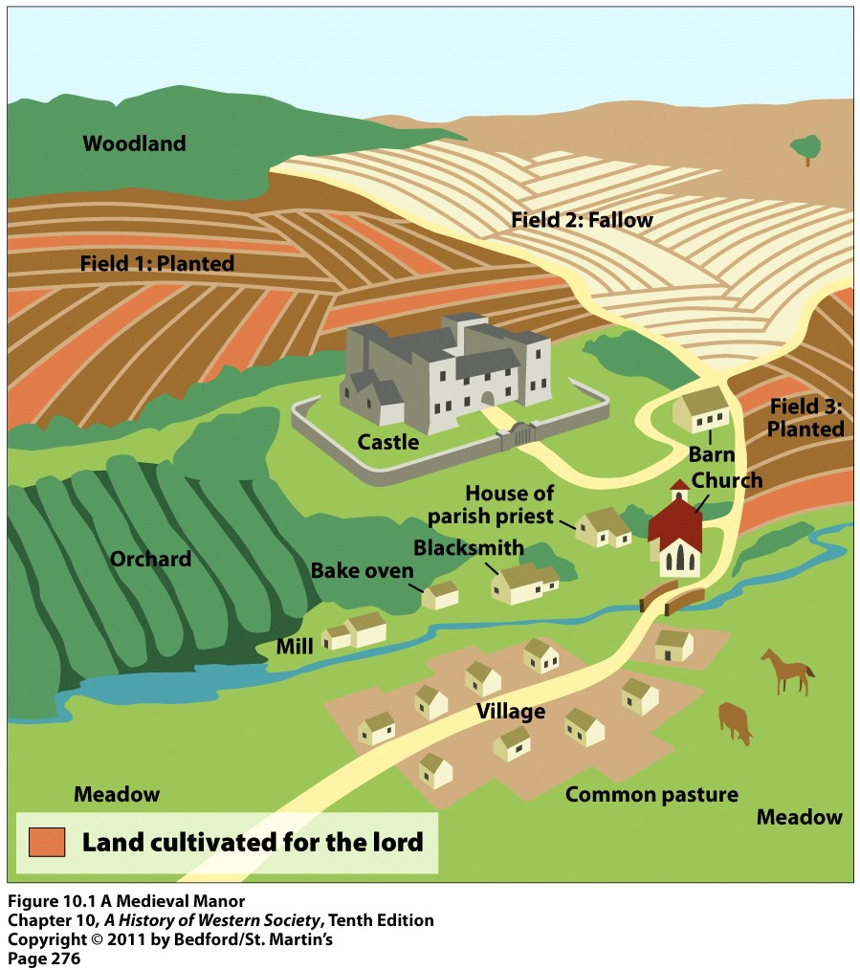
The Manor

Slide 11
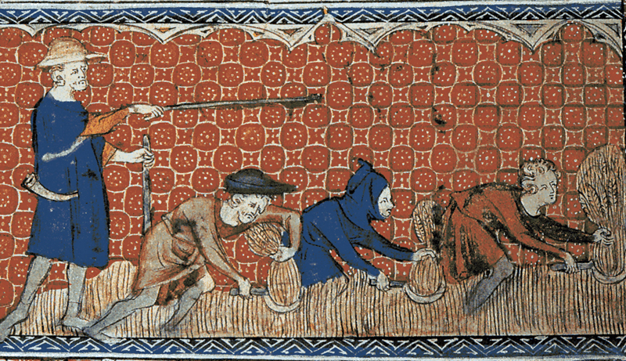
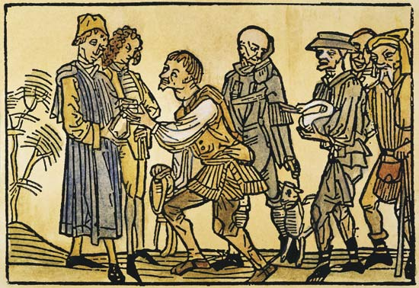
A Harsh Life
Peasants paid a high price
Taxes on grain
Taxes on marriage w/ lord’s consent
Pay a tithe (church tax) – 10%
Harsh diet, cramped quarters –
Life = work, work, work
Illness & malnutrition was rampant, many died young
35 years (life expectancy)
God determined their place

