Slide 1
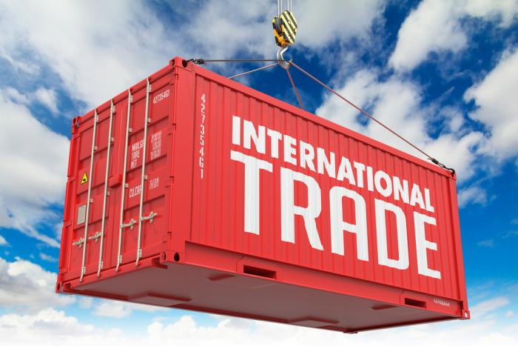
INTERNATIONAL TRADE

Slide 2
What is the Global Economy?
It is made up of all the buying and selling that is done by all the nations of the world.
Specialization: Division of labor into specific tasks and roles intended to increase the productivity of workers.
Globalization: Name for the process of increasing the connectivity and interdependence of the world's markets and businesses.

Slide 3
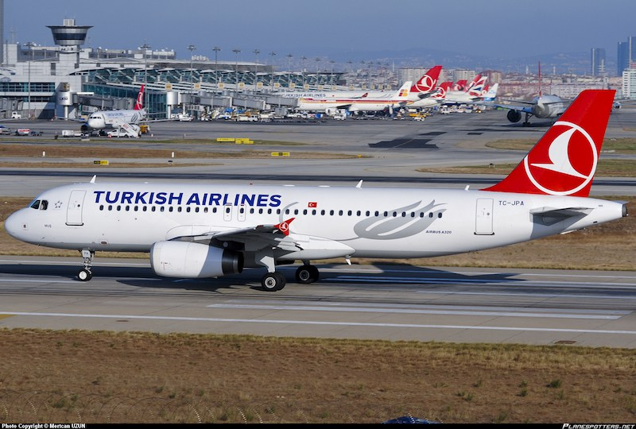
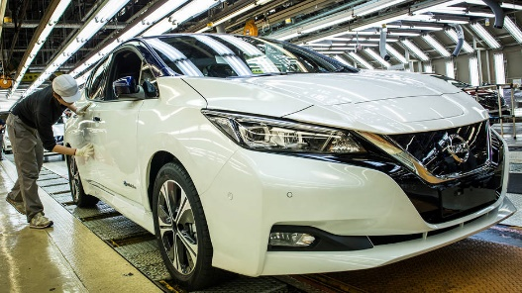
Nations’ Imports and Exports
International (foreign) trade: Buying/selling of goods and services across nations’ borders.
Imports: Goods/services that individuals and businesses purchase from foreign countries.
Examples of imported goods: Japanese automobiles, European textiles, and Central American fruit
Examples of imported services: Flights overseas on foreign airlines or tours of foreign countries

Slide 4
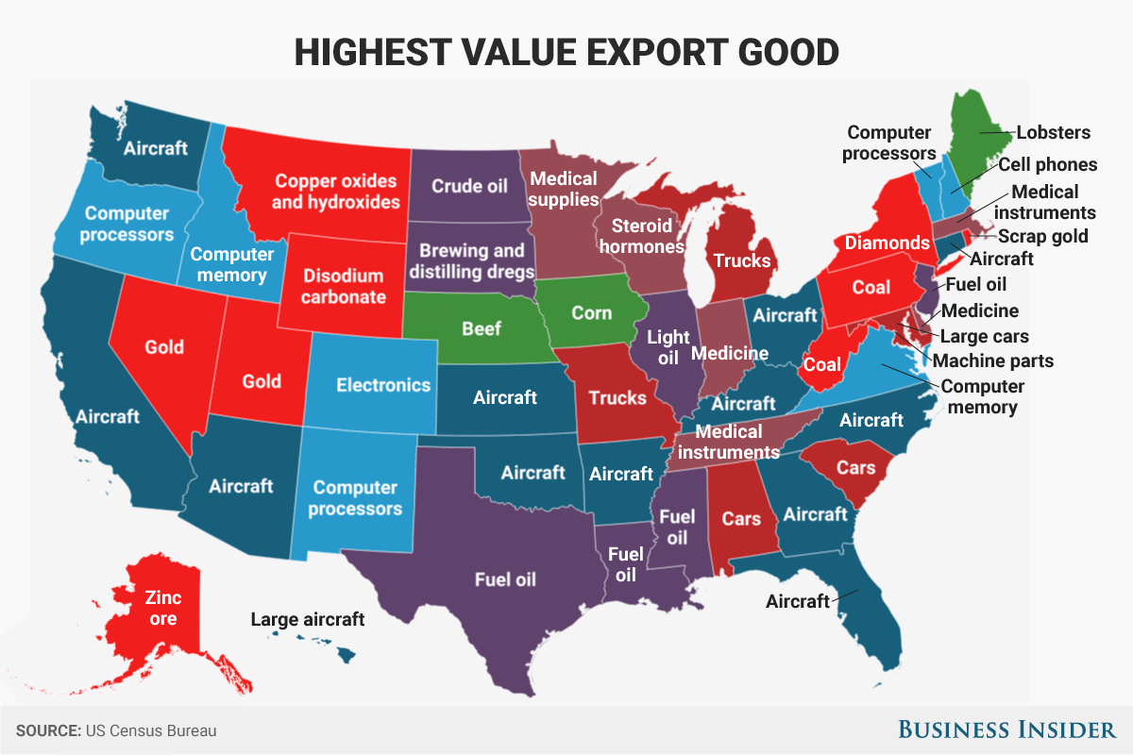
Nations’ Imports and Exports
Exports: Goods/services that individuals and businesses sell to foreign countries.
Examples of U.S. exports: Sale of machinery to Canada or the sale of wheat to Russia
All nations, large or small, trade with one another in the global economy.

Slide 5
Absolute Advantage
Individual – exists when a person can produce more of a certain good/service than someone else in the same amount of time (or can produce a good using the least amount of resources.)
National – exists when a country can produce more of a good/service than another country can in the same time period.

Slide 6
Absolute Advantage Questions for Discussion
Is Absolute Advantage the only basis for trading?
What if a person or a nation has an absolute advantage in producing everything….would there still be a reason to specialize and trade?

Slide 7
Comparative Advantage
A person or a nation has a comparative advantage in the production of a product when it can produce the product at a lower domestic opportunity cost than can a trading partner.
Comparative advantage is the basis for all trade between individuals, regions, and nations.
A person or nation will specialize in the production of a product for which it has a lower opportunity cost and trade to obtain those products for which its opportunity cost is higher.

Slide 8
Specialization and Trade
Gains from trade are based on comparative advantage, not absolute advantage
Specialization and trade increase productivity within a nation and increase a nation’s output and standard of living.
Everyone can benefit when people trade with one another. Not only can people enjoy a greater quantity of goods and services, but they can also enjoy a greater variety of goods.

Slide 9
 | Bake Cakes | Make Pizza
Ms. Gray | 2 cakes/hr. | 6 pizzas/hr.
Mr. Pinson | 4 cakes/hr. | 8 pizzas/hr.
Who has the absolute advantage in producing cakes? Mr. Pinson
Who has the absolute advantage in producing pizza? Mr. Pinson
Would Mr. Pinson be better off if he specializes and trades?

Slide 10
Mr. Pinson should specialize and trade if he has a
comparative advantage (lower opportunity cost)
in the production of one of the products.
 | Bake Cakes | Make Pizza
Ms. Gray | 2 cakes/hr. (1c = 3p) | 6 pizzas/hr. (1p = 1/3c)
Mr. Pinson | 4 cakes/hr. (1c = 2p) | 8 pizzas/hr. (1p = 1/2c)
Mr. Pinson has a lower opportunity cost in producing cakes; therefore, he should specialize in the production of cakes. Ms. Gray has a lower opportunity cost in producing pizza; therefore, she should specialize in the production of pizza.

Slide 11
Terms of trade
 | Bake Cakes Pinson will specialize in cakes. | Make Pizza Gray will specialize in pizzas.
Ms. Gray | 1c = 3p For one cake, Gray would be willing to pay anything up to 3 pizzas. | 1p = 1/3c For one pizza, Gray will want more than 1/3 cakes.
Mr. Pinson | 1c = 2p For one cake, Pinson will want more than 2 pizzas. | 1p = 1/2c For one pizza, Pinson would be willing to pay anything up to ½ cake.

Slide 12
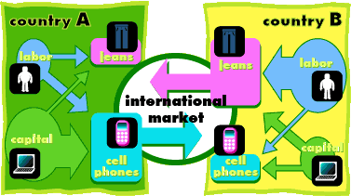
Benefits from Specialization and Trade
Specialization and trade increase productivity and the standard of living within a nation.
Because of specialization and trade, there will be a larger global output of goods and services.
Everyone can benefit when people trade with one another. Not only can people enjoy a greater quantity of goods and services, but they can also enjoy a greater variety of goods.

Slide 13
Costs of Specialization and Trade
Domestic jobs are lost.
Domestic income is lost.
National security.
Nations “dumping” goods trying to drive out domestic competition.
Other nations don’t treat their workers fairly.

Slide 14
Barriers to Trade
Tariffs: a tax on imports
Quotas: a restriction on the amount of imports

Slide 15
Trade Agreements
Trade agreements regulate international trade between two or more nations. An agreement may cover all imports and exports, certain categories of goods, or a single category. The United States is currently engaged in some 320 trade agreements with various nations.
General Agreements on Tariffs and Trade (GATT)
North American Free Trade Agreement (NAFTA)
World Trade Organization

