Slide 1
Regulation of International Trade

Slide 2
Trade Barriers
Trade Barriers are strategies that countries use to limit foreign imports in order to protect domestic producers from foreign competition.
These types of policies are known as protectionism.

Slide 3
Types of Trade Barriers
Tariffs are taxes on imported goods.
They raise the price of imported goods above the price of domestically produced goods making domestically produced goods more affordable.
Import quotas specify a maximum amount that can be imported during a certain time period.
This reduces the supply and raises the price of these goods. The foreign importer cannot sell as much, but does receive a higher price for each item.
Quotas are more effective than tariffs at protecting domestic industries.

Slide 4
Effects of Trade Barriers
They increase the cost of goods and services to consumers.
They reward inefficient industries by protecting them from more efficient foreign competition.
They reduce the choices consumers had.
They lead to trade wars and other trade disputes with other nations.

Slide 5
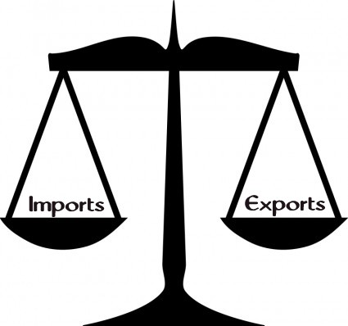
The Balance of Trade
Balance of trade– relationship between a nation’s imports and its exports
Trade surplus– a nation exports more than it imports
Trade deficit– when a nation imports more than it exports
Notes:
Nations seek to get a balance of trade with values of imports equal to the values of exports. By balancing trade, a nation can protect the value of its currency on the international market. If a trade imbalance continues, with one country importing more than it is exporting, the value of its currency falls.

Slide 6
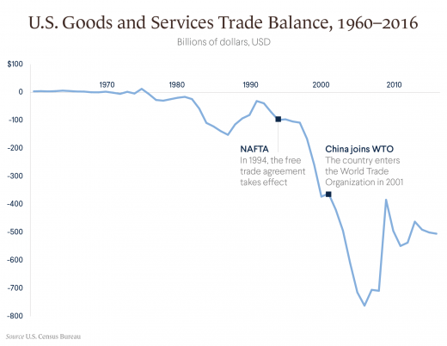
The United States Trade Deficit
Notes:
Although the United States sells many good abroad, in general it buys more goods from abroad than it sells. The result is that the United States is running a large trade deficit, and has been for several decades. Has existed since the 1970’s.

Slide 7
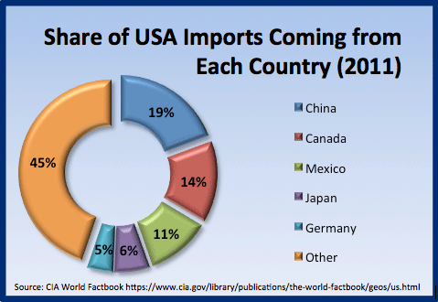
United States Trade Deficit
Although the United States sells many goods abroad, it buys more goods from abroad than it sells. The result is that the United States is running a large trade deficit, and has been for several decades.
Since 1970s

Slide 8
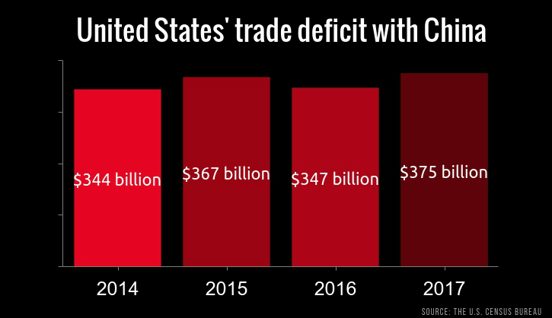
Results of the United States Trade Deficit
Extra dollars end up in the hands of foreigners.
Foreigners use these dollars to purchase land, stocks, and bonds.
This is a form of export and balances our trade accounts.
The value of the dollar against other currencies may fall.

Slide 9
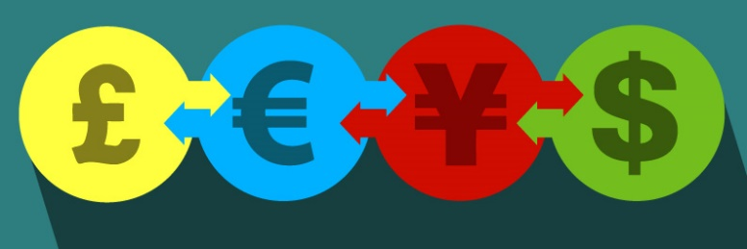
Exchange Rates
Exchange rate– the value of a foreign nation’s currency in terms of another nation’s currency
Converts prices from one currency to another currency
For Example:
18.08 pesos equal $1
Notes:
International trade takes place whenever a good or service is produced in one country and sold in another
Changing money is not a simple matter

Slide 10
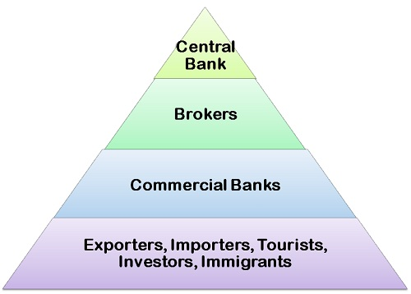
Foreign Exchange Market
Foreign exchange market– consists of 2,000 banks and other financial institutions that facilitate the buying and selling of foreign currencies
Located: New York, London, Tokyo, and many other major cities
Notes:
Example:
When a company in the United States sells computers in Japan, that company is paid in yen. It must, however, pay its United States workers in dollars. The company must therefore exchange its yen for dollars in order to pay its workers. This exchange takes place in the foreign exchange market. Because each nation uses different currency international trade would not be possible without this market.
The banks maintain close contact with each other through telephones and computers. This technology allows for the instantaneous transmission of market information and rapid financial transactions.

Slide 11
Strong and Weak Currencies
Appreciation– increase in the value of a currency. It takes less of a currency to buy another currency.
This currency is getting “stronger”
Depreciation– decrease in the value of a currency. It takes more of a currency to buy another currency.
This currency is “weakening”
Notes:
Example: If the exchange rate between the dollar and the yen increases from 100 yen per dollar to 110 yen per dollar, one dollar will purchase more yen. Since the dollar has increased in value, we say that the dollar has appreciated against the yen. This appreciation means that people in Japan will have to spend more yen to purchase a dollar’s worth of goods from the United States.
Example: If the dollar exchange rate fell to 90 yen per dollar, you would get fewer yen for each dollar. In other words, the dollar has depreciated against the yen.

Slide 12
Effects on Net Exports
Strong Dollar
Weak Dollar
American exports rise
As the dollar becomes stronger
Imports Increase
As the dollar becomes weaker…
American exports decline
Imports
Decrease
Notes:
12
A strong dollar leads to a decrease in exports. A weak dollar leads to an increase in exports.
When a nations currency depreciates, its products become cheaper to other nations. A depreciated, or weak, dollar means that foreign consumers will be able to better afford products made in the United States.

Slide 13
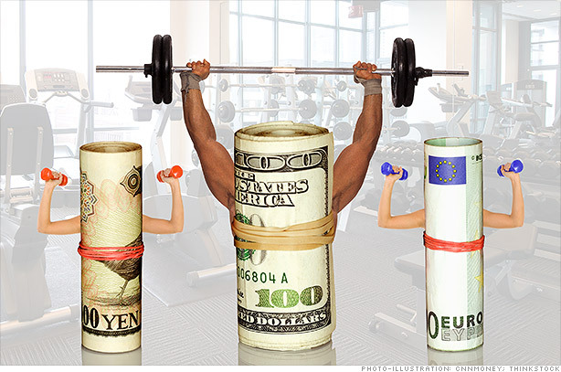
Exchange Rates and the Balance of Trade
A strong dollar will decrease US exports and increase our trade deficit
A strong dollar means our goods are more expensive to the rest of the world.
A strong dollar means other countries’ goods cost us less.

Slide 14
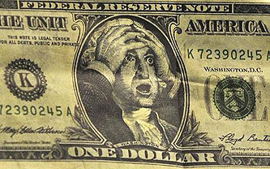
Exchange Rates and the Balance of Trade
A weak dollar will increase US exports and reduce our trade deficit.
A weak dollar means our goods are cheaper to the rest of the world.
A weak dollar means other countries’ goods cost us more.

