Slide 1
The Mongols

Slide 2
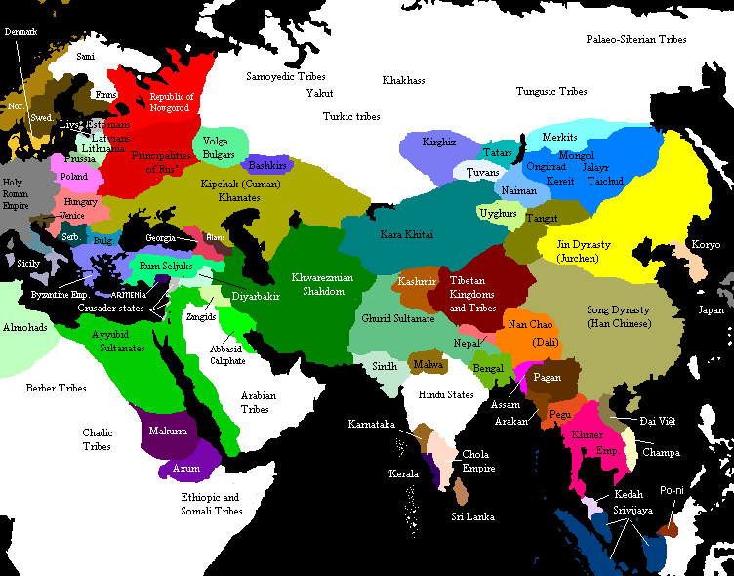
Eurasia in 1200 CE (Scattered tribes)

Slide 3
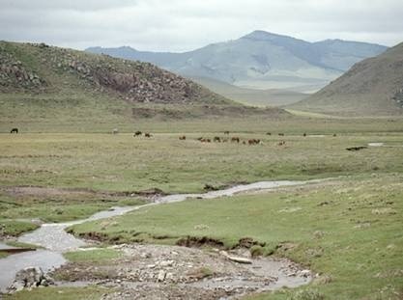
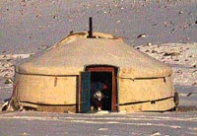
Mongol Society
Pastoralists
-Nomadic and herded animals, as they were constantly on the move looking for good pasture for the animals.
Clans
-Kinship groups of mostly family.
-Constant rivalry among different clans/tribes.

Slide 4
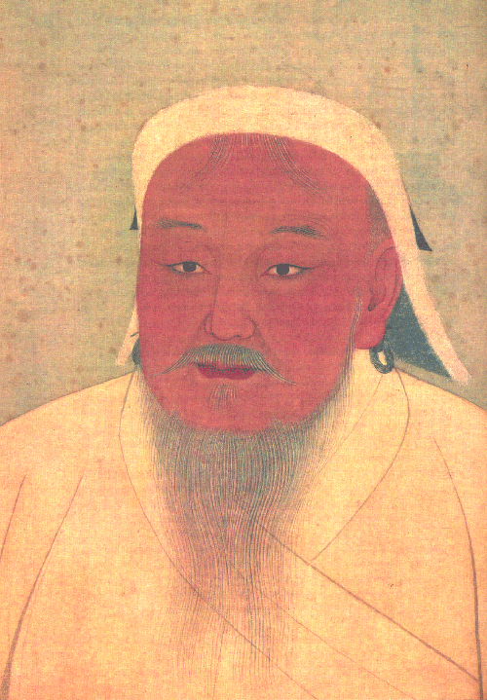
Genghis Khan
Genghis Khan (Means “universal ruler”)
Original name: Temujin
Unified Mongol tribes in 1206
Mongol Policies
Borrowed written script from the Uighur Turks
Created uniform legal code
Reorganized the military
Broke up tribal affiliations
Officials chosen based on talent

Slide 5
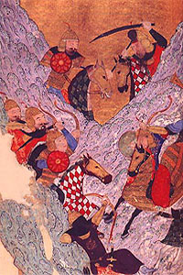
Conquests of Genghis Khan
Conquered northern China by 1220
Song dynasty still ruled southern China
Made examples of towns that resisted
Later towns simply surrendered
Mongols conquered Persia in 1221
Genghis Khan died in 1227
Mongols at battle with the Jin

Slide 6
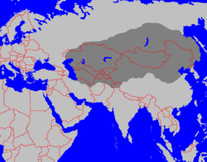
Mongol Empire in 1227

Slide 7
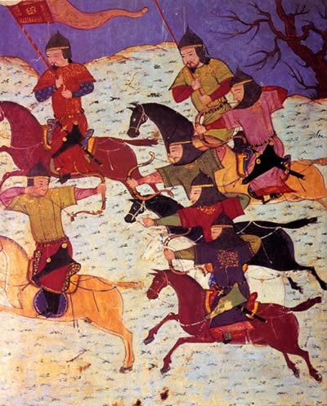
Mongol War Machine
Mongol warriors
Excellent horsemen & archers
Mongol armies
Entirely cavalry; depended on speed
Able to cover vast distances in one day
Well-organized & disciplined
Tumens contained 10,000 men

Slide 8
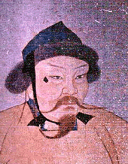
Conquest after Genghis Khan
Ogedei, son of Genghis Khan conquered Russia in 1240
Defeat the Seljuk Turks in 1253
Led to rise of the Ottomans
Conquered the Abbasid Caliphate in 1258
Defeated by Delhi Sultanate in India & the Mamlukes in Egypt

Slide 9
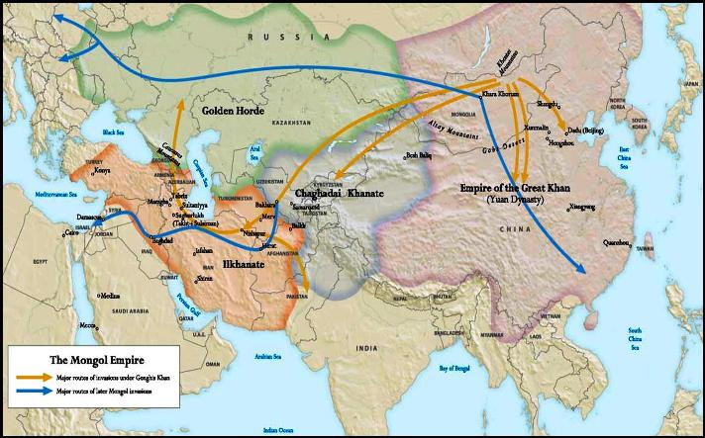
Mongol Empire after 1227

Slide 10
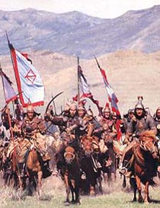
The Mongol Empire
Mongol rule was generally tolerant
Religious toleration
Administrators drawn from Islamic and Chinese worlds
Intellectuals taken from conquered kingdoms
Trade and cultural exchange flourished
Pax Mongolica
Protect merchants

Slide 11
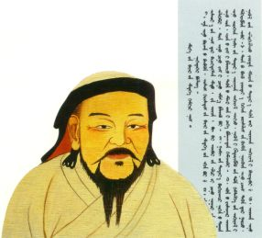
Yuan Dynasty
Kublai Khan finished conquering the Song dynasty in 1276
Launched two failed invasions of Japan
New Social Hierarchy
Mongols; foreigners; northern Chinese; Southern Chinese
Ended exam system
Favored merchants & peasants over elites

Slide 12
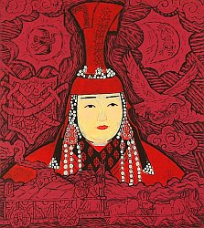
Yuan Social Policies
Mongols could not settle in China
Outlawed intermarriage
Promoted Buddhism & supported Daoism
Mongol women refused to adopt Chinese customs
Retained influential status
Resisted footbinding

Slide 13
Mongol Impact on Southwest Asia
Created two khanates
Ilkhanate of Persia & Khanate Of Chaghadai
Destroyed numerous cities
Captured Baghdad in 1258
Destroyed agricultural lands & irrigation systems
Converted to Islam in 1295

Slide 14
Russia Under the Mongols
Ruled by the Khanate of the Golden Horde
Russian princes forced pay tribute
Princes raise taxes on peasants
Peasants reduced to serfdom
Cut Russia off from Western Europe
Renaissance has minimal influence on Russia
Rise of Moscow
Moscow profited as tribute collector for Mongol overlords
Princes of Moscow turned against the Mongols in 1380

Slide 15
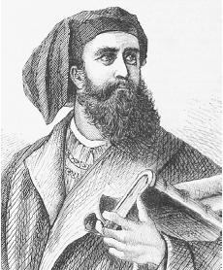
Mongol Impact on Europe
Europeans altered military organization
Mongol conquests facilitated trade across the steppes
Introduce gunpowder, printing press, & naval technology
Mongols may have spread Bubonic Plague
Marco Polo traveled to China (merchant family) on the Silk Road. He would later tell others in Europe of his many experiences in China during the time of Mongol rule.

Slide 16
Decline of the Mongols
Mongols too few in number, settled populations massive
Any interaction resulted in acculturation
Mongol rule resented by conquered populations
Settled populations began to use firearms

