Slide 1
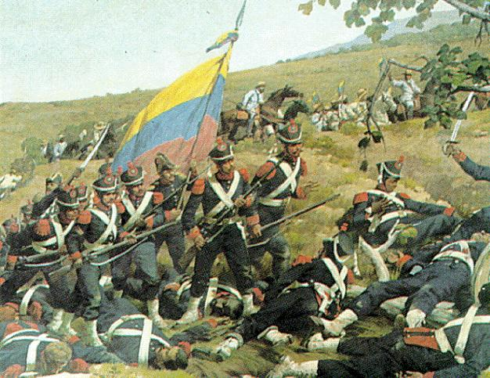
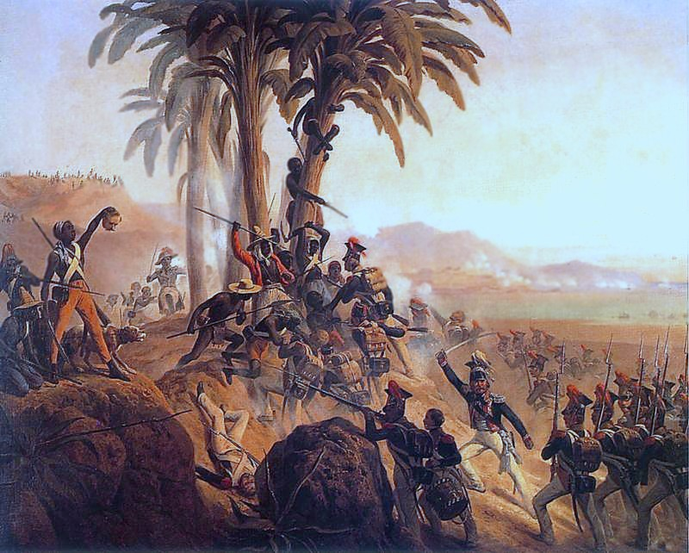
Nationalistic Revolutions in the West

Slide 2
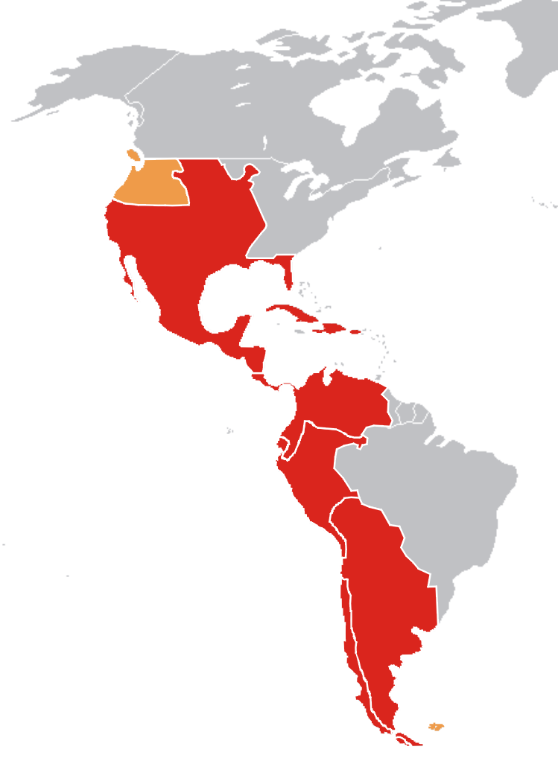
Spanish-Controlled Latin America

Slide 3
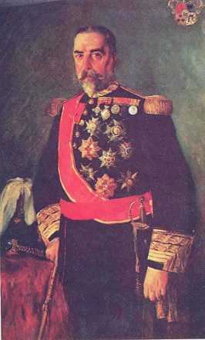
Colonial Society Divided
Class commanded people’s place in society and jobs.
Peninsulares: People born in Spain.
Only they could hold high-level office in government.
Small % of population
Creoles: Spaniards born in Latin America.
Could not hold high-level political office
Could rise in rank in Spanish colonial armies
These 2 groups controlled land, wealth, and power in Spanish colonies.

Slide 4
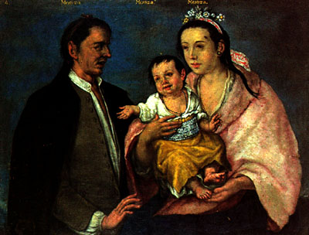
Colonial Society Divided
Mestizos: Persons of mixed European and Indian ancestry.
Mulattos: Persons of mixed European and African ancestry.
Also included enslaved Africans
Indians were at the bottom of the social ladder.

Slide 5
Critical Thinking
With only the small groups of peninsulares and creoles influencing the majority of society in Latin America, what was bound to happen?

Slide 6
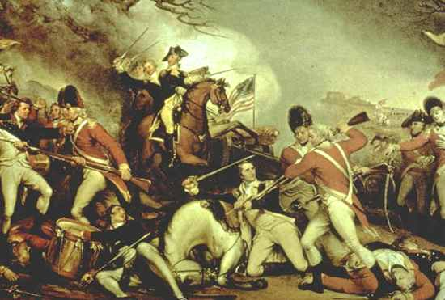
Revolutions in the Americas
Influences by Enlightenment ideals and American/French Revolutions.
Success of Americans in defeating a colonial power (Britain) encouraged them to gain freedom.

Slide 7
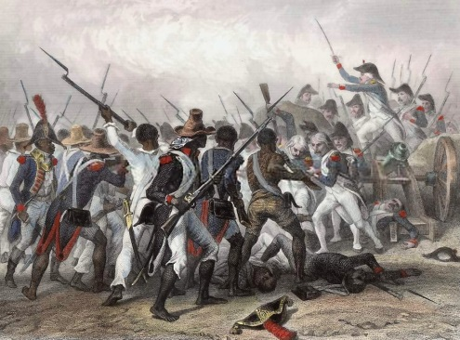
Revolution in Haiti
1st Latin American territory to free itself of European rule.
Controlled by the French
Land was called Saint Dominique by the French
Nearly 500,000 enslaved Africans outnumbered their masters.
Led by Toussaint L’Ouverture and Jean-Jacques Dessalines
After defeating the French, the freed people renamed it Haiti (“mountainous land”)

Slide 8
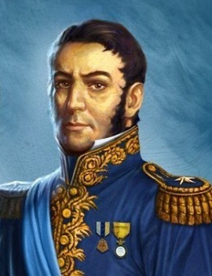
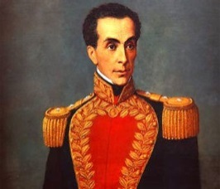
Creoles Lead Independence
Even though they were the least oppressed in Latin America, creoles were influenced by the Enlightenment.
Many were educated in Europe and learned of Enlightenment ideals in person.
Simón Bolivar: Venezuelan creole and a general declared Venezuela independent of Spanish rule after many difficult battles.
José de San Martin: Argentinian general who freed Argentina, Chile, and other regions of South America.
United troops with Simón Bolivar’s troops.

Slide 9
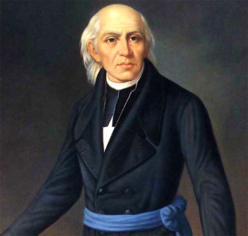
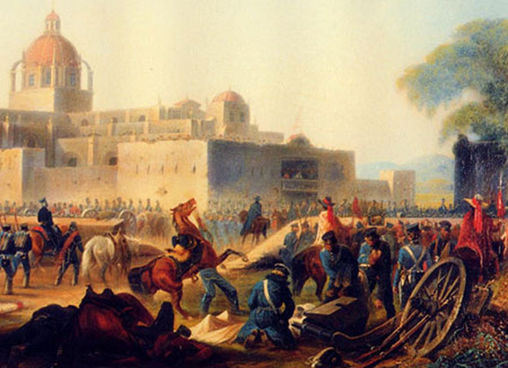
Mexico Ends Spanish Rule
1810: Miguel Hidalgo (priest) gathered the peasants in the church at the village of Dolores and called for a rebellion against the Spanish.
Marched towards Mexico City
Numbers grew to 80,000
Were defeated by Spanish/creole army in 1811
1820: Creoles, fearful of losing privileges under the Spanish, finally united with the people against the Spanish.
Proclaimed independence in 1821

Slide 10
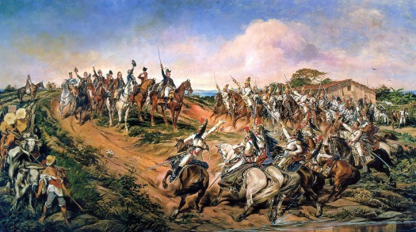
Other Latin American Revolutions
Central American colonies started to declared independence.
Future countries Nicaragua, Guatemala, Honduras,
El Salvador, and Costa Rica.
Brazil: Independence from Portugal without any bloodshed.
Many Brazilians signed a petition demanding independence, which was granted. (1822)

