Slide 1
Prehistory, the Neolithic Revolution, and River Civilizations
Notes:
Um, approximate!! 7 MYA diverge (bentley says 5M), 3.5 MYA bipedal, not until 50K great leap fwd
Prehistory- means before writing, so we’re working here in anthropology and archaeology

Slide 2
Pre-history
Pre-historic = before written records
Two periods of pre-history to know
Paleolithic
Neolithic

Slide 3
Pre-history
Paleolithic
(Old) Stone age period
Stone primary material for tools
Hunter-gathers
Nomadic lifestyle

Slide 4
PALEOLITHIC AGE
Homo sapiens
The term means "consciously thinking human"
The advantages of intelligence over other species
Migrations of Homo sapiens
Spread throughout Eurasia
Several ice ages
Land bridges enabled them to populate Indonesia and New Guinea
Eventually migrated to North America
The natural environment
Homo sapiens used knives, spears, bows, and arrows
Brought tremendous pressure on other species

Slide 5
PALEOLITHIC CULTURE
Neandertal peoples
Named after the site of the Neander valley in S.W. Germany
Careful, deliberate burials-evidence of a capacity for emotion and feelings
Social Organization
Small family units, clans of generally no more than 15-20 people
Organized hunting bands, led by elders with greatest knowledge of hunting, gathering
Women could be leaders
Venus figurines and paintings
The figurines reflect a deep interest in fertility
Cave paintings
Subjects: mostly animals; Purposes: aesthetic, "sympathetic magic

Slide 6
Pre-history
Neolithic Age
(New) stone age
Stone still primary tool material
Agriculture
Domestication of animals
Some settlement
Some nomadic groups

Slide 7
WHY?
Why would perfectly happy and healthy hunter-gatherers have settled down to be farmers? What processes encouraged this transition?
How do periods of cold and warm weather affect human development?
Notes:
Began cultivating little gardens at rest stops -> planting lots -> wanting to stay & build -> private property -> fighting… saw that animals would stay closer with intentional feeding ->populations boom, began building bigger settlements -> community projects like irrigation -> surplus -> leaders
Needed clothes, needed housing, needed fire, cold enables migration across land bridges, warm enables agriculture, change hunting and gathering methods- need to adapt!!! (think!) as they get smarter, figure out environment- AND MOVE!!! Ice age gets rid of farmland in the Sahara desert…

Slide 8
EARLY AGRICULTURAL SOCIETY
Population explosion caused by surplus
Emergence of villages and towns
Jericho, earliest known Neolithic village
Agricultural society, supplemented by hunting and limited trade
Mud huts and defensive walls
Social distinctions
Agriculture brought about private land ownership
Beliefs
Neolithic peoples celebrated deities associated with life cycle
Increasing deification, anthropomorphism of nature, seasons
Increasing masculinization of deities

Slide 9
ORIGINS OF URBAN LIFE
Emergence of cities
Tended to emerge in hostile environments
Harsh environments required stronger organization
Cities were larger and more complex
Cities influenced life of large regions
Earliest cities in Southern Mesopotamia
Other hearths of urban civilization
Indus River Valley
Nile River Valley
River Valley of the Huang He
Coastal Jungles of Mexico

Slide 10
The Agricultural Revolution
The Neolithic Revolution is also called the Agricultural Revolution. People developed farming for the first time.
For generations, humans had noticed plants growing where they had spit out seeds.
Humans began planting seeds on purpose, which was the invention of farming.
The first farming method was slash-and-burn. Farmers burnt grass and trees to clear a field. The ashes fertilized the soil. Farmers relocated every few years after exhausting the soil.
People continued to hunt, returning to their farms to harvest their crops. Eventually, people built permanent homes near their farms so they could store and guard their grain.
Permanent homes made following game difficult. Eventually, farmers domesticated animals, such as cattle, goats, pigs, and sheep. Animals ate farm waste while fertilizing the soil.

Slide 11
Farming
1st Agricultural Revolution
Neolithic
Age
Paleolithic
Age

Slide 12
Surplus Food
Neolithic
Age
People Start to Settle
Develop Civilization

Slide 13
Civilization
A form of culture, characterized by cities,specialized workers, complex institutions, record-keeping and advanced technology

Slide 14
Civilization
To be a civilization, society must have:
Cities Specialized labor
Government
Religion Arts and Architecture
Public Works
Social classes
Written language

Slide 15
Why Live in a Settled Community?
Pros
Cons
Common culture expressed
Mutual protection
Disease spreads more rapidly among a dense population
Near farms
Grain and seed storage
Grain stores were tempting to raiders
Permanent settlements suffered from natural disasters (drought, fire, floods)

Slide 16
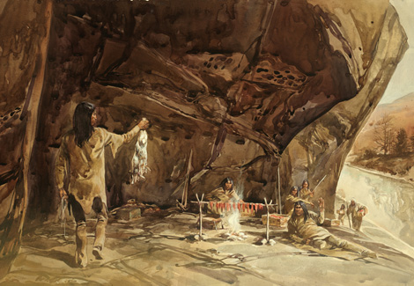
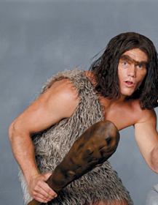
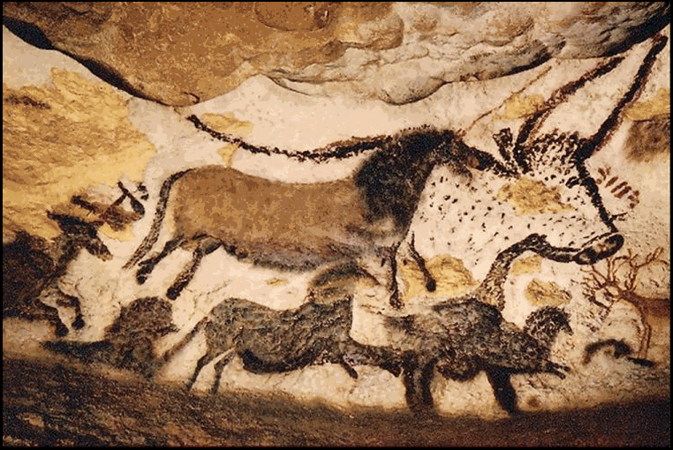
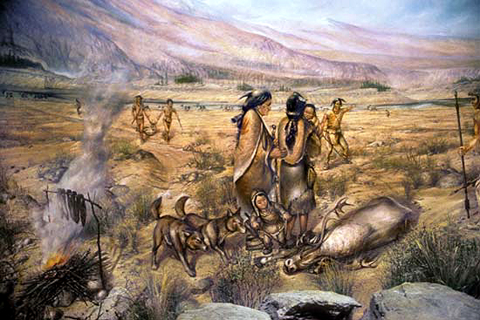
Society went from this….

Slide 17
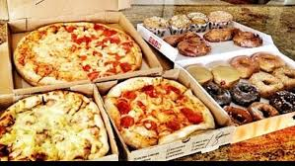
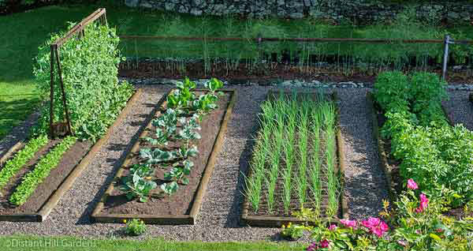
To this!

