Slide 1
Russian Revolution

Slide 2
Causes of the Revolution
Industrialization of Russia
Used foreign investment to build factories
Poor working conditions led to urban unrest
Russo-Japanese War
Russia was embarrassed by loss to Japan
Revolution of 1905—”Bloody Sunday”
Russian soldiers fire on unarmed protesters
500-1000 people were killed

Slide 3
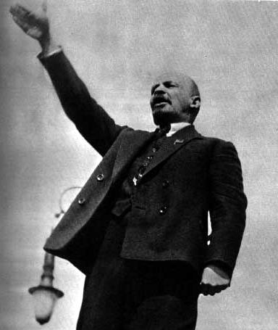
Resistance Movements
Workers begin to support the revolutionary ideas of Karl Marx
Communist writings
Believed industrial workers (everyday people) would overthrow the czar
Bolshevik party formed in 1903
Led by Vladimir Lenin (right)

Slide 4
Causes of the Revolution
World War I
Russia was consistently defeated by Germany
4 million casualties in the first year
Demonstrates weakness of czar’s rule
Defeats destroyed the moral of Russia troops
Soldiers mutinied, deserted, or ignored orders

Slide 5
February Revolution
Women in St. Petersburg led citywide strike in March 1917
200,000 workers joined the strike
Soldiers sent to stop the strike joined the strikers
Led to general uprising in Russia
Czar was forced to abdicate his throne
Provisional government established
Led by Alexander Kerensky

Slide 6
Bolshevik Revolution
Lenin and the Bolsheviks seize power in October 1917
Motto was “Peace, Land, Bread”
Immediate Reforms
Ordered all farmland be distributed to peasants
Control of factories given to workers
Withdrew from World War I
Treaty of Brest-Litovsk
Russian Civil War

Slide 7
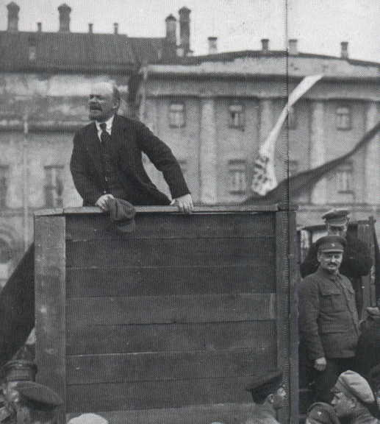
Reforms of Vladimir Lenin
New Economic Policy
Creates limited capitalists reforms in order to promote agricultural and industrial development
Dies in 1924
Battle for succession between Leon Trotsky and Joseph Stalin

Slide 8
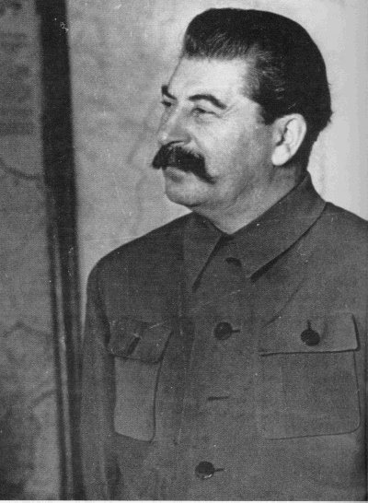
Reforms of Joseph Stalin
Goal was to create communist state envisioned by Bolsheviks
Collectivization
Eliminate private farms in favor of collective farms
Kills millions of peasants
Secures Soviet control of countryside

Slide 9
Five-Year Plans
First Five-Year Plan (1928) focuses on iron, steel, machine tools, and electricity
Called for 1115% increase in coal production, 200% increase in iron, and 335% in electric power
Posted worker production in factories
Workers who failed to meet production quotas were shot or imprisoned in the Gulag

Slide 10
Great Purge (1936-1939)
Attempt by Stalin to eliminate political opposition
Leading members of the Bolshevik party were executed or sent to labor camps
Stalin purged prominent military officials
50% of a military officers were purged
Historians estimate 10 to 20 million people died during the Great Purge

