Slide 1
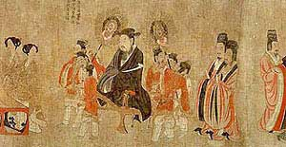
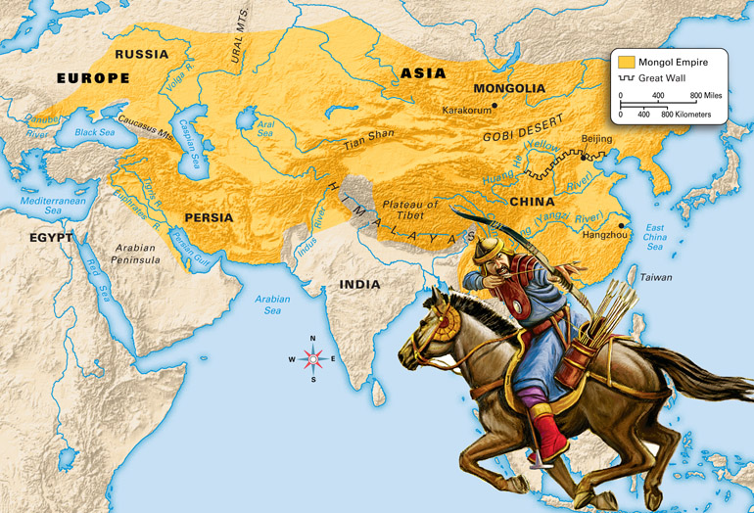
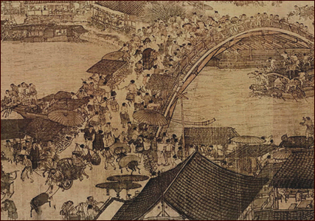
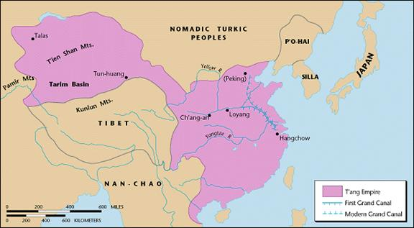
Empires of East Asia

Slide 2
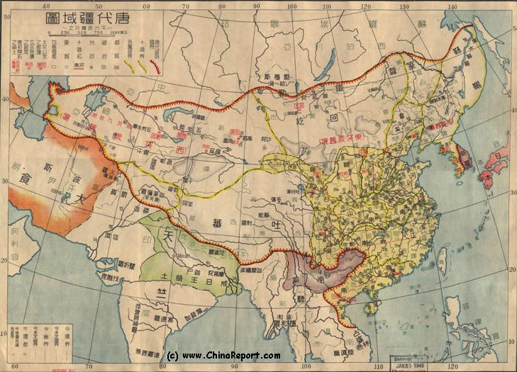
Tang and Song China
After collapse of Han dynasty
More than 30 local dynasties rose and fell.
Next 2 empires would be a golden age.
United north and south China

Slide 3
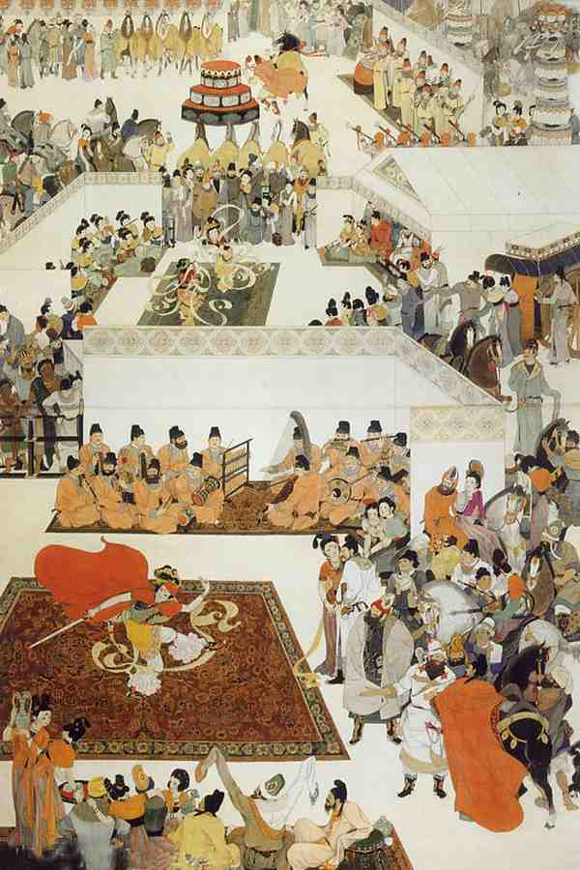
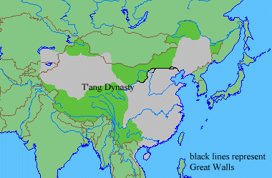
Tang Dynasty
Last for almost 300 years
Empire expanded
Reconquered northern and western lands
Extended influence over Korea

Slide 4
Empress Wu Zhao
Ruler of campaign to control Korea
Held weak power while weak emperors sat on the throne.
Finally, she assumed the title of emperor herself.
Only woman ever to do so in China

Slide 5
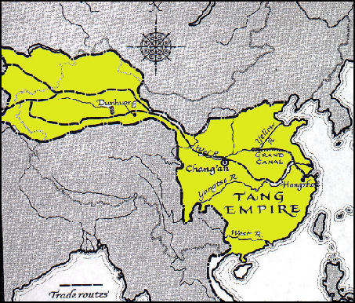
Tang Dynasty
Strong central government
Special departments
Army, agriculture, and so on
Established 2 capitals to better control empire
Cha’ng-an
Luoyang

Slide 6
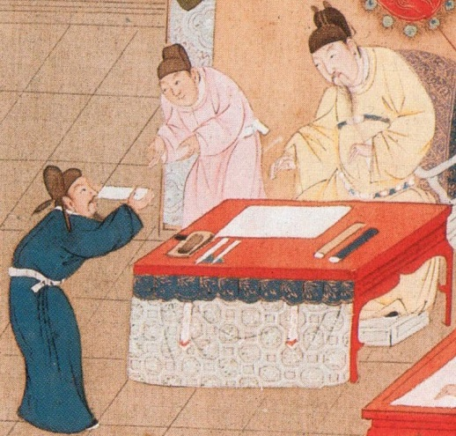
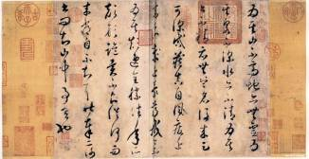
Tangy Dynasty
Examination system
Meant to make sure only qualified people could work in government.
Open to men only
Usually, only rich could afford education for exams

Slide 7
Song Dynasty
Several reasons Tang grew weaker
Heavy taxes on population
Struggled to control vast empire
Invasions, etc.
Internal rebellions
Rival warlords divided China
General Taizu reunited China
FIRST SONG EMPEROR

Slide 8
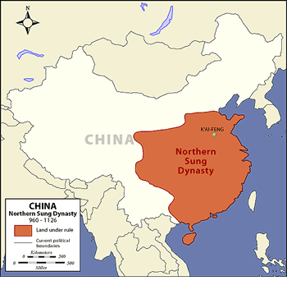
Song Dynasty
Mainly ruled only southern China after struggle with northern tribes.
New capital at Hangzhou

Slide 9
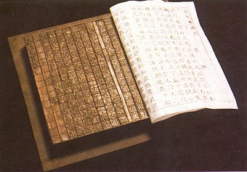
Song Dynasty
Population grew above 100 million
At least 10 cities with over a million people
Advanced civilization
Movable type: Arranging blocks of individual characters in a frame to make up a page for printing.
Gun powder, porcelain, mechanical clock, paper money, magnetic compass, etc.
Arithmetic and algebra

Slide 10
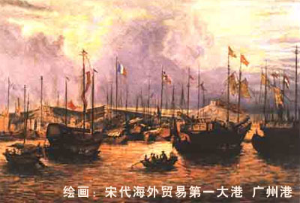
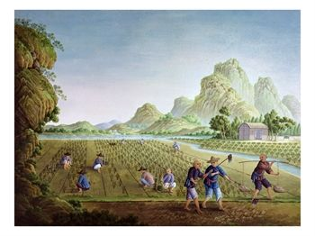
Song Dynasty
Economic advances
Fast-ripening rice
Able to harvest 2 rice crops a year
Trade
Silk Road connected China with the west
Sea traders

