Slide 1
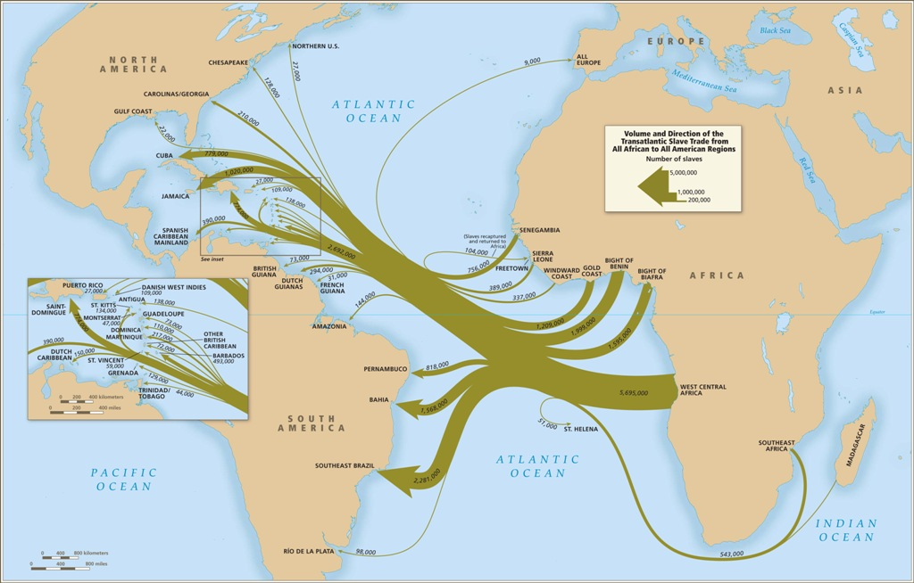
The Atlantic Slave Trade

Slide 2
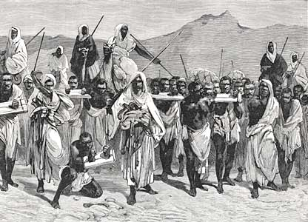
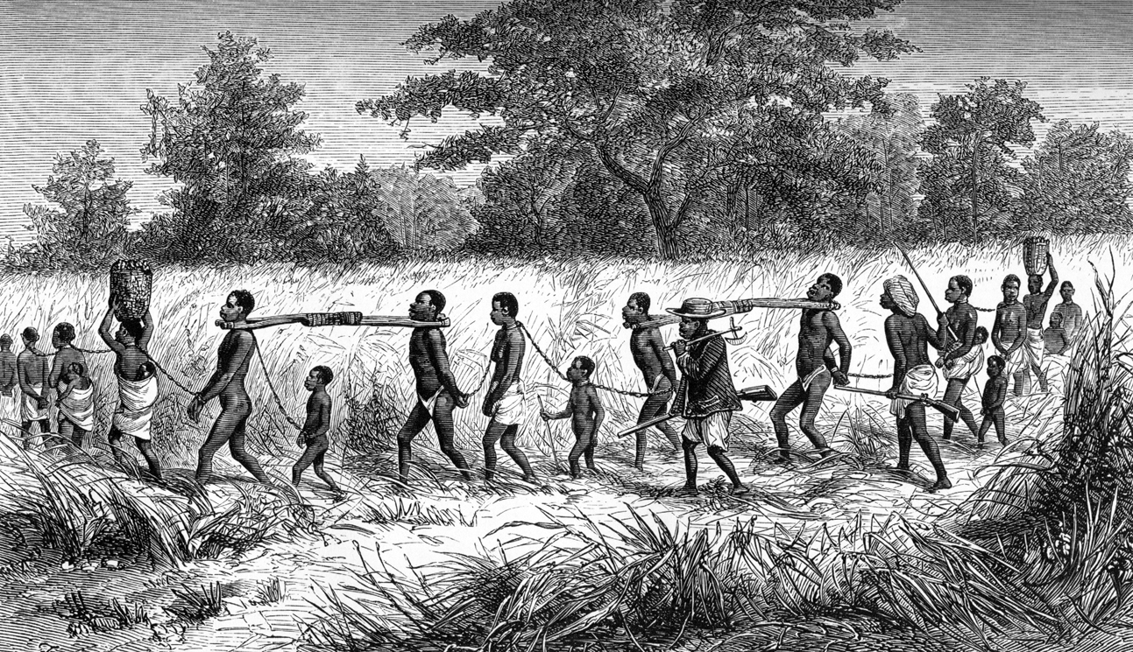
Causes: Africa
Slavery had existed for centuries
Islam leads to rise/expansion of slavery
Practice of selling non-Muslims into slavery
650-1600: 17 million
Slaves have some legal rights:
Own property, become generals, etc.

Slide 3
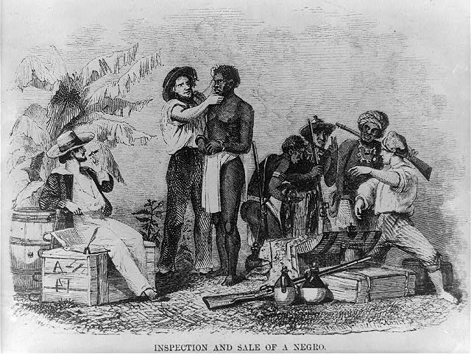
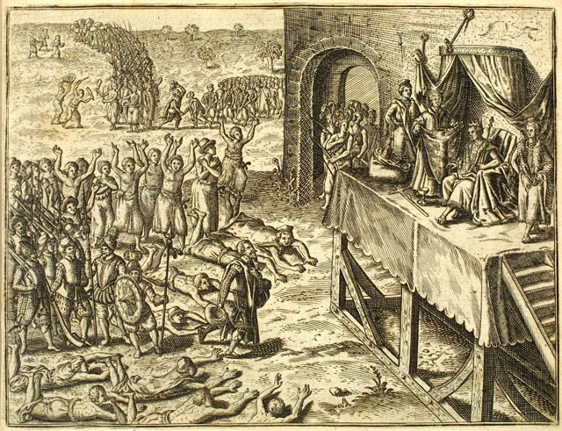
Demand
Colonization = death of Native Americans = demand for labor = Africans as slaves
Advantages:
Exposure to European diseases
Experience in farming = plantation work
Unfamiliar w/ the land
Skin color
Demand = Atlantic Slave Trade
Spain & Portugal lead the way
Brazil = Sugar Plantations

Slide 4
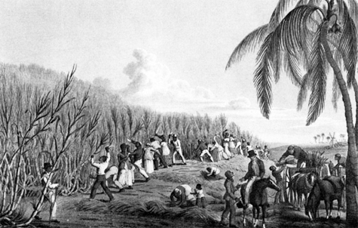
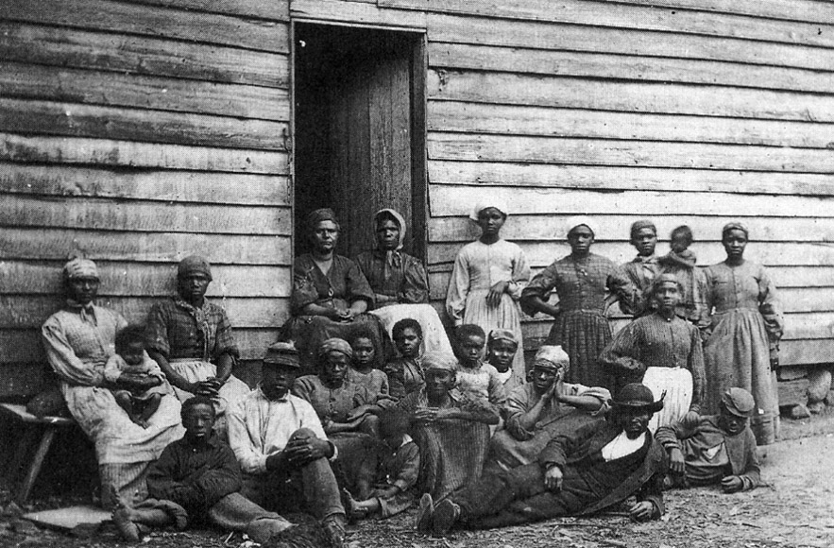
Spread: England
More colonies = more slaves
England grows to dominate trade
1690-1807: 1.7m slaves
Transport slaves to the Caribbean = sugar & cotton
400k sent to America = slave population grows steadily
2m+ by 1830

Slide 5
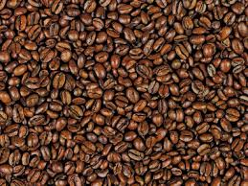
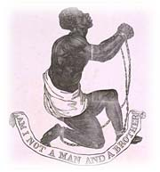
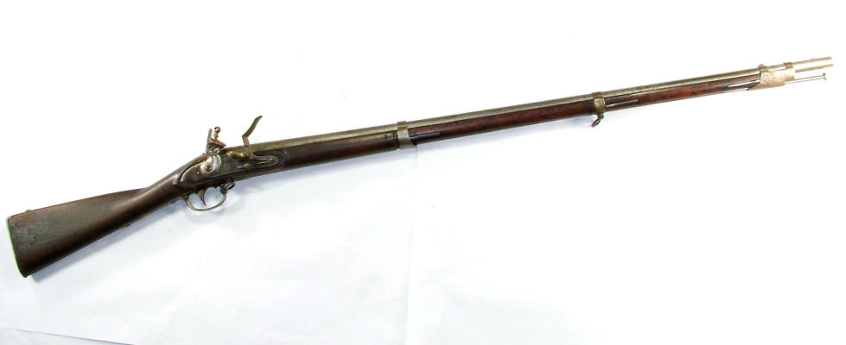
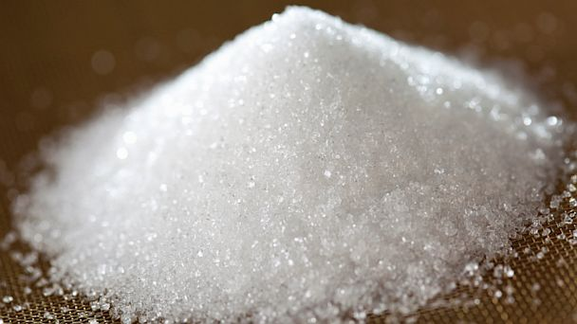
Triangular Trade
Trade of slaves = one leg of Atlantic Trade
Triangular Trade:
1) European manufactured goods to West Africa
2) Slaves exchanged & sent to Americas
3) Sugar, coffee, & tobacco back to Europe
Perfect trade system = great wealth

Slide 6
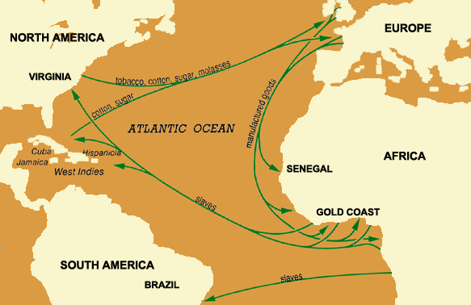
Triangular Trade

Slide 7
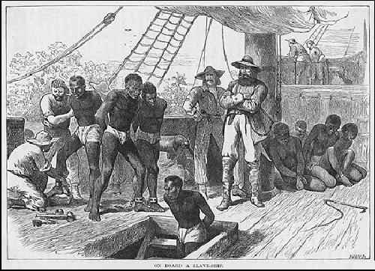
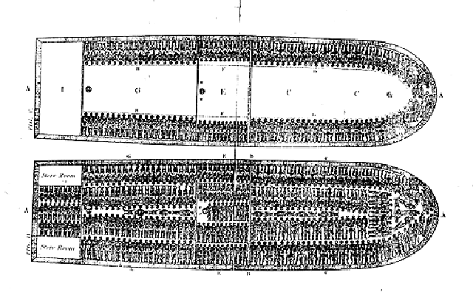
Middle Passage
Voyage from Africa to the Americas
Middle leg of triangle
Cruelty:
Africans packed tightly in dark holds
Whippings, beatings, disease
Many die from disease & abuse, or commit suicide
Est: 20% die during voyage

Slide 8
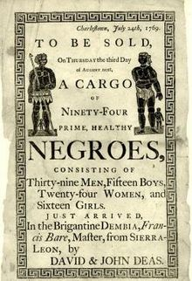
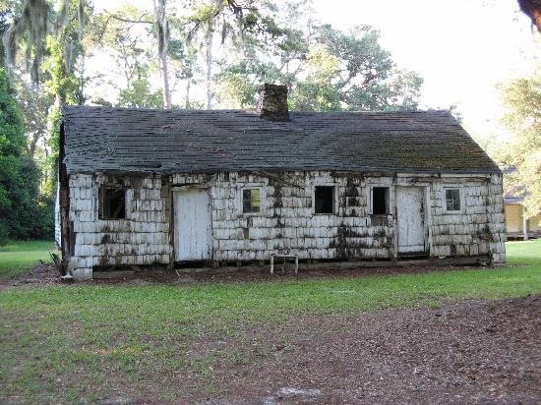
Harsh Life
Slaves auctioned off to the highest bidder
Families split up
Work in mines, plantations, or as servants
Grueling existence:
Little food, long hours, dirty huts, beatings
Lifelong & hereditary

Slide 9
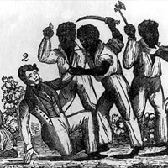
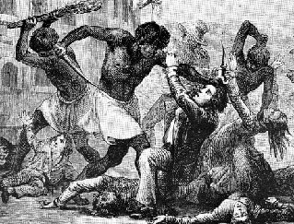
Resistance
Resistance:
Work slow, damage tools, run away, etc.
Rebellion:
Become more frequent as time passes = all places
1739: Stono Rebellion = South Carolina
1803-4: Haitian Revolution
Coping w/ life:
Sing songs, tell stories, & keep culture alive

Slide 10
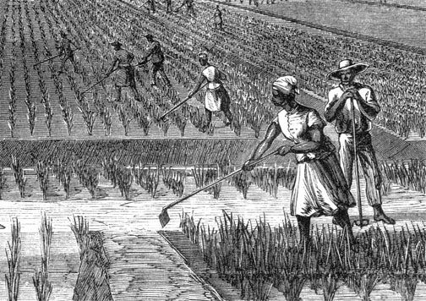
Consequences
Africa:
Cultures lose generations of able young people
Families torn apart
Guns introduced to continent
Americas:
Colonies survive, become profitable
New culture created: Art, music, religion, language, food
Populations: United States, Brazil, Caribbean

