Slide 1
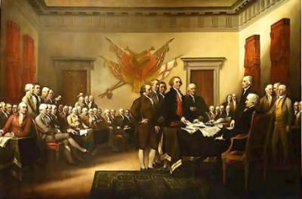
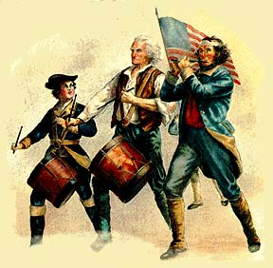
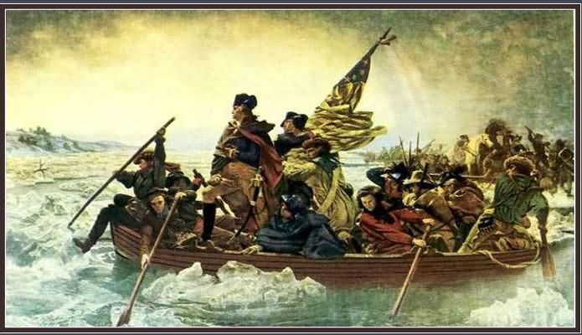
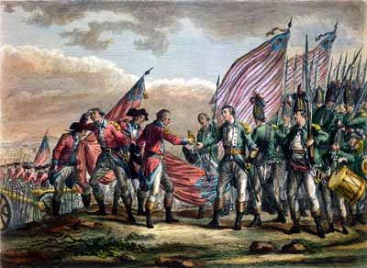
The Enlightenment and American Revolution

Slide 2
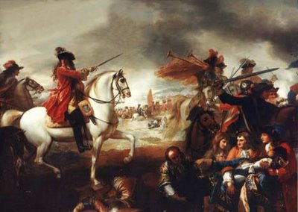
Events in England Before American Revolution
Glorious Revolution of 1688
Gave England a constitutional monarchy
Power of the king was limited

Slide 3
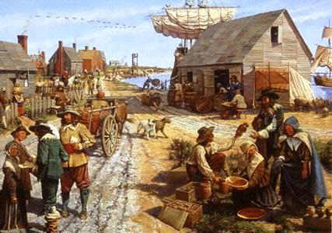
Britain and It’s American Colonies
1600s – 1700s
Population was rapidly growing
Thrived in trade with nations of Europe
New sense of identity in the colonies
They had been living “independent” of Britain for many years.
Even though they were British citizens, they didn’t see themselves as that anymore.
Virginians, Pennsylvanians, etc.

Slide 4
Critical Thinking
If the colonies had been living “independent” of Britain for many years, where do you think this situation was going?

Slide 5
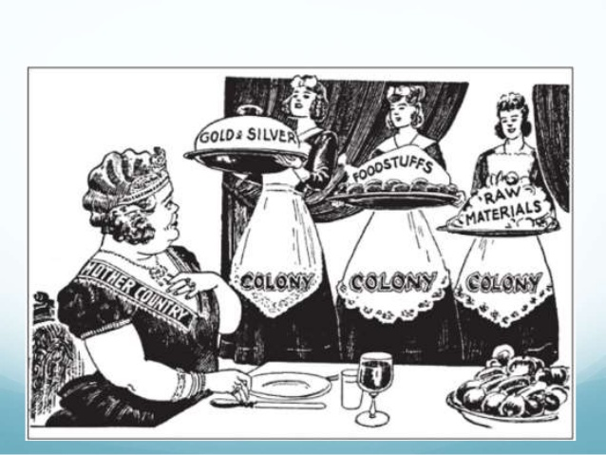
The Spark Begins
Navigation Acts (1651)
Said the colonists could only sell their most valuable products to Britain.
Limited trade
Also, made the colonists pay high taxes from products they bought from the French and Dutch.

Slide 6
Tensions Grow
Britain had a high debt from the French and Indian War (1754-1763)
To raised money to pay it, they started taxing the colonies.
Stamp Act
Called for all paper goods to have an official stamp on it that had to be bought with a tax payment.
Angered the colonists
“TAXATION WITHOUT REPRESENTATION”
What does that mean? Connection to Enlightenment ideas?

Slide 7
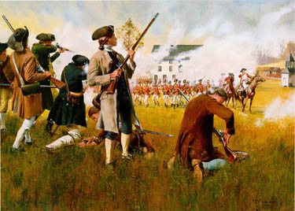
War Starts
Other taxes angered the colonists further.
The British government ignored the colonists’ complaints (1st Continental Congress).
2nd Continental Congress debated what to do next.
Fighting between both sides started on April 19, 1775
Lexington and Concord

Slide 8
Influence of the Enlightenment
Colonists believed the social contract was broken.
What was the social contract again?
Declaration of Independence (July 1776)
Free speech, religious freedom, natural rights, civil liberties
Ideas of John Locke
During the war, colonists were the ones fighting and motivated by their ideals of freedom, etc.

Slide 9
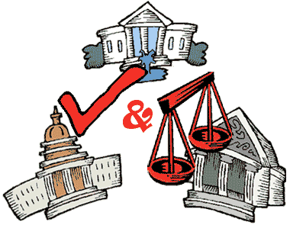
After Winning Independence
Creating a national government
Checks and balances
Each branch of government limiting the power of the other branches.
Federal system
Power divided between national and state governments
Enlightenment influence?

Slide 10
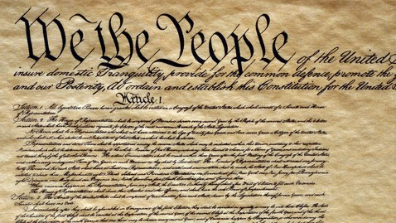
Bill of Rights
U.S. Constitution signed on September 17, 1787
Eventually approved by state conventions
Some wanted a strong national government, and some wanted stronger state governments.
Power of governed vs power of government
Bill of Rights added to Constitution
Granted individual freedoms
Speech, press, assembly, and religion

Slide 11
Critical Thinking
How much did the Enlightenment influence the American Revolution?
What specific examples?

