Slide 1
“…the spark to fall in a flash…and blow Europe sky high”
Austria-Hungary issued a list of ten demands to Serbia called the July Ultimatum
Serbia accepted 9 of the 10 demands
Austria-Hungary declared war on Serbia on July 28, 1914
Russia immediately mobilized its army
“The Guns of August”
Germany declared war on Russia on August 1, 1914
Germany declared war on France on August 3, 1914
Great Britain declared war on Germany on August 4, 1914

Slide 2
Europe at the start of World War I

Slide 3
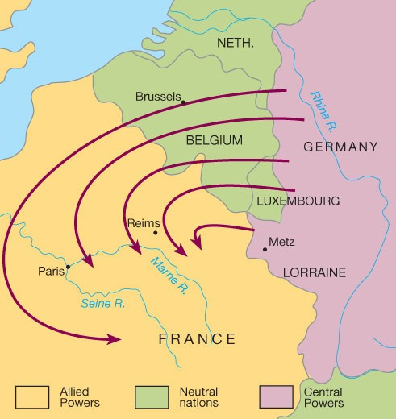
The Schlieffen Plan
The Plan: Germany Wins
The Reality: A Stalemate
Notes:
Schlieffen Plan
Devised by Germany in 1905
Germany’s plan to avoid fighting a war on two fronts
Called for rapid attack on France through Belgium
Rapid attack fails
Result is a stalemate on Western Front characterized by trench warfare

Slide 4
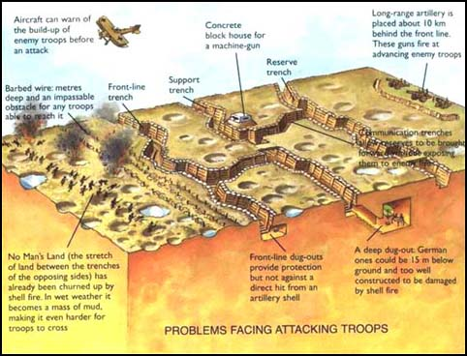
The Result: Trench Warfare

Slide 5
Trench Warfare

Slide 6
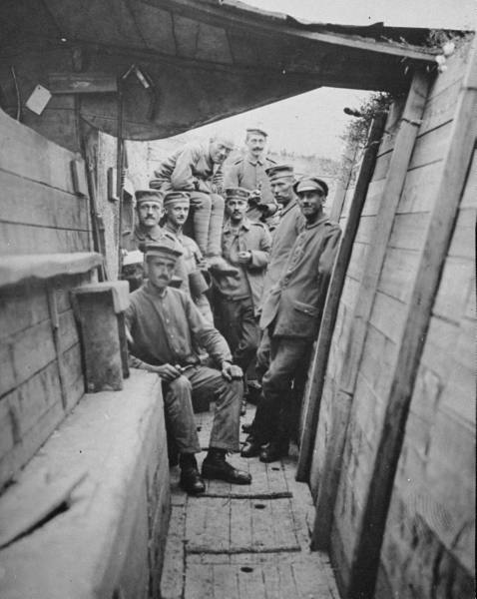
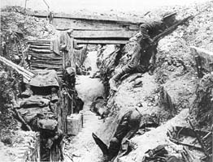
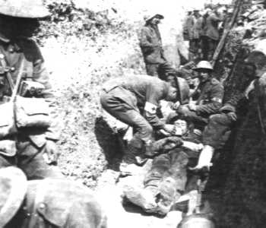

Slide 7
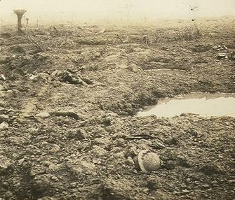
“No Man’s Land”
"No Man's Land is pocketmarked like the body of foulest disease and its odour is the breath of cancer...No Man's Land under snow is like the face of the moon, chaotic, crater-ridden, uninhabitable, awful, the abode of madness.
Wilfred Owen

Slide 8
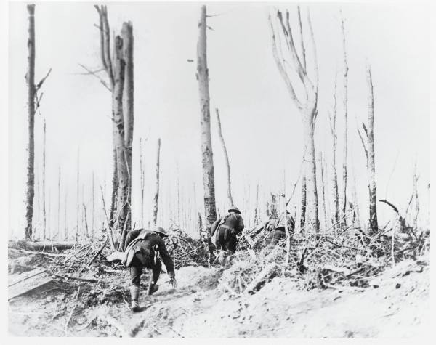
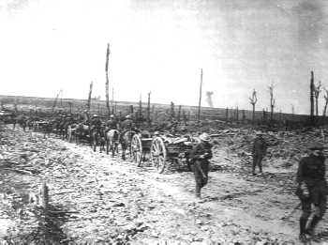
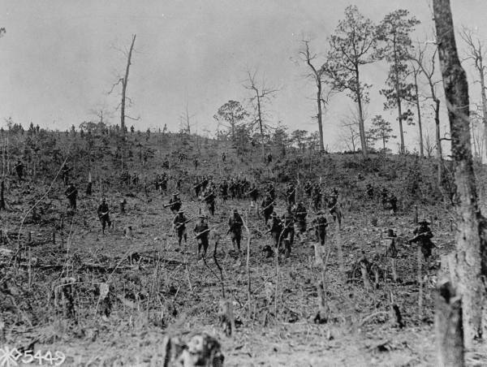
The Result
Northern France by 1917

Slide 9
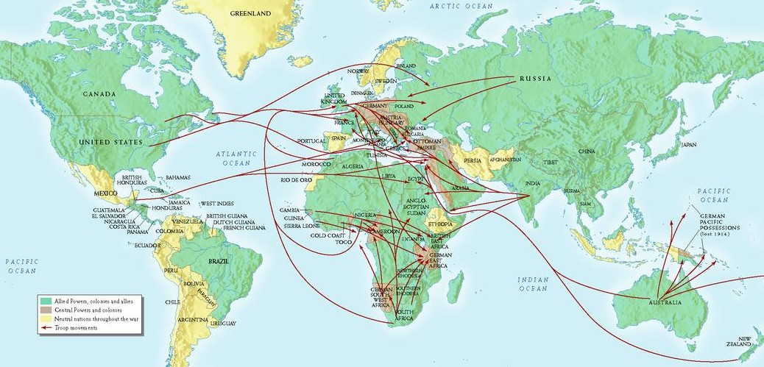
Point of Emphasis: The Great War was a “global” war

Slide 10
The Middle East
Ottoman Empire joins Central Powers
Attempt to regain territory in Balkan peninsula
Arab Revolt of 1916
Arabs want independence from the Ottoman Empire
British promise military aid
Revolt was unsuccessful due to the lack of military support
Arabs gain their “independence” after World War I
T.E. Lawrence, leader of the Arab revolt

Slide 11
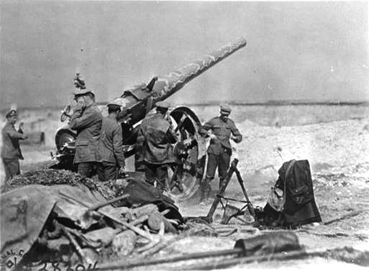
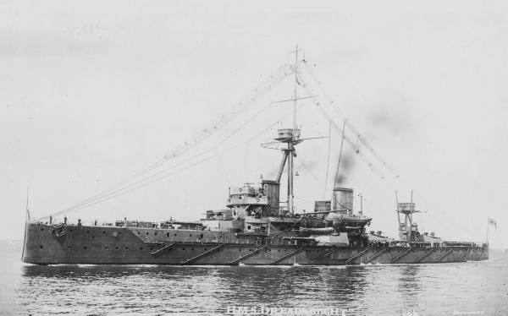
Point of Emphasis: World War I was a high-tech war
New technology changes nature of warfare
Over 8 million soldiers killed; over 19 million wounded
Over 8 million civilians were also killed

Slide 12
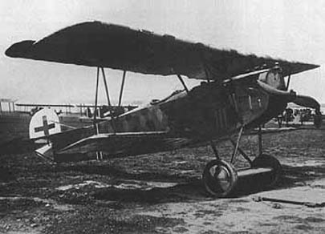
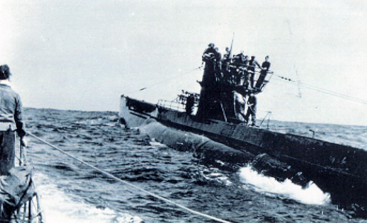
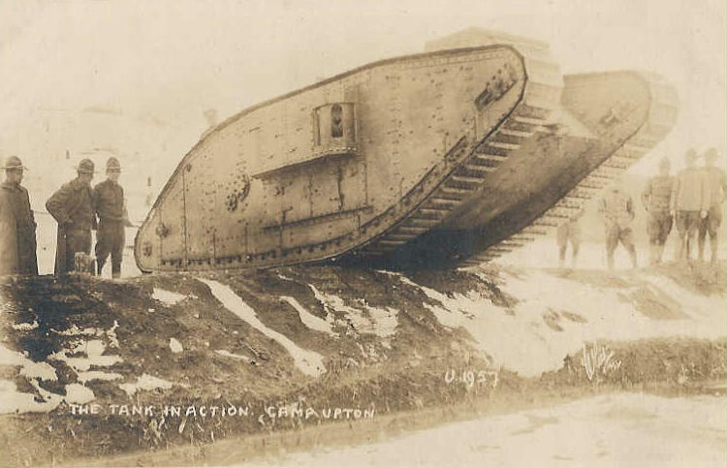
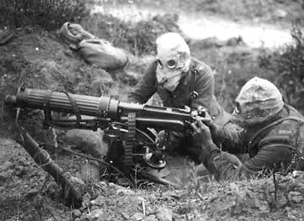
World War I biplane
German U-boat
British Tank
Machine gunners w/ gas masks

Slide 13
Point of Emphasis: World War I was a Total War
Definition of Total War
Conflict in which the participating countries devote all of their resources to the war effort
Aspects of Total War
Mandatory military conscription (a.k.a. the draft)
Control of the economy & nationalization of industry
Rationing of food and other essentials
The Home Front
Women, children, ethnic minorities, etc. are considered a vital part of the war effort
Propaganda

Slide 14
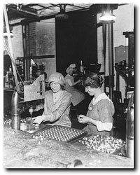
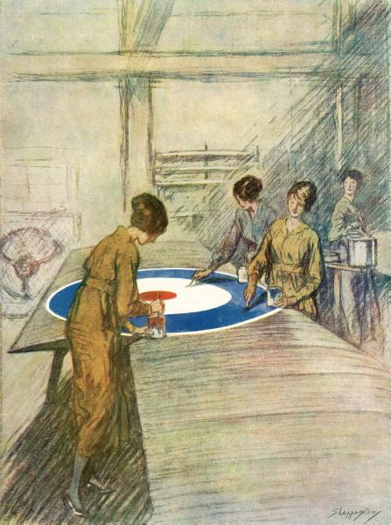
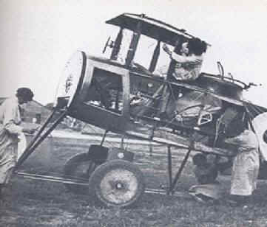
The Home Front
Women in the Great War
Factory workers, nurses, farmers
Strengthens suffrage movements

Slide 15
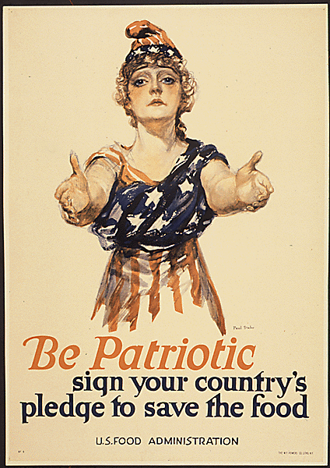
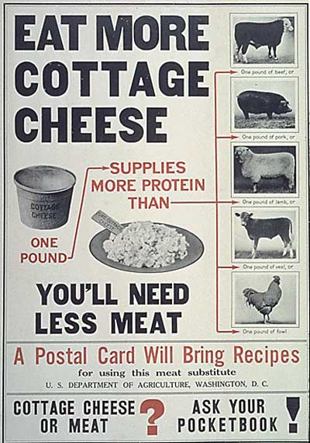
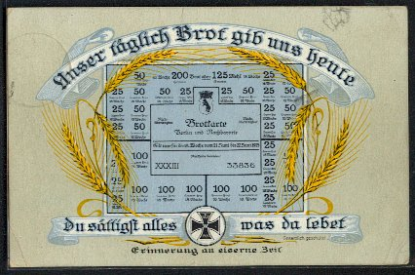
The Home Front
Rationing
Food Shortages
Diets Change
Left: German bread ration card
Above: U.S. Food Administration propaganda posters

Slide 16
African-Americans in World War I
380,000 African-Americans served in the army
200,000 were sent to Europe; only 42,000 saw combat

Slide 17
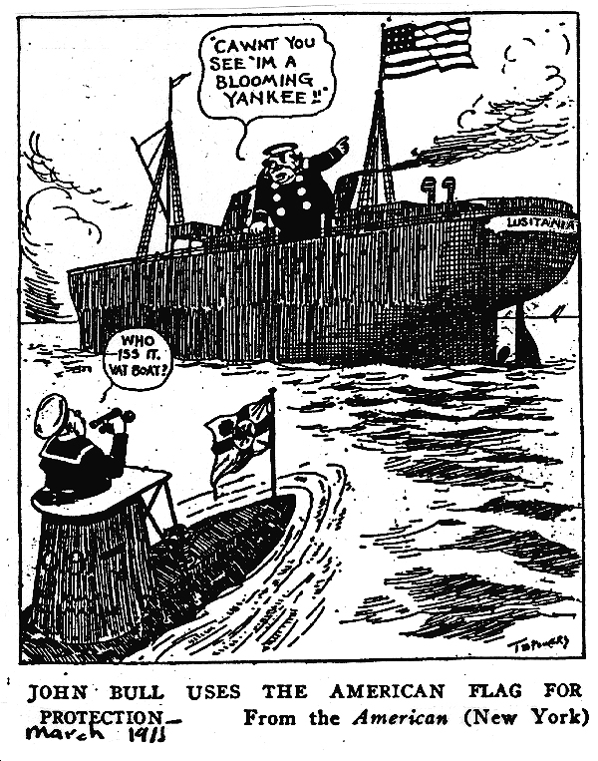
U.S. Enters the Great War
Germans sink the Lusitania on May 7, 1915
Unrestricted submarine warfare
Zimmerman Note in February 1917
U.S. declares war on Germany on April 6, 1917

Slide 18
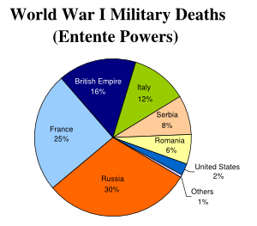
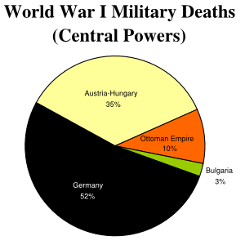
End of the Great War
Russia withdraws in February 1918
Russian Revolution
Treaty of Brest-Litvosk
War of Attrition
Almost no fighting occurs in Germany
Germany surrenders at 11:00 on November 11, 1918
Treaty of Versailles conference starts January 1919

Slide 19
Versailles Peace Conference
Council of Four
British Prime Minister David Lloyd George
French Prime Minister Georges Clemenceau
Italian Prime Minister Vittorio Orlando
American President Woodrow Wilson
Not in Attendance
Russia and Germany
Left to Right: David Lloyd George, Georges Clemenceau, Woodrow Wilson

Slide 20
Europe after World War I
New Countries
Poland
Finland
Estonia
Latvia
Lithuania
Czechoslovakia
Austria
Hungary
Turkey
Yugoslavia

